Slide 1
Novel and Emerging Chronic Migraine Therapies
Stewart J. Tepper, MD, FAHS
Professor of Neurology
Geisel School of Medicine at Dartmouth
Vice President
The New England Institute for Neurology and Headache
Stamford, CT

Slide 2



Resource Information
About This Resource
These slides are one component of a continuing education program available online at MedEd On The Go titled Chronic Migraine Prevention: Novel Treatment Strategies
Program Learning Objectives:
Inform clinicians on the overuse of OTC and other prescription medication by their patients experiencing migraines
Provide clinicians with up-to-date, evidence-based guidelines on the use of current prophylactic therapies used to manage chronic migraines
Improve clinician's ability to differentiate between the new and emerging preventative, chronic migraine therapies
MedEd On The Go®
www.mededonthego.com
This content or portions thereof may not be published, posted online or used in presentations without permission.
This content can be saved for personal use (non-commercial use only) with credit given to the resource authors.
To contact us regarding inaccuracies, omissions or permissions please email us at support@MedEdOTG.com

Slide 3
Disclaimer
The views and opinions expressed in this educational activity are those of the faculty and do not necessarily represent the views of Total CME, LLC, the CME providers, or the companies providing educational grants. This presentation is not intended to define an exclusive course of patient management; the participant should use their clinical judgment, knowledge, experience, and diagnostic skills in applying or adopting for professional use any of the information provided herein. Any procedures, medications, or other courses of diagnosis or treatment discussed or suggested in this activity should not be used by clinicians without evaluation of their patient's conditions and possible contraindications or dangers in use, review of any applicable manufacturer’s product information, and comparison with recommendations of other authorities. Links to other sites may be provided as additional sources of information.

Slide 4
Chronic Migraine Prevention: Novel Treatment Strategies
CM is defined by the International Headache Society as greater than or equal to 15 headache days per month, of which 8 are migrainous
6 medications are approved by the US FDA for CM prevention
The migraine-specific preventive medications for CM prevention have been shown to be superior to the older non-specific migraine preventive medications in a myriad of studies for:
4 non-invasive neuromodulation devices are cleared by the FDA for migraine prevention, including CM
Efficacy
Adverse events
Placebo-subtracted analysis
Direct comparison
Onset of effect: All separate from placebo for EM and CM by one week
RRs: Unprecedented RRs of greater than or equal to 75 to 100%
Working in those for whom greater than or equal to 2 to 4 older non-specific preventive migraine medications failed
Conversion of CM to EM and out of medication overuse in greater than or equal to 50%
Adherence
Allowing specific targeted treatment for comorbid illnesses
Improving interictal burden of disease

Slide 5
FDA Approved or Cleared Treatments for CM Prevention
The medications that are FDA approved for CM include:
OnabotulinumtoxinA
Erenumab, an anti-CGRP receptor MAB
Fremanezumab, an anti-CGRP ligand MAB
Galcanezumab, an anti-CGRP ligand MAB
Eptinezumab, an anti-CGRP ligand MAB
Atogepant, a small molecule CGRP receptor antagonist
These medications work peripherally in the meninges for the most part on the migraine pain mechanisms

Slide 6
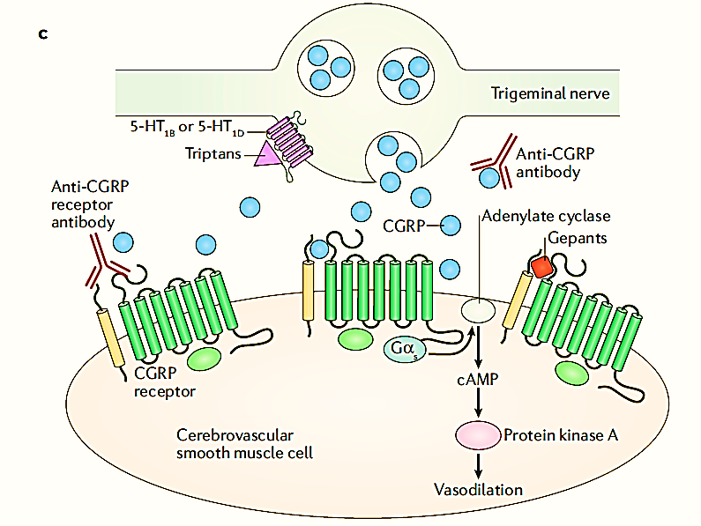
Chronic Migraine Prevention Target: CGRP
Neurogenic inflammation and

Slide 7
Chronic Migraine Prevention Target: CGRP
OnabotulinumtoxinA prevents CGRP release
Anti-CGRP ligand mAbs: Galcanezumab, fremanezumab, eptinezumab
Anti-CGRP receptor MAb: Erenumab
CGRP receptor antagonists
(gepants):
Atogepant
Neurogenic inflammation and

Slide 8
Old Non-Specific Versus New Migraine-Specific CM Prevention
Old
New
Hold off on prevention until forced to prescribe due to severe disability, high frequency episodes, increasing use of acute medications and risk for transformation
Prescribe non-specific oral migraine preventive treatments
Try to combine non-specific treatment for migraine and co-morbid illnesses
Plan a wean of overused acute medications
Live with suboptimal response:
Efficacy
Lack of adherence with treatment
Measure effectiveness by reduction in mean monthly migraine days
Cost/benefit analysis changes due to high efficacy and tolerability and safety for preventive therapies
Use migraine-specific prevention early based on disability or impact and prescribe onabotunlinumtoxinA, a MAB, atogepant, or a non-invasive neuromodulation device
Use optimal treatment for the comorbid illness and a different targeted treatment for the CM
Prescribe prevention and allow acute medication use to drop
MABs are superior to older non-specific prevention for
Efficacy
Adverse events
Placebo-subtracted analysis
Direct comparison
Onset of effect: All separate from placebo for EM and CM by one week
RRs: unprecedented RRs of greater than or equal to 75 to 100%
Work in those for whom greater than or equal to 2 to 4 older non-specific preventive migraine medications failed
Conversion of CM to EM and out of MOH in greater than or equal to 50%
Adherence
Allow specific targeted treatment for comorbid illnesses
Improve interictal burden of disease

Slide 9


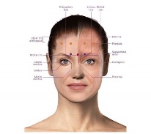
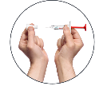


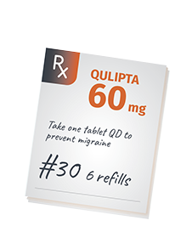
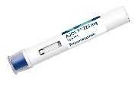
Quick Guide to the CM Migraine Prevention Medications
OnabotulinumtoxinA: 155 units given IM in the PREEMPT protocol head & neck quarterly
Erenumab: 70 or 140 mg SC given monthly with autoinjector
Fremanezumab: 225 mg SC monthly or 675 mg given quarterly with autoinjector or prefilled syringe
Galcanezumab: 240 mg SC loading dose followed by 120 mg SC monthly given by autoinjector or prefilled syringe
Eptinezumab: 100 mg or 300 mg IV quarterly
Atogepant: 60 mg tablet PO daily

Slide 10
Summary
Targeting CGRP has resulted in two new classes of CM prevention:
MABs and gepants, and 4 MABs and one gepant are FDA approved for CM prevention
The newer treatments are better tolerated, safer, and more effective than the older, non-specific migraine preventive treatments
The older treatments are not specifically FDA approved for CM prevention
The older non-specific migraine preventive treatments and the non-invasive neuromodulation devices prevent migraine centrally, while onabotulinumtoxinA, the MABs, and atogepant have predominant peripheral preventive effects

Slide 11



Looking for more resources on this topic?
CME/CE in minutes
Congress highlights
Late-breaking data
Quizzes
Webinars
In-person events
Slides & resources
www.MedEdOTG.com

