Slide 1
One for the Books:
A Most Unusual Case of PAH
Ioana Preston, MD
Associate Professor of Medicine,
Tufts University School of Medicine
Director, Pulmonary Hypertension Center,
Pulmonary, Critical Care and Sleep Division
Tufts Medical Center
Boston, MA

Slide 2
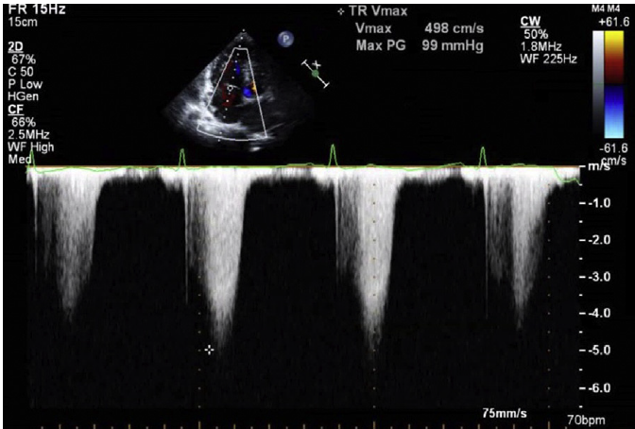
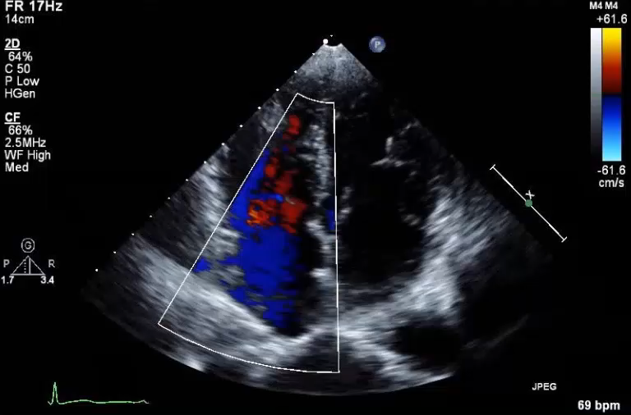
Patient Presentation
Pre-treatment ePASP Imaging
A man in his 60s with a history of systemic hypertension and increasing dyspnea on exertion was referred to an outpatient pulmonary clinic for further evaluation of pulmonary hypertension
While later hospitalized for systemic hypertensive urgency, a TTE was performed due to the patient’s increasing dyspnea
TTE revealed a mildly dilated RV and an increased ePASP of 76 mmHg

Slide 3
Additional Initial Observations
Patient was observed to have
  lower extremity swelling and rash
  joint pain in the hips, knees, and feet for 4 months preceding evaluation
Inquiries from the patient’s PH team revealed he had been subsisting principally on a diet of candy and sports drinks

Slide 4
Physical Examination Results
Hypertrophy of the gums
Increased P2 on cardiac auscultation
Bilateral, symmetrical pitting edema
Hair loss on the extremities
Diffuse, petechial lower extremity rash running bilaterally from the mid-calf downwards
Lungs clear on auscultation
No RV heave
No jugular venous distension
Due to the high ePASP, the patient was referred for RHC

Slide 5
Right Heart Catheterization and Other Results
PAP = 72/22 mmHg
mPAP = 41 mmHg
PCWP = normal
Autoimmune antibody evaluation was negative
Biopsy of lower extremity rash revealed mild vascular proliferation in the papillary dermis with perivascular hemosiderin deposition and perifollicular erythrocyte extravasation
Focal fat necrosis was observed but no evidence of vasculitis noted

Slide 6
Full RHC Data
Condition | Resting Values | After Inhaled NO 20 ppm
Heart rate, beats/min | 72 | 70
Arterial pressure, mmHg | 159/98 | ----
Arterial oxygen saturation (room air) | 99% | 99%
RA oxygen saturation | 61% | ----
PA oxygen saturation | 58% | 71%
Cardiac output (thermodilution), L/min | 3.5 | 4.3
Cardiac index, L/min/m² | 2.2 | 2.7
Mean RA pressure, mmHg | 5 | ----
PA pressure: systolic/diastolic (mean), mmHg | 72/22 (41) | 47/13 (28)
Mean PA wedge, mmHg | 11 | 11
Pulmonary vascular resistance, dyn • s/cm⁵ | 694 | 316

Slide 7
At This Point…Can You Make The Call?
What do the patient’s symptoms suggest as the cause of his PAH?
What tests or procedures would you order next?

Slide 8
The Diagnostic Call
Clinical findings were suggestive of severe vitamin C deficiency
This was based on the patient’s negative autoimmune evaluation
Rheumatology consultation did not believe his rash was vasculitic, and vascular surgery department discounted venous disease
The patient had no medication exposure that would explain petechial rash or gum hypertrophy
Blood Tests
Vitamin C level of <0.1 mg/dL (0.2–2 mg/dL)
Hemoglobin level of 8.4 g/dL (13.5–16 g/dL)
Iron level of 22 mg/dL (49–181 mg/dL),
25-OH vitamin D level of 12 ng/mL (20–100 ng/mL)
So what is the prescription?

Slide 9
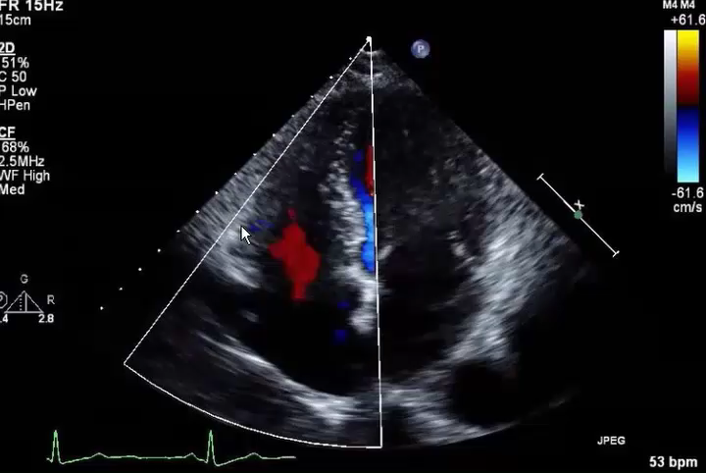
Initial Treatment Approach and First Results
The patient was prescribed vitamin C1g bid and 1,000 units of vitamin D3 daily
Initial Results
Lower extremity rash, swelling, and dyspnea improved
Vitamin C level increased to 1.5 mg/dL
Hemoglobin level rose to 11.3 g/dL
Repeat TTE revealed normal RV size and function, with a drop in ePASP to 29 mmHg

Slide 10
Summary and Conclusions
This case illustrates the potential contribution of dietary vitamin C deficiency to the development of PAH
  Patient had a history of several months of malnourishment associated with weight loss, a virtually undetectable vitamin C level, and a right heart catheterization documenting the presence of moderate PAH
PAH resolved following repletion of vitamin C, suggesting vitamin C deficiency as the major cause of PAH
This case is unique as the patient’s PAH resolved with vitamin C supplementation alone and without iron supplementation or PAH-specific treatment

Slide 11
Perspective
Vitamin C deficiency is defined as a serum concentration <0.2 mg/dL; occurs when vitamin C intake is below a critical amount (10 mg/d) for a prolonged period
Associated with features of scurvy, which include failed wound healing, petechial hemorrhages, follicular hyperkeratosis, gum hypertrophy, and bleeding¹
Vitamin C is a multipotent substance integral to the hydroxylation of proline and lysine, which are essential to collagen synthesis and connective tissue integrity²
Vitamin C also acts to increase the content of endothelial cell tetrahydrobiopterin, which increases the activity of nitric oxide synthase, an enzyme vital to healthy endothelial function³

Slide 12
Perspective
Both iron and vitamin C stimulate hypoxia-inducible family hydroxylases; deficiency of either leads to upregulation of hypoxia-inducible family transcription factors and critical oxidase enzymes, which in turn promotes endothelial dysfunction that predisposes to PAH¹⁻³
In this regard, it is remarkable that in this patient, vitamin C supplementation alone, without iron supplementation, was associated with reversal of PAH
Vitamin C may alleviate some of the effects of iron deficiency as well. Vitamin C is needed for dietary absorption of iron as well as for maximal uptake of iron from transferrin, the sole source of iron for erythropoiesis⁴
The current case highlights the importance of checking vitamin C levels in patients with PAH at risk for vitamin C deficiency and the potential therapeutic role of vitamin C supplementation in patients who are deficient.

