Slide 1
A Case of CTEPH: What To Do?
Richard Channick, MD
Saul Brandman Endowed Chair in Pulmonary Arterial Hypertension
Co-Director, Pulmonary Vascular Disease Program
Director, Acute and Chronic Thromboembolic Disease Program
Professor of Medicine
Pulmonary and Critical Care Division
David Geffen School of Medicine at UCLA
Los Angeles, CA

Slide 2
Case: 56-yr-old Female
Complained of dyspnea: 2 years
History of PE 4 years prior, + anticardiolipin Ab, no DVT
Maintained on a DOAC since initial PE, but persistent dyspnea on exertion
Recent onset of leg swelling, started on furosemide
ECHO reported to show PH and patient had been started on sildenafil with minimal change in symptoms; discontinued

Slide 3
Physical Exam
HR 84, BP 124/60, RR 16, O₂ sat. 96%
No JVD
Heart regular with II/VI TR murmur, slightly prominent P2
Trace pedal edema

Slide 4
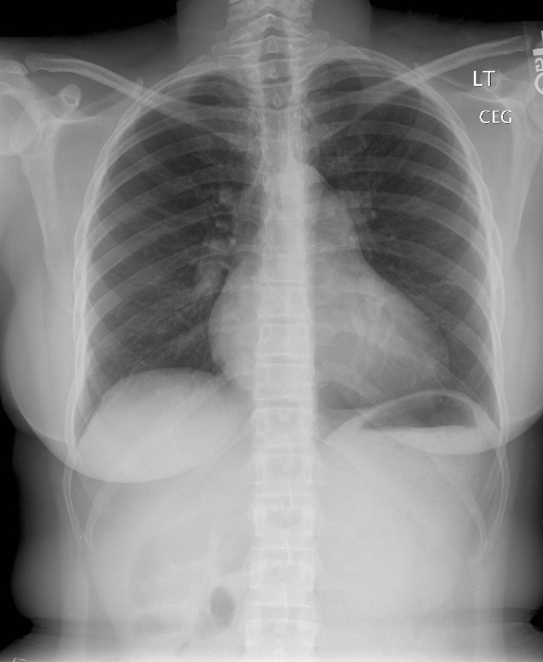
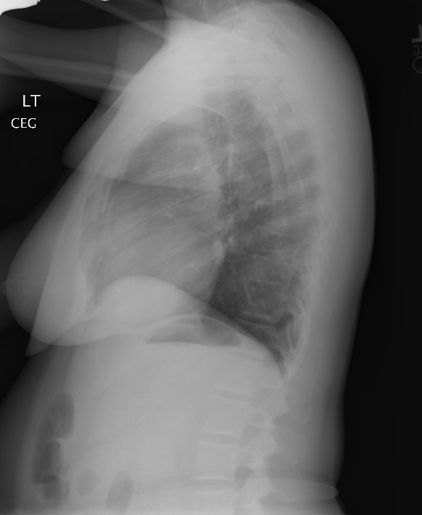
Chest Radiograph

Slide 5
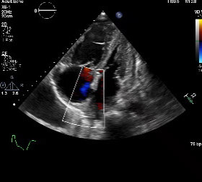
Echocardiogram
Severe RV enlargement and reduced function
TAPSE 1.1
Estimated RVSP 84 mm Hg

Slide 6
What Would You Order Next?
V/Q scan
CT angiogram
PFTs
Stress test

Slide 7
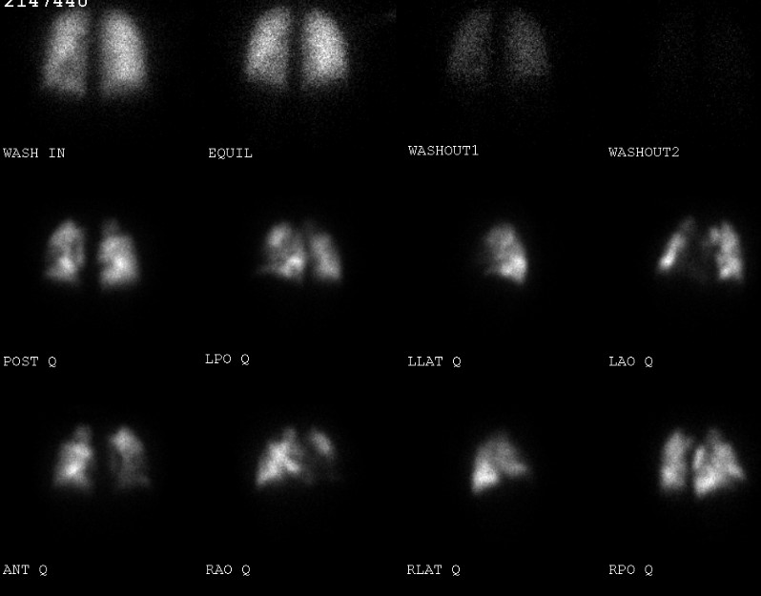
V/Q Scan (CTPA Reported as “No pulmonary emboli noted”)

Slide 8
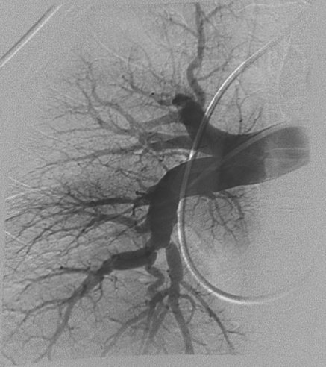
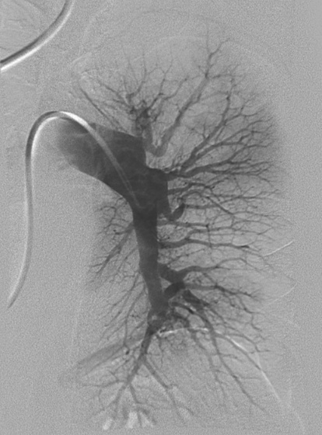
RHC and Pulmonary Angiogram
RAP 13 mm Hg
PAP 80/34 (52) mm Hg
CO/CI 2.6/1.3
PVR 16 WU
R
L

Slide 9
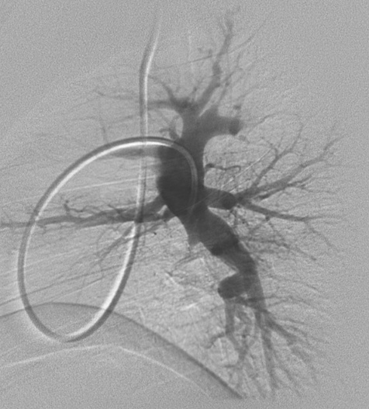
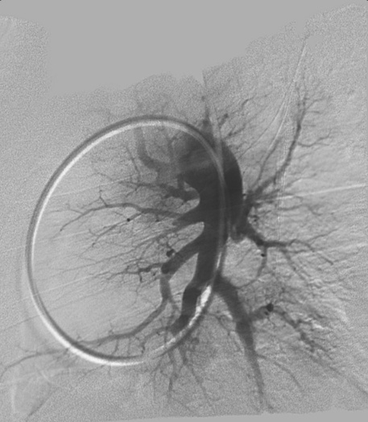
Lateral Views
R
L

Slide 10
Now What?
Is she a surgical candidate?
What about preoperative medical therapy?
What about balloon pulmonary angioplasty?
J. 2004;23:595-600.

Slide 11
Treatment Algorithm for CTEPH
Diagnosis of CTEPH Confirmed By Expert PH Center
Lifelong Anticoagulation
Operability Assessment by a
Multidisciplinary CTEPH Team
Technically Operable
Technically Non-Operable
Acceptable
Risk/Benefit Ratio
Non-Acceptable
Risk/Benefit Ratio
Targeted Medical
Therapy
Pulmonary
Endarterectomy
Persistent
Symptomatic PH
Consider BPA
In Expert Center
Consider Lung
Transplantation
Persistent Severe
Symptomatic PH

Slide 12
Follow-Up Data
PTE was offered, but with higher estimated mortality
Type III (segmental) disease removed bilaterally
Post-operative hemodynamics:
RA 8
PA 64/22 (mean 36)
CO/CI 5.8/2.9

Slide 13
Would You Post-Operatively Start Medical Therapy in this Patient?
If so, what medication?
What about BPA, post PTE surgery?
Would you give the patient more time to recover and reassess in 4-6 months?

Slide 14
Post-Operative Course
Patient discharged after 12 days; doing well
Discharged on warfarin with goal of an INR 2.5-3.5
Pre-discharge perfusion scan showed increased flow to both lower lobes with “steal” from LUL
2 months later, patient noted improvement in dyspnea but still some exercise limitation
Echo showed mild to moderate RV enlargement and estimated RVSP 62 mm Hg, TAPSE 1.6
Repeat V/Q scan was unchanged from early post-discharge scan

Slide 15
Repeat RHC
RA 10
PA 72/36 (mean 48)
PCW 10
CO/CI 4.6/2.3
PVR 8.2

Slide 16
What Now?
Send for balloon pulmonary angioplasty
No further treatment options
Start targeted medical therapy for residual pulmonary hypertension

Slide 17
What Now? (Continued)
Based on residual pulmonary hypertension and no evidence for new pulmonary emboli, the patient was started on targeted medical therapy
Improved clinical status, additional medications being considered

Slide 18
Take Home Messages
High-risk case based on preoperative relationship between hemodynamic severity and radiographic burden of disease
Operability assessment remains subjective; referral to experienced CTEPH team recommended
Role of bridging medical therapy in high-risk patients needs careful investigation and must be weighed against the risks of delaying PTE
Careful follow-up assessment is critical after PTE with consideration of medical therapy for residual PH

