Slide 1
Portopulmonary Hypertension (PoPH): A Case of Complex Physiology and Management
Jean Elwing, MD
Professor of Medicine
Director, Pulmonary Hypertension Program
Division of Pulmonary, Critical Care and Sleep Medicine
University of Cincinnati
Cincinnati, OH

Slide 2
Reginald: Progressive Decline in Health With Liver Disease
Reggie is a 53-year-old man who presented to his primary care physician's office for evaluation of worsening swelling and shortness of breath with ADLs
Struggled with his weight; BMI was >45 since his teenage years
Fatty liver change noted on abdominal ultrasound completed at age 35 for assessment of abdominal pain; diet and weight loss recommended
Developed diabetes at age 40; now controlled with insulin
Noted jaundice about 6 months prior and was recently admitted with a GI bleed and found to have varices
Diagnosed with NASH cirrhosis with portal hypertension and required banding at that time

Slide 3
Reginald: Clinical Evaluation and Testing
Vitals: 105/72, 92, 14, 92%
Lab Testing and Imaging
General: alert, interactive, no respiratory distress
Skin: mild jaundice
CV: RRR, heave, accentuated P2, 2/6 systolic murmur at RMSB
Lungs: CTA bilaterally
Abdomen: distended, mild ascites
Extremities: 2+ edema
Labs: unremarkable, except elevated INR=2.0, Hgb=11, PLT=100, Bili=4.5, Cr=1.3, BNP=250
CXR: clear, without infiltrates
HRCT: no ILD, enlarged PA/RV
PFT: moderate restriction with low ERV, no obs, no response to BD, low DLCO (70%)
6MWD: 234 m, 90%
Echocardiogram ordered

Slide 4
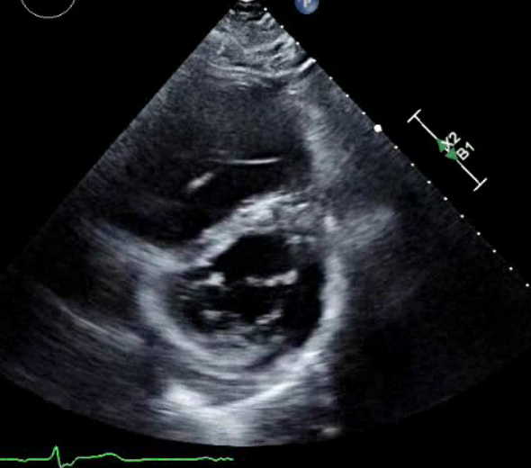
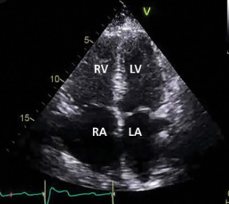
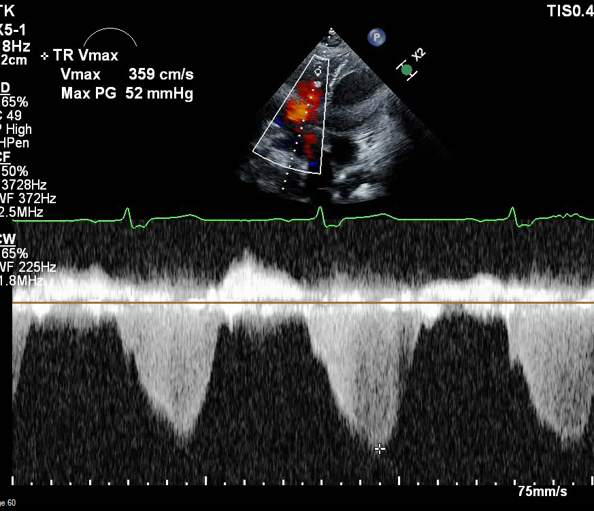
Echocardiographic Findings
Apical 4-chamber view
TR jet velocity
Parasternal short axis view

Slide 5
Echocardiographic Findings
Apical 4-chamber view
TR jet velocity
Parasternal short axis view
What would be the next step?

Slide 6
Echocardiographic Findings
Apical 4-chamber view
TR jet velocity
Parasternal short axis view
What would be the next step?
Patient referred to the pulmonary hypertension clinic for further evaluation of this abnormal echocardiogram

Slide 7
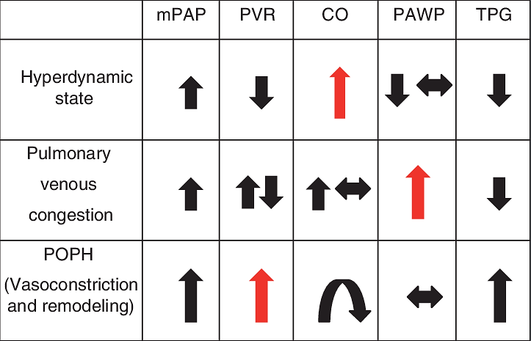
Right Heart Catheterization to Evaluate Hemodynamics

Slide 8
Right Heart Catheterization to Evaluate Hemodynamics
RHC needed to evaluate complex hemodynamics

Slide 9
Right Heart Catheterization to Evaluate Hemodynamics
RHC needed to evaluate complex hemodynamics
Portal hypertensive patients at risk for volume overload, high flow state, and increased pulmonary vascular resistance increasing pulmonary pressures

Slide 10
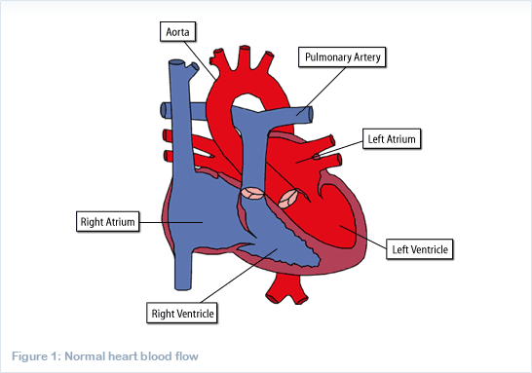
Right Heart Catheterization
Aorta
110/62 Art 93%
RA 72%
Pulmonary Artery
PA 73%
RV 74%
92/42
(58)
Left Atrium
10
Right Atrium
18
95/16
Left Ventricle
Right Ventricle
CO/CI 7.4/3.0
PVR 519

Slide 11
Right Heart Catheterization
Aorta
110/62 Art 93%
RA 72%
Pulmonary Artery
Diagnosis:
Portopulmonary Hypertension (PoPH)
High PVR and normal wedge
CO elevated but NOT the cause of PH
PA 73%
RV 74%
92/42
(58)
Left Atrium
10
Right Atrium
18
95/16
Left Ventricle
Right Ventricle
CO/CI 7.4/3.0
PVR 519

Slide 12
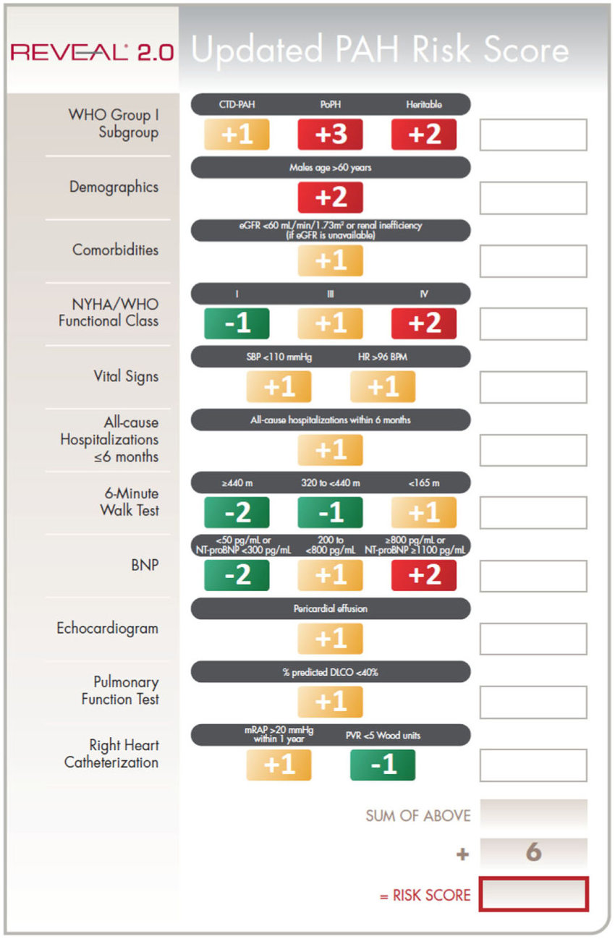
REVEAL 2.0 Risk Assessment
3
Risk category is defined by overall point score:
Low, ≤6; Intermediate, 7–8; High, ≥9
C-index (95% CI) 0.76 (0.74 –0.78)
0
1
1
1
0
0
1
1
0
0
8
14

Slide 13
Portopulmonary Hypertension (PoPH): Some Basics
Coexistence of portal and pulmonary hypertension
Serious complication of liver disease, present in 0.25% to 4% of all patients suffering from cirrhosis
No longer absolute contraindication to liver transplantation (LT) due to rapid advances in treatment of PoPH
However, the impact of LT on PoPH remains a complex and unresolved issue
Uncontrolled PoPH has a negative impact on post-LT right heart failure and death
Echo assessment recommended for screening of at-risk patients
But, if well treated, stabilization or normalization of pulmonary hemodynamics may be achievable in post-LT patients

Slide 14
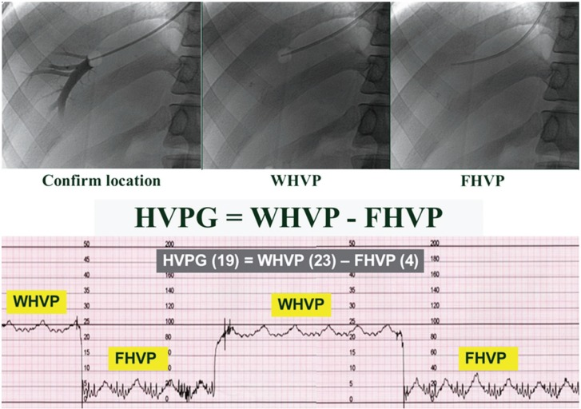
Portopulmonary Hypertension: Current Definitions
Several clinical observations report that the hepatic and portal system regulate vasoreactivity and angiogenesis in the pulmonary and systemic circulations
PoPH has the same definition as Group 1 PAH
mPAP >20 mmHg
PAWP <5 mmHg
PVR >3 WU (240 dynes); elevation in PVR integral to PoPH diagnosis
Threshold of 3 WU may exclude patients with early PoPH
In addition to the presence of portal hypertension as confirmed by a hepatic venous pressure gradient (HVPG) >5 mmHg, or suggested by the presence of splenomegaly, thrombocytopenia, esophageal varices, or portosystemic shunt

Slide 15
Portopulmonary Hypertension: Epidemiology
Measured prevalence varies by population studied and hemodynamic definition
In a series of 502 consecutive patients, prevalence was 2%¹
In cirrhotic patient candidates for LT, prevalence of PoPH varies from 3 to 6% (criterion PVR for this analysis was 1.5 WU, not 3 WU)²
In the REVEAL registry, 4.9% of 3900 patients with PAH had associated portal hypertension³
The French registry showed a higher prevalence at ~15%⁴
Most patients diagnosed with PoPH in the US are cirrhotic, awaiting LT

Slide 16
Portopulmonary Hypertension: Pathogenesis
PORTAL HYPERTENSION + CIRRHOSIS
Hyperdynamic Circulatory Syndrome
Porto-Systemic Shunts
Systemic Endotoxinemia
Cirrhosis
Imbalance Between Pro- and Anti-Angiogenic Factors
Shear Stress
Systemic Inflammation
Endothelial Dysfunction/Local Inflammation
Genetic Factors
Autoimmunity
Toxic Factors
Female
Pulmonary Vascular Remodeling

Slide 17
Portopulmonary Hypertension: Risk Factors for Disease Development
PoPH can develop irrespective of the severity of underlying liver disease
Patients with compensated cirrhosis or extrahepatic portal hypertension account for >50% of patients in the French registry
No clear evidence that PoPH prevalence is higher in decompensated cirrhosis
No apparent correlation between HVPG and PVR¹
Main risk factors:
Presence of portal hypertension
Female gender with portal hypertension²
Presence of autoimmune cirrhosis, less frequent in hepatitis C-related cirrhosis^{2,3}

Slide 18
Portopulmonary Hypertension: Outcomes Are Worse Than for IPAH/HPAH
5-Year Survival From Diagnosis of PoPH
100
Time From Diagnosis (Years)
80
64 ± 2%
60
Survival (%)
40 ± 6%
40
IPAH/FPAH, n=1190ª
20
PoPH, n=153ª
Overall Wald chi-square P<0.001
0
0
1
2
3
4
5
Time From Diagnosis (Years)
# at risk:
IPAH/FPAH
419
485
527
472
393
311
PoPH
56
63
59
55
43
27

Slide 19
Portopulmonary Hypertension: General Management and Treatments
Anticoagulation: not recommended in PoPH
In presence of severe hepatocellular insufficiency, and/or thrombocytopenia, and/or uncontrolled esophageal varices¹
Fluid Overload
Often observed in PoPH; diuretics required in most patients
O₂ Therapy
Recommended in PoPH when PaO₂ consistently <8 kPa (60 mmHg)
β-Blockers
Prophylactic treatment may be associated with worsening of exercise capacity and hemodynamics; negative effects on RV (↓ CO and ↑ PVR)²
No transjugular intrahepatic portosystemic shunt
CCBs: not indicated in PoPH
CCBs can induce splanchnic vasodilation and increase HVPG

Slide 20
What data do we have about PAH therapies in portopulmonary hypertension?

Slide 21
Portopulmonary Hypertension: PAH-targeted Therapies
Use of standard PAH-targeted therapies based on existing data for patients with IPAH
In general, patients with chronic liver disease have been excluded from all randomized controlled PAH therapy trials
Important for clinicians to account for the severity of underlying liver disease in their treatment decisions
The available PAH medications are available for use in PoPH
Treatments should be initiated through a PH specialty center with expertise in PH management

Slide 22
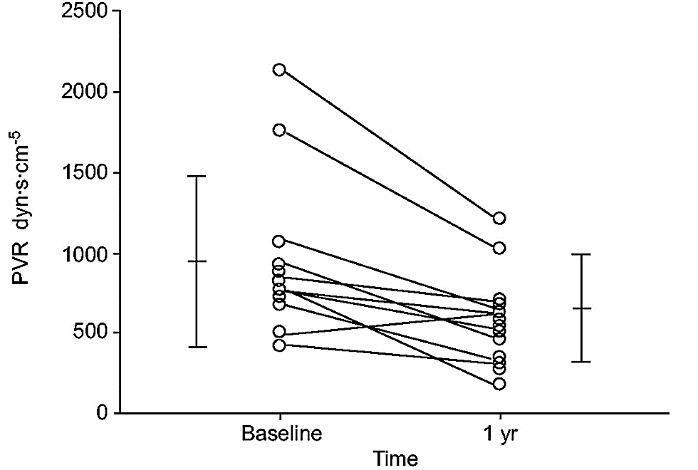
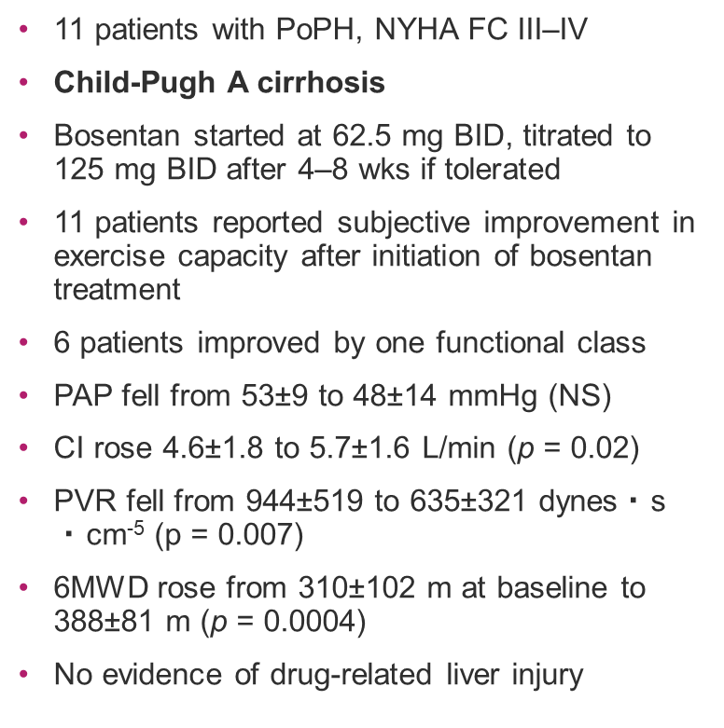
Bosentan: Reduces PVR in PoPH Child-Pugh A Cirrhosis
Impact of bosentan treatment on pulmonary vascular resistance
(PVR) in 11 patients with PoPH
11 patients with PoPH, NYHA FC III–IV
Child-Pugh A cirrhosis
Bosentan started at 62.5 mg BID, titrated to 125 mg BID after 4–8 wks if tolerated
11 patients reported subjective improvement in exercise capacity after initiation of bosentan treatment
6 patients improved by one functional class
PAP fell from 53±9 to 48±14 mmHg (NS)
CI rose 4.6±1.8 to 5.7±1.6 L/min (p = 0.02)
PVR fell from 944±519 to 635±321 dynes$・$s $・$cm⁻⁵ (p = 0.007)
6MWD rose from 310±102 m at baseline to 388±81 m (p = 0.0004)
No evidence of drug-related liver injury
2500
2000
1500
PVR dyn·s·cm⁻⁵
1000
500
0
Baseline
1 yr
Time

Slide 23
Bosentan: Improves PVR, CI, and 6MWD in Child-Pugh B Cirrhosis
Changes in CI, PVR, and 6MWD in noncirrhotic portal hypertension or cirrhosis Child–Pugh (C-P) class A (n=23) and patients with cirrhosis C-P class B (n=8) 4 months after initiation of bosentan (62.5 mg BID/4 wks, then 125 mg BID) according to liver disease severity
***
50
**
c)
50
NS
a)
200
b)
200
150
0
100
100
∆CI%
∆PVR%
∆6WMD%
50
0
-50
0
-100
-50
-100
C-P class A cirrhosis
or noncirrhotic portal
hypertension
C-P class B
cirrhosis
C-P class A cirrhosis
or noncirrhotic portal
hypertension
C-P class B
cirrhosis
C-P class A cirrhosis
or noncirrhotic portal
hypertension
C-P class B
cirrhosis
Bosentan treatment associated with short-term improvements in functional status, 6MWD, and hemodynamics; improvements maintained over the long term.
Type of response in Child-Pugh B patients is generally observed in patients with PAH associated with inflammatory conditions
Annual rates of liver enzyme elevation observed in this study were similar to reports from post-marketing surveillance of bosentan

Slide 24
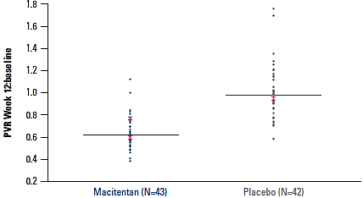
Macitentan: Safety and Efficacy in PoPH (PORTICO)
85 patients randomized to macitentan, 10 mg (n=43) or placebo (n=42) for the 12-week, double-blind treatment period
Main inclusion criteria: age ≥18 years; PVR ≥320 dyn・sec・cm⁻⁵; 6MWD ≥50 m
Primary endpoint: change in PVR at Week 12 expressed as a ratio of baseline value
PVR at Week 12 as Ratio of Baseline
Endpoints | Macitentan (n=43) |  | Placebo (n=42) |  | Treatment Effect (95% CI) | P-value
 | Baseline (BL) mean (SD) | Mean (SD) Δ from BL to Week 12 | Baseline mean (SD) | Mean (SD) Δ from BL to Week 12
mRAP, mmHg | 7.3 (3.7) | 1.6 (5.6) | 6.7 (3.6) | 0.3 (3.3) | 1.67 (–0.10, 3.44) | 0.0637
mPAP, mmHg | 46.4 (7.9) | −6.4 (4.9) | 43.8 (8.5) | 0.4 (7.0) | –5.99 (–8.40, –3.57) | <0.0001
CI, L/min/m² | 3.1 (0.8) | 0.6 (0.8) | 2.9 (0.8) | 0.1 (0.6) | –171.48 (–223.67, –119.30) | 0.0009
TPR, dyn·sec·cm^{–5} | 689.3 (228.6) | −199.8 (163.1) | 671.5 (199.7) | −18.3 (135.3) | –171.48 (–223.67, –119.30) | <0.0001
SvO₂ | 69.2 (9.9) | 1.1 (6.7) | 69.9 (5.3 | 0.8 (7.8) | 0.03 (–2.85, 2.91) | 0.9844
35% reduction in PVR with macitentan vs. placebo
No significant differences in mRAP or mVO₂
No significant differences in change from BL to Week 12 in 6MWD or WHO FC.

Slide 25
What About Other Classes of PAH Medications?
No RCTs studying effects of PDE5i’s on PoPH
Small retrospective studies reported sildenafil improves functional capacity and hemodynamics with no safety issues
Most studies have enrolled patients awaiting LT¹⁻³
No data on riociguat
Prostanoids^{4,5}
Proven efficacy and safety in PAH (epoprostenol)
Epoprostenol has no RCTs for patients with PoPH
Small retrospective studies reported improvements in functional capacity and hemodynamics
Major limitation of epoprostenol is its route of administration (via tunneled central venous catheter)
Increased risks of bleeding and infection
Prostanoids may help bridge patients to transplantation
No clinical trial evidence for selexipag

Slide 26
Liver Transplantation and Portopulmonary Hypertension: Interactive Effects?
PoPH and LT have mutually interactive effects
Outcomes of PoPH after LT are unpredictable
Transplantation evaluation is pursued only in patients with controlled PAH, as long as liver disease meets transplantation criteria
In contrast to hepatopulmonary syndrome, PoPH is not in itself a criterion for LT
If patients with PoPH have severe hemodynamic impairments, there is a very high risk of perioperative mortality
Therefore, uncontrolled PoPH is a contraindication for LT

Slide 27
Management of PoPH Candidates for Liver Transplantation
PoPH in Liver Transplantation Candidates
Management in Expert Centers
mPAP >35 mmHg
mPAP <35 mmHg
PAH-targeted Therapies
Goal Of PAH Treatment
mPAP 35 mmHg - 50 mmHg and
PVR <3–4 WU
Yes
Inscription on Waiting List for LT
No
Definitive Contraindication for LT
Perioperative Right Heart Failure
Fluid Volume Optimization
CO and Systemic Pressure Optimization
Inhaled NO
Reinforcement of PAH-targeted Therapies
Refractory Right Heart Failure
ECMO?
Liver Transplantation
Perioperative Monitoring and
PA Catheterization
Close Monitoring for PoPH After LT
Adaptation of PAH-targeted Therapies
According to Hemodynamic Evolution at
Distance of Liver Transplantation

Slide 28
Reginald: PoPH Management and Transplantation Evaluation
PoPH Management
Liver Transplant
Aggressive management required
Advanced symptoms
High risk according to risk scoring
Initiated combination PAH therapy with IV epo, PDE5i
Plans for macitentan in future
Monitored closely with serial echos and RHC
Patient interested
No contraindications except his PoPH
PoPH precluded him from transplant at time of diagnosis
Risk was greater than benefit at diagnosis
Aggressive treatment and reevaluation recommended

Slide 29
Detection of Pulmonary Hypertension
Aorta
110/62 Art 93%
RA 78%
Pulmonary Artery
PA 79%
RV 77%
50/25
(33)
Left Atrium
10
Right Atrium
8
51/10
Left Ventricle
Right Ventricle
CO/CI 9.4/4
PVR 196

Slide 30
Detection of Pulmonary Hypertension
Improved
Portopulmonary Hypertension (PoPH)
Aorta
110/62 Art 93%
RA 78%
Pulmonary Artery
PA 79%
RV 77%
50/25
(33)
Left Atrium
10
Right Atrium
8
51/10
Left Ventricle
Right Ventricle
CO/CI 9.4/4
PVR 196

Slide 31
Detection of Pulmonary Hypertension
Improved
Portopulmonary Hypertension (PoPH)
Aorta
110/62 Art 93%
RA 78%
Pulmonary Artery
PA 79%
Increased CO/CI
**Monitor in the setting of liver disease
RV 77%
50/25
(33)
Left Atrium
10
Right Atrium
8
51/10
Left Ventricle
Right Ventricle
CO/CI 9.4/4
PVR 196

Slide 32
Detection of Pulmonary Hypertension
Improved
Portopulmonary Hypertension (PoPH)
Aorta
110/62 Art 93%
RA 78%
Pulmonary Artery
PA 79%
Increased CO/CI
**Monitor in the setting of liver disease
RV 77%
50/25
(33)
Left Atrium
10
Right Atrium
8
51/10
Left Ventricle
He now meets hemodynamic criteria for LT listing
Right Ventricle
CO/CI 9.4/4
PVR 196

Slide 33
Mayo Clinic Guidelines: Liver Transplantation in PoPH
Current Mayo Clinic Intraoperative Guidelines Concerning Pulmonary Hemodynamics in Patients With Portopulmonary Hypertension
Mean Pulmonary Artery Pressure (mPAP) | Intraoperative Guideline | Reported Mortality (%)
<35 mmHg | Proceed with OLT | 0/14 (0)
35–50 mmHg | If PVR* <250 proceed with OLT If PVR* >250 cancel OLT | 0/6 (0) 7/14 (50) ‡
>50 mmHg | Cancel OLT† | 6/6 (100)
*PVR in dynes · s · cm⁻⁵. †If untreated, refer for additional pulmonary hypertension evaluation/therapeutic considerations and reevaluate for OLT ‡One patient died of right cardiac failure after transplantation hospitalization

Slide 34
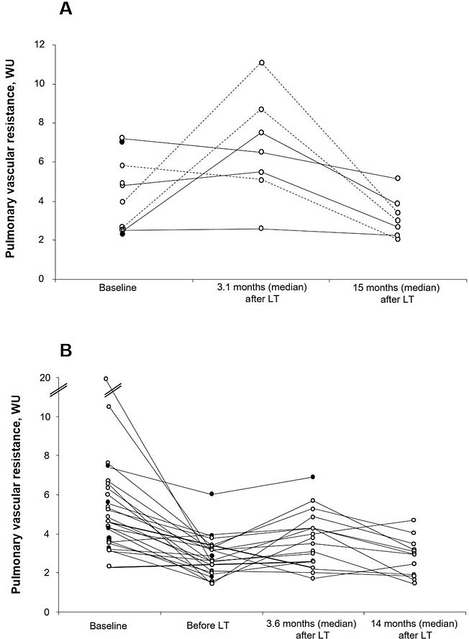
PoPH Can Worsen Long After Liver Transplantation
Short-term and long-term evolution of PVR after LT in patients both untreated and treated with targeted therapies before LT
Worsening may require escalation of PAH therapy
However, the mechanisms underlying the worsening of PAH post-LT have not been elucidated
In a series of 35 patients with PoPH undergoing LT, those who survived >6 mos treated with epoprostenol were weaned off epoprostenol several months post-LT and many were maintained on ERAs or PDE5i’s (55%)
Findings suggest stabilization of PAH post-LT is achievable
Evolution of PVR at median 3.1 months (IQR 2.1–4.1) after LT (short-term evolution) and 15 months (IQR 13–33) after LT (long-term evolution)
Evolution of PVR in patients treated with PAH-targeted therapies before LT, at median 3.6 months (IQR 3–4.1) after LT (short-term evolution) and 14 months (IQR 11–35) after LT (long-term evolution)

Slide 35
Summary
Portal hypertension is a frequent sequela to cirrhosis and complicates the medical management of the LT candidate
Portal hypertension and cirrhosis can lead to imbalances in pro- and anti-angiogenic factors, and/or systemic endotoxemia, and/or inflammation or hyperdynamic circulatory syndrome, and increased shear stress in blood vessels
Resultant endothelial dysfunction is thought to contribute to imbalances in vasoregulation in the pulmonary vasculature, resulting in pulmonary hypertension
Aside from portal hypertension, the clinical manifestations of PoPH are similar to other forms of Group 1 PAH

Slide 36
Summary
Screening all LT candidates for presence of PoPH via TTE and, if warranted, RHC, is an essential step in early diagnosis and possible treatment
There are currently no approved medications to specifically treat PoPH
General treatment measures should be implemented; use of ERAs, while supported by some clinical studies, does not always yield consistent outcomes
To date, there have been limited randomized clinical trials specifically targeting efficacy and safety of approved PAH-targeted therapies in treating PoPH

Slide 37
Summary
PoPH and LT appear to have interactive effects
Even after LT, PoPH may persist and even worsen
All LT candidates with mPAP >35 mmHg should be treated in advance of LT to reduce mPAP before surgery
Management of PAH hemodynamics improves outcomes after LT
It has been proposed that a mPAP <35 mmHg and PVR <3–4 WU in the pre-transplant patient may improve results of LT and, possibly, long-term survival

