Slide 1
A Stimulating Cause of PAH: Methamphetamine-Induced PAH
Sudarshan Rajagopal, MD, PhD
Associate Professor of Medicine
Co-Director, Pulmonary Vascular Disease Center
Duke University School of Medicine
Durham, NC

Slide 2
Initial Presentation
59-year-old man presented in 2015 with a past medical history of hypertension, type 2 diabetes, hyperlipidemia, and obesity He had developed shortness of breath and chest tightness. Had a history of provoked pulmonary embolism (since he is a truck driver)
Developed shortness of breath with any degree of exercise or even simple exertion. He had not passed out but had multiple presyncopal episodes as well as frequent palpitations
Assessed at FC IV
Consulted a local MD, was noted as requiring oxygen, and was given the diagnosis of COPD; he never smoked
A concern for shunting was raised at that time as well. He preferred not to be on continuous oxygen
Referred to community hospital

Slide 3
Studies
RHC at Community Hospital:
RAP = 10 mmHg
RVP = 104/9–14 mmHg
PAP = 112/56 (mPAP = 77) mmHg
Could not obtain accurate PCWP
CI 1.4 L/min/m²; full report unavailable
Referred to Our Center
TTE on 2/25/15:
LVEF >55%
Mild LVH
Grade 1 LVDD
Flattening of interatrial septum
RV moderately enlarged with mild global decrease in function
RVH present
IVC normal in size with normal respiratory collapse
Mild TR
PFT on 4/27/15
TLC: 95%pred
FVC: 95%pred
FEV1: 74%pred
FEV1/FVC: 61%pred
DLCO: 107%pred

Slide 4
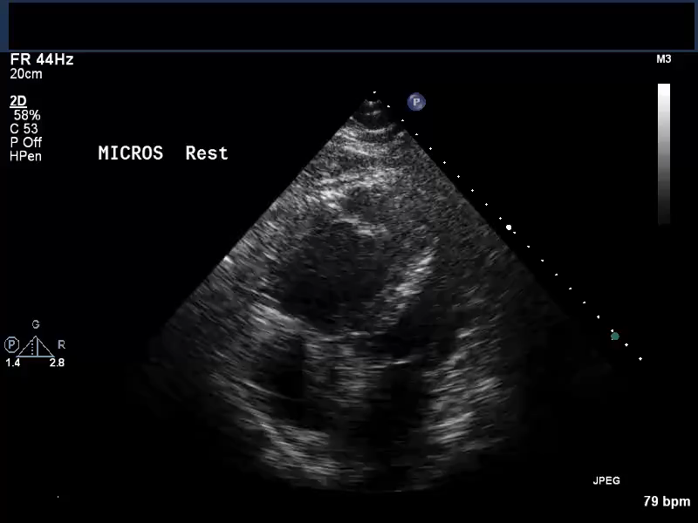
Echocardiogram: Bubble Study

Slide 5
Studies
VQ scan on 4/27/15: very low probability of PE
CT chest w/o contrast on 4/28/15:
Calcified mediastinal lymph nodes and scattered nodules, likely sequelae of prior granulomatous disease
Enlarged main PA, as seen in PAH
Severe coronary artery calcifications; 6-mm noncalcified nodule in RML; recommended repeat in 6–12 mos to establish stability
RHC on 4/28/15:
RAP = 12 mmHg,
RVP = 111/9–14 mmHg
PAP 110/49 mmHg (mPAP = 74)
PCWP = 14 mmHg
CO (Fick) = 3.8 L/min
CI (Fick) = 1.7 L/min
PVR = 19.2 WU
Shunt run with H SVC 69.2, IVC 73.8, RA 64.5, PA 66.5, FA 93.5, LU PV 96.9, LA 98.3; oxygenation stable during catheterization, likely orthodeoxia

Slide 6
What would be an appropriate initial course of treatment for this patient?

Slide 7
Medical Therapy
Admitted to the hospital for initiation of IV treprostinil, tadalafil, and ambrisentan
Treprostinil up-titrated to ~ 30 ng/kg/min during hospital stay
Concerns arose regarding the patient’s level of social support—the patient lived alone
Exertional hypoxemia had resolved by hospital discharge
Treprostinil further up-titrated to ~ 120 ng/kg/min as an outpatient

Slide 8
Three Years Later…
Patient walked next door to his niece's house feeling very dizzy, with palpitations, but denied syncope. The patient's niece called EMS—noted HR in 160s and SBP in 60s
At OSH, initial HR noted to be 160 bpm with BP 70/46 mmHg; patient was given 6 mg adenosine, which reduced HR to 110 bpm sinus tachycardia, and BP increased to 91/53 mmHg. He was given 1 L IVF and transferred
During transfer, patient again had 3 episodes of SVT for which he was given 12 mg adenosine x 3 and a 150-mg amiodarone push
Upon arrival, patient's HR was in the 140s with BP 90s/60s. After completing the admiodarone bolus, he converted to NSR with HR in the 90s. He was alert and oriented and denied dizziness, chest pain, or dyspnea
The patient noted that he was not compliant with all of his medications. He was compliant with treprostinil treatment as his niece helped with it. He missed doses of other medications several times a week
He said that he did smoke marijuana on 5/20, but denied IVDU or other illicit substance use but was using OTC meds (including cough and cold medications)

Slide 9
Urine Toxicology
Component Ref Range & Units
Amphetamine/Methamphetamine, Urine Positive/Abnormal
Barbiturates, Urine Negative
Benzodiazepine, Urine Negative
Cocaine Metabolites, Urine Negative
Opiates, Urine Negative
Tetrahydrocannabinol (THC), Urine Negative
On further discussion, patient endorsed
using methamphetamine for ~ 5 years

Slide 10
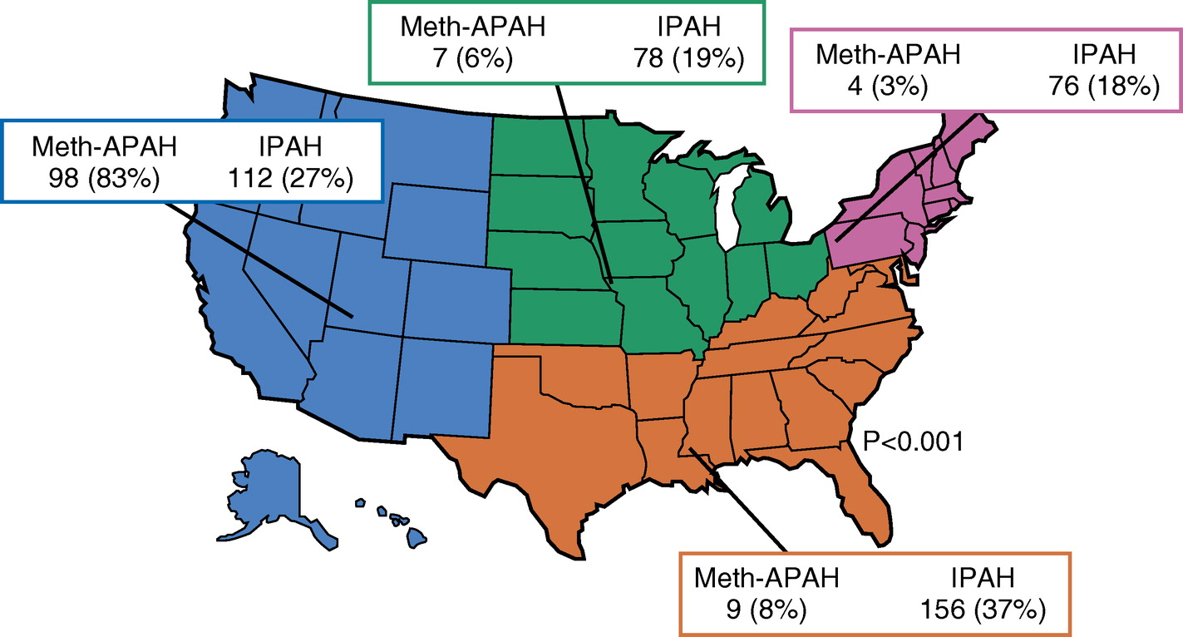
Meth-APAH and IPAH in the Pulmonary Hypertension Association Registry

Slide 11
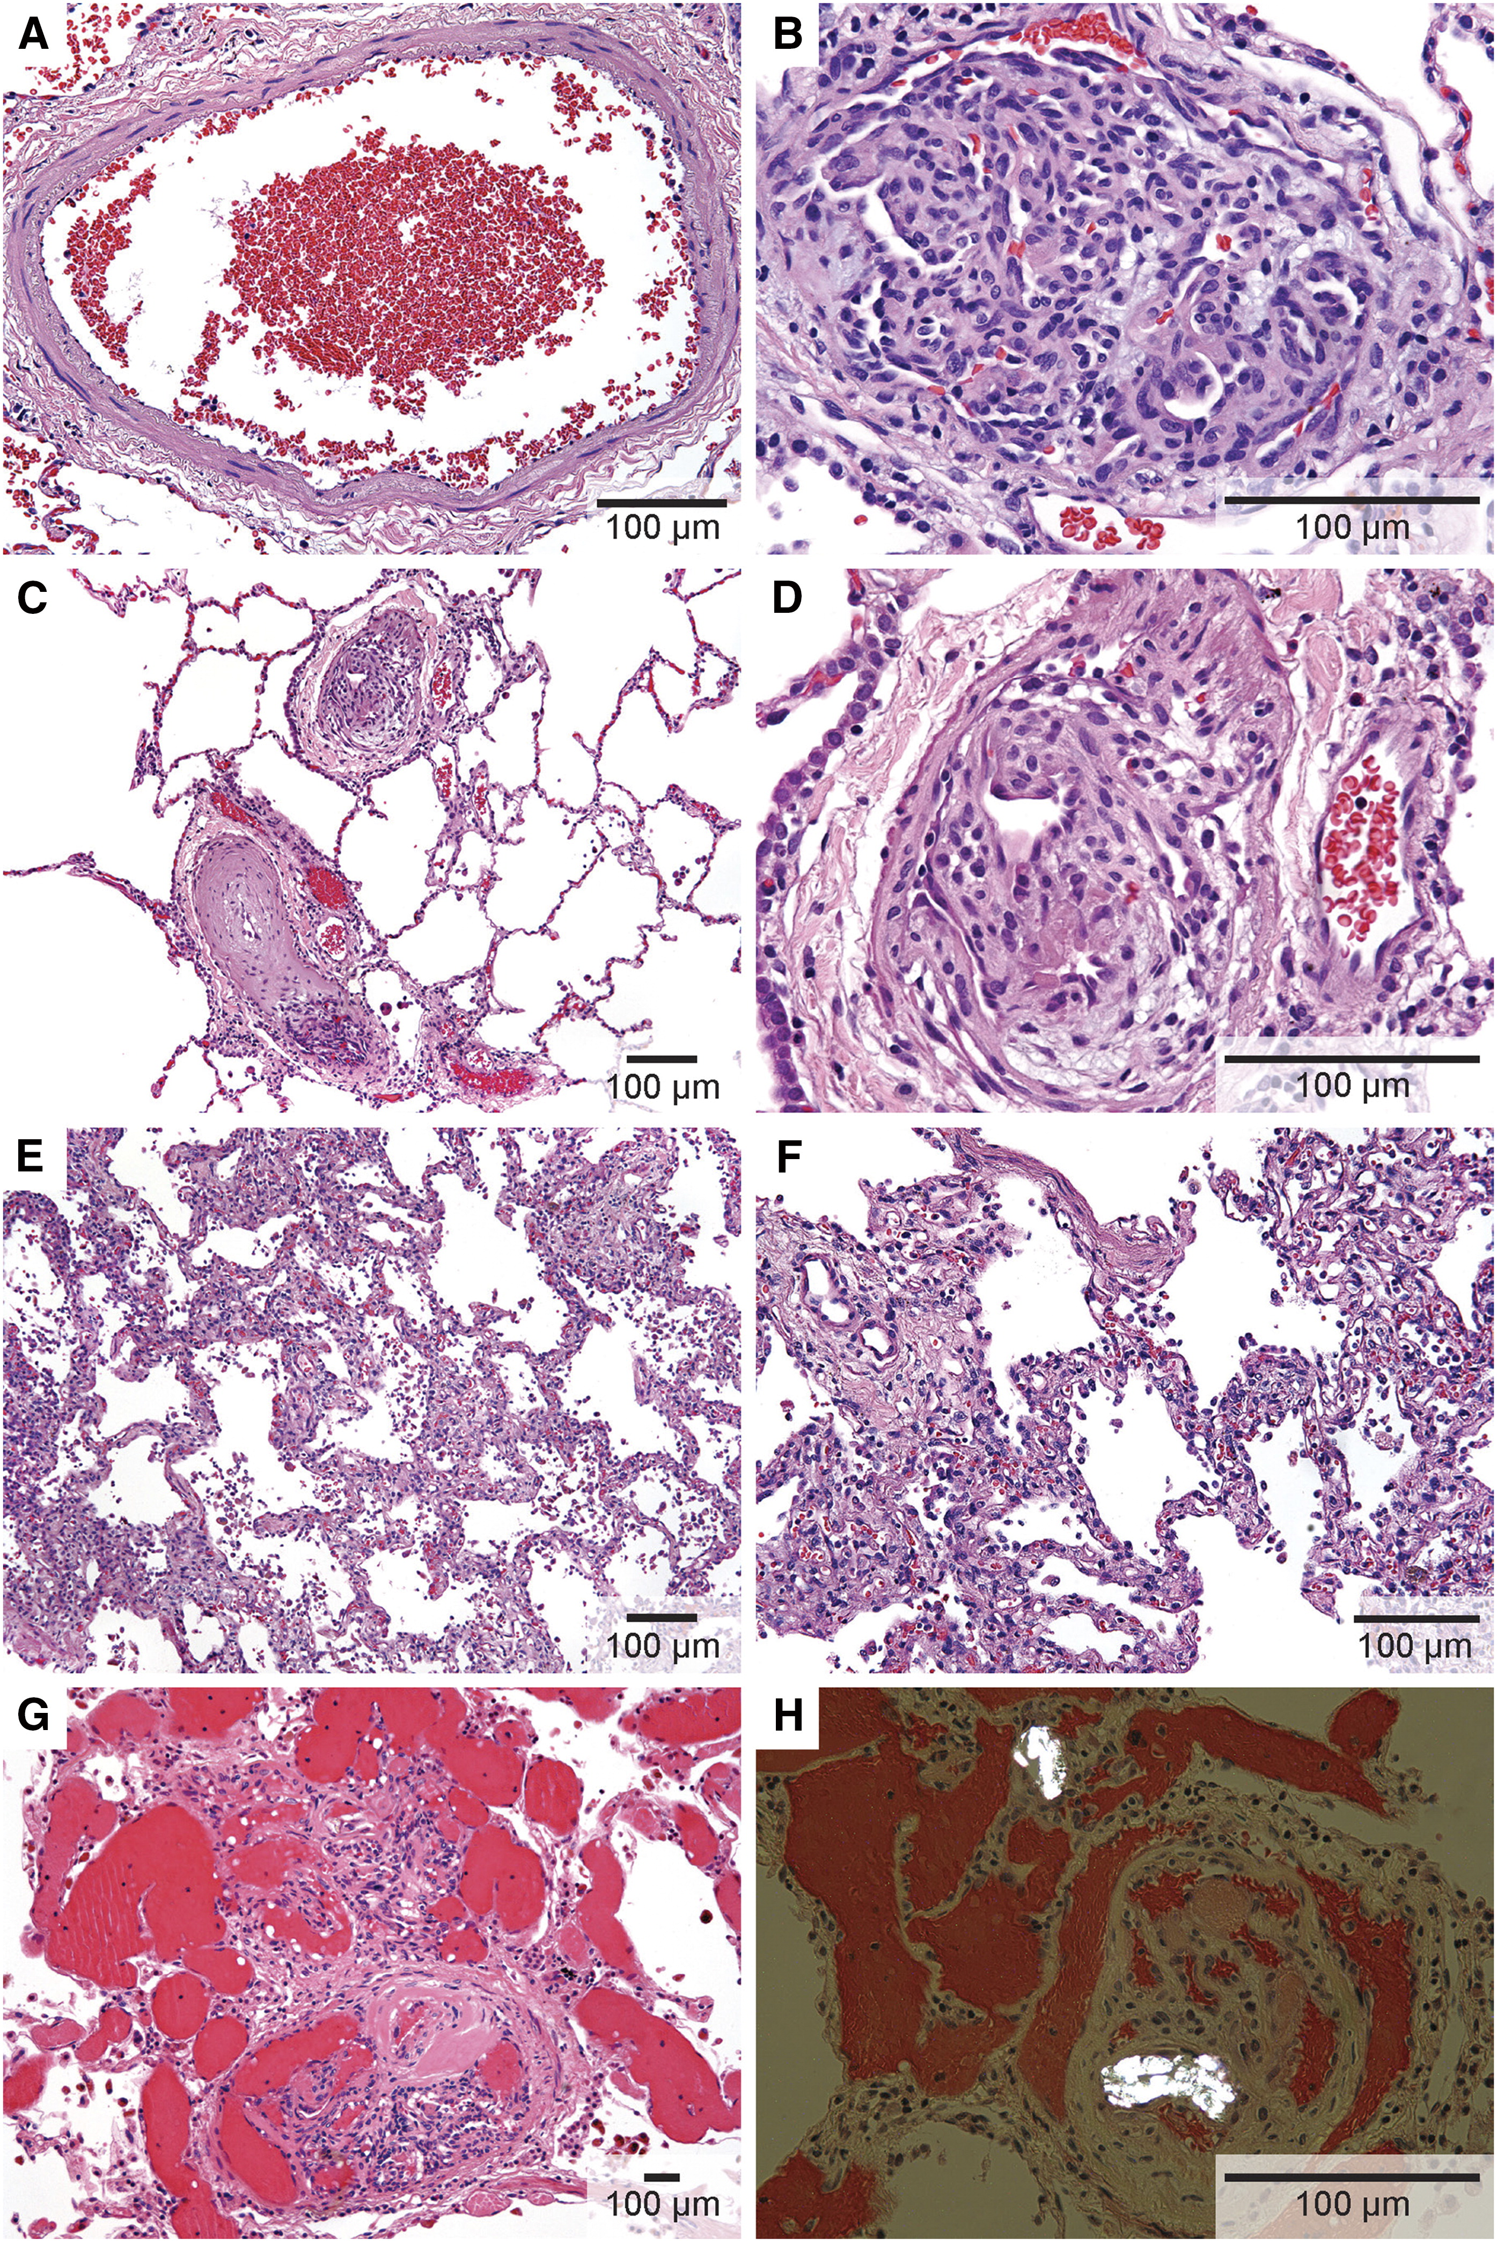
Histopathology of Meth-APAH and IPAH
Control
IPAH
Meth-APAH

Slide 12
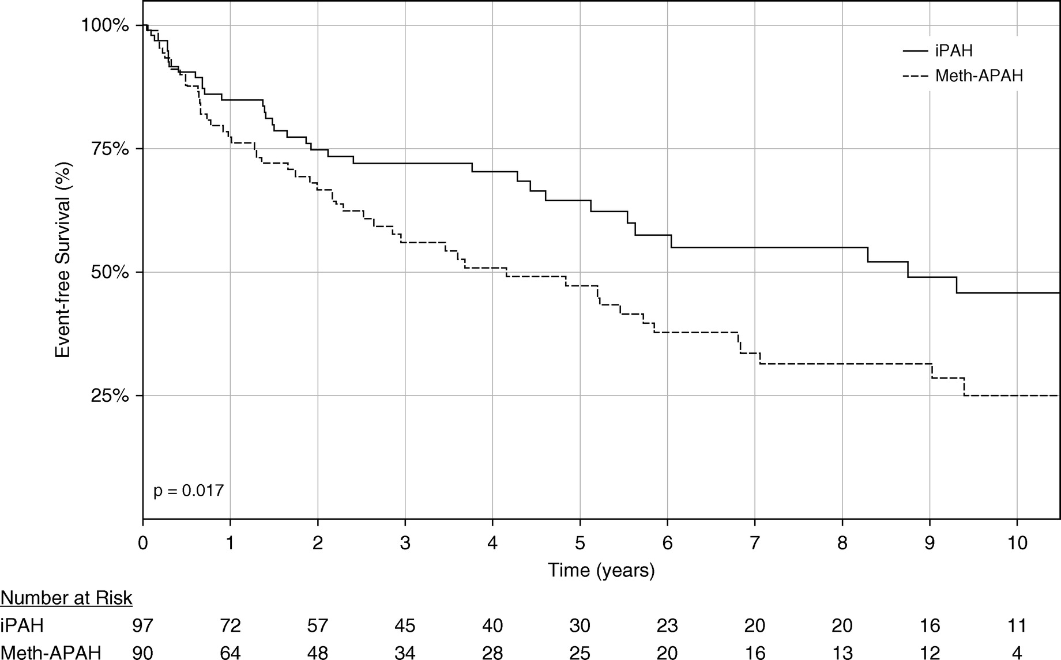
Outcomes in Meth-APAH and IPAH

Slide 13
What Should We Do Now?
Transition from IV treprostinil to oral treprostinil?
Make no changes?

Slide 14
Summary and Next Steps
We chose to continue his therapies
He was continued on IV treprostinil, tadalafil, and ambrisentan
It was decided that he was more likely to be adherent to IV treprostinil as it was given continuously via parenteral route; not concerned about IV drug use
Discussion with the patient and his niece about importance of adherence to medications and abstinence from drug use

Slide 15
Follow-up
Continued on triple therapy with IV treprostinil, PDE5i, and ERA
Normalization of RV size and function
REVEAL 2.0 risk score confirms low risk status

