Slide 1
Pulmonary Hypertension in a Patient With Adult-Onset Still’s Disease
Rajan Saggar, MD
Professor of Medicine
Co-Director, Pulmonary Vascular Disease Program
Co-Director, Medical Intensive Care Unit
Lung & Heart-Lung Transplant and Pulmonary Hypertension Programs
David Geffen School of Medicine
UCLA Medical Center
Los Angeles, CA

Slide 2
Case Presentation
38 y.o. female diagnosed with Adult-Onset Still’s Disease (AOSD)
4/2020: Met Yamaguchi criteria (prolonged fever (103-104F) > one month)
Profound myalgias/arthralgias (arms > legs)
N/V, diarrhea
Nonpruritic rash (forearms/legs > face/torso)
Splenomegaly, abnormal LFT, negative ANA/RF

Slide 3
Searching for Best Treatment for Still’s Disease
4/2020 (initial diagnosis) | 5/2020 | 7/2020 | 12/2020 | 4/2021 | 5/2021 | 11/2021
MTX and CS | +etanercept | (stopped etanercept) +sarilumab | (stopped sarilumab) +anakinra | MTX; CS; anakinra +COVID mRNA vaccine (#1 of 2) |  | MTX; CS; anakinra
Ferritin | 65,000ng/mL |  |  | 200ng/mL (just prior to COVID vaccine) | 28,000 ng/mL | 5,524 ng/mL (11/15) 18,179 ng/mL (11/18)

Slide 4
Case Presentation
11/2021: the patient presented with progressive DOE and nonproductive cough spanning ~8 weeks; unresponsive to outpatient antibiotics
Elevated ferritin (5,524ng/mL), intermittent fever, relative tachycardia, “slight” rash on forearms, initial pulse oximetry 90% (room air)
Vitals temperature 37.8C; BP 110/70; HR 107; RR 28; pox 96% 4 liters NC oxygen
11/18/2021: Echocardiogram
Small LV
Flattened IVS (systole)
LVEF 65%
Severe RVE and reduced systolic function
TAPSE 1.6 cm
DTI 9.3 cm/s
Moderately increased RV wall thickness
Normal LA; mild RAE
Echo Parameter
RAP, mmHg | 15
RVSP, mmHg | 77 (assuming RAP = 15 mm Hg)
Other Findings
Trace MR
Mild-Moderate TR
Dilated IVC (< 50% change)
Small to moderate pericardial effusion without tamponade
14% MV variation

Slide 5
Patient’s RHC Data and Lab Values
RHC (11/17/2021):
Labs:
RAP 7 mm Hg
RV P 70/1/13
PA 70/34 mmHg, mean 47
CO 4.2
CI 2.45
no response to iNO
troponin 0.04
WBC 3.8
Hgb 10.7
MCV 74.4
platelet 177,000
ESR 25
sodium 137
K⁺ 4.2
Chloride 104
Bicarbonate 22.8
BUN 10
creatinine 0.76; albumin 3.4; AST 112; ALT 29; alk phos 62; total bilirubin 0.4; LDH 1121; TSH 2.56; ferritin 5524; CRP 52.95; normal lactate
negative tox screen
negative pregnancy
negative U/A

Slide 6
11/18/2021
Ferritin 18,179 ng/mL
CRP 6.6 mg/dL
BNP 331 pg/mL
Troponin I 0.09 ng/mL
12/21/2021
Ferritin 38,820 ng/mL
CRP 2.2 mg/dL
BNP 229 pg/mL
Troponin I < 0.04 ng/mL
1/7/2022
Ferritin 6,711 ng/mL
CRP <0.3 mg/dL
BNP 117 pg/mL
Troponin I < 0.04 ng/mL

Slide 7
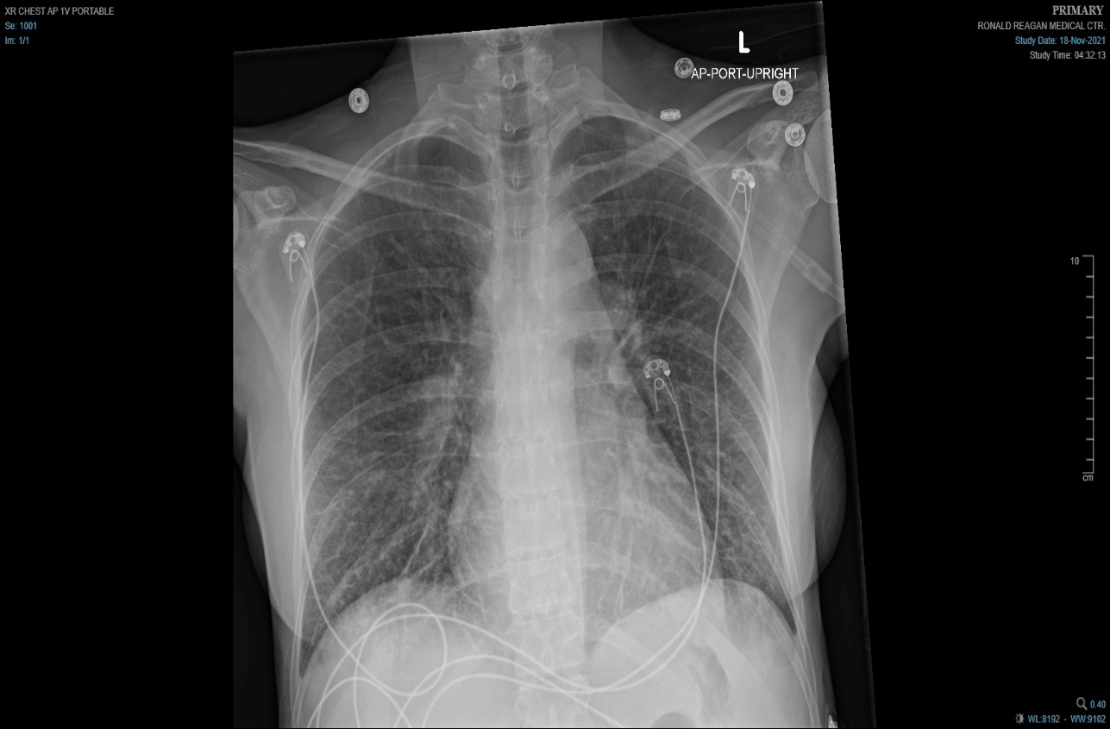
11/18/2021
Ferritin 18,179 ng/mL
CRP 6.6 mg/dL
BNP 331 pg/mL
Troponin I 0.09 ng/mL
12/21/2021
Ferritin 38,820 ng/mL
CRP 2.2 mg/dL
BNP 229 pg/mL
Troponin I < 0.04 ng/mL
1/7/2022
Ferritin 6,711 ng/mL
CRP <0.3 mg/dL
BNP 117 pg/mL
Troponin I < 0.04 ng/mL

Slide 8
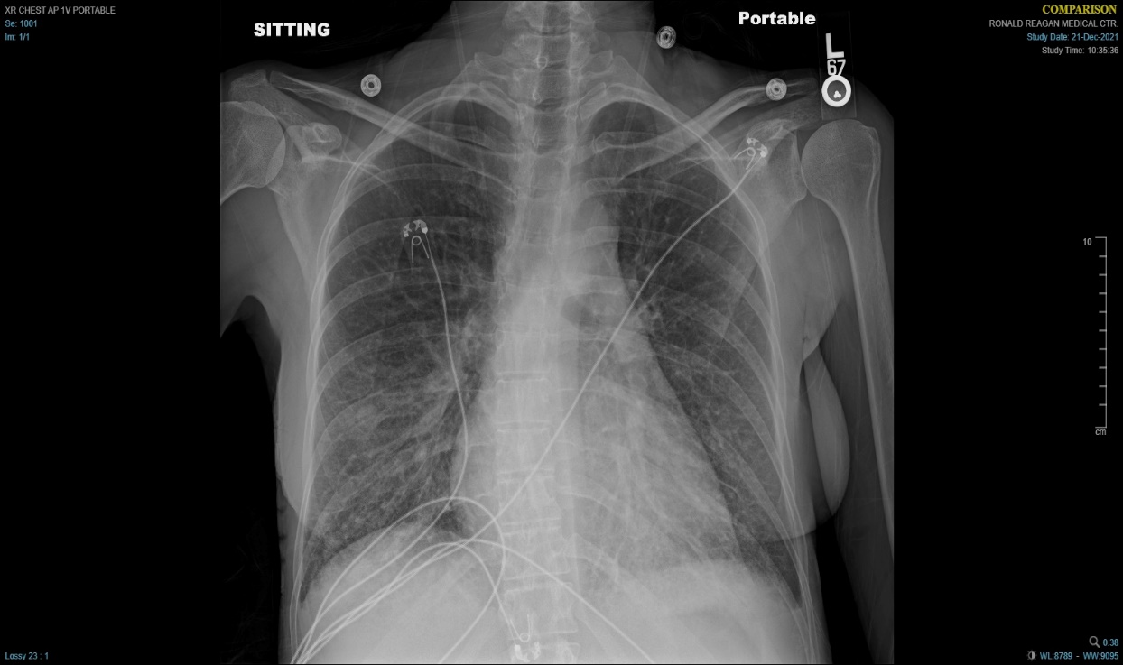
11/18/2021
Ferritin 18,179 ng/mL
CRP 6.6 mg/dL
BNP 331 pg/mL
Troponin I 0.09 ng/mL
12/21/2021
Ferritin 38,820 ng/mL
CRP 2.2 mg/dL
BNP 229 pg/mL
Troponin I < 0.04 ng/mL
1/7/2022
Ferritin 6,711 ng/mL
CRP <0.3 mg/dL
BNP 117 pg/mL
Troponin I < 0.04 ng/mL

Slide 9
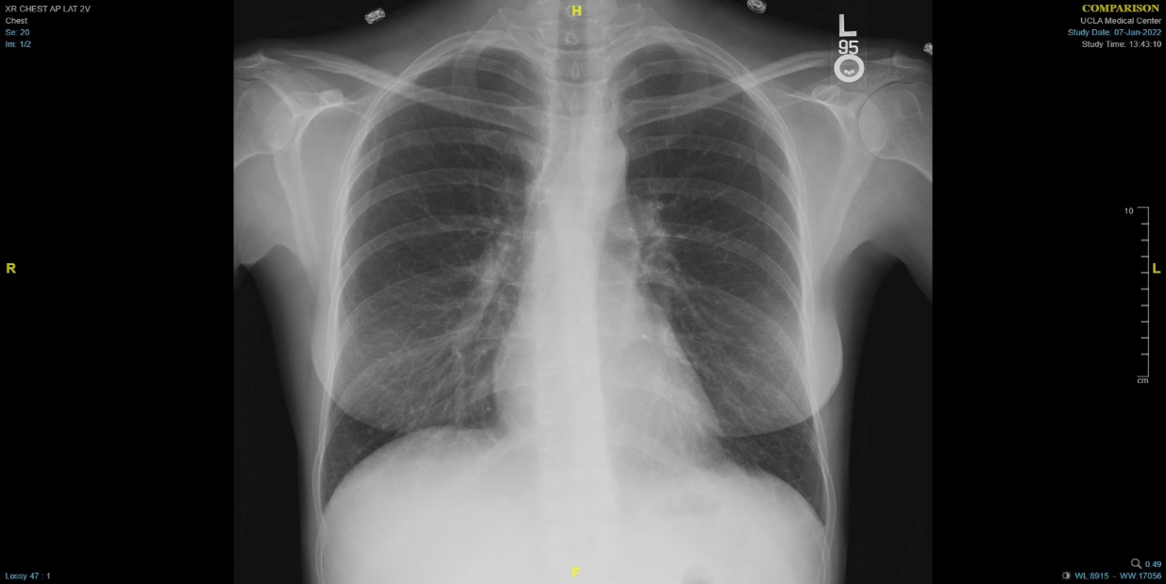
11/18/2021
Ferritin 18,179 ng/mL
CRP 6.6 mg/dL
BNP 331 pg/mL
Troponin I 0.09 ng/mL
12/21/2021
Ferritin 38,820 ng/mL
CRP 2.2 mg/dL
BNP 229 pg/mL
Troponin I < 0.04 ng/mL
1/7/2022
Ferritin 6,711 ng/mL
CRP <0.3 mg/dL
BNP 117 pg/mL
Troponin I < 0.04 ng/mL

Slide 10
Clinical Course of PH and Still’s Disease Treatments
Date | 11/23/2021 | 12/4/2021 | 12/7/2021 | 12/19/2021 | 12/29/2021 | 1/6/2021
Medical Regimen | Anakinra; CS Stopped MTX Started CSA Dose of rituximab given HSV skin lesion and HSV 1 DNA +blood | Concern for MAS started etoposide and dexamethasone Stopped CSA Changed anakinra to QID | Tocilizumab dose #1 Etoposide dose #2 Increased dexamethasone to 30 mg qday -Intubated | -tocilizumab #2 -Etoposide #3 (12/11/2021) and #4 (12/21/2021) -Extubated | Started ruxolitinib | Decreased anakinra to BID Dexamethasone at 12 mg qd
PH Regimen | Tadalafil (11/19) Macitentan (11/20)
Ferritin | 6,102 ng/mL | 101,160 ng/mL | 115,850 ng/mL | 15,212 ng/mL | 13,970 ng/mL | 7,066 ng/mL
NK cell cytotoxicity | Reduced | Reduced
Lumbar puncture |  | Increased protein
IL-2 soluble receptor |  |  | 2x ULN |  |  | Just above ULN

Slide 11
Discussion
AOSD (Adult-Onset Still’s disease)
Incidence: 1.6 cases per million (rare)
Monophasic, intermittent, chronic
Can be complicated by MAS (1.7% of AOSD cases)
Can be complicated by interstitial pneumonia, pleural effusion, and/or transient pulmonary infiltrates
22 case reports (to date) describing PAH associated with AOSD
Appears to be associated with severe/persistent AOSD
Reported 22% mortality

Slide 12
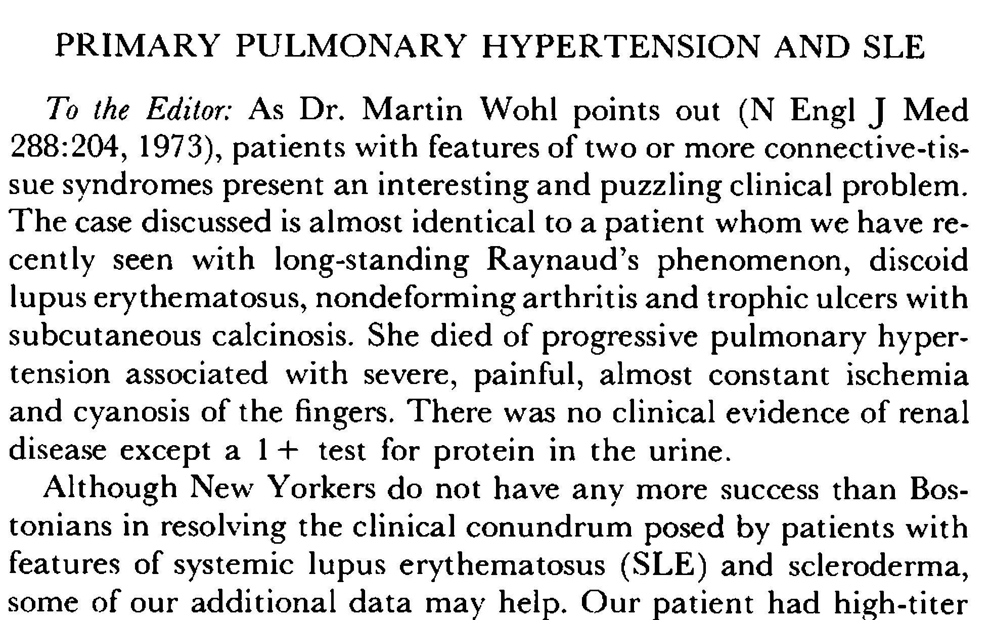
SLE and PAH; The Concept of a Corticosteroid Responsive Pulmonary Artery Vasculitis

Slide 13
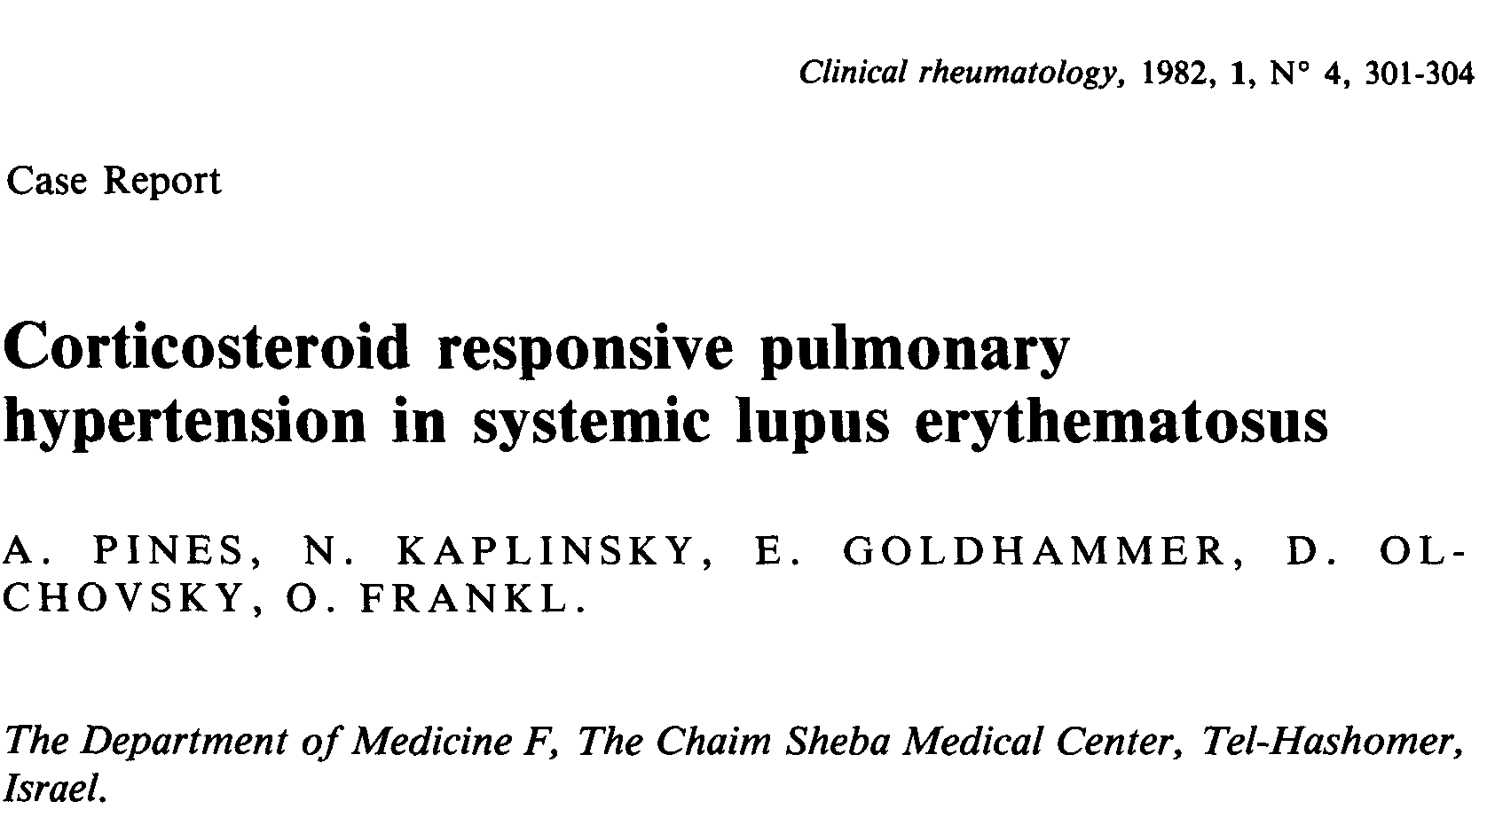
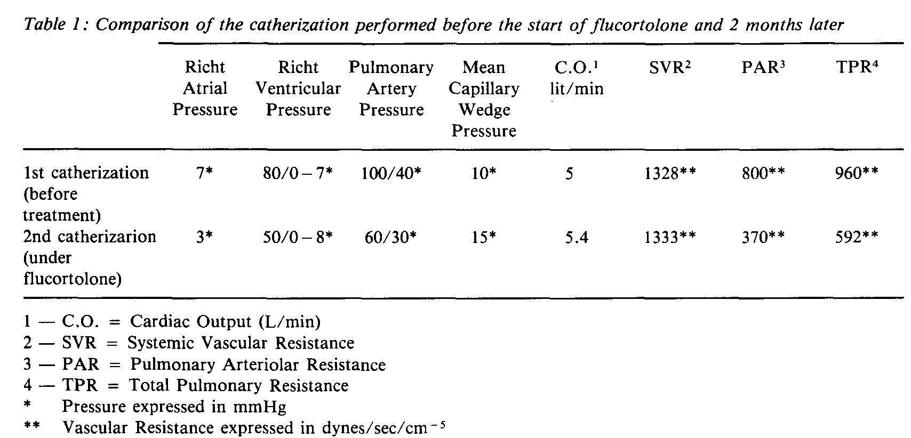
SLE and PAH; The Concept of a Corticosteroid Responsive Pulmonary Artery Vasculitis

Slide 14
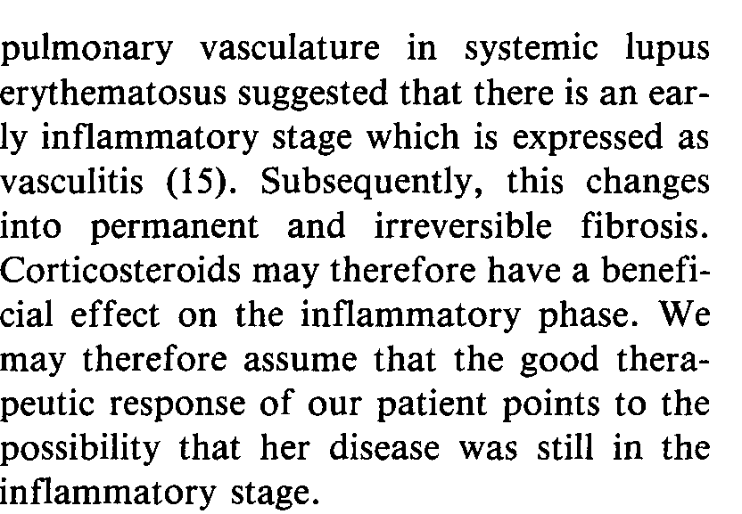
SLE and PAH; The Concept of a Corticosteroid Responsive Pulmonary Artery Vasculitis

Slide 15
Discussion
In general, CTD-APAH more likely to receive immunosuppression than IPAH

Slide 16
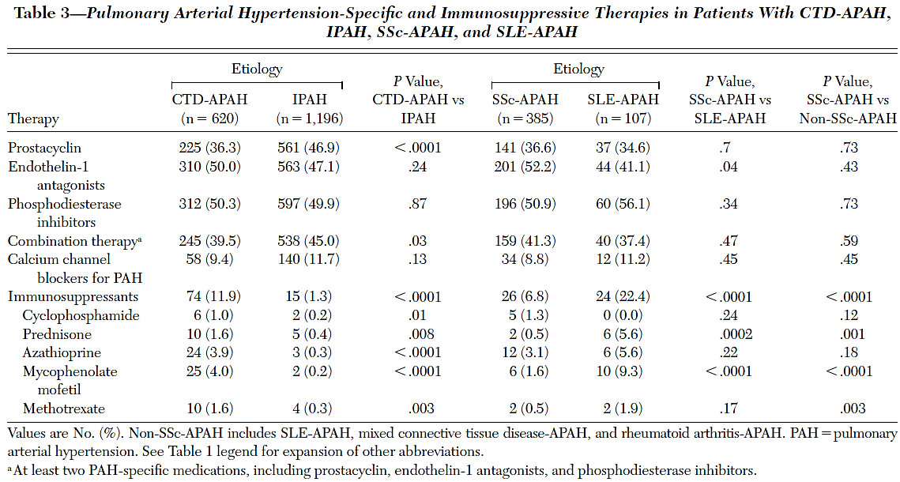
Discussion
In general, CTD-APAH more likely to receive immunosuppression than IPAH

Slide 17
Discussion
In general, CTD-APAH more likely to receive immunosuppression than IPAH

Slide 18
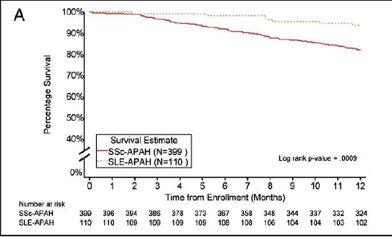
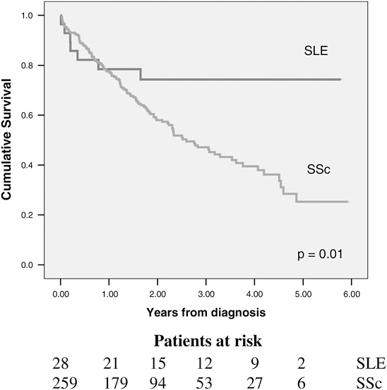
Discussion
In general, CTD-APAH more likely to receive immunosuppression than IPAH

Slide 19
Response to Immunosuppression
Table 3―Comparison of Patients Who Responded and
Did Not Respond to First-Line Immunosuppressive Therapy*
Characteristics | Improved (n = 8) | P Value | Not improved (n = 20)
Age, yr | 32 ± 12 |  | 43 ± 18
Male/female gender, No. | 1/7 |  | 4/16
SLE | 5 (62) |  | 8(40)
MCTD | 3(38) |  | 5(25)
CREST | 0(0) |  | 5(25)
Other | 0(0) |  | 2(10)
NYHA functional class
I | 0(0) | < 0.05 | 0(0)
II | 3(38) | < 0.05 | 5(25)
III | 5 (62) | < 0.05 | 10(50)
IV | 0(0) |  | 5(25)
6-min walk distance, m | 294 ± 118† |  | 240 ± 107‡
Mean right atrial pressure, mm Hg | 5 ± 3 |  | 7 ± 5
mPAP, mm Hg | 49 ± 16 | 34 ± 11 | 51 ± 12
Cardiac index, L/min/m² | 3.1 ± 0.5 | 3.5 ± 0.5 | 2.6 ± 0.7
PVR index, Wood U/m² | 15.6 ± 4 | 10.1 ± 4 | 21.4 ± 8
Svo_{2,} % | 68 ± 9 | 69 ± 15 | 65 ± 8
*Data are presented as No. (%) or mean ± SD unless otherwise indicated.
CREST = calcinosis, Raynaud phenomenon, esophageal dysmotility,
Sclerodactyly, telangiectasia.
Responder defined as patients with NHYA FC I/II with sustained hemodynamic improvement after at least one year of immunosuppressive therapy (cyclophosphamide and CS)

Slide 20
Response to Immunosuppression
Table 3―Comparison of Patients Who Responded and
Did Not Respond to First-Line Immunosuppressive Therapy*
Characteristics | Improved (n = 8) | P Value | Not improved (n = 20)
Age, yr | 32 ± 12 |  | 43 ± 18
Male/female gender, No. | 1/7 |  | 4/16
SLE | 5 (62) |  | 8(40)
MCTD | 3(38) |  | 5(25)
CREST | 0(0) |  | 5(25)
Other | 0(0) |  | 2(10)
NYHA functional class
I | 0(0) | < 0.05 | 0(0)
II | 3(38) | < 0.05 | 5(25)
III | 5 (62) | < 0.05 | 10(50)
IV | 0(0) |  | 5(25)
6-min walk distance, m | 294 ± 118† |  | 240 ± 107‡
Mean right atrial pressure, mm Hg | 5 ± 3 |  | 7 ± 5
mPAP, mm Hg | 49 ± 16 | 34 ± 11 | 51 ± 12
Cardiac index, L/min/m² | 3.1 ± 0.5 | 3.5 ± 0.5 | 2.6 ± 0.7
PVR index, Wood U/m² | 15.6 ± 4 | 10.1 ± 4 | 21.4 ± 8
Svo_{2,} % | 68 ± 9 | 69 ± 15 | 65 ± 8
*Data are presented as No. (%) or mean ± SD unless otherwise indicated.
CREST = calcinosis, Raynaud phenomenon, esophageal dysmotility,
Sclerodactyly, telangiectasia.
Responder defined as patients with NHYA FC I/II with sustained hemodynamic improvement after at least one year of immunosuppressive therapy (cyclophosphamide and CS)

Slide 21
Response to Immunosuppression
Table 3―Comparison of Patients Who Responded and
Did Not Respond to First-Line Immunosuppressive Therapy*
SLE- or MCTD-associated PAH
conventional therapy
(anticoagulant with an INR from 1.5 to
2.5, diuretics and oxygen if needed)
Characteristics | Improved (n = 8) | P Value | Not improved (n = 20)
Age, yr | 32 ± 12 |  | 43 ± 18
Male/female gender, No. | 1/7 |  | 4/16
SLE | 5 (62) |  | 8(40)
MCTD | 3(38) |  | 5(25)
CREST | 0(0) |  | 5(25)
Other | 0(0) |  | 2(10)
NYHA functional class
I | 0(0) | < 0.05 | 0(0)
II | 3(38) | < 0.05 | 5(25)
III | 5 (62) | < 0.05 | 10(50)
IV | 0(0) |  | 5(25)
6-min walk distance, m | 294 ± 118† |  | 240 ± 107‡
Mean right atrial pressure, mm Hg | 5 ± 3 |  | 7 ± 5
mPAP, mm Hg | 49 ± 16 | 34 ± 11 | 51 ± 12
Cardiac index, L/min/m² | 3.1 ± 0.5 | 3.5 ± 0.5 | 2.6 ± 0.7
PVR index, Wood U/m² | 15.6 ± 4 | 10.1 ± 4 | 21.4 ± 8
Svo_{2,} % | 68 ± 9 | 69 ± 15 | 65 ± 8
NYHA
II
IV
III ( CI>3.1
L/min/m² )
III ( CI≤3.1
L/min/m² )
immunosuppressive therapy
alone
pulmonary vasodilators
± immunosuppressive therapy ?
clinical and hemodynamic
evaluation 4-6 months later
clinical and hemodynamic
evaluation 4-6 months later
no response
response
response
no response
start maintenance regimen
(azathioprine, mycophenolate
mofetil)
stop immunosuppressive therapy
unless indicated
consider combination of
pulmonary vasodilators
stop immunosuppressive therapy
unless indicated
consider combination of
pulmonary vasodilators
clinical and hemodynamic
follow up
Figure 2. Proposed algorithm for treatment of patients with systemic
lupus erythematous (SLE)- or mixed connective tissue disease
(MCTD)-associated pulmonary arterial hypertension (PAH). Responders
to immunosuppressive therapy were defined as patients in New York Heart Association (NYHA) functional class I or II with hemodynamic improvement
after the last pulse of cyclophosphamide. This algorithm must be read with
caution because it relies on retrospective and open-label data and must
therefore be confirmed by future randomized controlled trials. INR = international normalized ratio; CI – cardiac index.
*Data are presented as No. (%) or mean ± SD unless otherwise indicated.
CREST = calcinosis, Raynaud phenomenon, esophageal dysmotility,
Sclerodactyly, telangiectasia.
Responder defined as patients with NHYA FC I/II with sustained hemodynamic improvement after at least one year of immunosuppressive therapy (cyclophosphamide and CS)

Slide 22
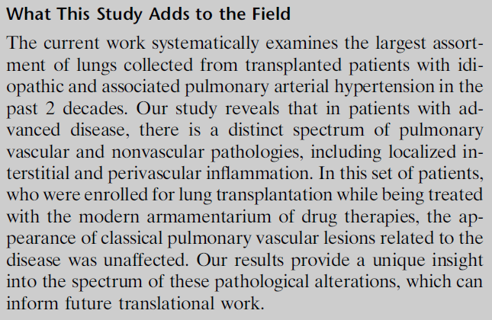
PAH and Inflammation

Slide 23
PAH and Inflammation

Slide 24
Conclusions
AOSD may be associated with PAH and this PAH may respond to immunosuppression +/- PAH-specific therapy (like Lupus)

