Slide 1
Trials and Tribulations of Treating PAH in Geriatric Patients
Oksana A. Shlobin, MD
Medical Director, Pulmonary Hypertension Program
Inova Fairfax Hospital
Associate Professor, University of Virginia School of Medicine
Associate Professor, Georgetown University School of Medicine
Falls Church, VA

Slide 2
Let’s Meet Our Patient
RR is 75 y.o. female with idiopathic PAH treated at the OSH
Initial RHC in 2017
Hemodynamics
HR (bpm) |  | 95
RA pressure (mm Hg) |  | 16
PAP (mm Hg) |  | 84/27 (mean: 49)
Mean PAP w/inh NO (mm Hg) |  | ND
PCWP (mm Hg) |  | 10
Arterial pressure (mm Hg) |  | 98/60
CI | Thermodilution | 4.47/2.28
PVR (Wood units) |  | 8.84
6MWD (m) |  | 463
ECHO 2017 with RVSP 85 mm Hg; moderately decreased RV function; flattened septum in systole and diastole

Slide 3
Let’s Meet Our Patient
RR is 75 y.o. female with idiopathic PAH treated at the OSH
Initial RHC in 2017
Hemodynamics
HR (bpm) |  | 95
RA pressure (mm Hg) |  | 16
PAP (mm Hg) |  | 84/27 (mean: 49)
Mean PAP w/inh NO (mm Hg) |  | ND
PCWP (mm Hg) |  | 10
Arterial pressure (mm Hg) |  | 98/60
CI | Thermodilution | 4.47/2.28
PVR (Wood units) |  | 8.84
6MWD (m) |  | 463
ECHO 2017 with RVSP 85 mm Hg; moderately decreased RV function; flattened septum in systole and diastole
Started on sildenafil and oral Treprostinil at the outside hospital

Slide 4
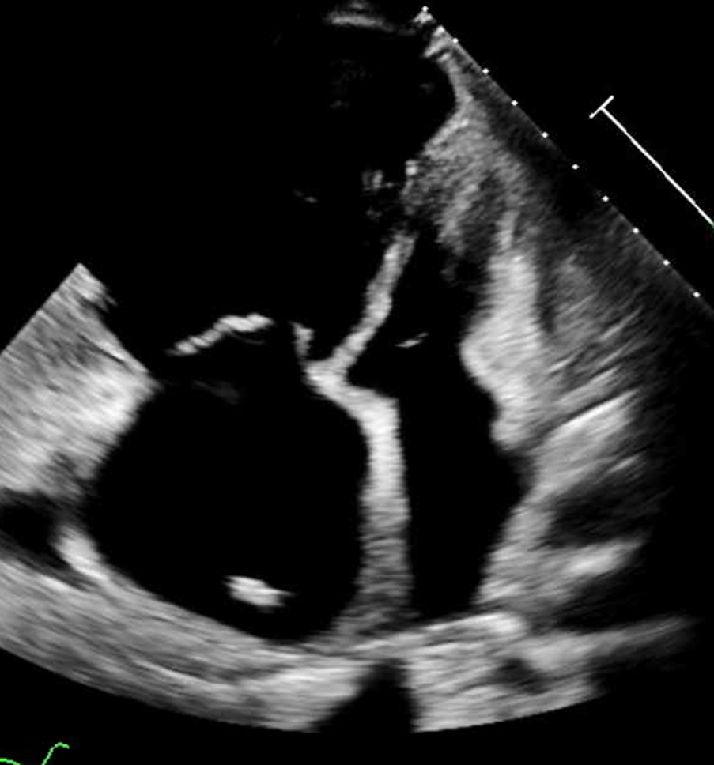
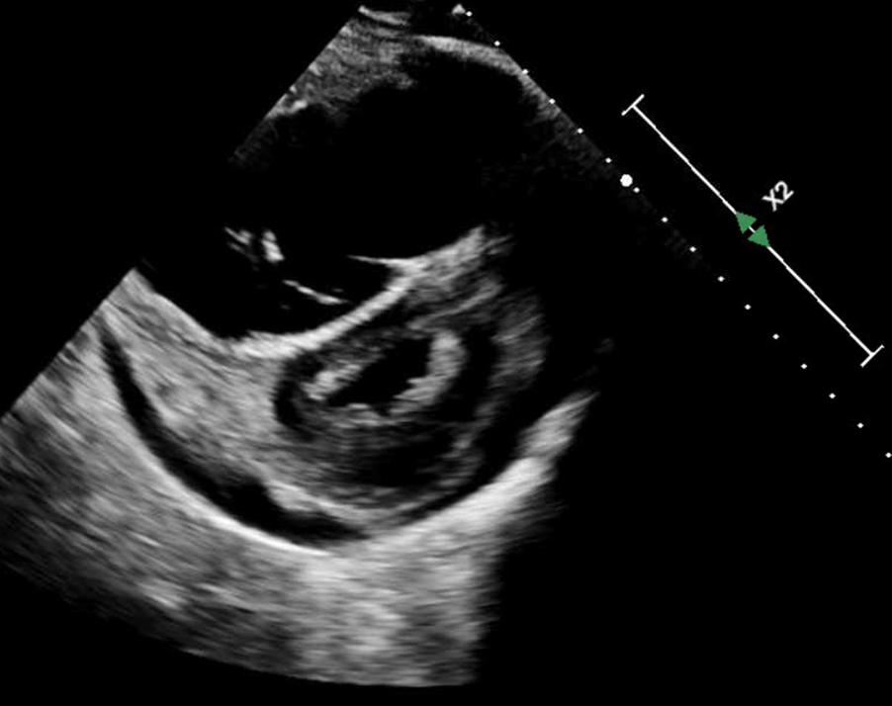
Let’s Meet Our Patient: 2nd Opinion in 2018 at Our Center
ECHO with RVSP 110 mm Hg and severely decreased RV function; flattened septum in systole and diastole
FC 3 symptoms
ECHO 2018 with RVSP 88 mm Hgm RAP~15 and severely decreased RV function
FAC 11%, EF 21% and flattened septum in systole and diastole
BNP 855
4 Chamber Apical View
Parasternal Short Access View

Slide 5
2018: Additional Data
Hemodynamics on Sildenafil (20 mg TID) and Oral Treprostinil (2 mg TID)
HR (bpm) |  | 105
RA pressure (mm Hg) |  | 15
PAP (mm Hg) |  | 96/32 (mean: 52)
Mean PAP w/inh NO (mm Hg) |  | 50*
PCWP (mm Hg) |  | 10
Arterial pressure (mm Hg) |  | 95/52
CI | Thermodilution | 3.8/1.9
PVR (Wood units) PA% |  | 11.05 61%
6MWD (m) RA |  | 331m 92->88%

Slide 6
Using REVEAL to Determine Risk Status
 |  |  |  | Patient’s Score
WHO Group | CTD +1 point | PoPH +3 points | FPH +2 points | ______
Demographics |  | Male >60 years |  | ______
 |  | +2 |  | 2
Comorbidities | GFR <60 mL/min/1.73 m² or Renal insufficiency |  |  | ______
 | +1 point |  |  | 1
Functional class | I | III | IV | +1
 | -1 point | +1 point | +2 points
Vital signs | SBP <110 mm Hg | HR >96/min |  | +2
 | +1 | +1
All-cause 6-month hospitalization | Hospitalized within 6 months |  |  | ______
 | +1
6MWD | >440 meters | 320-440 meters | <165 meters | -1
 | -2 | -1 | +1 | -1
BNP NT-proBNP | <50 pg/mL <300 pg/mL -2 | 200-800 ----- +1 | >800 >1500 +2 | +2
Echocardiogram | Pericardial effusion +1
 | +1 |  |  | +1
PFT | DLco <40% +1 |  |  | ______
 | +1
RHC | mRAP >20 mm Hg +1 | PVR <5 WU -1
 | +1 | -1
REVEAL Score | Risk Status
<7 | Low
7-8 | Average
9 | Moderately high
10-11 | High
>11 | Very high
Total Points = 5
Total Score = 5 + 6 = 11
According to REVEAL, our patient is Very
High Risk

Slide 7
Using REVEAL to Determine Risk Status
 |  |  |  | Patient’s Score
WHO Group | CTD +1 point | PoPH +3 points | FPH +2 points | ______
Demographics |  | Male >60 years |  | ______
 |  | +2 |  | 2
Comorbidities | GFR <60 mL/min/1.73 m² or Renal insufficiency |  |  | ______
 | +1 point |  |  | 1
Functional class | I | III | IV | +1
 | -1 point | +1 point | +2 points
Vital signs | SBP <110 mm Hg | HR >96/min |  | +2
 | +1 | +1
All-cause 6-month hospitalization | Hospitalized within 6 months |  |  | ______
 | +1
6MWD | >440 meters | 320-440 meters | <165 meters | -1
 | -2 | -1 | +1 | -1
BNP NT-proBNP | <50 pg/mL <300 pg/mL -2 | 200-800 ----- +1 | >800 >1500 +2 | +2
Echocardiogram | Pericardial effusion +1
 | +1 |  |  | +1
PFT | DLco <40% +1 |  |  | ______
 | +1
RHC | mRAP >20 mm Hg +1 | PVR <5 WU -1
 | +1 | -1
REVEAL Score | Risk Status
<7 | Low
7-8 | Average
9 | Moderately high
10-11 | High
>11 | Very high
Total Points = 5
Total Score = 5 + 6 = 11
According to REVEAL, our patient is Very
High Risk
Switched to IV epo

Slide 8
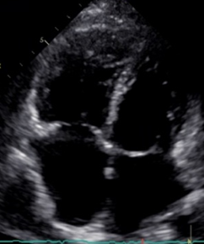
The Story Continues…
Added macitentan → triple therapy
  Improved over the following 2 years → FC 2
  6MWD 420m
  BNP 250
  REVEAL 6
  GI SEs interfered with titration of epo

Slide 9
The Story Continues…
Added macitentan → triple therapy
  Improved over the following 2 years
  → FC 2
  6MWD 420m
  BNP 250
  REVEAL 6
  GI SEs interfered with titration of epo
Diagnosed with local breast cancer
→ underwent mastectomy
  Not a transplant candidate

Slide 10
Follow Up
Lost patient assistance for macitentan → dual therapy
Telemedicine visits during COVID-19 pandemic
  Did not want to come in
Progressive L knee OA s/p steroid injections
Stopped pulmonary rehab due to COVID-19
Felt “okay” with limited ability
No BNP due to Medicare coverage
Unable to assess accurate REVEAL score

Slide 11
In-Person Follow Up
Progressive DOE with ADLs
FC 3 symptoms
Cannot perform 6MWT
Updated BNP 576
SBP 95, HR 97

Slide 12
PH: Distribution of Age
 | Overall | Group 1 | Group 3 | Group 4 | Group 5 | P*
n (%) | 363 (100) | 164 (45.2) | 109 (30) | 65 (17.9) | 25 (6.9) | -
Age (years) | 69 (14-89) | 65 (14-87) | 72 (44-89) | 76 (46-86) | 54 (27-97) | <0.001
Age > 65 (n (%)) | 225 (62) | 84 (51.2) | 82 (75.2) | 53 (81.5) | 6 (24) | <0.001
Female/Male ratio | 0.81 | 1.4 | 0.14 | 1.5 | 1.27 | <0.001
Co-morbidities (n (%))
HFpEF | 10 (3) | 3 (1.8) | 5 (4.5) | 1 (1.5) | 1 (5.2) | 0.06
CHD | 64 (21) | 25 (15) | (29) (26.6) | 9 (13.8) | 1 (4.0) | 0.15
Diabetes | 71 (23) | 33 (20.3) | 25 (22.9) | 10 (15.4) | 3 (12) | 0.32
Hypertension | 159 (51) | 73 (44.3) | 52 (47.9) | 26 (40) | 8 (31.7) | 0.23
COPD | 70 (23) | 20 (12) | 40 (36.7) | 6 (9.2) | 4 (16) | <0.001
Liver cirrhosis | 23 (8) | 15 (9) | 2 (1.8) | 4 (6.2) | 3 (10.4) | 0.07
Solid tumor | 43 (14) | 16 (9.8) | 14 (12.8) | 9 (13.8) | 4 (15.6) | 0.95
Renal failure | 49 (16) | 22 (13.5) | 18 (16.5) | 6 (9.2) | 3 (12) | 0.57
Charlson index | 4 (0-10) | 3 (0-10) | 4 (0-8) | 3 (0-8) | 3 (0-7) | 0.02
NYHA class (n (%)) |  |  |  |  |  | <0.001
I | 11 (3) | 8 (4.9) | 0 (0) | 2 (3.1) | 1 (4)
II | 134 (36.9) | 79 (48.2) | 19 (17.4) | 28 (43.1) | 8 (32)
III | 189 (52.1) | 67 (40.8) | 75 (68.8) | 33 (50.7) | 14 (56)
IV | 29 (8) | 10 (6.1) | 15 (13.8) | 2 (3.1) | 2 (8)
6MWD (m) | 271 (0-640) | 320 (0-640) | 222 (0-511) | 271 (0-600) | 348 (0-500) | <0.001
Follow-up time (years) | 3.4 (2.8) | 3.5 (2.7) | 2.3 (2.6) | 3.8 (2.2) | 5 (3.8) | <0.001
PFT
FVC (%) | 89 (34-128) | 91 (66-123) | 78 (34-125) | 100 (55-128) | 75 (38-109) | <0.001
TLC (%) | 86 (34-124) | 88 (69-121) | 78 (34-125) | 91 (58-109) | 75 (38-109) | 0.02
FEVI (%) | 76 (18-111) | 81 (66-111) | 62 (25-108) | 87 (33-111) | 56 (18-102) | <0.001
KCO (%) | 60 (7-109) | 64 (15-107) | 35 (7-108) | 71 (12-108) | 52 (37-109) | <0.001
Pa02 (mmHg) | 60 (30-93) | 63 (34-93) | 52 (30-83) | 60 (34-82) | 62 (32-87) | <0.001
LTO (n (%)) | 200 (55) | 70 (42.6) | 96 (88) | 26 (40) | 11 (44) | <0.001
Deaths (n (%)) | 129 (35.5) | 50 (30.5) | 63 (57.8) | 11 (16.9) | 5 (20) | <0.001

Slide 13
PH: Distribution of Age
 | Overall | Group 1 | Group 3 | Group 4 | Group 5 | P*
n (%) | 363 (100) | 164 (45.2) | 109 (30) | 65 (17.9) | 25 (6.9) | -
Age (years) | 69 (14-89) | 65 (14-87) | 72 (44-89) | 76 (46-86) | 54 (27-97) | <0.001
Age > 65 (n (%)) | 225 (62) | 84 (51.2) | 82 (75.2) | 53 (81.5) | 6 (24) | <0.001
Female/Male ratio | 0.81 | 1.4 | 0.14 | 1.5 | 1.27 | <0.001
Co-morbidities (n (%))
HFpEF | 10 (3) | 3 (1.8) | 5 (4.5) | 1 (1.5) | 1 (5.2) | 0.06
CHD | 64 (21) | 25 (15) | (29) (26.6) | 9 (13.8) | 1 (4.0) | 0.15
Diabetes | 71 (23) | 33 (20.3) | 25 (22.9) | 10 (15.4) | 3 (12) | 0.32
Hypertension | 159 (51) | 73 (44.3) | 52 (47.9) | 26 (40) | 8 (31.7) | 0.23
COPD | 70 (23) | 20 (12) | 40 (36.7) | 6 (9.2) | 4 (16) | <0.001
Liver cirrhosis | 23 (8) | 15 (9) | 2 (1.8) | 4 (6.2) | 3 (10.4) | 0.07
Solid tumor | 43 (14) | 16 (9.8) | 14 (12.8) | 9 (13.8) | 4 (15.6) | 0.95
Renal failure | 49 (16) | 22 (13.5) | 18 (16.5) | 6 (9.2) | 3 (12) | 0.57
Charlson index | 4 (0-10) | 3 (0-10) | 4 (0-8) | 3 (0-8) | 3 (0-7) | 0.02
NYHA class (n (%)) |  |  |  |  |  | <0.001
I | 11 (3) | 8 (4.9) | 0 (0) | 2 (3.1) | 1 (4)
II | 134 (36.9) | 79 (48.2) | 19 (17.4) | 28 (43.1) | 8 (32)
III | 189 (52.1) | 67 (40.8) | 75 (68.8) | 33 (50.7) | 14 (56)
IV | 29 (8) | 10 (6.1) | 15 (13.8) | 2 (3.1) | 2 (8)
6MWD (m) | 271 (0-640) | 320 (0-640) | 222 (0-511) | 271 (0-600) | 348 (0-500) | <0.001
Follow-up time (years) | 3.4 (2.8) | 3.5 (2.7) | 2.3 (2.6) | 3.8 (2.2) | 5 (3.8) | <0.001
PFT
FVC (%) | 89 (34-128) | 91 (66-123) | 78 (34-125) | 100 (55-128) | 75 (38-109) | <0.001
TLC (%) | 86 (34-124) | 88 (69-121) | 78 (34-125) | 91 (58-109) | 75 (38-109) | 0.02
FEVI (%) | 76 (18-111) | 81 (66-111) | 62 (25-108) | 87 (33-111) | 56 (18-102) | <0.001
KCO (%) | 60 (7-109) | 64 (15-107) | 35 (7-108) | 71 (12-108) | 52 (37-109) | <0.001
Pa02 (mmHg) | 60 (30-93) | 63 (34-93) | 52 (30-83) | 60 (34-82) | 62 (32-87) | <0.001
LTO (n (%)) | 200 (55) | 70 (42.6) | 96 (88) | 26 (40) | 11 (44) | <0.001
Deaths (n (%)) | 129 (35.5) | 50 (30.5) | 63 (57.8) | 11 (16.9) | 5 (20) | <0.001

Slide 14
PAH: Distribution of Age in Registries
80
71
70
60
53
60
50
55
50
48
50.1
40
y = 3.4655x + 37.293
R² = 0.7121
30
36
20
10
Average age at diagnosis [years]
Linear (Average age at diagnosis [years])
0
NIH
French
US
REVEAL
UK/Ireland
ASPIRE
COMPERA
Swiss

Slide 15
COMPERA: Real Life PH Population
COMPERA European Registry cluster analysis
  2007 – ongoing (n=9864 with PH)
    iPAH patients (prior definition, n 2276 → 841)
Clusters
  Younger, female predominant, no comorbidities (12.5%) --> “classic” phenotype
  Older, frequent comorbidities, inadequate treatment response, and worst clinical outcomes
    Significant heterogeneity within the 2nd cluster
Patients in the COMPERA registry
n=9864
Not fulfilling the adult IPAH criteria*
n=223 patients < 18 years
n=6930 patients without IPAH
n=3288 patients not fulfilling
PVR > 240 dyn-sec-cm-5
PAWP ≤ 15 mmHg
PAPm ≥ 25 mmHg
Adult patients with IPAH fulfilling
The haemodynamic criteria
N=2276
Excluded*
N=1313 patients due to missing values
in DLCO, smoking and/or comorbidities
n=427 patients with diagnosis more than
6 months before baseline visit
N=228 patients without follow-up visit
Selected patients
N=841

Slide 16
COMPERA: Real Life PH Population
COMPERA European Registry cluster analysis
  2007 – ongoing (n=9864 with PH)
    iPAH patients (prior definition, n 2276 → 841)
Clusters
  Younger, female predominant, no comorbidities (12.5%) → “classic” phenotype
  Older, frequent comorbidities, inadequate treatment response, and worst clinical outcomes
    Significant heterogeneity within the 2nd cluster

Slide 17
COMPERA: Real Life PH Population
COMPERA European Registry cluster analysis
  2007 – ongoing (n=9864 with PH)
    iPAH patients (prior definition, n 2276 → 841)
Clusters
  Younger, female predominant, no comorbidities (12.5%) → “classic” phenotype
  Older, frequent comorbidities, inadequate treatment response, and worst clinical outcomes
    Significant heterogeneity within the 2nd cluster
Patients in the COMPERA registry
n=9864
Not fulfilling the adult IPAH criteria*
n=223 patients < 18 years
n=6930 patients without IPAH
n=3288 patients not fulfilling
PVR > 240 dyn-sec-cm-5
PAWP ≤ 15 mmHg
PAPm ≥ 25 mmHg
Adult patients with IPAH fulfilling
The haemodynamic criteria
N=2276
Excluded*
N=1313 patients due to missing values
in DLCO, smoking and/or comorbidities
n=427 patients with diagnosis more than
6 months before baseline visit
N=228 patients without follow-up visit
Selected patients
N=841

Slide 18
Older Patients: Higher Rate of Comorbidities
A higher rate of comorbidities
  Ischemic heart disease
  HTN
  A Fib
  Obesity
  Renal disease
  OSA
  Thyroid dysfunction
  DM
Orthopedic complications
Cancers
Dementia
Depression
Registries

Slide 19
Older Patients: Higher Rate of Comorbidities
A higher rate of comorbidities
  Ischemic heart disease
  HTN
  A Fib
  Obesity
  Renal disease
  OSA
  Thyroid dysfunction
  DM
Orthopedic complications
Cancers
Dementia
Depression
Registries

Slide 20
Geriatric-Related Issues
Social support
Response to therapy
  Longer time to diagnosis
  More overlap in phenotypes (Group 2, 3 and 4)
  More advanced disease at presentation
  More symptomatic at diagnosis
  Less mobile at diagnosis
  Less aggressive treatment --> less ERAs and prostanoids

Slide 21
Geriatric-Related Issues
Social support
Response to therapy
  Longer time to diagnosis
  More overlap in phenotypes (Group 2, 3 and 4)
  More advanced disease at presentation
  More symptomatic at diagnosis
  Less mobile at diagnosis
  Less aggressive treatment → less ERAs and prostanoids

Slide 22
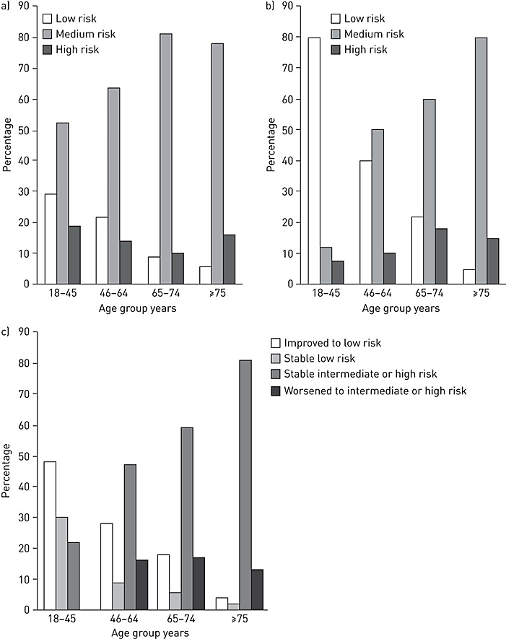
Risk Stratification in Elderly
No improvement in risk stratification scores
REVEAL: Males > 60 y.o.
Distance adjustment for age?
FC assessment?
Variables unaccounted by the risk scores may predict survival
  Ischemic heart disease

Slide 23
Risk Stratification in Elderly
No improvement in risk stratification scores
REVEAL: Males > 60 y.o.
Distance adjustment for age?
FC assessment?
Variables unaccounted by the risk scores may predict survival
  Ischemic heart disease

Slide 24
Survival in Older Patients
COMPERA
  Significantly lower 1, 3, 5-year survival in patients > 65 y.o. (89.8%, 78.6% and 68%)
Analysis of 6 RCTs showed that patients > 65 y.o. had significantly higher mortality
  28.6% vs 24.6% (50-65 y.o.) vs 16.6% (≤ 50 y.o.) (P=0.0004)

Slide 25
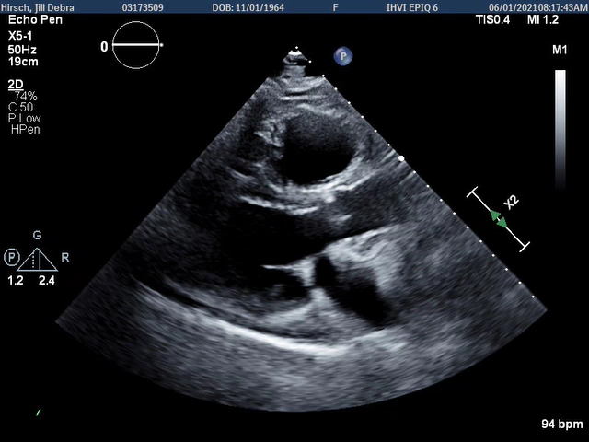
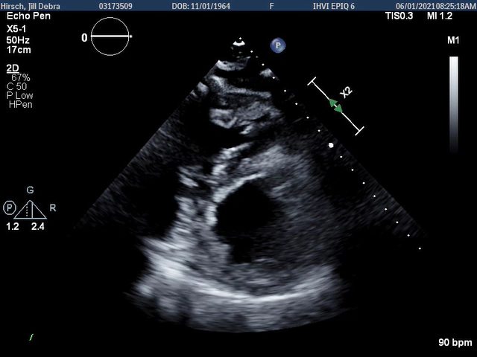
Back to Our Patient
Short Axis View
Parasternal Long Axis View

Slide 26
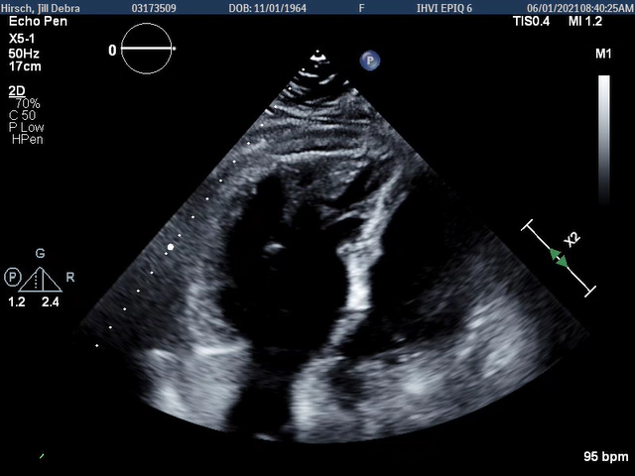
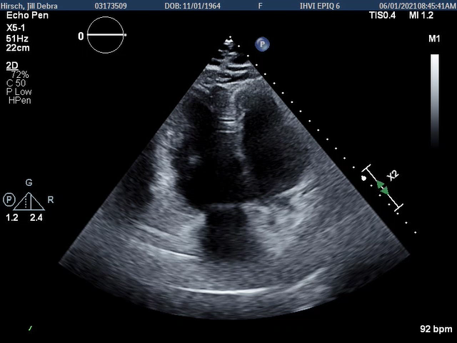
RV Focused View
RV Modified View

Slide 27
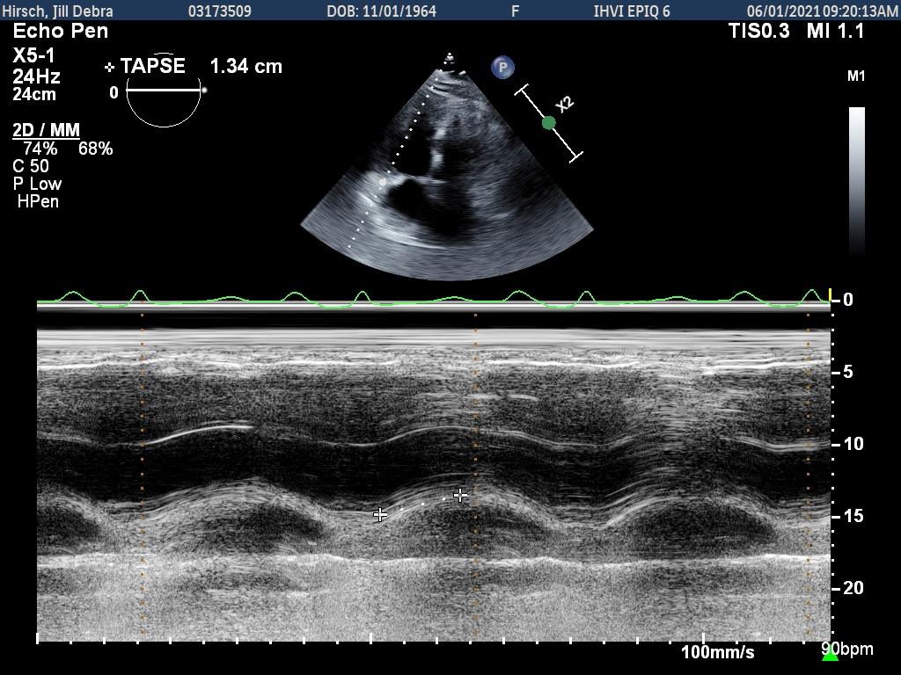
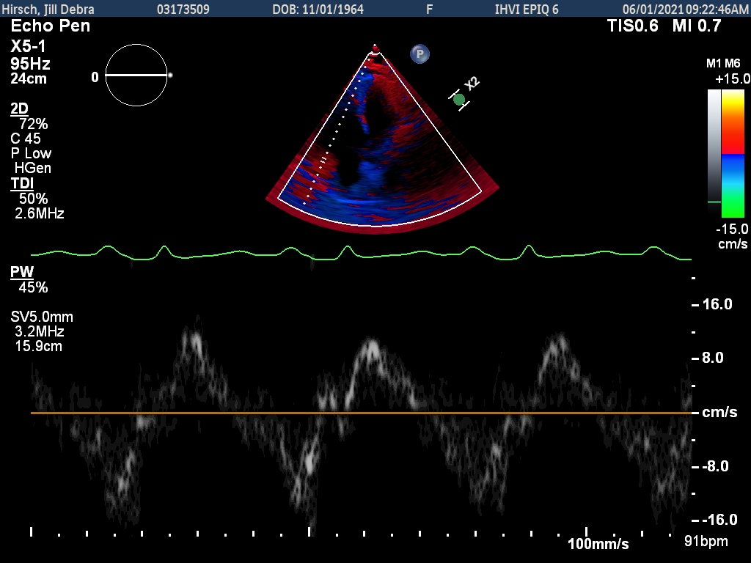
S’ 12 cm/sec
TAPSE 1.34 cm

Slide 28
S’ 12 cm/sec
TAPSE 1.34 cm
LHC: 3V CAD → medical management

Slide 29
Conclusion
PAH is more common in older patients
Mixed phenotypes are more common in older patients with PAH
Older patients with PAH experience longer time to diagnosis, less aggressive management, and worse outcomes
Older patients with PAH are more likely to have noncardiopulmonary comorbidities that affect their PAH care
Older patients with PAH may require different tools to complement traditional risk evaluation tools, as latter may not accurately capture their underlying disease

