Slide 1
Pulmonary Hypertension in an Adult With Complex Congenital Heart Disease
Richard Krasuski, MD
Professor of Medicine and Pediatrics
Director, Adult Congenital Heart Disease Center
Director, Hemodynamic Research
Director, Interventional CTEPH Program
Duke University Medical Center
Durham, NC

Slide 2
A Complicated Return to Care
A 34-year-old woman with complex congenital heart disease presented to urgent care complaining of progressive dyspnea on exertion
Born with transposition of the great arteries, a ventricular septal defect, a small atrial septal defect, and pulmonic stenosis
She had been followed by the pediatric cardiology clinic until age 26 but had not seen a physician since then due to insurance issues

Slide 3
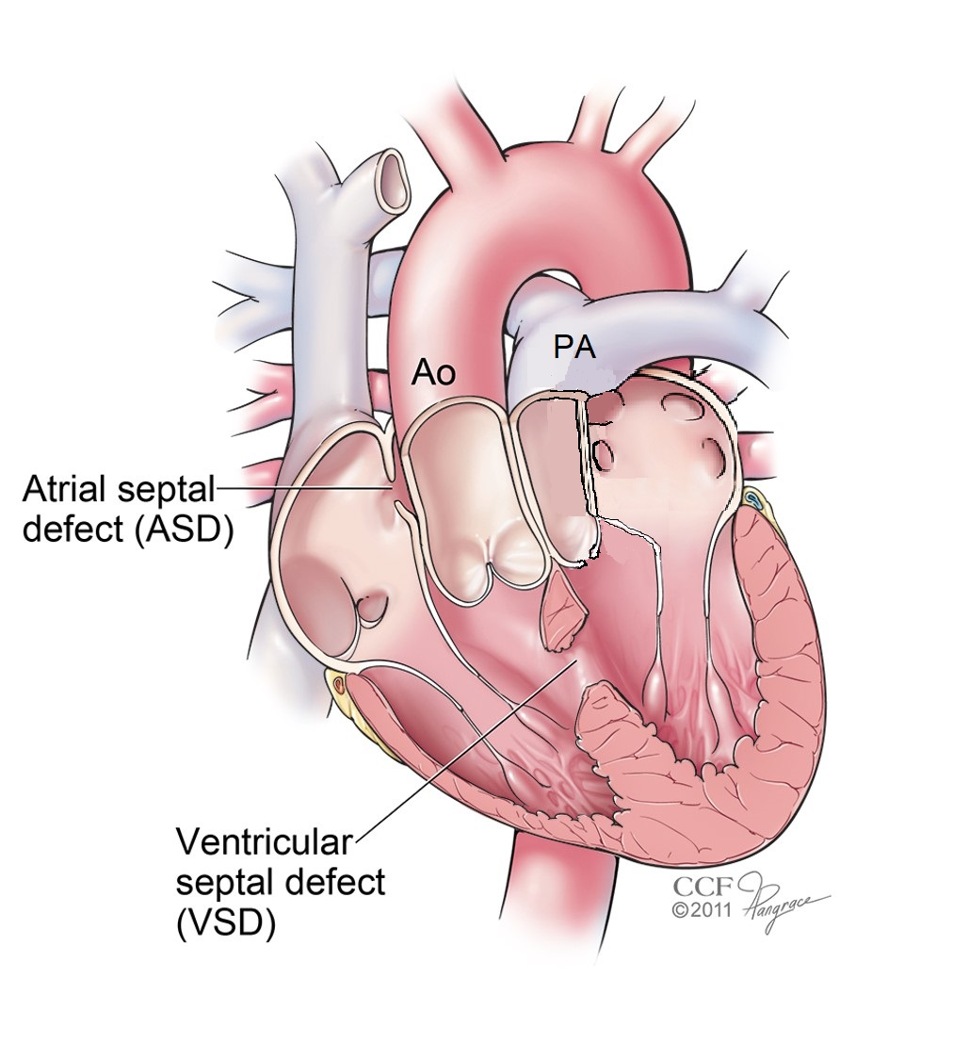
D-transposition of the Great Arteries With Pulmonic Stenosis and a Ventricular Septal Defect
TGA accounts for 5–7% of all congenital heart disease
Associated lesions
40–50% ventricular septal defects
25% LV outflow tract obstructions
5% coarctations of the aorta

Slide 4
A Complicated Return to Care
Atrial septostomy at birth and a Rastelli procedure at age 3
3 subsequent operations described as conduit revisions
For about 3 years, she had experienced dyspnea with activity—first when exercising and later almost any activity
Exam notable for O₂ sat. of 95%, JVP of 11 with large V-waves, III/VI pansystolic murmur, clear lungs, and 2+ edema

Slide 5
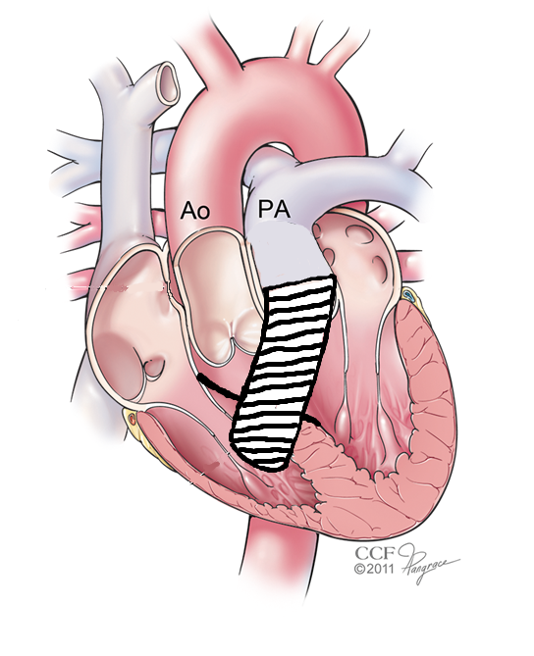
Rastelli Procedure for d-TGA with VSD and RVOT Obstruction
First performed in 1967 at the Mayo Clinic
Aortic outflow routed through the VSD via patch
Pulmonic valve opening is oversewn
Conduit placed from RV to PA
Restores the LV as systemic ventricle; unlike atrial switch procedures (eg, Mustard or Senning), no long-term risk of heart failure or systemic atrioventricular valve regurgitation
Results in frequent need for conduit interventions
Warnes CA. Circulation 2006;114:2699-2709.

Slide 6
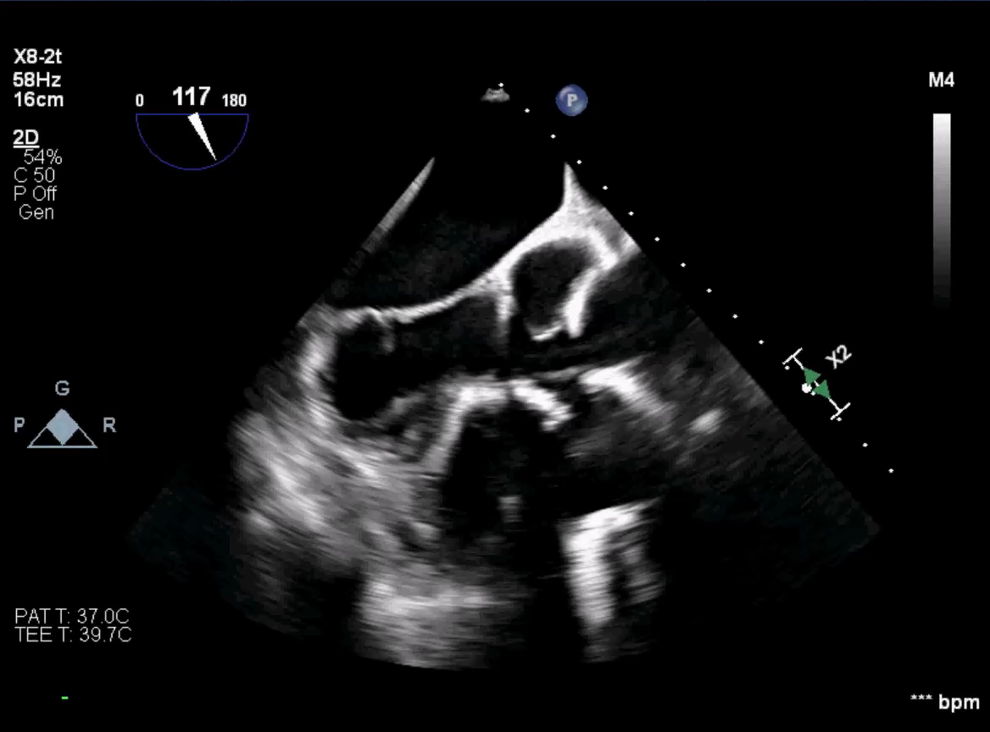
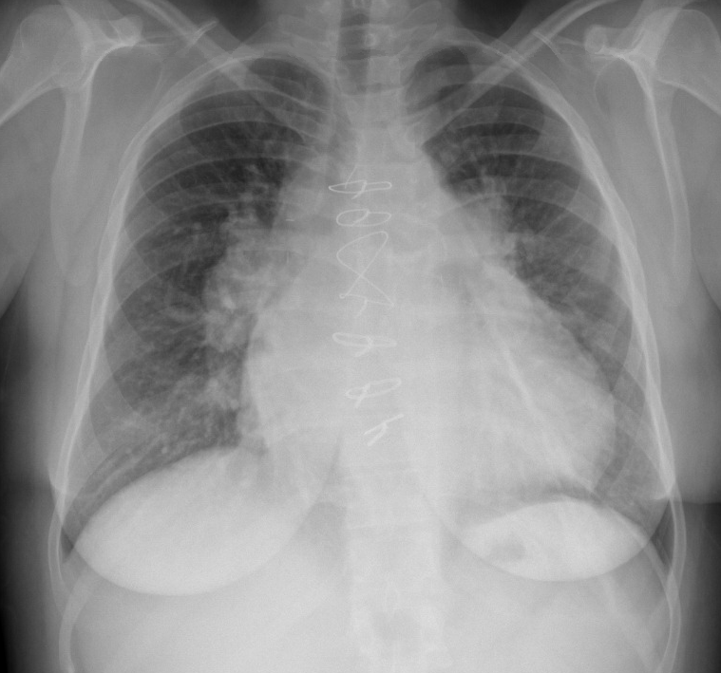
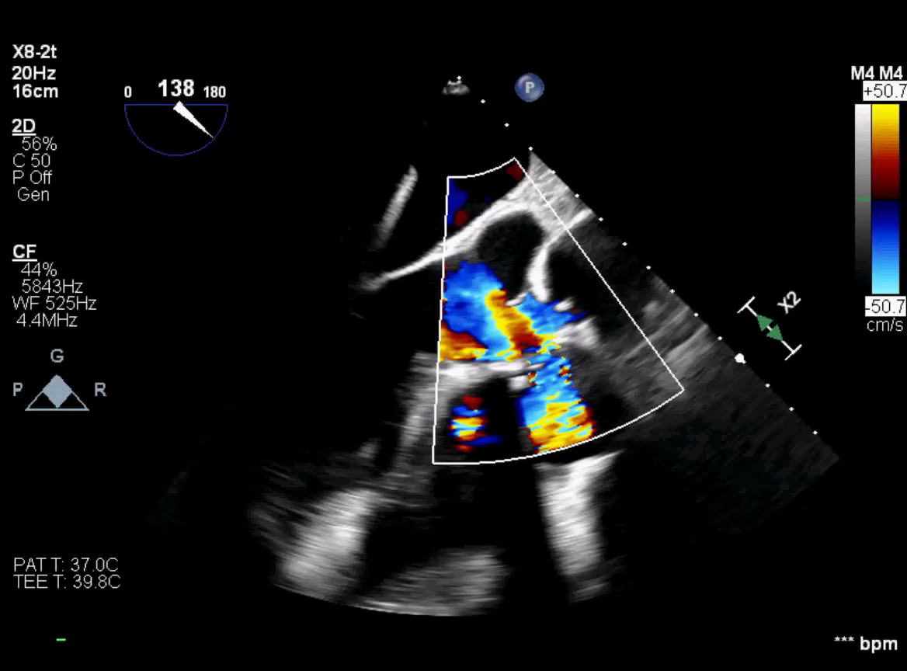
Imaging Studies in Sequence
Chest X-ray
Enlarged cardiac silhouette, prominent PAs, post-op changes
V/Q
Low probability of pulmonary embolism
Transthoracic/ Transesophageal Echos
Normal LV size and systolic function
Mildly dilated right ventricle with mildly reduced systolic function
Mild tricuspid regurgitation with estimated RVSP of 65 mmHg

Slide 7
Sequential Imaging Studies
Cardiac MRI
Partially dehisced VSD patch
Qp:Qs = 1.3:1
Moderately dilated right ventricle
Cardiac Catheterization
RAP = 8 mmHg; RVP = 70/8 mmHg; PAP = 70/30 mmHg (mPAP = 45); mPCWP = 8 mmHg
Qp = 7 l/min; Qs = 5 l/min; Qp:Qs = 1.4:1
PVR 5.3 Wood units (9.0 WU/m²)

Slide 8
What Would You Recommend for This Patient?
Refer the patient for reoperation to repair the shunt
Refer the patient for percutaneous intervention to attempt closure the shunt
Initiate advanced medical therapy for increased pulmonary vascular resistance
Make no changes and arrange for close observation

Slide 9
When Can Shunts Be Safely Closed?
Close defect when PVRi <4 Wood units/m², Qp:Qs is ≥1.5, and patient is symptomatic
Individual patient assessment recommended in tertiary centers when PVRi 4–8 Wood units/m²
Trial of balloon occlusion may be instructive
Vasodilator testing - ↓ in PVRi ≥20% to <6 Wood units/m²; PVRi/SVRi <0.3
Treat-and-repair approach (advanced therapies and reassessment followed by closure if indicated) being studied
Close follow-up with planned repeat invasive hemodynamics recommended after closure
Partial defect closure (fenestrated patch or device) may have role in selected patients in “grey zone”
100
PAH&PVD
90
DO NOT CLOSE
80
Grey Zone
70
PVRi 20
PVRi 16
PVRi 12
Mean PA pressure (mmHg)
60
50
PVRi=8WU*msq
PAH
but no PVD
Close defect
40
PVRi=4WU*msq
30
25
2
4
6
8
10
12
14
Pulmonary Blood Flow, Indexed (l/min/m²)

Slide 10
Medical Therapy Initiated
Patient started on macitentan; tadalafil added later
6MWD improved from 310 to 350 m
NYHA functional class improved from III to II
Repeat cardiac catheterization 6 months later
RAP = 6 mmHg; RVP = 50/6 mmHg; PAP = 50/24 mmHg; mPAP 30; mPCWP = 6 mmHg
Qp = 9.5 l/min; Qs = 6 l/min; Qp:Qs = 1.6:1
PVR 2.5 Wood units (4.3 WU/m²)

Slide 11
What Would You Recommend for This Patient Now?
Refer the patient for reoperation to repair the shunt
Refer the patient for percutaneous intervention to attempt closure the shunt
Add a third drug for persistently elevated pulmonary vascular resistance
Make no further changes and arrange for close observation

Slide 12
Multiple Therapeutic Options Discussed
With 5 prior sternotomies, surgery was considered a prohibitive risk
Device closure was attempted and was unsuccessful
Transplant evaluation was pursued but patient was prohibitively alloimmunized
The decision was made to attempt coverage of the defect with a covered stent placed within the pulmonary artery

Slide 13
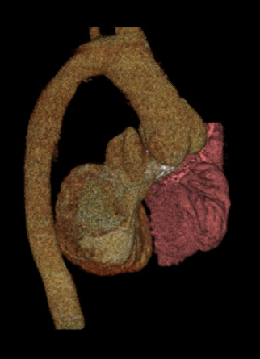
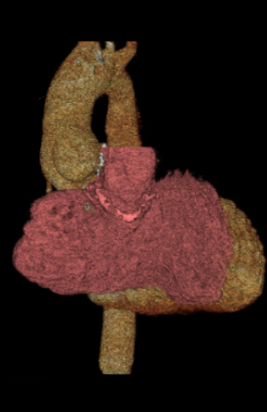
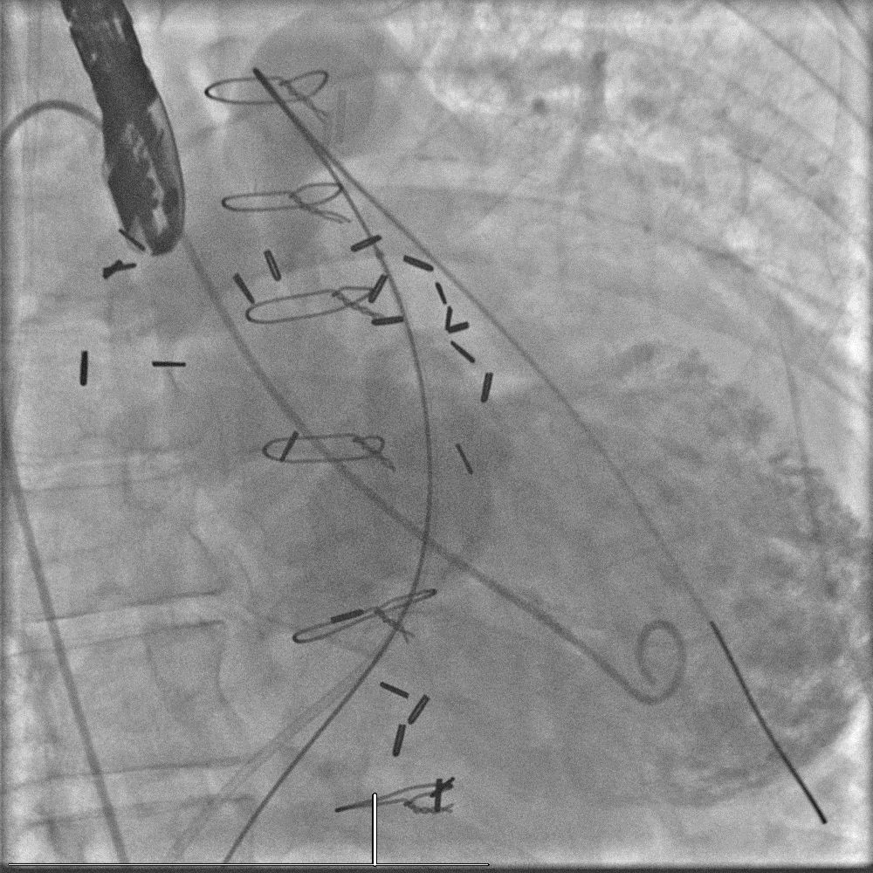
3D Printing to Aid a Complex Intervention

Slide 14
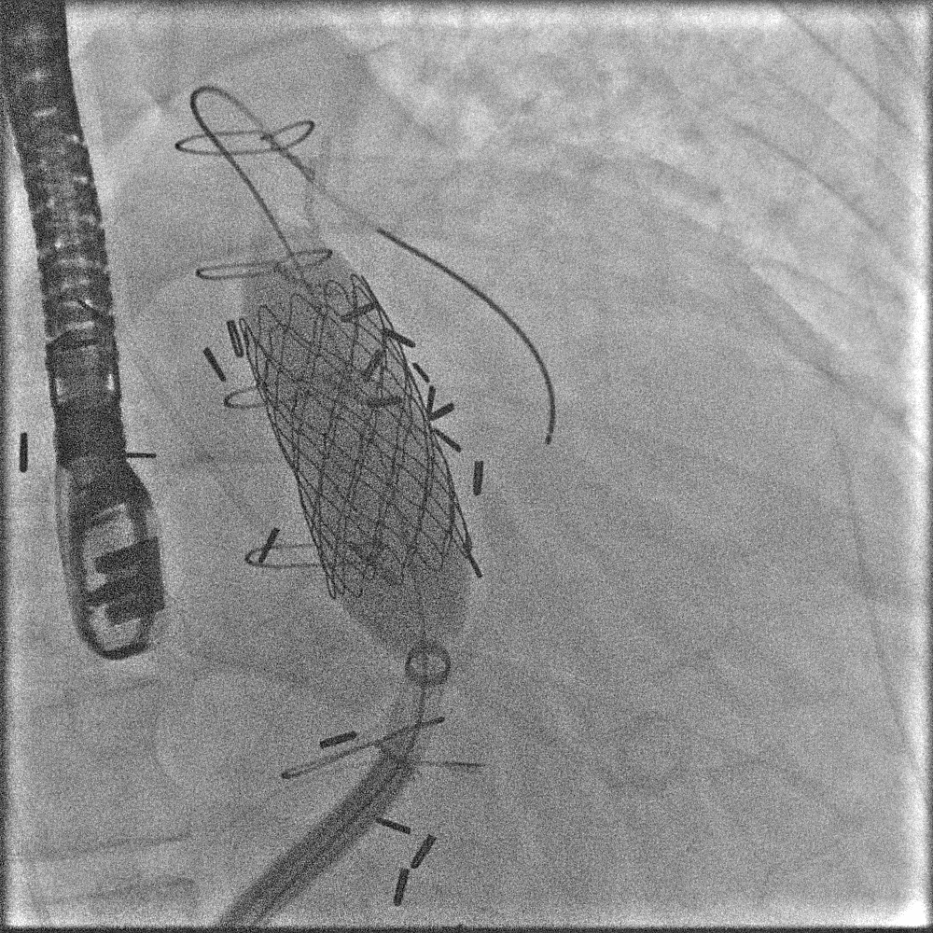
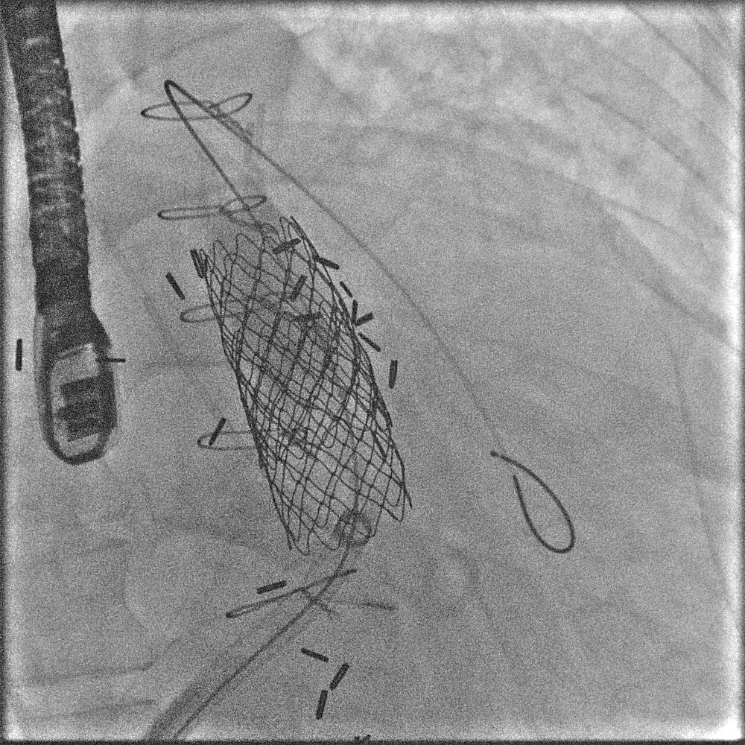
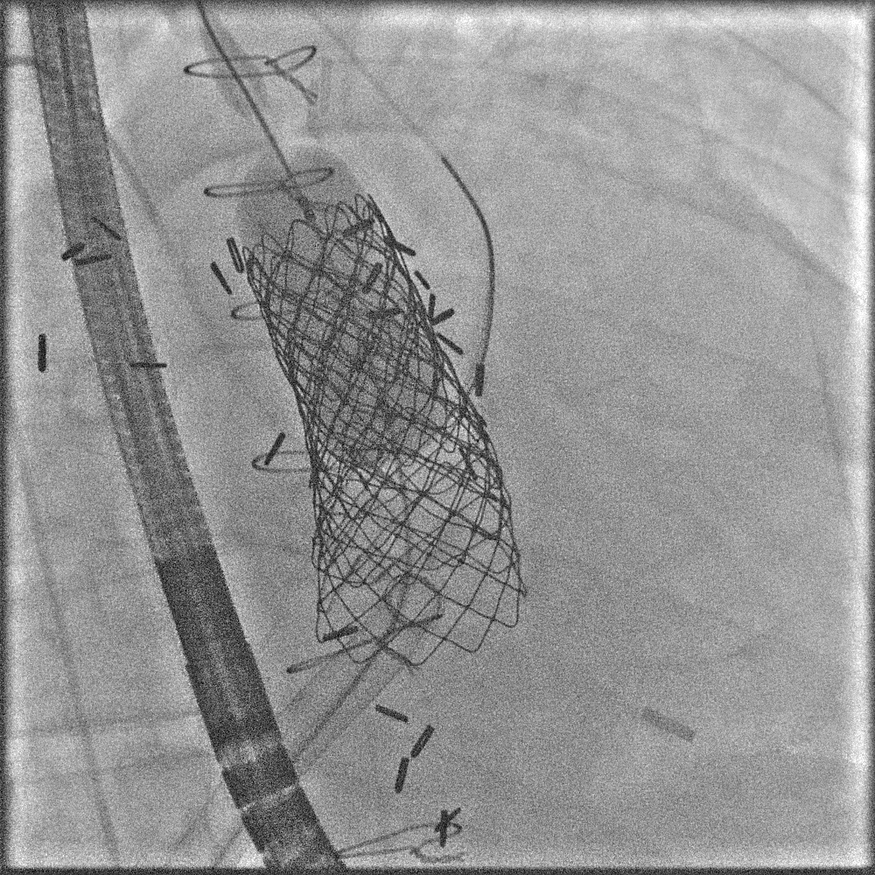
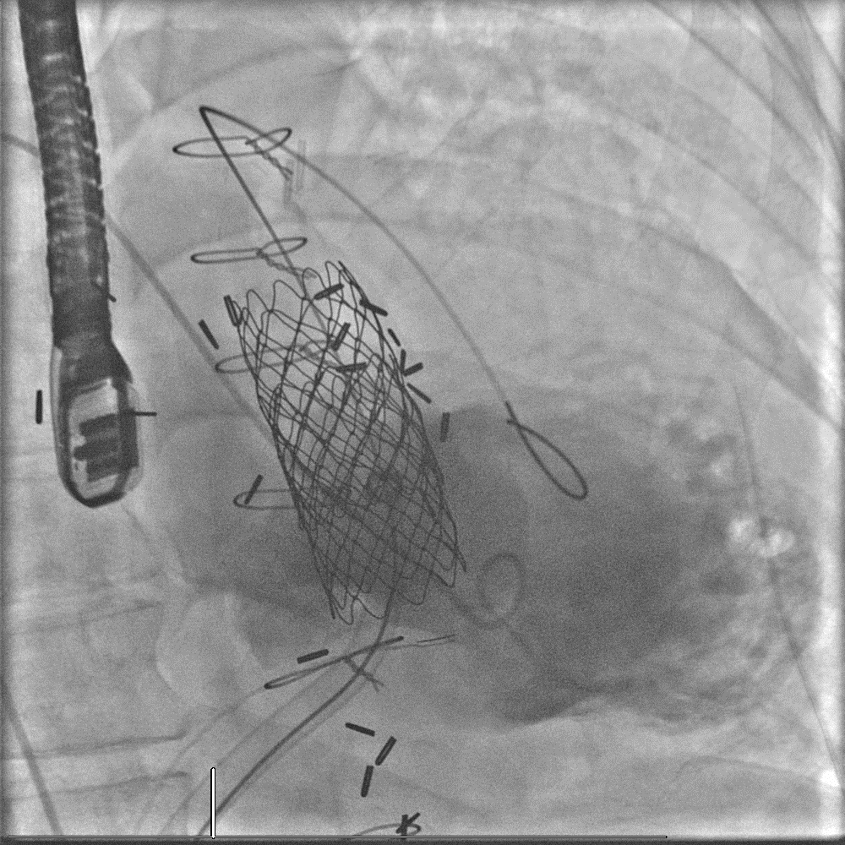
The Complex Transcatheter Intervention

Slide 15
Follow-up: 3 Months After the Procedure
Patient had been maintained on macitentan and tadalafil
6MWD further improved from 350 m to 410 m
NYHA functional class improved from II to I
Repeat echo showed near-normal size RV and estimated RVSP of 40 mmHg with 13/8 mmHg peak/mean gradients across pulmonic valve

Slide 16
What Would You Recommend Now?
Continue both drugs
Discontinue both drugs
Discontinue tadalafil
Discontinue macitentan

Slide 17
Pulmonary Hypertension in d-Transposition
Usually occurs after late repair (>age 2) with atrial switches
More common if shunt present before repair
Need to exclude pulmonary venous pathway obstruction
Associated with very high mortality
Baskaran J et al. Pulmonary Circulation 2017; 7(2) 547–550.

Slide 18
Putting it Together: Potential Treatment Algorithm for CHD-PAH
Expert Referral and Confirmation
of PAH associated with CHD
Systemic to Pulmonary Shunts
Eisenmenger Syndrome
PAH with small defects
PAH after defect correction
PVR normal or slightly ⬆
PVR moderately⬆
PVR severely ⬆
Structural intervention generally contraindicated
Assess functional class
Structural intervention generally contraindicated
Assess functional class
Defect can be safely repaired
Individualized decision
Repair contraindicated
WHO FC I
WHO FC > I
WHO FC > I
WHO FC > I
WHO FC I
Initiation of medical therapy
Supportive care with watchful monitoring

