Slide 1
Changing BTK Inhibitor Treatment in a Patient Intolerant to Acalabrutinib
72-year-old woman with long history of CLL presents with worsening arthralgia and myalgia 9 months after starting acalabrutinib for CLL
1L fludarabine + rituximab – remission for 3 years
Venetoclax + rituximab for 2 years – relapsed after 18 mo
Began acalabrutinib at standard dose with great disease control
After 6 months, bilateral muscle and joint pain with minimal response to OTC pain medications
Acalabrutinib dose reduction had minimal benefit; holding acalabrutinib improved pain symptoms but recurred after restarting
Patient wants to discuss alternative BTK inhibitor options

Slide 2
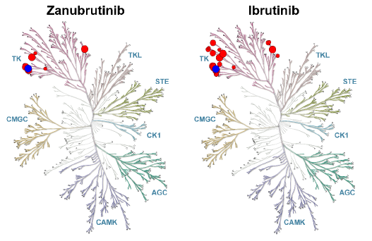
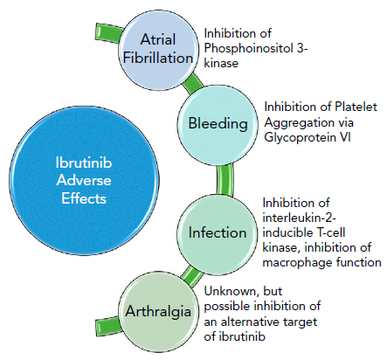
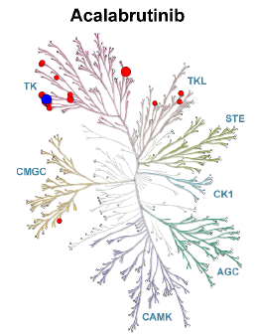

Choice of BTK Inhibitors
Proposed Mechanisms for Ibrutinib-Related
Adverse Events
Treatment discontinuation rates
due to toxicity
Ibrutinib | Frontline: 15% Relapsed: 22%
Acalabrutinib | Frontline: no data Relapsed: 12%

Slide 3
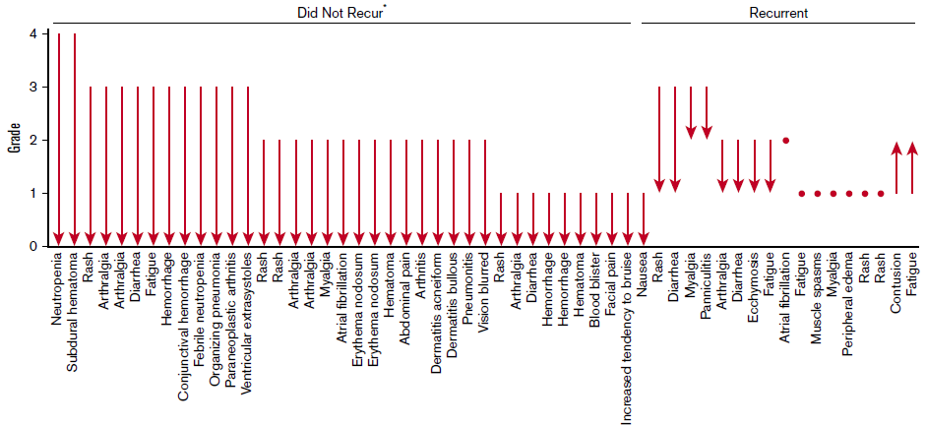
Acalabrutinib in Ibrutinib Intolerant Patients
Of 61 ibrutinib-related adverse events associated with intolerance, 72% did not recur and 13% recurred at a lower grade with acalabrutinib
*An additional 6 events of unknown grade (rash, diarrhea, hemorrhage, decreased appetite, dyspnea, and weight decreased) did not recur.

Slide 4
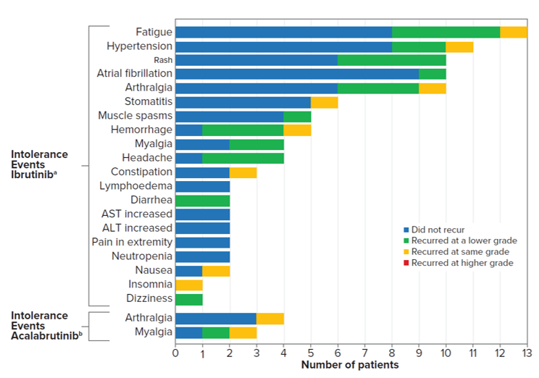
Zanubrutinib in Acalabrutinib/Ibrutinib Intolerant Patients
34/57 (59.6%) of patients who took ibrutinib and 7/10 (70.0%) of patients who took acalabrutinib did not have recurrence of any intolerance event
No ibrutinib or acalabrutinib intolerance events recurred at a higher severity
81/115 (70.4%) of ibrutinib intolerance events and 15/18 (83.3%) of acalabrutinib intolerance events did not recur
25/38 (65.8%) grade 3 ibrutinib intolerance events and 3/4 (75%) grade 3 acalabrutinib intolerance events did not recur while on zanubrutinib
All grade 4 intolerance events (neutropenia [n=2], ALT increase [n=1], did not recur on zanubrutinib
1 patient (1.5%) discontinued zanubrutinib due to recurrence of a prior intolerant event (myalgia; acalabrutinib)

Slide 5
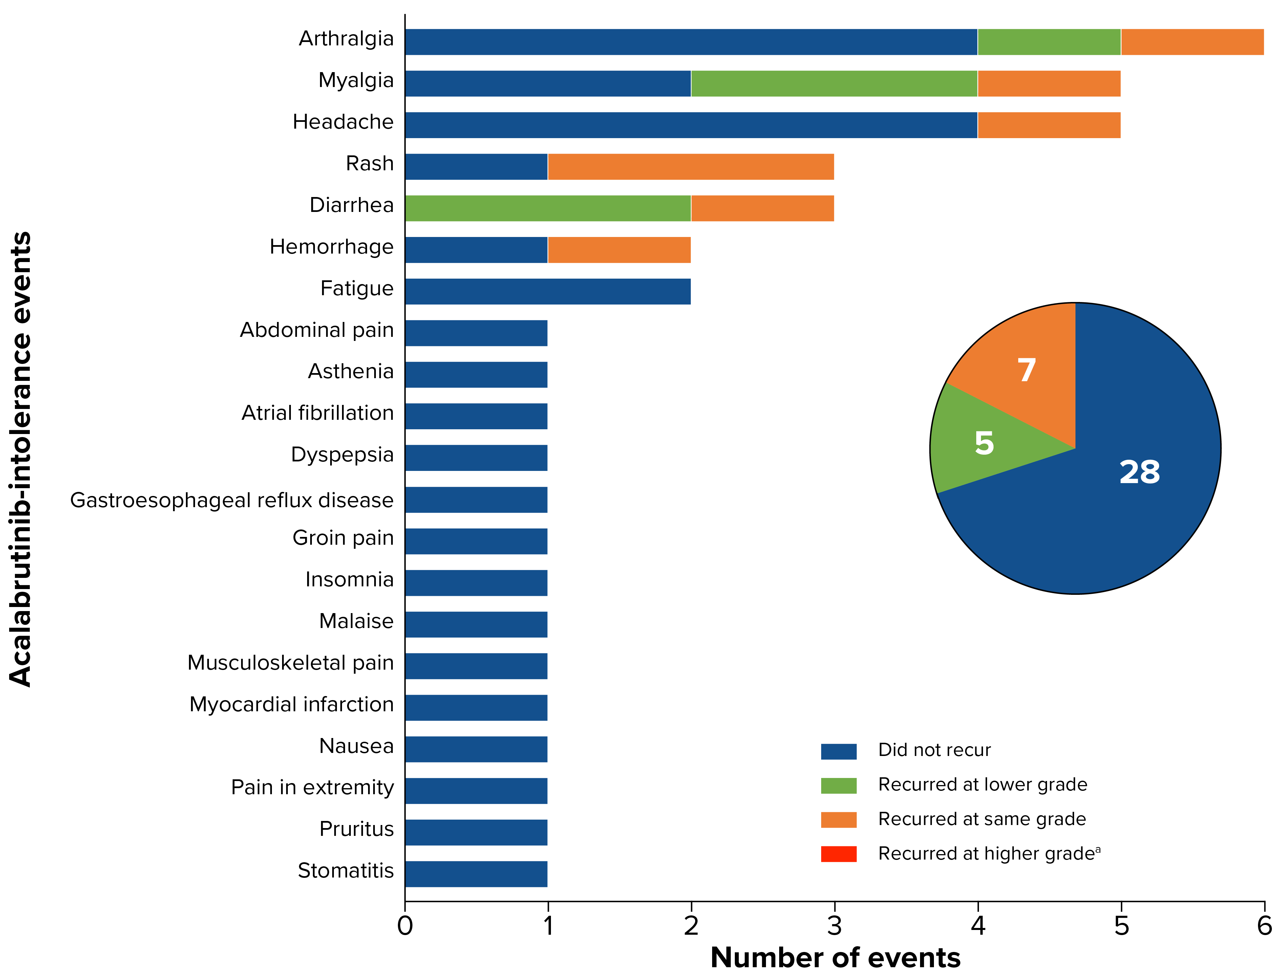

Recurrence of Acalabrutinib-Intolerance Events in Patients Taking Zanubrutinib
Most acalabrutinib-intolerance events did not recur at any grade with zanubrutinib
No events recurred at a higher severity
7 events recurred at the same grade
5 recurred at a lower grade
63% of patients did not experience any recurrence of acalabrutinib intolerance events
ªNo events recurred at a higher grade.

