Slide 1
BTK Inhibitor Selection Following Chemoimmunotherapy in CLL
68-year-old man with 6-year history of CLL
Bilateral axillary and cervical lymphadenopathy over the past 2 months
del(13q) and mutated IGHV
Bendamustine + rituximab 4 year ago, 3-year remission
WBC 35,000, ALC 93%, normal Hct and Plt
Repeat FISH panel – del(17p) in addition to del(13q)
Businessperson who travels frequently
Patient is interested in treatment with BTK inhibitor

Slide 2
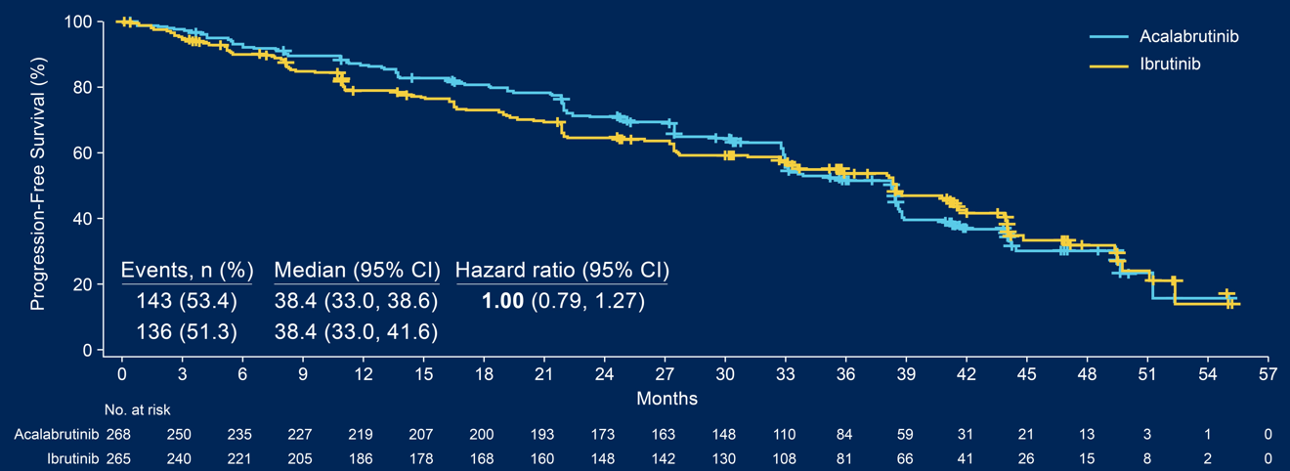
Ibrutinib vs. Acalabrutinib in Patients with Previously Treated CLL and del(17p) or del(11q) (ELEVATE-RR)
High-risk patients only:
Del(17p): 45%
TP53 mutated: 37-42%
Unmutated IGHV: 82-89%
Stopped because of adverse events:
14.9% in acalabrutinib and 22.3% in ibrutinib group
CI, confidence interval; HR, hazard ratio.
Byrd JC, et al. ASCO 2021. Abstract 7500.
Median follow-up: 40.9 months (range, 0.0-59.1).

Slide 3
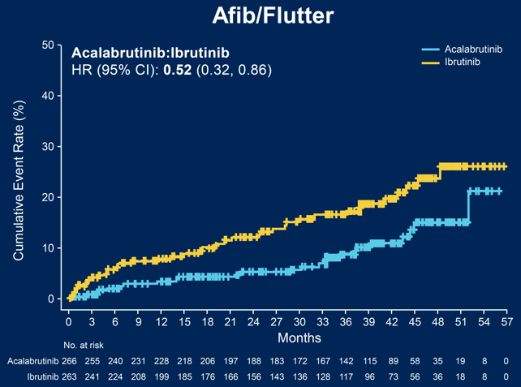
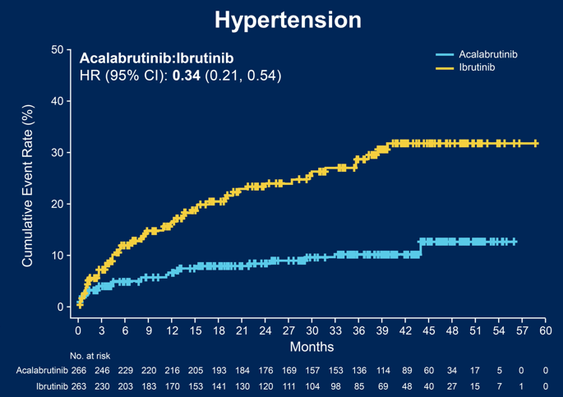
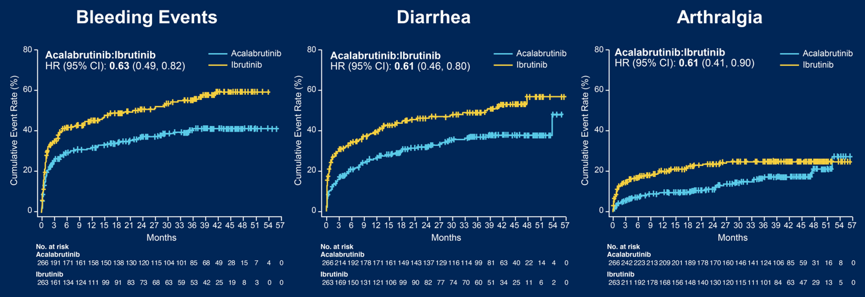
Ibrutinib vs. Acalabrutinib in Patients with Previously Treated CLL and del(17p) or del(11q) (ELEVATE-RR)
CI, confidence interval; HR, hazard ratio.
Byrd JC, et al. ASCO 2021. Abstract 7500.

Slide 4
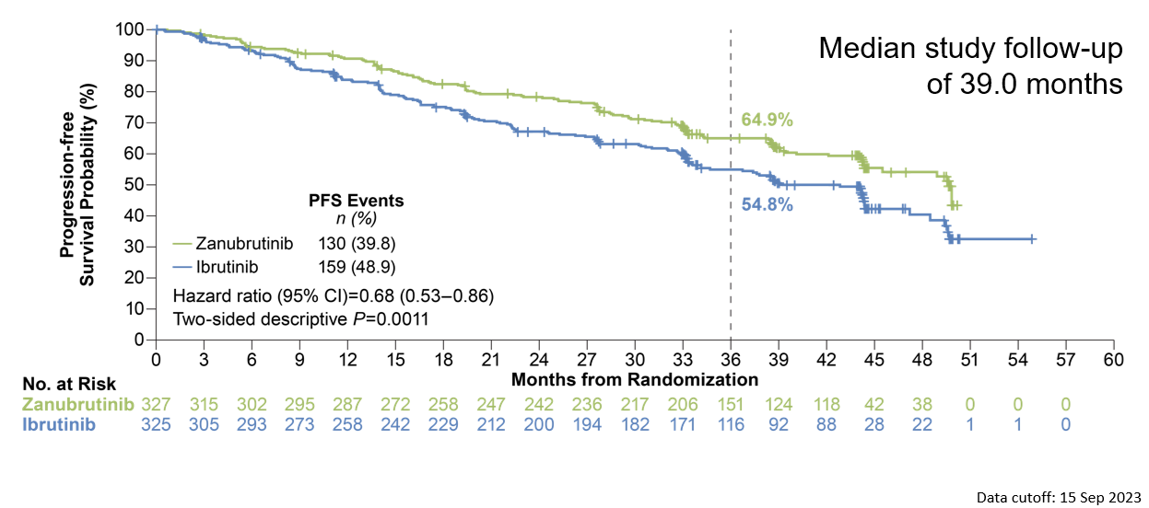
Zanubrutinib Sustains PFS Benefit Over Ibrutinib at Extended Follow-Up

Slide 5
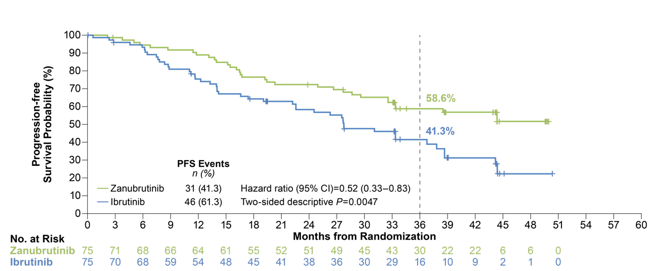
Improved PFS Was Demonstrated with Zanubrutinib in Patients with del(17p)/ TP53^{mut}

Slide 6
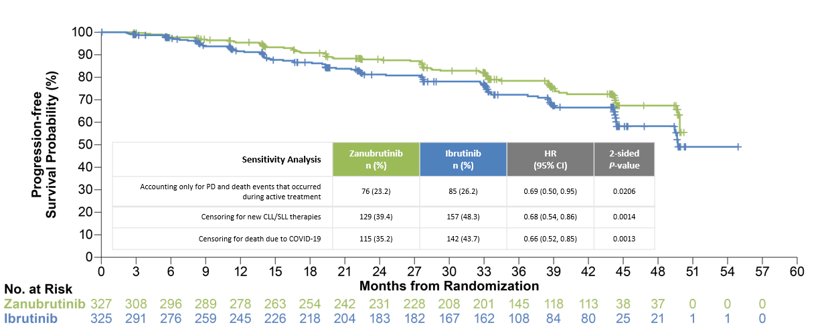
Zanubrutinib PFS Benefit Was Consistent Across Multiple Sensitivity Analyses

Slide 7
Zanubrutinib Demonstrates a More Favorable Cardiac Safety Profile Than Ibrutinib
 | Zanubrutinib (n=324) |  | Ibrutinib (n=324)
 | Any Grade | Grade ≥3 | Any Grade | Grade ≥3
Hypertension | 86 (26.5) | 53 (16.4) | 80 (24.7) | 47 (14.5)
Atrial fibrillation/flutter | 22 (6.8) | 10 (3.1) | 53 (16.4) | 16 (4.9)
Fatal cardiac eventsª: zanubrutinb, n=0 (0%); ibrutinib, n=6 (1.9%)

Slide 8
Summary
Zanubrutinib has shown clinical efficacy over ibrutinib
Acalabrutinib has shown non-inferior efficacy with ibrutinib
Both acalabrutinib and zanubrutinib have a favorable safety profile

