Slide 1
Treatment-Naïve, Symptomatic, Unfit Older Patient With High-Risk Cytogenetics
68-year-old man with CLL x 2 years
del(17) and unmutated IGHV
Presents with fatigue and slowly progressive lymphadenopathy over past 3 months
Cervical, axillary, and inguinal lymphadenopathy detected
Spleen not palpable
WBC 86,000, ALC 95%, Hct 31%, Plt 98,000
What are the considerations regarding the choice of initial therapy?

Slide 2
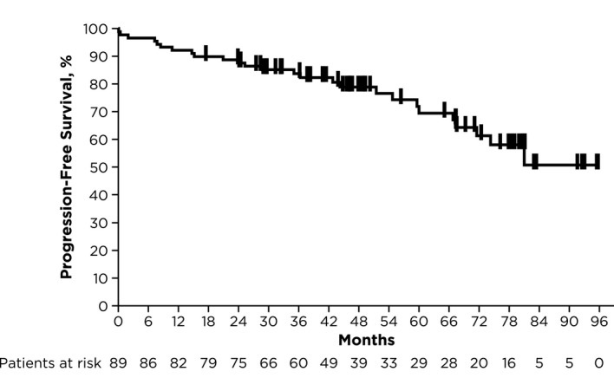
Ibrutinib for CLL in Patients with TP53 Aberrations
Pooled analysis including PCYC-1122e, RESONATE-2, iLLUMINATE and ECOG-ACRIN E1912

Slide 3
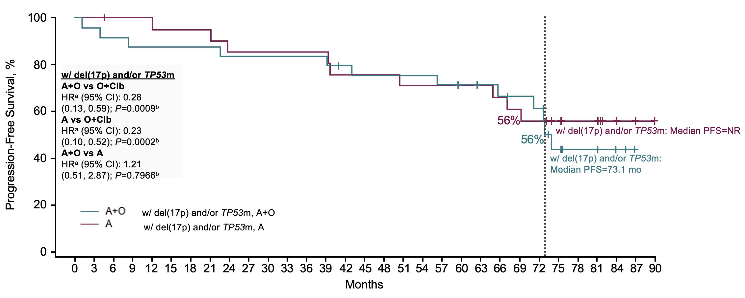
Acalabrutinib in Patients with del(17p) and/or TP53m
ELEVATE-TN 6 Year Update
ªHazard ratio based on unstratified Cox proportional-hazards model.
^{b}P-value based on unstratified log-rank test.

Slide 4
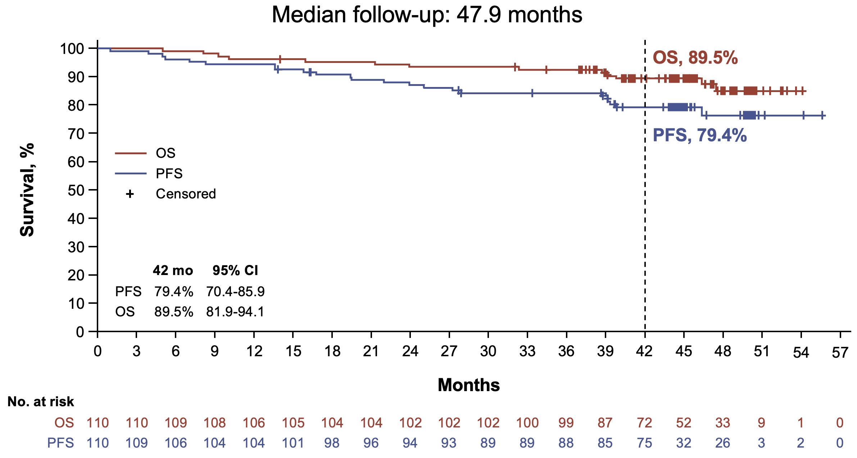
Zanubrutinib in Patients with del(17p)
SEQUOIA
CR/CRi rate, 14.5%

Slide 5
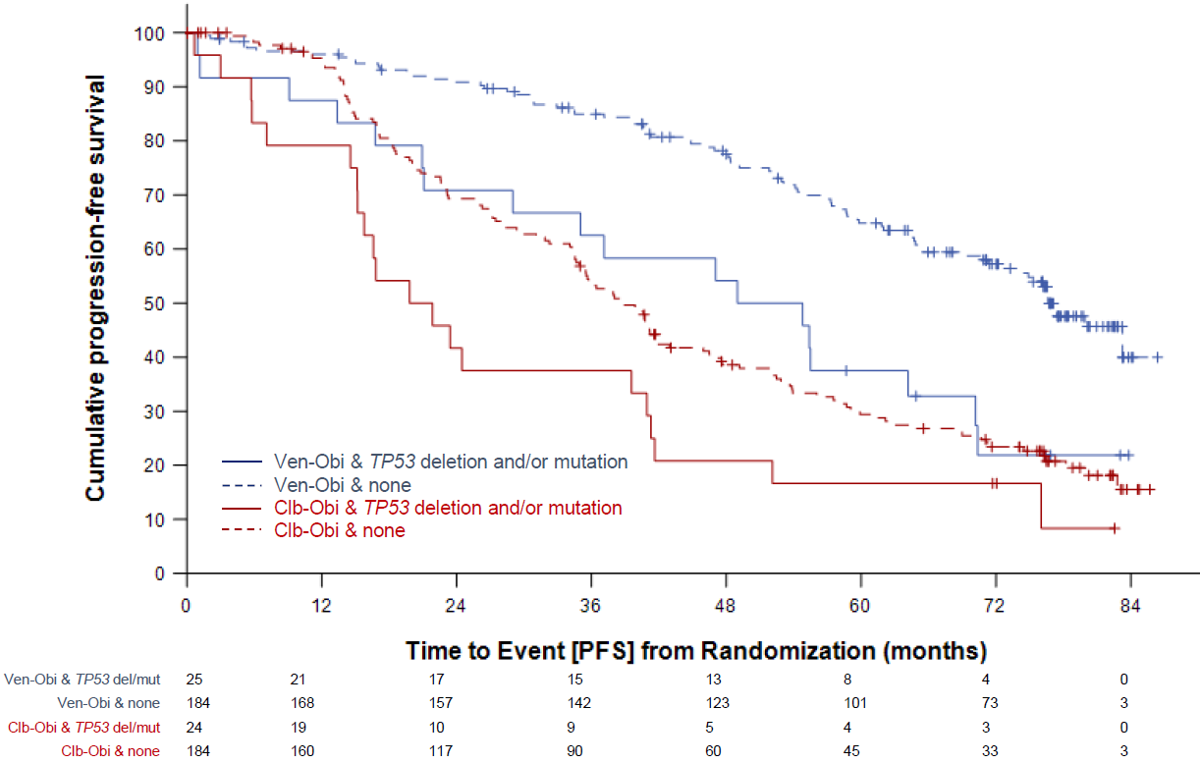
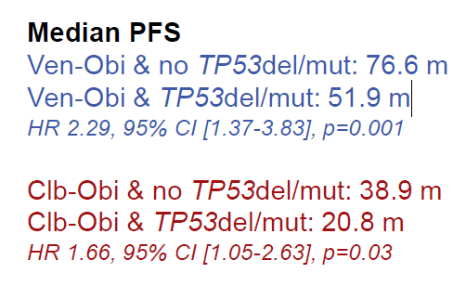
Venetoclax + Obinutuzumab and TP53 del/mutant CLL

Slide 6
Summary
Covalent BTK inhibitors are treatment of choice for patients with CLL and high-risk cytogenetics
Safety profile of acalabrutinib and zanubrutinib are superior to ibrutinib
Efficacy of zanubrutinib is superior to ibrutinib

