Slide 1
Should We Be Resistant to Newer Therapies on the Horizon?
Keith C. Ferdinand, MD, FACC, FAHA, FASPC, FNLA
Gerald S. Berenson Endowed Chair in Preventive Cardiology
Professor of Medicine
Tulane University School of Medicine
New Orleans, LA

Slide 2
Disclaimer
The views and opinions expressed in this educational activity are those of the faculty and do not necessarily represent the views of TotalCME, Inc., the CME providers, or the companies providing educational grants. This presentation is not intended to define an exclusive course of patient management; the participant should use their clinical judgment, knowledge, experience, and diagnostic skills in applying or adopting for professional use any of the information provided herein. Any procedures, medications, or other courses of diagnosis or treatment discussed or suggested in this activity should not be used by clinicians without evaluation of their patient's conditions and possible contraindications or dangers in use, review of any applicable manufacturer’s product information, and comparison with recommendations of other authorities. Links to other sites may be provided as additional sources of information.

Slide 3
Emerging Drug Classes for Difficult to Treat and RH
Atrial Natriuretic Peptides (ANP)
Endothelin Receptor Antagonists (ERA)
Centrally Acting Aminopeptidase A Inhibitors (APAi)
Nonsteroidal Mineralocorticoid Receptor Antagonists (MRA)
Dual Angiotensin II Receptor-neprilysin Inhibitors (ARNI)
Sodium-glucose Cotransporter 2 Inhibitors (SGLT2i)

Slide 4
Emerging Drug Classes for Difficult to Treat and RH
Atrial Natriuretic Peptides (ANP)
Endothelin Receptor Antagonists (ERA)
Centrally Acting Aminopeptidase A Inhibitors (APAi)
Nonsteroidal Mineralocorticoid Receptor Antagonists (MRA)
Dual Angiotensin II Receptor-neprilysin Inhibitors (ARNI)
Sodium-glucose Cotransporter 2 Inhibitors (SGLT2i)

Slide 5
Emerging Drug Classes for Difficult to Treat and RH
Atrial Natriuretic Peptides (ANP)
Endothelin Receptor Antagonists (ERA)
Centrally Acting Aminopeptidase A Inhibitors (APAi)
Nonsteroidal Mineralocorticoid Receptor Antagonists (MRA)
Dual Angiotensin II Receptor-neprilysin Inhibitors (ARNI)
Sodium-glucose Cotransporter 2 Inhibitors (SGLT2i)

Slide 6
Emerging Drug Classes for Difficult to Treat and RH
Atrial Natriuretic Peptides (ANP)
Endothelin Receptor Antagonists (ERA)
Centrally Acting Aminopeptidase A Inhibitors (APAi)
Nonsteroidal Mineralocorticoid Receptor Antagonists (MRA)
Dual Angiotensin II Receptor-neprilysin Inhibitors (ARNI)
Sodium-glucose Cotransporter 2 Inhibitors (SGLT2i)

Slide 7
Emerging Drug Classes for Difficult to Treat and RH
Atrial Natriuretic Peptides (ANP)
Endothelin Receptor Antagonists (ERA)
Centrally Acting Aminopeptidase A Inhibitors (APAi)
Nonsteroidal Mineralocorticoid Receptor Antagonists (MRA)
Dual Angiotensin II Receptor-neprilysin Inhibitors (ARNI)
Sodium-glucose Cotransporter 2 Inhibitors (SGLT2i)

Slide 8
Emerging Drug Classes for Difficult to Treat and RH
Atrial Natriuretic Peptides (ANP)
Endothelin Receptor Antagonists (ERA)
Centrally Acting Aminopeptidase A Inhibitors (APAi)
Nonsteroidal Mineralocorticoid Receptor Antagonists (MRA)
Dual Angiotensin II Receptor-neprilysin Inhibitors (ARNI)
Sodium-glucose Cotransporter 2 Inhibitors (SGLT2i)

Slide 9
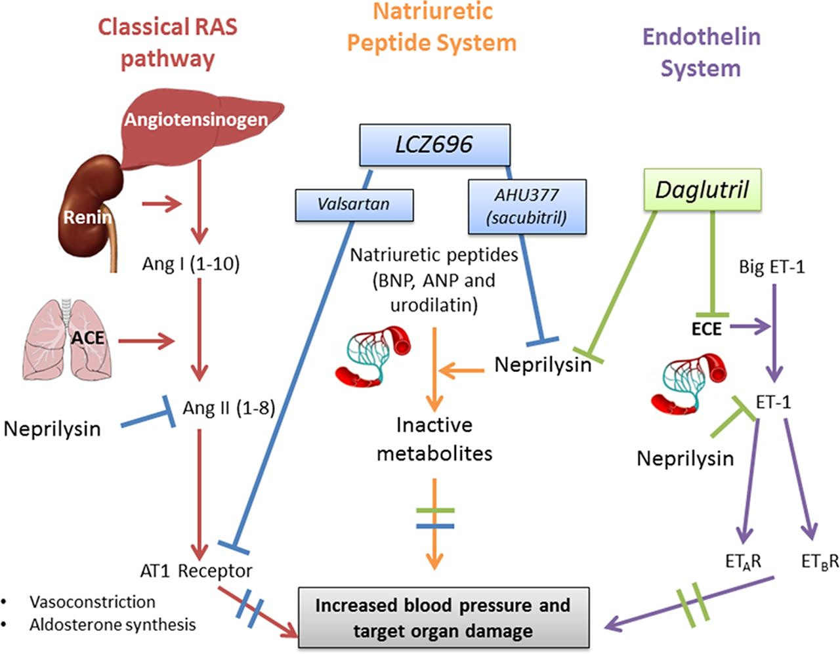

Slide 15
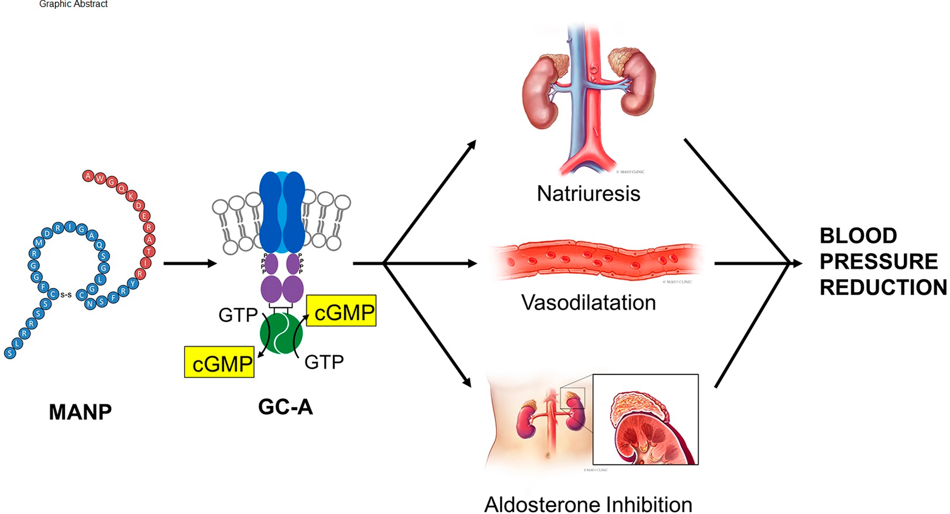
A Novel ANP in Hypertension

Slide 16
A Novel ANP in Hypertension

Slide 17
A Novel ANP in Hypertension

Slide 18
A Novel ANP in Hypertension

Slide 19
A Novel ANP in Hypertension

Slide 20
A Novel ANP in Hypertension

Slide 21
Dual Endothelin Receptor Antagonist Aprocitentan in HTN
Aprocitentan: potent, orally active, dual endothelin A/endothelin B (ETA/ETB) receptor antagonist
ETA/ETB inhibitory potency ratio 1:16

Slide 22
Nonsteroidal Mineralocorticoid Receptor (MR) Antagonists
Steroidal MRAs (spironolactone and eplerenone) are one of the most effective methods to reduce BP in RH
First-in-class new generation MRA: finerenone
Finerenone is highly selective for MR vs. glucocorticoid, androgen, progesterone, and estrogen receptors

Slide 23
Sacubitril/Valsartan
Dual ARNi
NEP
AT1R
ANP and related
peptides
ANG II effects
Vasodilation
Sodium excretion
Antihypertrophic effect
Vasoconstriction
Sodium retention
Hypertrophic effect
Blood pressure
Target-organ effects

Slide 24
Sacubitril/Valsartan
Dual ARNi
NEP
AT1R
ANP and related
peptides
ANG II effects
Vasodilation
Sodium excretion
Antihypertrophic effect
Vasoconstriction
Sodium retention
Hypertrophic effect
Blood pressure
Target-organ effects

Slide 25
Sacubitril/Valsartan
Dual ARNi
NEP
AT1R
ANP and related
peptides
ANG II effects
Vasodilation
Sodium excretion
Antihypertrophic effect
Vasoconstriction
Sodium retention
Hypertrophic effect
Blood pressure
Target-organ effects

