Slide 1

Does the PRECISION Trial Change the Landscape of Resistant Hypertension?
PANEL DISCUSSION

Slide 2
Disclaimer
The views and opinions expressed in this educational activity are those of the faculty and do not necessarily represent the views of TotalCME, Inc., the CME providers, or the companies providing educational grants. This presentation is not intended to define an exclusive course of patient management; the participant should use their clinical judgment, knowledge, experience, and diagnostic skills in applying or adopting for professional use any of the information provided herein. Any procedures, medications, or other courses of diagnosis or treatment discussed or suggested in this activity should not be used by clinicians without evaluation of their patient's conditions and possible contraindications or dangers in use, review of any applicable manufacturer’s product information, and comparison with recommendations of other authorities. Links to other sites may be provided as additional sources of information.

Slide 3
Disclaimer
The views and opinions expressed in this educational activity are those of the faculty and do not necessarily represent the views of TotalCME, Inc., the CME providers, or the companies providing educational grants. This presentation is not intended to define an exclusive course of patient management; the participant should use their clinical judgment, knowledge, experience, and diagnostic skills in applying or adopting for professional use any of the information provided herein. Any procedures, medications, or other courses of diagnosis or treatment discussed or suggested in this activity should not be used by clinicians without evaluation of their patient's conditions and possible contraindications or dangers in use, review of any applicable manufacturer’s product information, and comparison with recommendations of other authorities. Links to other sites may be provided as additional sources of information.

Slide 4
The PRECISION Trial Study Objective
To evaluate the safety and BP-lowering effect of aprocitentan when combined with other antihypertensive drugs in patients with resistant hypertension

Slide 5
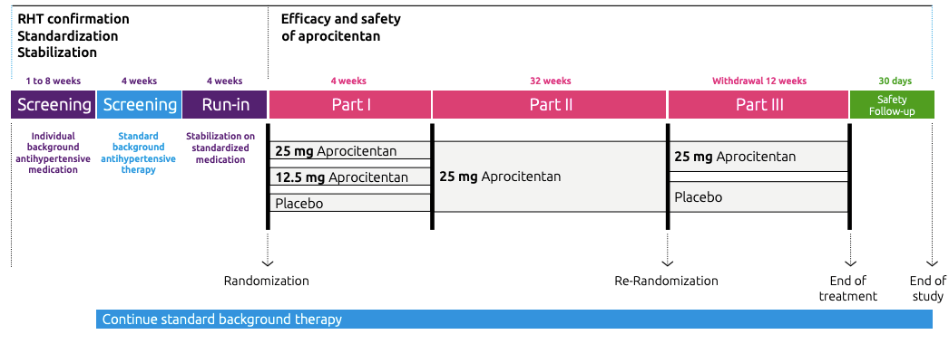
Study Design

Slide 6
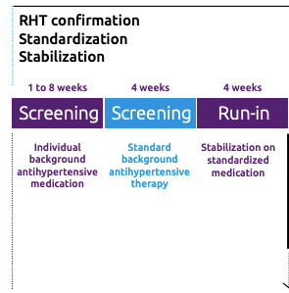
Patient Population: True Resistant Hypertension
Mean SBP ≥ 140 mmHg measured by unattended AOBP on standardized triple therapy
Amlodipine
Valsartan
HCTZ
Strengths available: 5/160/25 or 10/160/25

Slide 7
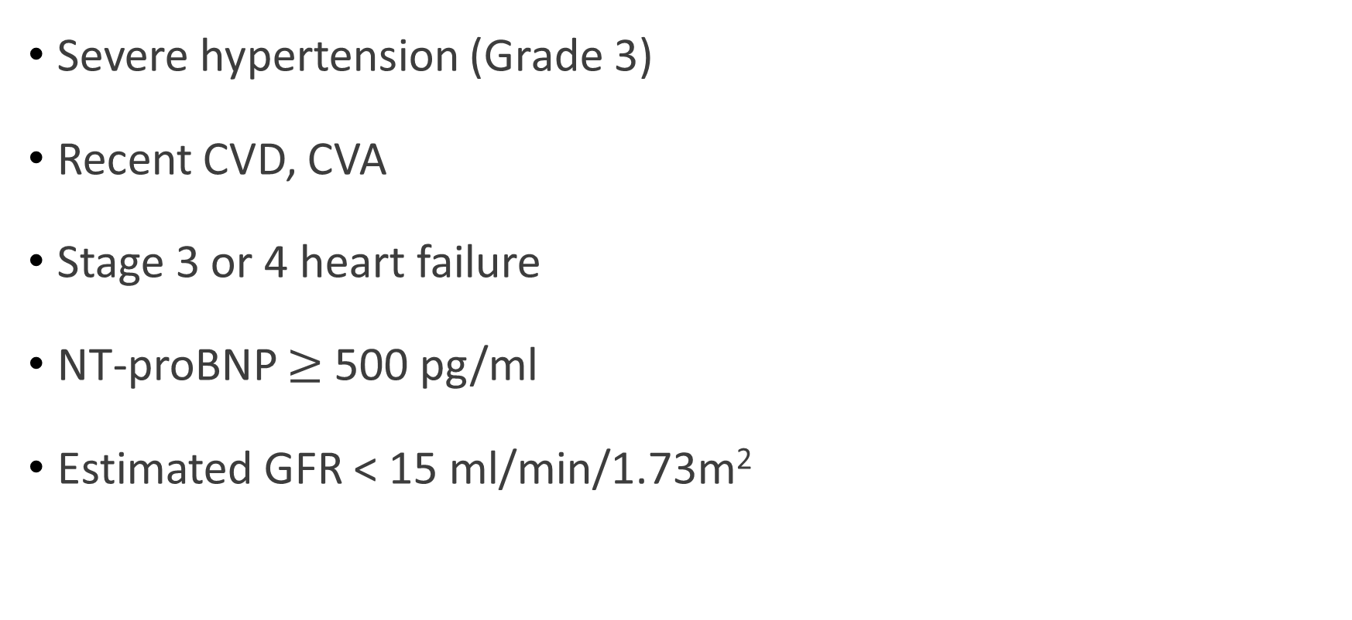
Exclusion Criteria
Severe hypertension (Grade 3)
Recent CVD, CVA
Stage 3 or 4 heart failure
NT-proBNP $≥$500 pg/ml
Estimated GFR < 15 ml/min/1.73m²

Slide 8
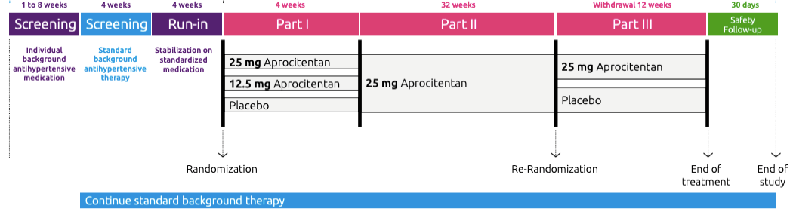
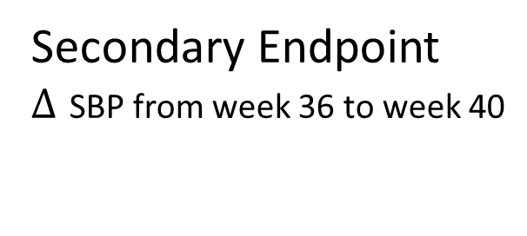

Study Endpoints
Primary Endpoint
$∆$ SBP from baseline to week 4
Secondary Endpoint
$∆$ SBP from week 36 to week 40

Slide 9
Full Study Results to be Released at the 2022 AHA Conference

