Slide 1

New Modalities and MOAs for Resistant Hypertension?
Sreekanth Vemulapalli, MD
Assistant Professor of Medicine, Division of Cardiology
Duke University School of Medicine
Durham, NC

Slide 2
Disclaimer
The views and opinions expressed in this educational activity are those of the faculty and do not necessarily represent the views of TotalCME, Inc., the CME providers, or the companies providing educational grants. This presentation is not intended to define an exclusive course of patient management; the participant should use their clinical judgment, knowledge, experience, and diagnostic skills in applying or adopting for professional use any of the information provided herein. Any procedures, medications, or other courses of diagnosis or treatment discussed or suggested in this activity should not be used by clinicians without evaluation of their patient's conditions and possible contraindications or dangers in use, review of any applicable manufacturer’s product information, and comparison with recommendations of other authorities. Links to other sites may be provided as additional sources of information.

Slide 3
Disclaimer
The views and opinions expressed in this educational activity are those of the faculty and do not necessarily represent the views of TotalCME, Inc., the CME providers, or the companies providing educational grants. This presentation is not intended to define an exclusive course of patient management; the participant should use their clinical judgment, knowledge, experience, and diagnostic skills in applying or adopting for professional use any of the information provided herein. Any procedures, medications, or other courses of diagnosis or treatment discussed or suggested in this activity should not be used by clinicians without evaluation of their patient's conditions and possible contraindications or dangers in use, review of any applicable manufacturer’s product information, and comparison with recommendations of other authorities. Links to other sites may be provided as additional sources of information.

Slide 4
Specific Therapeutic Regimens
Tailored to comorbidities (Stable Ischemic Heart Disease, HFrEF, HFpEF, CKD, Stroke, DM, Aortic Insufficiency, Thoracic Aortic Disease)
Comorbidity | Management Considerations
Volume Control, Edema Resolution | Thiazide → chlorthalidone→ loop diuretic
Stable Ischemic Heart Disease | β-blocker, ACE-I
HFrEF | Sacubitril/valsartan, β-blocker, MRA, SGLT-2i; hydralazine + nitrates in African Americans
HFpEF | MRA, SGLT-2i, sacubitril/valsartan
CKD/DM with Albuminuria | ACE or ARB and SGLT-2i, finerenone
Aortic Insufficiency | Avoid nodal blocking agents (β-blockers, non-dihydropyridine CCB)
Thoracic Aortic Disease | β-blockers, ACE-I/ARB

Slide 5
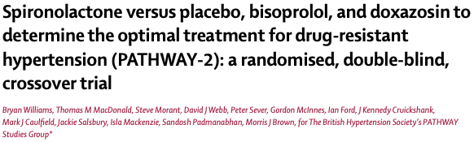
4th Line Antihypertensive Agents and Beyond
150
148
p<0.0001
146
p<0.0001
144
Sistolic
142
140
138
136
Home blood pressure (mm Hg)
134
86
84
82
Diastolic
80
78
76
Placebo
(n=274)
Baseline
(n=314)
Spironolactone
25-50 mg
(n=285)
Doxazosin
4-8 mg
(n=282)
Bisoprolol
5-10 mg
(n=285)

Slide 6
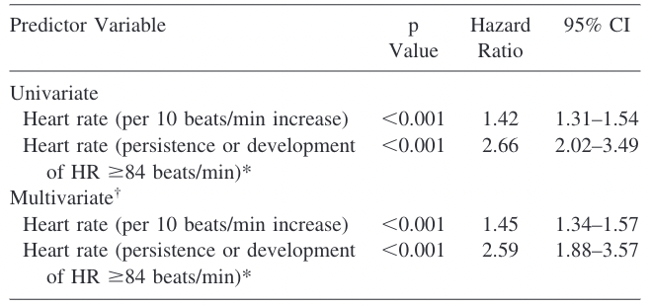
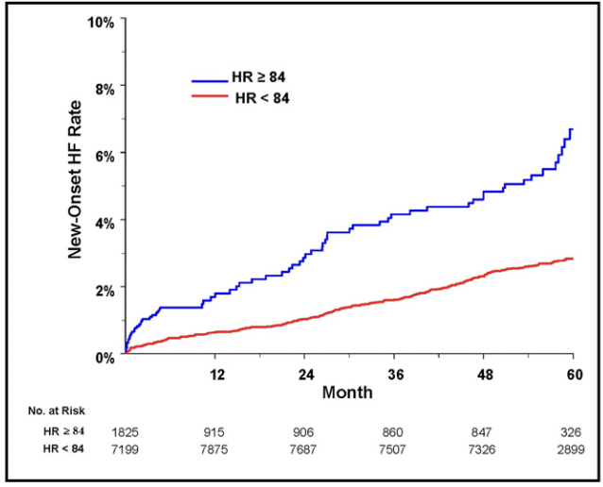

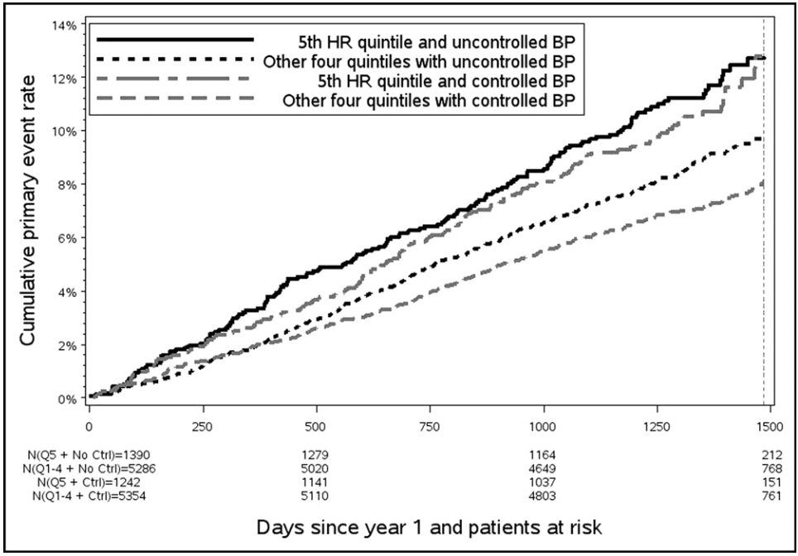
Heartrate
Secondary analysis of the Losartan Intervention for Endpoint Reduction (LIFE) study
  Increased heart failure and mortality associated with elevated heart rates in patients with hypertension
Secondary analysis of the Valsartan Antihypertensive Long Term Use Evaluation (VALUE) study
  Increased composite of CV death/HF Hospitalization/nonfatal MI /emergency revascularization

Slide 7
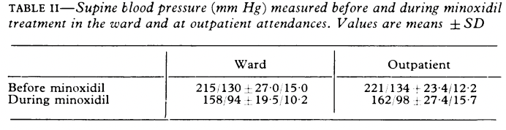
6th Line Therapy – Direct Vasodilators
Hydralazine
  Use with nitrates in HF, especially in African Americans
Minoxidil:
  Reflex tachycardia – use with
  β-blocker
  Volume overload – use with
  loop diuretic

Slide 8
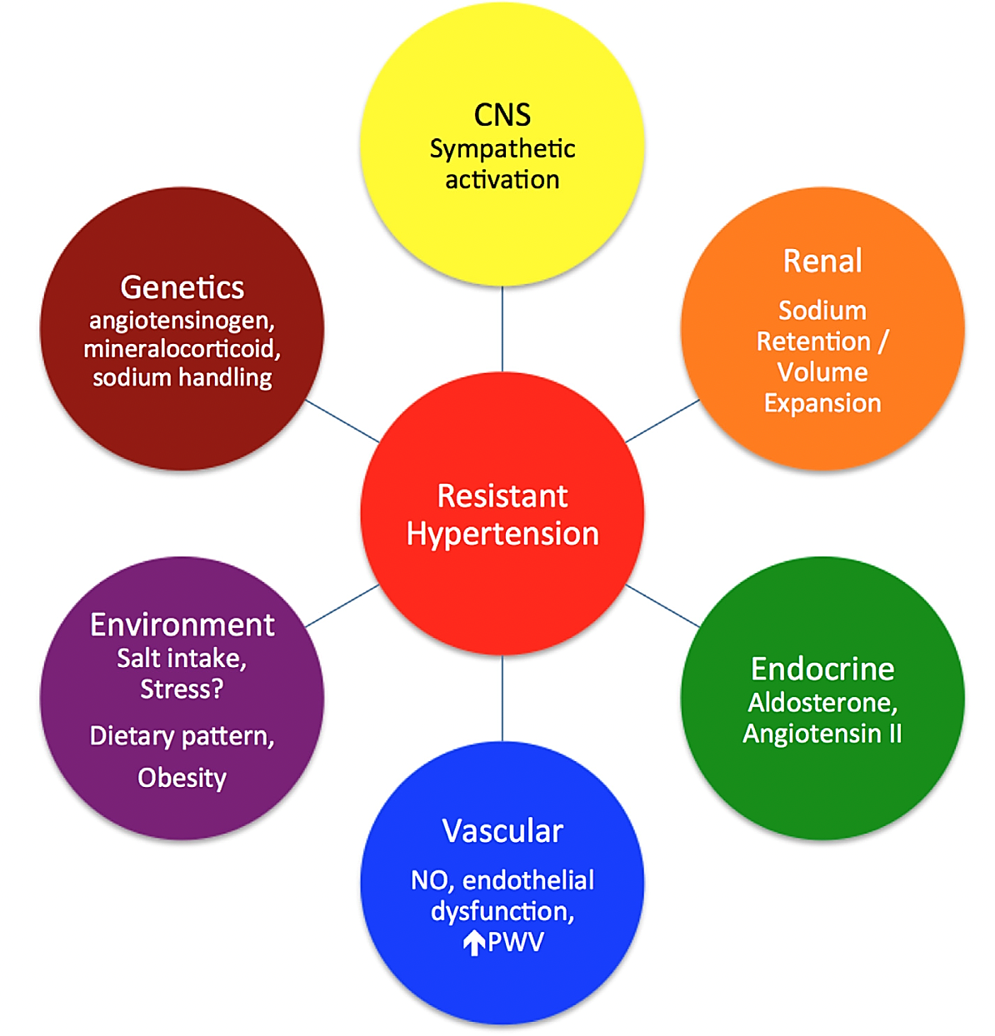
Device-Based Therapies for
Resistant Hypertension
Renal Denervation

Slide 9
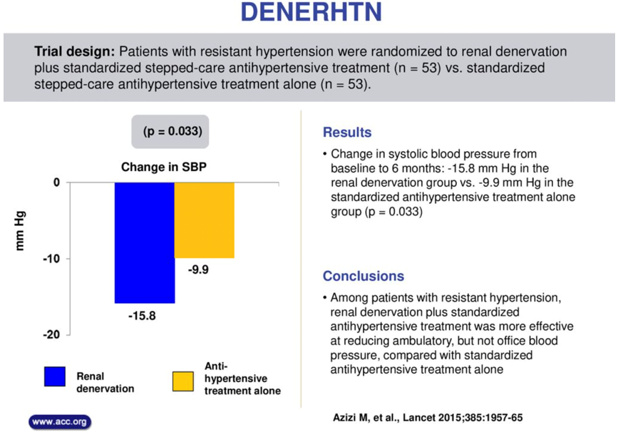
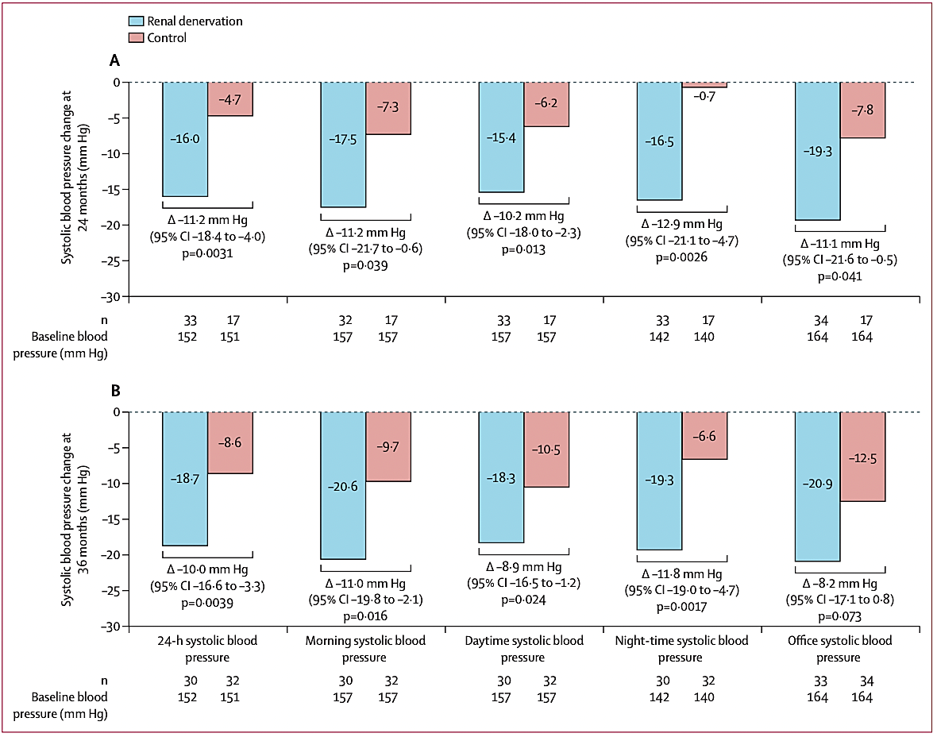
Renal Denervation
SPYRAL HTN-ON-MED Pilot 3-year Data

Slide 10
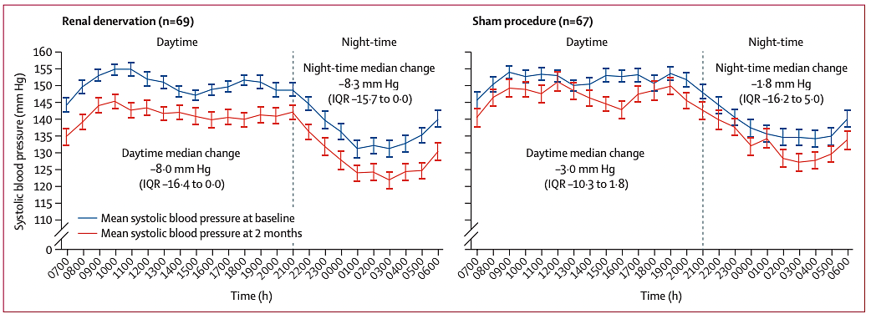
Renal Denervation
RADIANCE-HTN TRIO
  ~ 130 patients with uncontrolled HTN despite ≥ 3 meds, including a diuretic

Slide 11
New Medical Therapies in Development
Agent | Mechanism of Action | Trial Details
Baxdrostat CinCor Pharma | Non-steroidal inhibitor of the mineralocorticoid receptor Reduces proteinuria in CKD patients | BrigHtn Phase 2 study to be presented at AHA 2022 Randomized double-blind placebo-controlled study
Aprocitentan Janssen | Endothelin regulates vascular tone through G-coupled protein receptors ETA and ETB. Aprocitentan is a dual endothelin receptor antagonist. | Phase 3 PRECISION Trial (AHA 2022) in 1,971 patients with resistant HTN.

Slide 12
Key Messages
Spironolactone is recommended as a 4th line agent in resistant hypertension
The direct vasodilators hydralazine and minoxidil are 6th line agents
Targeting the sympathetic nervous system through renal denervation is on the horizon
Endothelin receptor antagonist is being presented at AHA 2022 and may be on the horizon

