Slide 1

How Do We Apply These Practices Locally?
PANEL DISCUSSION

Slide 2
Disclaimer
The views and opinions expressed in this educational activity are those of the faculty and do not necessarily represent the views of TotalCME, Inc., the CME providers, or the companies providing educational grants. This presentation is not intended to define an exclusive course of patient management; the participant should use their clinical judgment, knowledge, experience, and diagnostic skills in applying or adopting for professional use any of the information provided herein. Any procedures, medications, or other courses of diagnosis or treatment discussed or suggested in this activity should not be used by clinicians without evaluation of their patient's conditions and possible contraindications or dangers in use, review of any applicable manufacturer’s product information, and comparison with recommendations of other authorities. Links to other sites may be provided as additional sources of information.

Slide 3
American Society of Hypertension (ASH) Evidence-Based Fixed-Dose Antihypertensive Combinations
Preferred
ACE inhibitor/diuretic* ARB/diuretic* ACE inhibitor/CCB* ARB/CCB*
Acceptable
Beta blocker/diuretic* CCB (dihydropyridine)/β-blocker CCB/diuretic Renin inhibitor/diuretic* Renin inhibitor/ARB* Thiazide diuretics/K+ sparing diuretics*
Less Effective
ACE inhibitor/ARB ACE inhibitor/β-blocker ARB/β-blocker CCB (nondihydropyridine)/β-blocker Centrally acting agent/β-blocker

Slide 4
Pharmacologic Management
General Principles – maximally tolerated doses
CCB
ACE/ARB
Diuretic – thiazide vs. chlorthalidone vs. torsemide per GFR
4th line agent: Spironolactone
Issue Associated with Treatment Resistance | Management Considerations
Volume control, edema resolution | Thiazide → chlorthalidone→ loop diuretic
Heart rate control inadequate | β-blocker, alpha/beta blocker, verapamil, diltiazem
Renin and aldosterone levels low | Avoid nighttime work, low salt diet, amiloride
Renin low and aldosterone normal to high normal | MRA
Split dosing? | At-home BP evaluations and ambulatory monitoring
Questionable medical adherence | Investigate non-adherence and address directly
Sleep disordered breathing or anxiety | Initiate non-drug strategies +/- pharmacotherapy

Slide 5
​ | ​ | ​ | Approximate Impact on SBP
 | Nonpharmacologic intervention | Dose | Hypertension | Normotension
Physical activity | Aerobic | ● 90-150 min/wk ● 65%-75% heart rate reserve | -5/8 mm Hg | -2/4 mm Hg
 | Dynamic resistance | ● 90-150 min/wk ● 50%-80% 1 rep maximum ● 6 exercises, 3 sets/exercise, 10 repetitions/set | -4 mm Hg | -2 mm Hg
 | Isometric resistance | ● 4 x 2 min (hand grip), 1 min rest between exercises, 30%-40% maximum voluntary contraction, 3 sessions/wk ● 8-10 wk | -5 mm Hg | -4 mm Hg
Healthy diet | DASH dietary pattern | Diet rich in fruits, vegetables, whole grains, and low-fat dairy products with reduced content of saturated and total fats | -11 mm Hg | -3 mm Hg
Weight loss | Weight/body fat | At least a 1 kg reduction in body weight for most adults who are overweight; however, attainment of an ideal body weight is optimal | -5 mm Hg | -2/3 mm Hg
Reduced intake of dietary sodium | Dietary sodium | Reduction of at least 1,000 mg/d reduction in most adults; <1,500 mg/d is optimal | -5/6 mm Hg | -2/3 mm Hg
Enhanced intake of dietary potassium | Dietary potassium | 3,500-5,000 mg/d, preferably by consumption of a diet rich in potassium | -4/5 mm Hg | -2 mm Hg
Moderation of alcohol intake | Alcohol consumption | In individuals who drink alcohol, reduce alcohol to: ● Men: <2 drinks daily ● Women: <1 drink daily | -4 mm Hg | -3 mm Hg

Slide 6
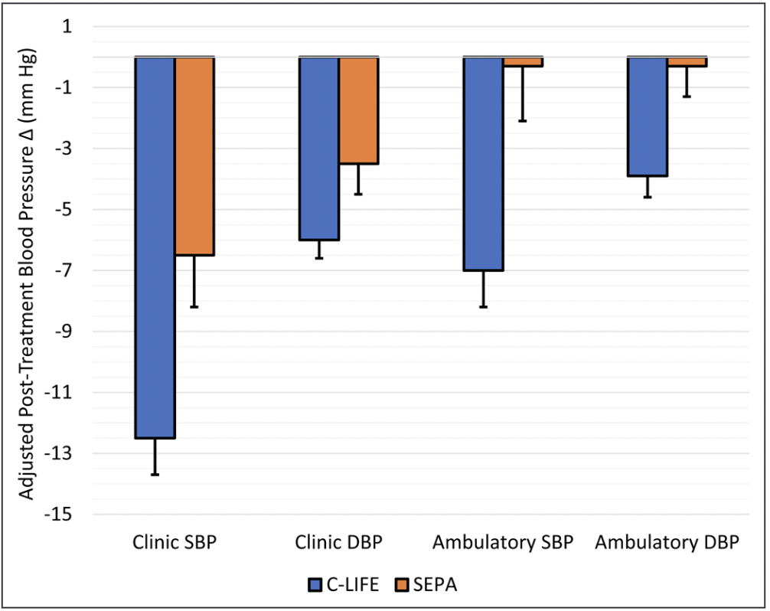
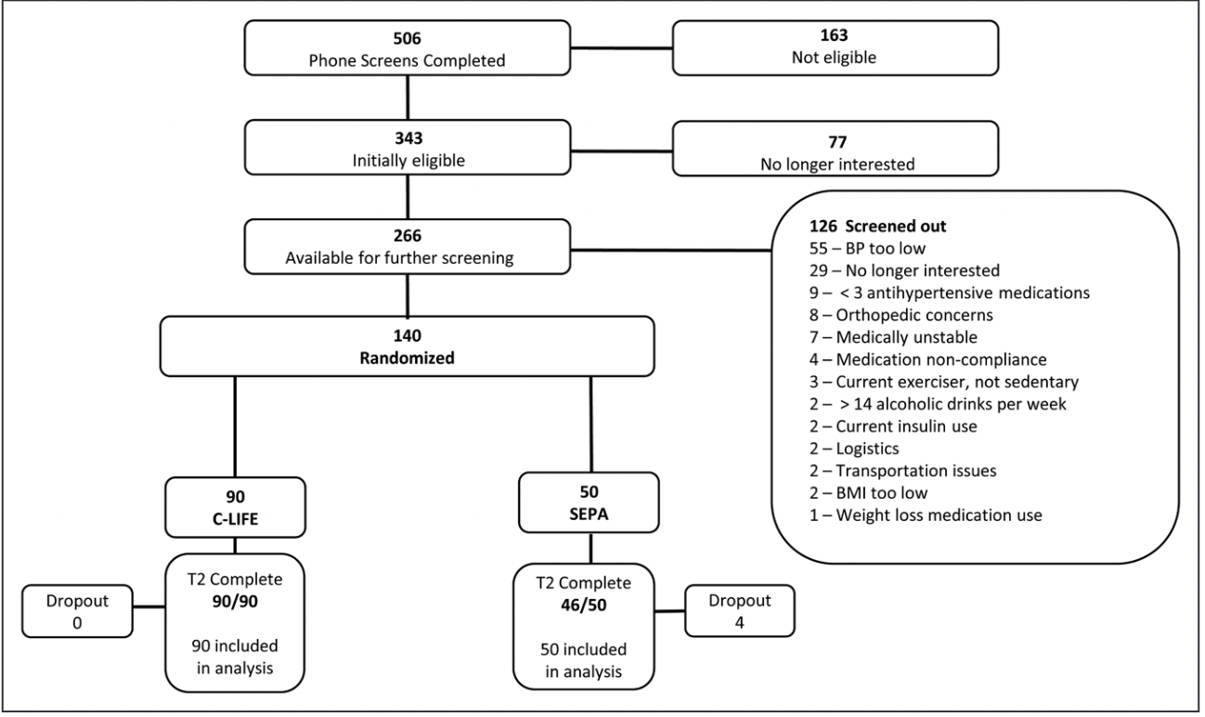
TRIUMPH Trial

Slide 7
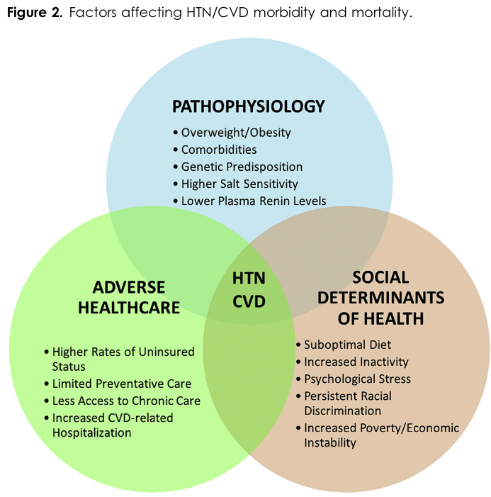
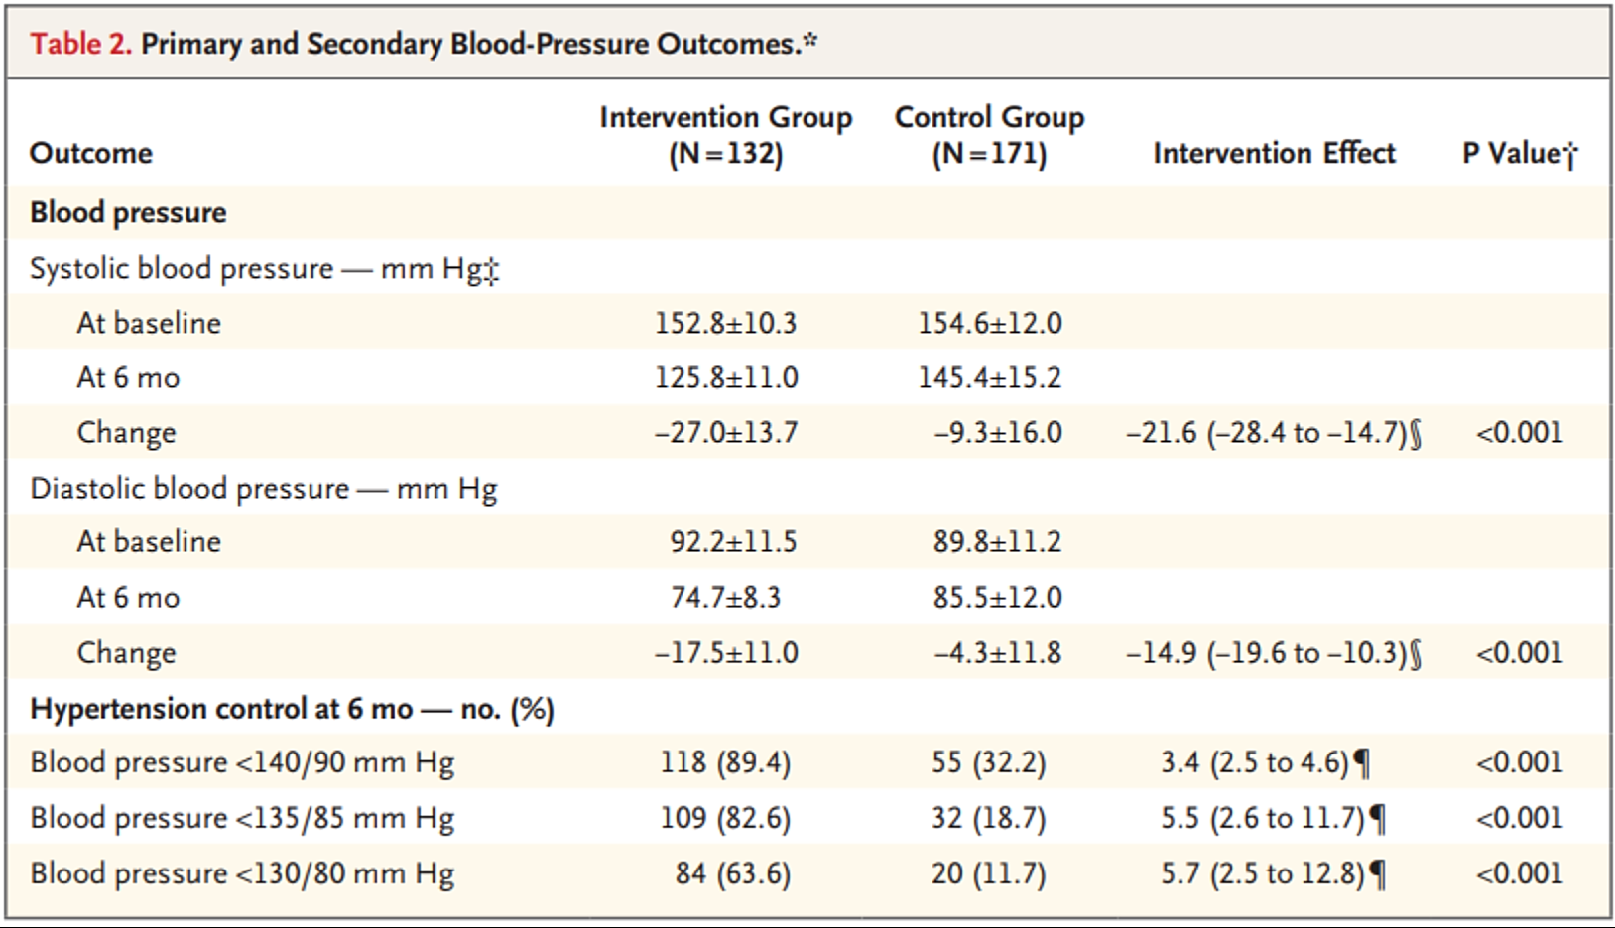
Social Determinants of Health and RH

Slide 8
Key Messages
Social determinants of health play an important role in resistant hypertension
Lifestyle modifications are important and have been shown to lower blood pressure, even in treatment-resistant patients
A 3-drug regimen with a CCB, ACE/ARB, and diuretic appropriate for GFR is the mainstay of therapy
MRA (spironolactone) is the first-choice 4th line agent based on evidence from RCTs

