Slide 1

What are the “Faces” of
Resistant Hypertension
Raven Voora, MD
Associate Professor of Medicine
University of North Carolina, Division of Nephrology and Hypertension
Chapel Hill, NC

Slide 2
Disclaimer
The views and opinions expressed in this educational activity are those of the faculty and do not necessarily represent the views of TotalCME, Inc., the CME providers, or the companies providing educational grants. This presentation is not intended to define an exclusive course of patient management; the participant should use their clinical judgment, knowledge, experience, and diagnostic skills in applying or adopting for professional use any of the information provided herein. Any procedures, medications, or other courses of diagnosis or treatment discussed or suggested in this activity should not be used by clinicians without evaluation of their patient's conditions and possible contraindications or dangers in use, review of any applicable manufacturer’s product information, and comparison with recommendations of other authorities. Links to other sites may be provided as additional sources of information.

Slide 3

Case 1
REFERRAL: Evaluation of (Uncontrolled) Hypertension
58-year-old male
BMI: 29
Past Medical History
  Type 2 diabetes
  High BP
  No known target-organ damage
Family history: Both parents have hypertension
Current Medications:
  Hydrochlorothiazide 25 mg QD
  Losartan 100 mg QD
  Amlodipine 10 mg QD
  Metformin 1000 mg BID
Blood Pressure
  Office reading
    156/92 (left arm)
    159/93 (right arm)
    Heart rate of 72 beats/min
  No change on standing
Physical exam is unremarkable

Slide 4

Case 2
REFERRAL: Evaluation of (Uncontrolled) Hypertension
51-year-old female
BMI: 27
Past Medical History
  Pre-eclampsia
  New onset headaches about 3 years ago
    BP was noted to be elevated (175/114 mmHg)
    Started on antihypertensive medications
Current Medications:
  Chlorthalidone 25 mg QD
  Losartan 100 mg QD
  Nifedipine SR 90 mg QD
Blood Pressure
  Office reading
    148/95 (left arm)
    146/93 (right arm)
    Heart rate of 82 beats/min
  No change on standing
Physical exam is unremarkable

Slide 5
Current Definition of Resistant & Refractory HTN
Refractory Hypertension
Failure to achieve BP control despite adherence to ≥ 5 meds
Maximally tolerated doses
Different classes
Includes a long-acting
thiazide-like diuretic and
a mineralocorticoid
receptor antagonist
5th
Drug
Refractory Hypertension
4th
Drug
Controlled Resistant Hypertension
BP controlled with 4 meds
Resistant Hypertension
Failure to achieve BP control despite adherence to 3-4meds
  *Maximally tolerated
  *Includes diuretic, NDHP-CCB,
  RAAS blocker
Resistant
Hypertension

Slide 6
Do These Patients Have Resistant Hypertension?
Maybe

Slide 7
Pseudo-Resistant Hypertension
Refers to poorly controlled hypertension that seems to be resistant to treatment but is attributable to other other factors, such as:
  Non-adherence to medications and lifestyle recommendations
  White-coat effect
  Non-optimized medication regimen
  Inaccurate BP measurement
  Poor sleep quality

Slide 8
Estimated Prevalence of Each Cause of Pseudoresistant Hypertension
65%
100
80
40%
Estimated prevalence (%)
60
35%
33%
40
20
0
Medication non-
adherence*
+
Under-treatment†
Inaccurate BP
measurement
White coat effect
+

Slide 9
True Resistant Hypertension Must Be Distinguished From Pseudo-Resistant Hypertension
Apparent Treatment Resistant Hypertension
  Uncontrolled BP despite ≥ 3 meds
*Ensure accurate BP measurement before making the diagnosis of resistant hypertension*
Exclusion of white coat effect?
  Out of office BP monitoring
Exclusion of non-adherence?
  Assess adherence to medications and lifestyle recommendations
True-Resistant Hypertension

Slide 10
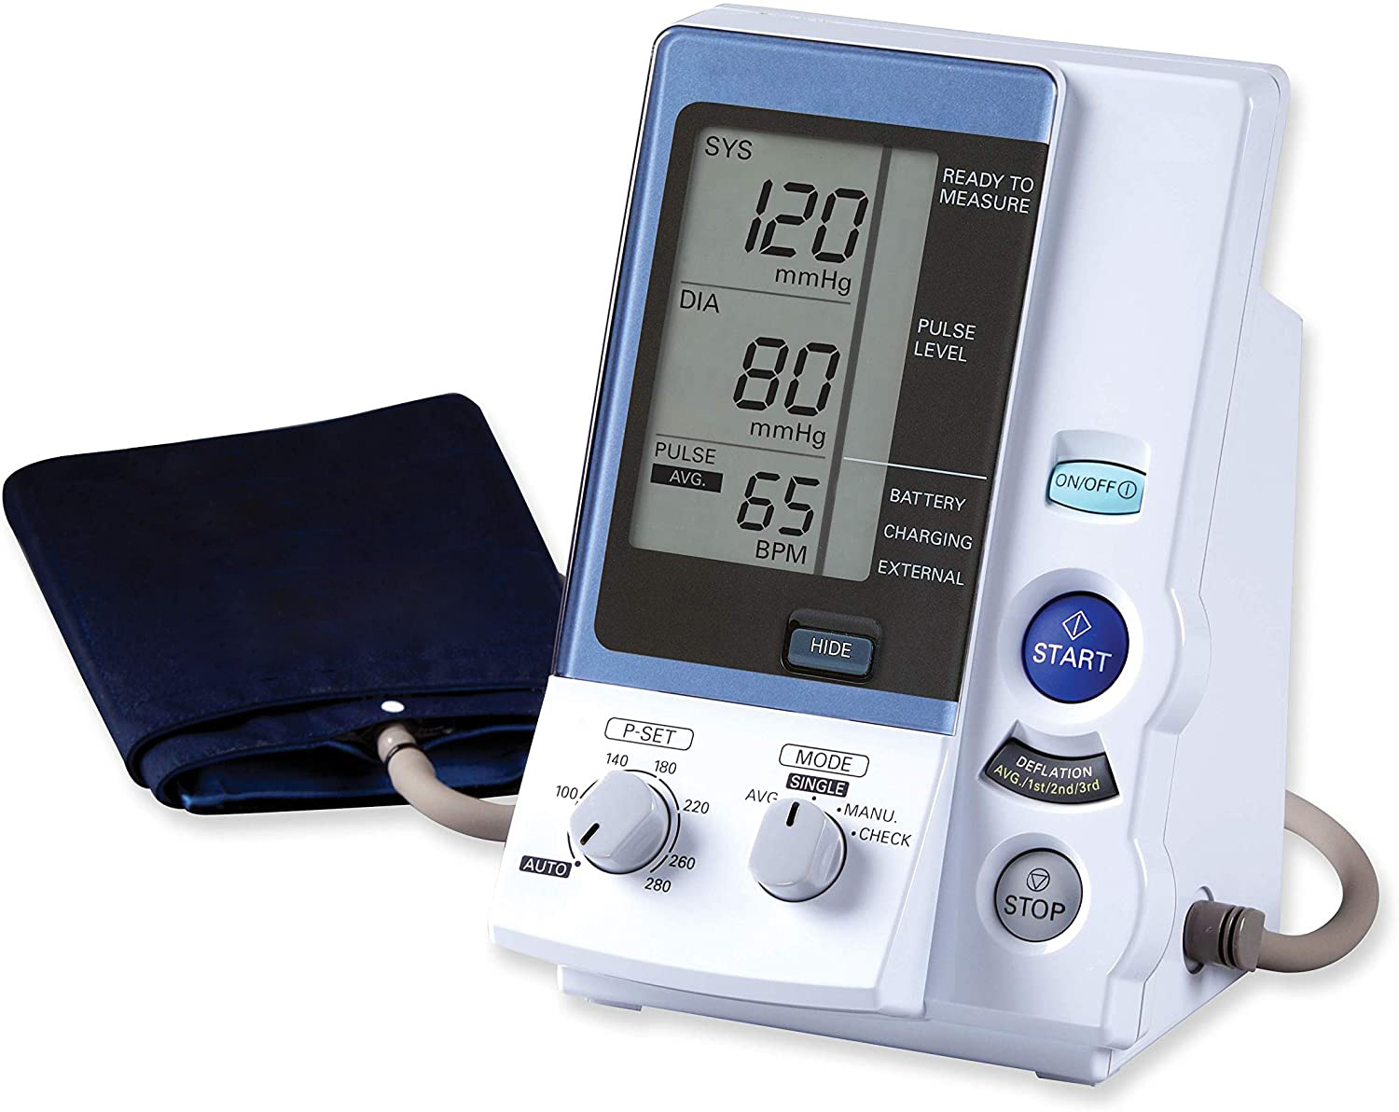
AOBP (Automated Office Blood Pressure) Measurement
Automated
Multiple readings
Patient Unattended

Slide 11
Key Messages
Exclude pseudo-resistance before diagnosing resistant hypertension
    Ensure accurate BP measurements
    Assess for non-adherence with prescribed medication regimen and lifestyle recommendations
    Obtain home, work and/or ambulatory BP readings to exclude a white coat effect

