Slide 1
The Journey from Diagnosis to Effective Management of
Bipolar I and II Depression
Manpreet Kaur Singh, MD MS
Associate Professor of Psychiatry and Behavioral Sciences
Stanford University
Stanford, CA

Slide 2
Disclaimer
The views and opinions expressed in this educational activity are those of the faculty and do not necessarily represent the views of TotalCME, Inc., the CME providers, or the companies providing educational grants. This presentation is not intended to define an exclusive course of patient management; the participant should use their clinical judgment, knowledge, experience, and diagnostic skills in applying or adopting for professional use any of the information provided herein. Any procedures, medications, or other courses of diagnosis or treatment discussed or suggested in this activity should not be used by clinicians without evaluation of their patient's conditions and possible contraindications or dangers in use, review of any applicable manufacturer’s product information, and comparison with recommendations of other authorities. Links to other sites may be provided as additional sources of information.

Slide 3
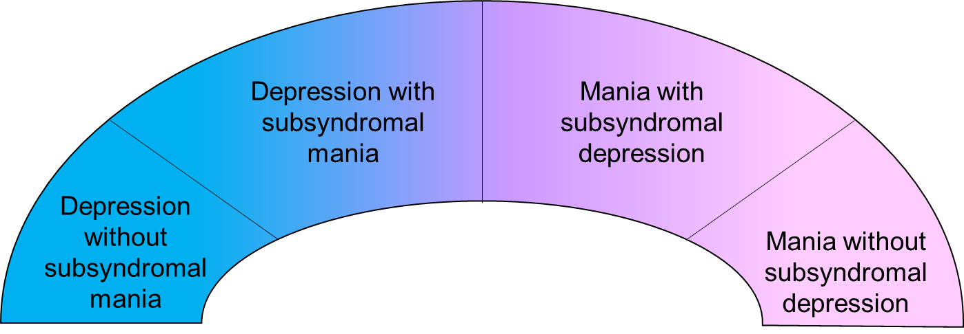
The Mood Disorder Spectrum
DSM-5-TR
Bipolar
Depression
DSM-5-TR
Bipolar
Mania
DSM-5-TR Major Depressive Disorder
Although categorical classifications may be useful for clinical practice, most people fall on a dimensional (spectrum) of mood disorders
  e.g., treatment response (antidepressant vs. mood stabilizing agent) and
  links with family history of bipolar disorder

Slide 4
Probabilistic Approach to Diagnosis
A ‘probabilistic’ approach may help identify patients who are more likely to have bipolar mood disorders
Many factors are more common in bipolar than in unipolar depression
The presence of any of these probabilistic factors is not necessarily indicative of mixed states, but accumulation of these factors should alert clinicians to the possibility of MDD with mixed features
Clinical History
Family history of bipolar disorder
Early age of onset of first depressive episode (<25 years)
Treatment History
Worse response to antidepressants
Antidepressant-induced hypomania
Symptoms
Psychotic features
Atypical depressive symptoms
Subsyndromal hypomanic symptoms
Impulsivity
Aggression
Hostility
Comorbid SUD
# of lifetime affective episodes
# of hospitalizations
Rapid onset of depressive episodes
Greater severity of depressive episodes
Unipolar
Bipolar
RM

Slide 5
Mood State at Presentation Across the Life Cycle
N=889

Slide 6
Bipolar Spectrum-Based First-Line Monotherapy Treatment Recommendations
Depression
Depression with
subsyndromal mania
Mixed
states
Mania with
subsyndromal depression
Mania
Increasing #/severity of manic symptoms
Increasing #/severity of depressive symptoms

Slide 7
Bipolar Spectrum-Based First-Line Monotherapy Treatment Recommendations
Depression
Depression with
subsyndromal mania
Mixed
states
Mania with
subsyndromal depression
Mania
Increasing #/severity of manic symptoms
Increasing #/severity of depressive symptoms
Antidepressant

Slide 8
Bipolar Spectrum-Based First-Line Monotherapy Treatment Recommendations
Depression
Depression with
subsyndromal mania
Mixed
states
Mania with
subsyndromal depression
Mania
Increasing #/severity of manic symptoms
Increasing #/severity of depressive symptoms
Second Generation
Antipsychotics
Antidepressant

Slide 9
Bipolar Spectrum-Based First-Line Monotherapy Treatment Recommendations
Depression
Depression with
subsyndromal mania
Mixed
states
Mania with
subsyndromal depression
Mania
Increasing #/severity of manic symptoms
Increasing #/severity of depressive symptoms
Mood stabilizer
Second Generation
Antipsychotics
Antidepressant

Slide 10
Bipolar Spectrum-Based First-Line Monotherapy Treatment Recommendations
Depression
Depression with
subsyndromal mania
Mixed
states
Mania with
subsyndromal depression
Mania
Increasing #/severity of manic symptoms
Increasing #/severity of depressive symptoms
Mood stabilizer
Second Generation
Antipsychotics
Antidepressant

Slide 11
Bipolar Spectrum-Based First-Line Monotherapy Treatment Recommendations
Depression
Depression with
subsyndromal mania
Mixed
states
Mania with
subsyndromal depression
Mania
Increasing #/severity of manic symptoms
Increasing #/severity of depressive symptoms
Only those patients with essentially NO symptoms of (hypo)mania should be considered for antidepressant monotherapy
Mood stabilizer
Second Generation
Antipsychotics
Antidepressant

Slide 12
Bipolar Spectrum-Based First-Line Monotherapy Treatment Recommendations
Depression
Depression with
subsyndromal mania
Mixed
states
Mania with
subsyndromal depression
Mania
Increasing #/severity of manic symptoms
Increasing #/severity of depressive symptoms
Only those patients with essentially NO symptoms of (hypo)mania should be considered for antidepressant monotherapy
Mood stabilizer
Second Generation
Antipsychotics
Antidepressant

Slide 13
Bipolar Spectrum-Based First-Line Monotherapy Treatment Recommendations
Depression
Depression with
subsyndromal mania
Mixed
states
Mania with
subsyndromal depression
Mania
Increasing #/severity of manic symptoms
Increasing #/severity of depressive symptoms
Unipolar depression?
Bipolar disorder?
Does it matter in terms of choosing the best treatment?
Only those patients with essentially NO symptoms of (hypo)mania should be considered for antidepressant monotherapy
Mood stabilizer
Second Generation
Antipsychotics
Antidepressant

Slide 14
Antidepressant Monotherapy for Bipolar Depression?
Antidepressant monotherapy should probably NOT be used in patients with even the slightest hint of (hypo)mania (or a family history of bipolar disorder)
You will most likely not know if your depressed patient has ever had any (hypo)manic symptoms and/or family history of bipolarity unless you ask
  Every patient. Every time.
Any patient on antidepressant monotherapy should be regularly monitored for response and emergence of hypomania

Slide 15
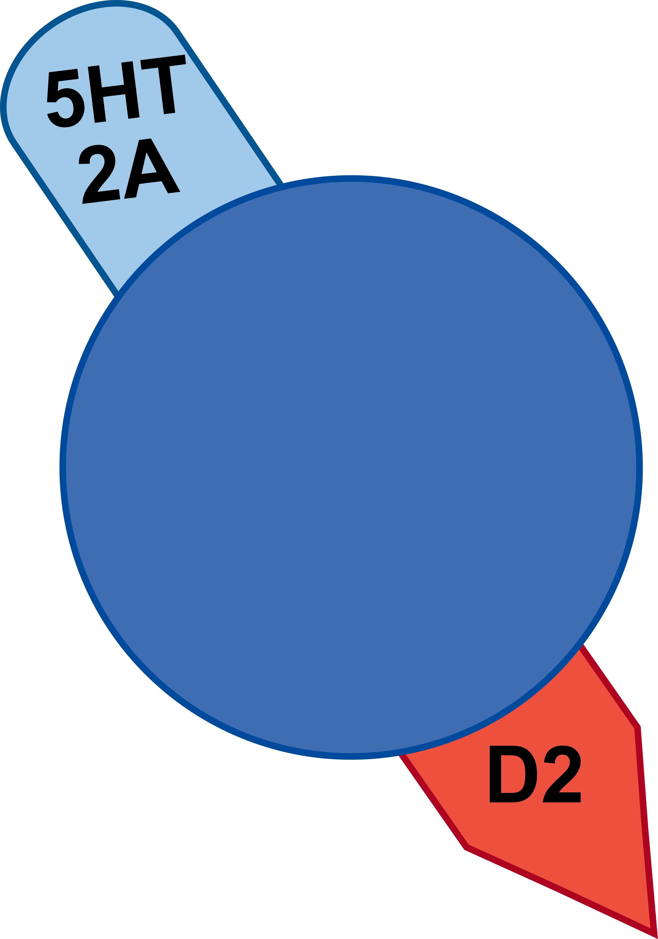
Serotonin/Dopamine Antagonists/Partial Agonists Across the Depression Spectrum
There is a major paradigm shift away from monoamine reuptake inhibitors for depression with mixed features
Serotonin (5HT 2A)/ dopamine (D2) antagonists/ partial agonists are effective at treating: bipolar depression and treatment-resistant depression (TRD)
Several of the agents that are approved for bipolar depression are also effective for depression with mixed features
There are currently no agents approved to treat mixed depression
Serotonin
Dopamine

Slide 16
Second Generation Antipsychotics for Adult Bipolar Disorder (BD)
 | Evidence of Efficacy in Mixed Features | FDA-Approved for BD I Depression | FDA-Approved for BD Mania | FDA-Approved for BD Maintenance | FDA-Approved for MDD
Aripiprazole |  |  |  |  |  (adjunct)
Asenapine |  MMX |  |  | 
Brexpiprazole
Cariprazine |  MMX, DMX |  | 
Lumateperone* |  DMX | 
Lurasidone |  DMX | 
Olanzapine |  MMX |  (with fluoxetine) |  |  |  (with fluoxetine)
Olanzapine-Samidorphan |  |  |  | 
Quetiapine* |  MMX |  |  |  |  (adjunct)
Risperidone |  |  |  | 
Ziprasidone |  MMX |  |  | 
* FDA-Approved for BPII; DMX: depressive mixed state; MMX: mania with mixed features

Slide 17
Mood Stabilizers for Adult Bipolar Disorder
 | Evidence of efficacy in DMX | FDA-approved for BD depression | FDA-approved for BD mania | FDA-approved for BD maintenance | FDA-approved for MDD
Carbamazepine |  |  | 
Lamotrigine |  |  |  | 
Lithium |  |  |  | 
Valproate |  |  | 
No mood stabilizer is approved for use in depression of any kind (unipolar, mixed, bipolar)

Slide 18
Mood Stabilizers for Adult Bipolar Disorder
 | Evidence of efficacy in DMX | FDA-approved for BD depression | FDA-approved for BD mania | FDA-approved for BD maintenance | FDA-approved for MDD
Carbamazepine |  |  | 
Lamotrigine |  |  |  | 
Lithium |  |  |  | 
Valproate |  |  | 
No mood stabilizer is approved for use in depression of any kind (unipolar, mixed, bipolar)
There are some data for the efficacy of lamotrigine or valproate for bipolar depression

Slide 19
Mood Stabilizers for Adult Bipolar Disorder
 | Evidence of efficacy in DMX | FDA-approved for BD depression | FDA-approved for BD mania | FDA-approved for BD maintenance | FDA-approved for MDD
Carbamazepine |  |  | 
Lamotrigine |  |  |  | 
Lithium |  |  |  | 
Valproate |  |  | 
No mood stabilizer is approved for use in depression of any kind (unipolar, mixed, bipolar)
There are some data for the efficacy of lamotrigine or valproate for bipolar depression
Lithium is well known for its anti-suicide effects; however, neither lithium nor carbamazepine monotherapy is recommended for the treatment of bipolar depression

Slide 20
FDA-Approved Treatments for Pediatric Bipolar Disorder
Acute Mania
Year/ Drug
1970 Lithium (Age ≥ 7–17)
2007 Risperidone (Age 10–17)
2008 Aripiprazole ^{(Age 10–17),(}*^{->e)}
2009 Quetiapine (Age 10–17)
Olanzapine (Age 13–17)
2015 Asenapine (Age 10–17)
Acute Bipolar I Depression
Year/ Drug
Olanzapine+fluoxetine
combination (Age 10–17)
2018 Lurasidone(Age 10–17)
Longer-Term
Year/ Drug
1974 Lithium (Age ≥ 7–17)
2008 Aripiprazole ^{(Age 10–17, ->e)}
*Adjunctive (as well as monotherapy);
^{(->e)}Extrapolated indication

Slide 21
FDA-Approved Treatments for Pediatric Bipolar Disorder
Acute Mania
Year/ Drug
1970 Lithium (Age ≥ 7–17)
2007 Risperidone (Age 10–17)
2008 Aripiprazole ^{(Age 10–17),(}*^{->e)}
2009 Quetiapine (Age 10–17)
Olanzapine (Age 13–17)
2015 Asenapine (Age 10–17)
Acute Bipolar I Depression
Year/ Drug
Olanzapine+fluoxetine
combination (Age 10–17)
2018 Lurasidone(Age 10–17)
Longer-Term
Year/ Drug
1974 Lithium (Age ≥ 7–17)
2008 Aripiprazole ^{(Age 10–17, ->e)}
Unmet
Need
(e,g, none approved
for Bipolar II)
Unmet
Need
*Adjunctive (as well as monotherapy);
^{(->e)}Extrapolated indication
Important unmet needs—well-tolerated treatments for acute depression and maintenance

Slide 22
Unmet Needs in the Journey from Diagnosis to Treatment
Screening
  Overdiagnosis versus underdiagnosis?
Diagnosis
  Need to assess for symptoms AND episodes AND disorder criteria
  No available diagnostic test
  Challenging to implement measurement-based care – mood charting
Treatment
  No one size fits all – need personalized treatments
  Few treatments FDA approved for Bipolar II Disorder
  Some treatments may increase risk for mania induction
  Adherence – trial and error can erode patient trust
  Side effects – need better drugs
  Patient centricity

