Slide 1
How Do You Risk Stratify Bipolar I and II Depression?
Joseph Frederic Goldberg, MD
Clinical Professor of Psychiatry
Icahn School of Medicine at Mount Sinai
New York, NY

Slide 2
Disclaimer
The views and opinions expressed in this educational activity are those of the faculty and do not necessarily represent the views of TotalCME, Inc., the CME providers, or the companies providing educational grants. This presentation is not intended to define an exclusive course of patient management; the participant should use their clinical judgment, knowledge, experience, and diagnostic skills in applying or adopting for professional use any of the information provided herein. Any procedures, medications, or other courses of diagnosis or treatment discussed or suggested in this activity should not be used by clinicians without evaluation of their patient's conditions and possible contraindications or dangers in use, review of any applicable manufacturer’s product information, and comparison with recommendations of other authorities. Links to other sites may be provided as additional sources of information.

Slide 3
Bipolar II vs. Bipolar I Clinical Comparisons
Bipolar II vs. Bipolar I:
Longer duration of untreated illness¹
More frequent comorbid anxiety disorders¹
More frequent depressive episodes¹
Longer episode durations¹
Later age at onset¹
Fewer lifetime hospitalizations¹
More frequent antidepressant use¹
Rapid cycling more common in bipolar II than bipolar I²
More residual depressive symptoms in bipolar II than bipolar I associated with greater functional impairment³

Slide 4
Suicide Risk in Bipolar I vs Bipolar II Disorder
Meta-analysis of 24 reports: no significant difference in lifetime suicide attempt prevalence rates in Bipolar I (36.3%) vs. bipolar II (32.4%) (p=0.07)¹
But: bipolar II patients tend to use more violent methods of suicide attempts than bipolar I patients¹
BP II suicide attempters perform more poorly on tests of simple reaction time and executive function (Stroop selective attention) than bipolar I suicide attempters²
Similar risk factors for suicide attempts in bipolar I and bipolar II patients:³
Female sex, history of rapid cycling, comorbid psychiatric/substance use disorders, early age at onset

Slide 5
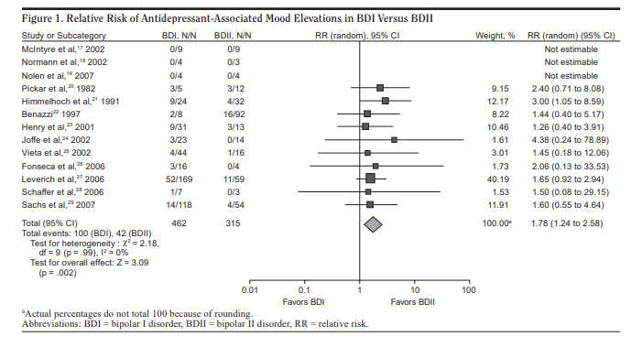
Lower Risk for Antidepressant-Associated Switch in Bipolar II Than Bipolar I Depression

Slide 6
Lower Risk for Antidepressant-Associated Switch in Bipolar II Than Bipolar I Depression

Slide 7
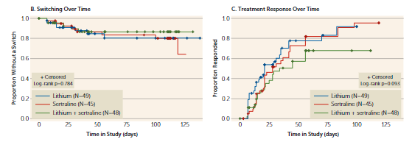
BP II Depression: Antidepressant Response and Switch Rates with Lithium, Sertraline, or Both
Comparable switch rates and response rates across all three groups
Higher dropout rates with combination therapy than either monotherapy

Slide 8
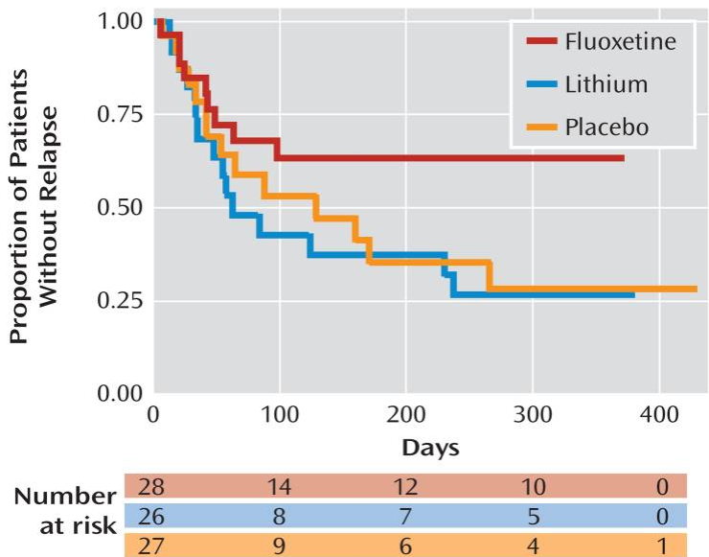
Bipolar II Depression: Better Long-Term Response to Fluoxetine Monotherapy Than Placebo or Lithium
Results pertain to initial fluoxetine responders
- 148 received open label fluoxetine monotherapy for 12 weeks
49.7% recovered and were then randomized to fluoxetine (mean dose 34 mg/day) vs. lithium (mean dose 1027 mg/day, mean serum[Li+]=0.69 mEq/L vs placebo

Slide 9
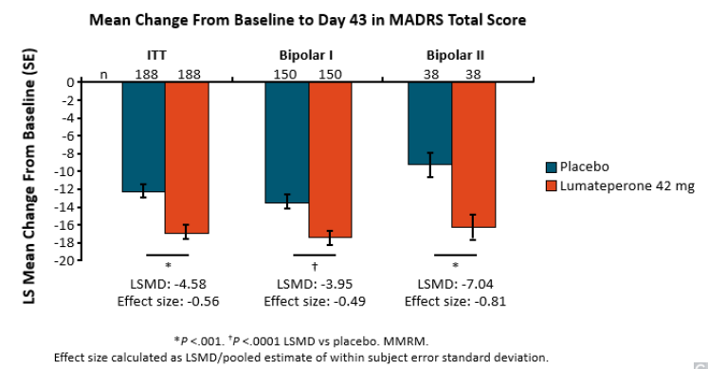
Treatment Response in Bipolar I vs. Bipolar II Depression: Lumateperone

Slide 10
Treatment Response in Bipolar I vs. Bipolar II Depression: Lumateperone

Slide 11
Treatment Response in Bipolar I vs. Bipolar II Depression: Lumateperone

Slide 12
Treatment Response in Bipolar I vs. Bipolar II Depression: Quetiapine
Ratio of estimated % improvement in depressive symptoms vs. placebo greater in Bipolar I (1.56) than Bipolar II (1.22) (p=0.04)
Metaregression model of association of factors with
response to quetiapine vs. placebo for acute major
depressive episodes in bipolar disorder
Summary of meta-analyses of 22 trials of quetiapine vs. placebo
Factor | Slope (95% CI) | Z-score | P-value
Bipolar I >Bipolar II | 2.19 (0.239-4.14) | 2.20 | 0.028
Trial duration (week) | 0.615 (0.235-1.47) | 1.42 | 0.156
Trial size (N) | 0.012 (0.006-0.030) | 1.29 | 0.198
Dose (mg/day) | 0.001 (0.004-0.002) | 0.59 | 0.558
Comparisons | Trials | SMD (95% CI) | Z-score | P-value
All trials | 22 | 1.87 (1.53-2.21) | 10.7 | <0.0001
Diagnosis Bipolar I Bipolar II | 11 11 | 2.35 (1.83-2.86) | 8.96 7.34 | <0.0001 <0.0001
Dose 300 mg/day 600 mg/day | 14 8 | 1.79 (1.37-2.22) 2.00 (1.38-2.62) | 8.26 8.96 | <0.0001 <0.0001

Slide 13
Conclusions
Morbidity, suicide risk and functional impairment in bipolar II disorder is comparable to bipolar I disorder largely due to residential depressive symptoms
Few randomized pharmacotherapy trials exist in bipolar II disorder
Possible lesser risk for antidepressant-associated polarity switches in bipolar II than bipolar I disorder, possible safety and efficacy with fluoxetine monotherapy based on preliminary data
Most robust placebo-controlled findings with lumateperone and quetiapine in bipolar II depression

