Slide 1
Bipolar 1 and 2 Depression: Distilling the Critical Differences
Manpreet Kaur Singh, MD MS
Associate Professor of Psychiatry and Behavioral Sciences
Stanford University
Stanford, CA

Slide 2
Disclaimer
The views and opinions expressed in this educational activity are those of the faculty and do not necessarily represent the views of TotalCME, Inc., the CME providers, or the companies providing educational grants. This presentation is not intended to define an exclusive course of patient management; the participant should use their clinical judgment, knowledge, experience, and diagnostic skills in applying or adopting for professional use any of the information provided herein. Any procedures, medications, or other courses of diagnosis or treatment discussed or suggested in this activity should not be used by clinicians without evaluation of their patient's conditions and possible contraindications or dangers in use, review of any applicable manufacturer’s product information, and comparison with recommendations of other authorities. Links to other sites may be provided as additional sources of information.

Slide 3
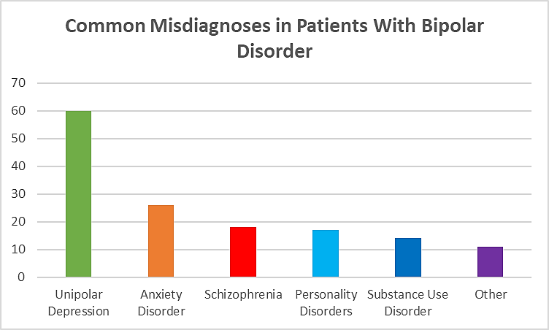
Misdiagnoses and Underdiagnoses Are Common Among Patients With Bipolar Disorder
Up to 60% of depressed patients with BPII are initially diagnosed with unipolar depression
Frequency of Misdiagnosis (%)

Slide 4

Factors That Contribute to Misdiagnosis
Reasons for misdiagnosis:
Incomplete understanding of bipolar disorder by healthcare professionals
Overlooked or no history of mania
Failure to differentiate symptoms that can help identify unipolar and bipolar depression
Misdiagnosis
Bipolar Depression
Consequences of misdiagnosis:
Inappropriate use of antidepressant agents
Increased acute risk of switching from depression to mania/hypomania with antidepressant use
Delay of proper treatment

Slide 5
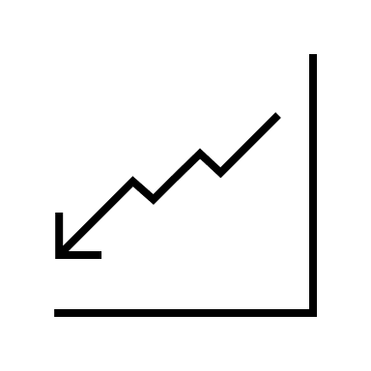

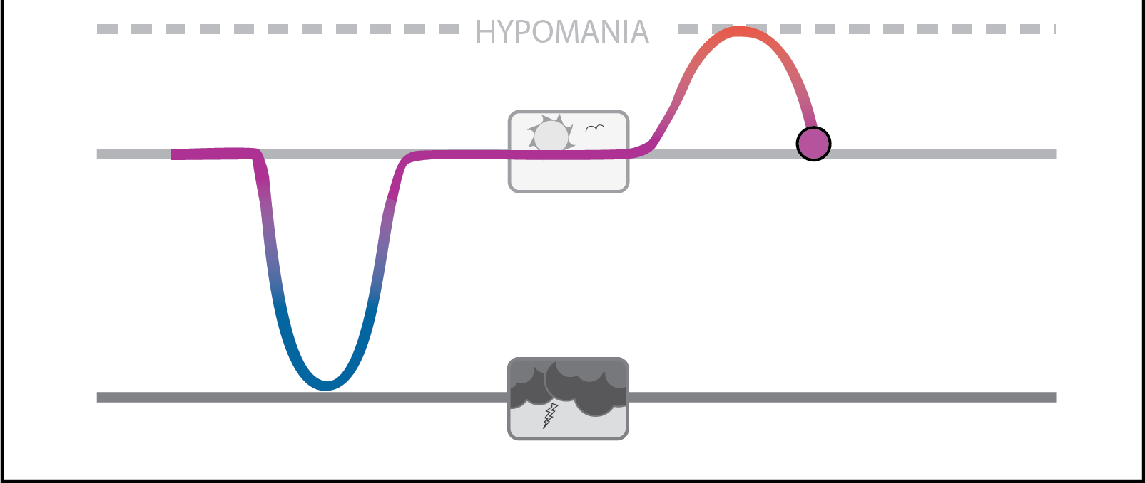



Why Is an Early, Accurate Diagnosis Important to Optimize Outcome?
Consequences of not identifying bipolar depression (BD) early:
Impaired quality of life
Inaccurate and potentially harmful treatment
Increased cycling and risk of relapse
Increased risk of suicide
Increased subsequent morbidity
High economic costs
Overall mortality rate for Bipolar Depression is over 2.5X higher than the general population

Slide 6
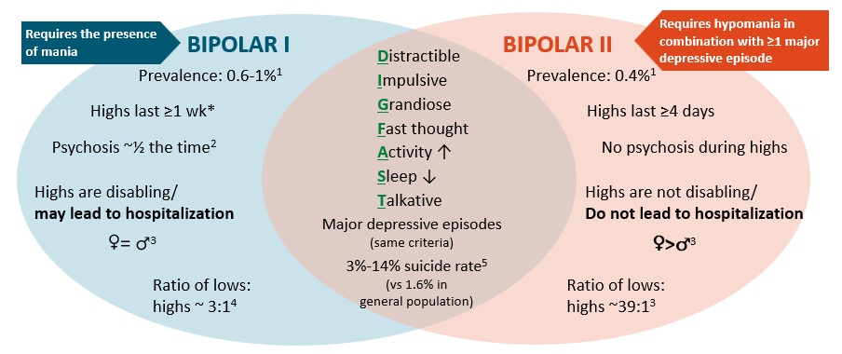
Phenomenology of Bipolar Disorder
*unless hospitalized; wk = week

Slide 7
Diagnostic Criteria for Bipolar II Disorder
DSM-5
A. Criteria have been met for at least one hypomanic episode and at least one major depressive episode.
B. There has never been a manic episode.
C. The occurrence of the hypomanic episode(s) and major depressive episode(s) is not better explained by schizoaffective disorder, schizophrenia, schizophreniform disorder, delusional disorder, or other specified or unspecified schizophrenia spectrum and other psychotic disorder.
D. The symptoms of depression or the unpredictability caused by frequent alternation between periods of depression and hypomania causes clinically significant distress or impairment in social, occupational, or other important areas of functioning.
Specify current or most recent episode: Hypomanic or Depressed
Specify course if full criteria for a mood episode are not currently met: In partial remission In full remission Specify severity if full criteria for a mood episode are met: Mild Moderate Severe
Specify if: With anxious distress With mixed features With catatonia. With mood-congruent psychotic features With peripartum onset With seasonal pattern: Applies only to the pattern of major depressive episodes. With rapid cycling
HYPOMANIC EPISODE:
A distinct period of abnormally and persistently elevated, expansive, or irritable mood and abnormally and persistently increased activity or energy, lasting at least 4 consecutive days and present most of the day, nearly every day.
Impact of the DSM-IV to DSM-5 Changes on the National Survey on Drug Use and Health [Internet]. Substance Abuse and Mental Health
Services Administration. Rockville (MD): Substance Abuse and Mental Health Services Administration (US); 2016 Jun.

Slide 8

Is It Bipolar Depression?
Patients with bipolar depression (BD) typically seek help during depressive, not manic, episodes (mixed features may be present)
Clinicians will first be confronted with differentiating between unipolar and bipolar depression
Is it bipolar depression?
Presence or history of (hypo)mania?
Current hypomania:
BP II with mixed features?
Past hypomania:
BP II depression?
Current mania:
BP I with mixed features?
Past mania:
BP I depression?

Slide 9
Symptoms With Potential Diagnostic Utility in Bipolar and Unipolar Depression: A Probabilistic Approach
Bipolar Depression
Unipolar Depression

Slide 10
Symptoms With Potential Diagnostic Utility in Bipolar and Unipolar Depression: A Probabilistic Approach
Bipolar Depression
Early onset of depression (<25 years)
Multiple prior episodes (≥5)
Positive family history of bipolar disorder
Hypersomnia/increased daytime napping
Hyperphagia/increased weight
Atypical depression signs
Psychomotor retardation
Psychotic features/pathological guilt
Mood lability/irritability/psychomotor agitation/racing thoughts
Post-partum affective symptoms
Substance abuse
Anxiety disorders
Unipolar Depression

Slide 11
Symptoms With Potential Diagnostic Utility in Bipolar and Unipolar Depression: A Probabilistic Approach
Bipolar Depression
Early onset of depression (<25 years)
Multiple prior episodes (≥5)
Positive family history of bipolar disorder
Hypersomnia/increased daytime napping
Hyperphagia/increased weight
Atypical depression signs
Psychomotor retardation
Psychotic features/pathological guilt
Mood lability/irritability/psychomotor agitation/racing thoughts
Post-partum affective symptoms
Substance abuse
Anxiety disorders
Unipolar Depression
Late onset of first depression (>25 years)
Long duration of current episode (>6 months)
Negative family history of bipolar depression
Initial insomnia/reduced sleep
Appetite/weight loss
Normal or increased activity levels
Somatic complaints
Tendency to blame others
Anxiety

Slide 12
Diagnostic Criteria for Major Depressive Disorder
DSM-5
A. Criteria have been met for at least one major depressive episode: Index Mood: sad, empty, hopeless (in kids, can be irritable) plus at least 4/9 of: Sleep: increased or insomnia, Interest: markedly decreased in activities, Guilt: feeling worthless; inappropriate guilt, Energy: fatigue or loss of energy, Concentration: hard to think/concentrate, Appetite: significant weight loss/gain (~5% change), Psychomotor activity: physically slowed or agitated, Suicide: thoughts, attempts, death thoughts;
B. There has never been a manic or hypomanic episode.
C. The occurrence of the major depressive episode(s) is not better explained by schizoaffective disorder, schizophrenia, schizophreniform disorder, delusional disorder, or other specified or unspecified schizophrenia spectrum and other psychotic disorder.
D. The symptoms of depression causes clinically significant distress or impairment in social, occupational, or other important areas of functioning.
E. Episode not attributable to physiological effects of a substance or another medical condition.
Specify current or most recent episode: Depressed, Recovered, Remitted (partially, fully); mixed features, anxious distress
Specify course if full criteria for a mood episode are not currently met: In partial remission In full remission Specify severity if full criteria for a mood episode are met: Mild Moderate Severe
Specify if: With anxious distress With mixed features With catatonia. With mood-congruent psychotic features With peripartum onset With seasonal pattern: Applies only to the pattern of major depressive episodes
MAJOR DEPRESSIVE EPISODE:
A distinct period of abnormally and persistently sad/anhedonic, (irritable in kids) mood lasting at least 2 consecutive weeks present most of the day, nearly every day.
Mixed episode or bereavement are no longer exclusionary.
Impact of the DSM-IV to DSM-5 Changes on the National Survey on Drug Use and Health [Internet]. Substance Abuse and Mental Health
Services Administration. Rockville (MD): Substance Abuse and Mental Health Services Administration (US); 2016 Jun.

Slide 13
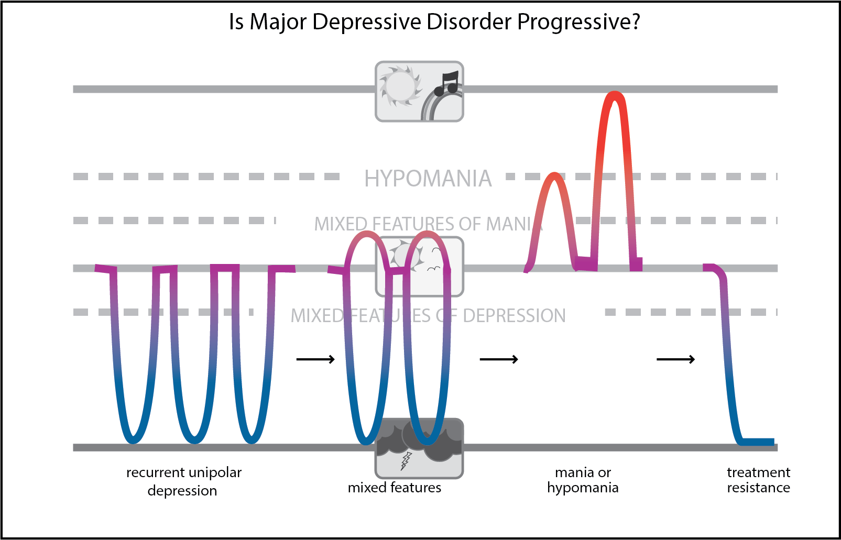
Can Unipolar Depression Convert to Bipolar Depression?

Slide 14
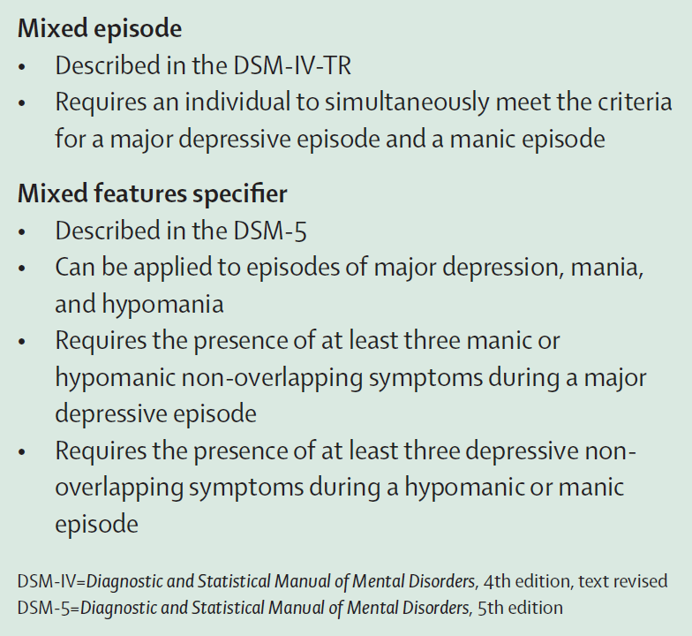
The “Five A’s” Increase Suspicion of Mixed Features
Anxiety
Agitation
Anger/irritability
Attentional disturbance-distractibility
Anhedonia
% of Individuals Who Met Criteria for Mixed Features During an Index Major Depressive Episode
Percentage (%)
*Data from a post hoc analysis of participants who met criteria for a current mood episode as part of MDD (n=506) or BD (BD-I: n=216, BD-II: n=130)

Slide 15
Conclusions
Up to 60% of patients with bipolar depression are misdiagnosed with unipolar depression
There are many factors and challenges that contribute to misdiagnosis of bipolar disorder
Being able to diagnose bipolar disorder with accurate screening and comprehensive assessment for hypomania/mania will improve outcomes

