Slide 1
Bringing it All Together: Real-World Data in Anticoagulation Reversal
Mark Crowther, MD, MSc, FRCPC, FRSC Chair, Department of Medicine Leo Pharma Chair in Thromboembolism Research McMaster University Hamilton, Ontario, Canada
Paul P. Dobesh, PharmD, FAHA, FACC, FCCP, BCPS, BCCP Professor of Pharmacy Practice and Science College of Pharmacy, University of Nebraska Medical Center Omaha, NE

Slide 2
Disclaimer
The views and opinions expressed in this educational activity are those of the faculty and do not necessarily represent the views of TotalCME, Inc., the CME providers, or the companies providing educational grants. This presentation is not intended to define an exclusive course of patient management; the participant should use their clinical judgment, knowledge, experience, and diagnostic skills in applying or adopting for professional use any of the information provided herein. Any procedures, medications, or other courses of diagnosis or treatment discussed or suggested in this activity should not be used by clinicians without evaluation of their patient's conditions and possible contraindications or dangers in use, review of any applicable manufacturer’s product information, and comparison with recommendations of other authorities. Links to other sites may be provided as additional sources of information.

Slide 3
4F-PCC Versus Andexanet Alfa for ICH
Study | Barra 2020 (n=29) | Ammar 2021 (n=44) | Pham 2022 (n=109)
Study design | Retrospective single center | Retrospective single center | Retrospective health system
Reversal agents | Andexanet alfa (n=18) vs. 4F-PCC (n=11) | Andexanet alfa (n=28) vs. 4F-PCC (n=16) | Andexanet alfa (n=47) vs. 4F-PCC (n=62)
Effective hemostasis at 24 hours | Good/effective: 89% andexanet alfa vs. 60% 4F-PCC | Stable head CT at 6 post dose: 78% andexanet alfa vs. 71% 4F-PCC 24 hours = 88% vs. 60% | Excellent: 71% andexanet alfa vs. 71% 4F-PCC
Thrombotic events | 16.7% andexanet alfa vs. 9.1% 4F-PCC | 7% andexanet alfa vs. 0% 4F-PCC | 8.5% andexanet alfa vs. 9.7% 4F-PCC
Mortality | In-hospital mortality: 22% andexanet alfa vs. 64% 4F-PCC | Death or hospice at discharge: 39% andexanet alfa vs. 38% 4F-PCC | In-hospital mortality: 34% andexanet alfa vs. 21% 4F-PCC
4F-PCC, four factor prothrombin complex concéntrate; CT, computed tomography; ICH, intracerebral brain hemorrhage; .
Barra ME, et al. J Thromb Haemost. 2020;18:1637-47; Ammar AA, et al. Neurocrit Care. 2021;35:255-61. Pharm H, et al. Am J Emerg Med. 2022;55:38-44.

Slide 4
Adjusted Analysis of Factors Associated With In-Hospital Mortality Risk
Factor
Adjusted OR (95% CI)
Reversal agent
Treatment with andexanet alfa demonstrated a 31% lower likelihood of death compared to 4F-PCC (OR, 0.69; 95% CI, 0.49-0.98)
Factors associated with higher odds of death included ICH (vs. GI bleed), presence of chronic kidney disease, impaired mental status, and a do not resuscitate order
Andexanet alfa (vs 4F-PCC)
0.69 (0.49, 0.98)
Anticoagulant use
Oral FXa inhibitor (vs enoxaparin)
1.26 (0.86, 1.87)
Subtype
ICH (vs GI bleed)
3.46 (2.35, 5.16)
Critical compartment (vs GI bleed)
0.93 (0.42, 1.87)
Other (vs GI bleed)
2.28 (0.61, 6.72)
Bleed cause
Trauma (vs spontaneous)
1.36 (0.96, 1.94)
Patient characteristics
Age (per year)
1.01 (1.00, 1.02)
Male (vs female)
1.10 (0.78, 1.55)
Systolic BP (per mmHg)
1.00 (1.00, 1.01)
Impaired mental status (vs none)
4.62 (3.03, 7.26)
Do not resuscitate order (vs no)
3.28 (2.29, 4.74)
Comorbid conditions
Liver disease (vs no)
1.23 (0.78, 1.88)
Chronic kidney disease (vs no)
2.00 (1.38, 2.88)
Heart failure (vs no)
1.15 (0.79, 1.66)
Diabetes (vs no)
1.02 (0.72, 1.45)
Oral anticoagulant
8-18 hrs since oral anticoagulant (vs >18 hrs)
1.51 (0.92, 2.55)
<8 hrs since oral anticoagulant (vs >18 hrs)
1.41 (0.86, 2.38)
*Model adjusted for all the variables above (N=2,548; events=184).
BP, blood pressure; CI, confidence interval; GI, gastrointestinal; OR, odds ratio.
Dobesh P, et al. ISTH 2022 Congress. Abstract PB1011.

Slide 5
Guidelines and Stewardship
Guidelines and stewardship programs should address the following:
Which patients should receive these reversal agents?
Which agents does your institution carry on formulary?
Do you limit to life-threatening bleeding? How do you define that?
Should you treat the abnormal coagulation tests?
What about goals of care/expected outcomes?
What about urgent surgery? Elective surgery?
When should labs be drawn to assess effect?
When should anticoagulation be restarted?
Multi-disciplinary discussion in conjunction with goals of care

Slide 6
Andexanet Alfa Clinical Considerations
Outside hospital transfer s/p PCC treatment
Hematoma expansion on CT
Anti-Xa (LMWH/UFH) level remains elevated
Elevated standard coagulation tests versus chromogenic drug levels
Anti-Xa (LMWH/UFH) versus drug concentration
Not indicated unless evidence of bleeding/expansion
Doses of factor Xa inhibitor greater than 18 hours prior
Life threatening bleeding on direct or indirect factor Xa inhibitors other than apixaban or rivaroxaban (edoxaban, betrixaban, LMWH, fondaparinux)
LMWH, low molecular weight heparin; s/p, status post; UFH, unfractionated heparin.

Slide 7
The Balance
RWD gives information on how and why the intervention is being used and provides good estimates of the outcome
CTD provides much more useful data on the specifics of the treatment, including how well it works and the high-frequency side effects of the treatment

Slide 8
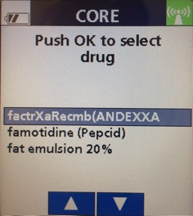
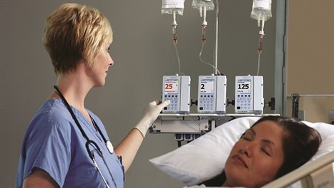
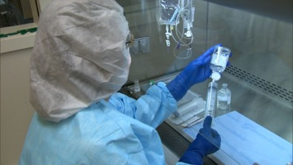
Time Frame for Establishing Hemostasis
Minutes | Hours | Days
Trauma, ICH patients on anticoagulation (AC) | Bleeding with Hemodynamic Changes | Bleeding
Hold anticoagulant & give a reversal agent Send laboratory analysis for baseline values and if necessary to modify therapy Initiate prior to lab being drawn or resulted | Hold anticoagulant & consider a reversal agent if expedited reversal is necessary Topical hemostatic agents may be used in select situations Supportive care: IV fluids, compression Send laboratory analysis for baseline values and if necessary to modify therapy, initiate prior to lab being drawn or resulted | Hold the anticoagulant Lab tests & reassess bleeding risks Supportive care
Time Verified to Delivery (Minutes)
30.9 Minutes
AC, anticoagulant; ICH, intracerebral hemorrhage.

