Slide 1

What Future Studies Are Out There on The Meaningfulness of Reversal in ICH?
Mark Crowther, MD, MSc, FRCPC, FRSC Chair, Department of Medicine Leo Pharma Chair in Thromboembolism Research McMaster University Hamilton, Ontario, Canada

Slide 2
Disclaimer
The views and opinions expressed in this educational activity are those of the faculty and do not necessarily represent the views of TotalCME, Inc., the CME providers, or the companies providing educational grants. This presentation is not intended to define an exclusive course of patient management; the participant should use their clinical judgment, knowledge, experience, and diagnostic skills in applying or adopting for professional use any of the information provided herein. Any procedures, medications, or other courses of diagnosis or treatment discussed or suggested in this activity should not be used by clinicians without evaluation of their patient's conditions and possible contraindications or dangers in use, review of any applicable manufacturer’s product information, and comparison with recommendations of other authorities. Links to other sites may be provided as additional sources of information.

Slide 3
Introduction
RWD studies are generally divided by whether they are “registered”
Unregistered, (usually) single-center studies vastly outnumber registered, (frequently) multicenter studies
As noted previously, the range of outcomes that can be directly addressed in large RWD studies is limited since they are restricted to “the data at hand” that is collected in the data sweep
Single-center or small studies can often contain more data because they can review specific outcomes from specific patient charts
RWD, real world data.

Slide 4
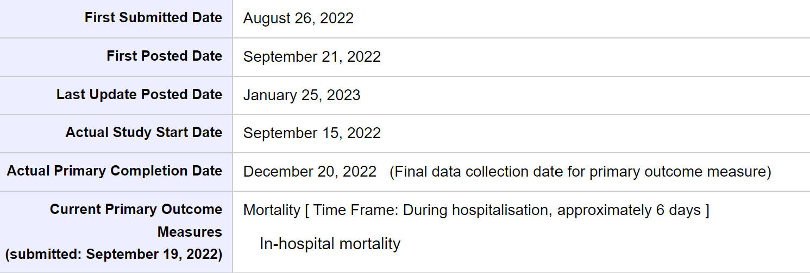
Ongoing Large Studies
Andexanet Alfa and 4F-PCC Use in Patients Hospitalized with an Anticoagulant-Related Major Bleed
EMR-based review of patients who receive andexanet alfa compared with 4-factor PCC examining outcomes including mortality and length of stay
Should report data shortly, and the database is said to be freely available
EMR, electronic medical record; PCC, prothrombin complex concentrate.
Costa OS, et al. Crit Care. 2022;26(1):180.

Slide 5
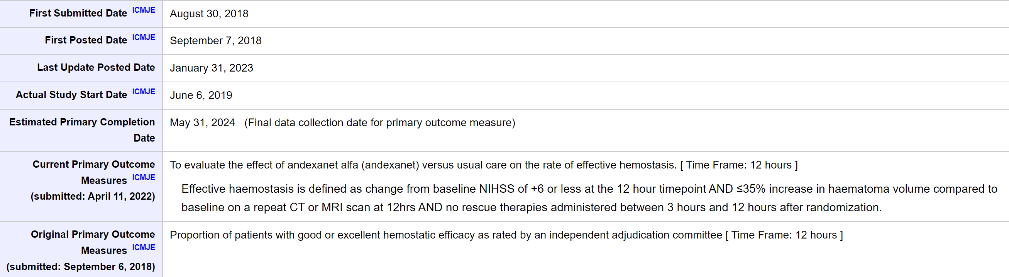
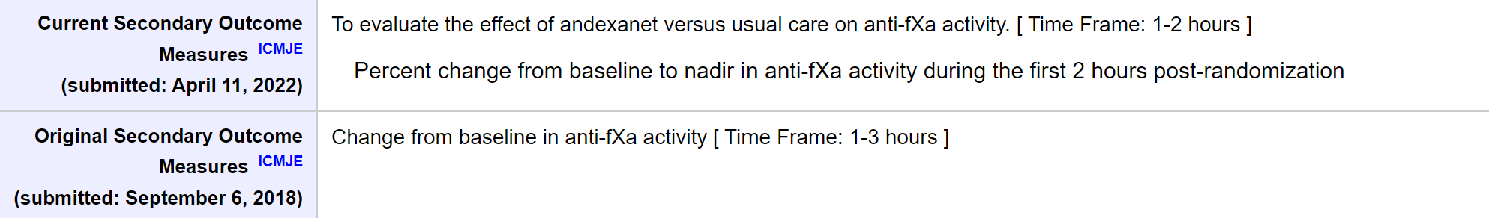
Ongoing Large Studies
Prospective randomized
Multicenter clinical trial
Determine the efficacy and safety of andexanet alfa compared to usual care in patients presenting with acute intracranial hemorrhage within 6 hours of symptom onset to baseline scan and within 15 hours of taking an oral factor Xa inhibitor
Open label (PROBE) design
Between 900 and 1200 patients are planned to be enrolled in the study
Trial of Andexanet Alfa in ICH Patients Receiving an Oral FXa Inhibitor
ICH, intracerebral brain hemorrhage.

Slide 6
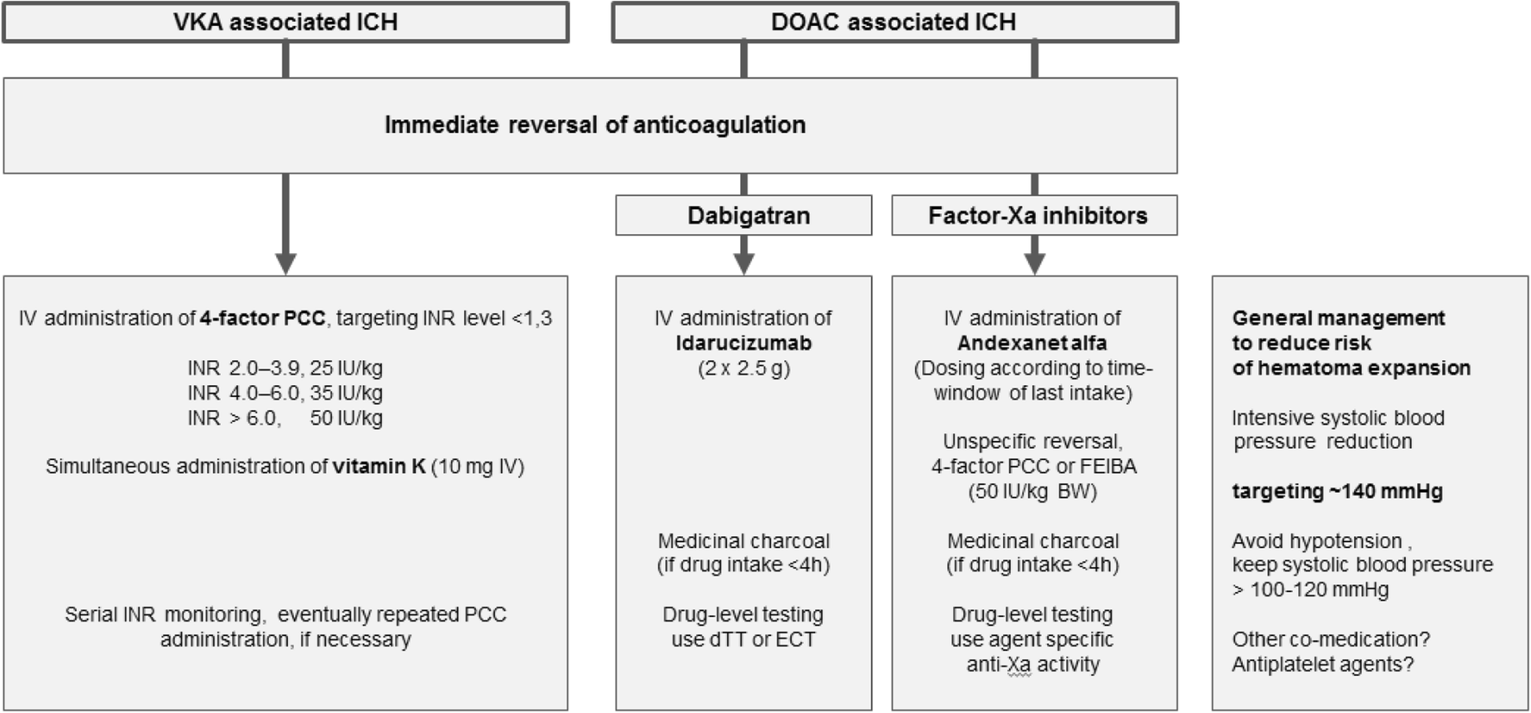
The Other Kind of Study: Reversal of Oral Anticoagulation in Patients with Acute Intracerebral Hemorrhage
VKA-ICH management: immediate reversal of elevated levels of international normalized ratio using prothrombin complex concentrates
Hemostatic management of DOAC-associated ICH requires specific antidotes
DOAC, direct oral anticoagulant; VKA, vitamin K agonist.
Kuramatsu JB, et al. Crit Care. 2019;23(1):206.

Slide 7
Andexanet Alfa After 4-factor PCC Administration for Intracranial Hemorrhage: A Case Series
Optimal reversal agent for factor Xa-inhibitors:
Lack of comparative data of andexanet alfa (AA) to 4-factor prothrombin complex concentrate (4F-PCC)
Institutional formulary restrictions
Navigation of clinical scenarios involving patients clinically worsen despite initial reversal efforts
The combination of 4F-PCC and AA has not been evaluated in clinical trials
Unknown outcomes of patients with FXa-inhibitor associated intracranial hemorrhage (ICH)
Patients received 4F-PCC prior to AA for FXa-inhibitor associated ICH (N=5)
n = 3 apixaban, n = 2 rivaroxaban; n = 4 ICH, n = 1 TBI
Doses: 4F-PCC ranged from 25 to 60 units/kg - administered within a range of 1.5-4.2 h prior to AA.
One patient required surgical intervention with craniotomy
Three patients underwent external ventricular drain placement. Two of the five patients developed an ischemic or thromboembolic complication within one week from 4F-PCC and AA administration
The results highlight the potentially increased thrombotic risk associated with combination use
Case series where 4F-PCC and AA were both administered for FXa-inhibitor associated ICH
For guideline consensus, it is vital to gather data in ongoing real patient cases. Data collection will also help with prioritizing initial reversal efforts and patient management during the bleed
Increased thrombotic risk associated with combination use
4F-PCC, four factor prothrombin complex concentrate; AA, andexanet alfa; TBI, traumatic brain injury.
Bradshaw PG, et al. J Thromb Thrombolysis. 2022;54(2):295-300.

