Slide 1

Real World Data and Quality of Evidence in Reversing Anticoagulation:
We Believe!
Paul P. Dobesh, Pharm. D. FAHA, FACC, FCCP, BCPS, BCCP
Professor of Pharmacy Practice and Science
College of Pharmacy, University of Nebraska Medical Center
Omaha, NE

Slide 2
Disclaimer
The views and opinions expressed in this educational activity are those of the faculty and do not necessarily represent the views of TotalCME, Inc., the CME providers, or the companies providing educational grants. This presentation is not intended to define an exclusive course of patient management; the participant should use their clinical judgment, knowledge, experience, and diagnostic skills in applying or adopting for professional use any of the information provided herein. Any procedures, medications, or other courses of diagnosis or treatment discussed or suggested in this activity should not be used by clinicians without evaluation of their patient's conditions and possible contraindications or dangers in use, review of any applicable manufacturer’s product information, and comparison with recommendations of other authorities. Links to other sites may be provided as additional sources of information.

Slide 3





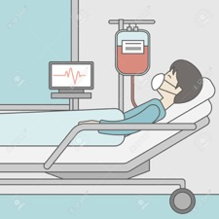
Anticoagulant Stewardship: Value-Added Service
Stewardship Structure
Anticoagulation Reversal Management
  Andexanet, Idarucizumab
Clotting Factor Management
  Ensure appropriate use of agents (i.e., aPCC, PCC, VIIa, VIII, IX, etc)
Anticoagulation Management of Mechanical Circulatory Support Devices
  ECMO, TAH, VAD
Direct Thrombin Inhibitor Management
  Updated Heparin-Induced Thrombocytopenia Guidelines
Hospital Administration
Prescriber
Hemostatic and Antithrombotic Stewardship
Hematology
Cardiology
Pharmacy
Patient
Pharmacy and Therapeutics Committee
aPCC, activated prothrombin complex concentrate; ECMO, extracorporeal membrane oxygenation; PCC, prothrombin complex concentrate; TAH, total artificial heart; VAD, ventricular assist device.
Amerine LB. Am J Health-Syst Pharm. 2015;72:1579-84; Padron M, et al. J Pharm Practice. 2015; 23:93-8; Ritchie BM. J Thromb Thrombolysis. 2016.42;616-22; Burnett A. J Thromb Thrombolysis. 2016:42:471-8; Wychowski MK. J Thromb Thrombolysis. 2017:43:380-6.

Slide 4
Guidelines for Reversal of Factor Xa Inhibitors for Major Bleeding
2020 ACC Expert Consensus Decision Pathway | Anticoagulation Forum Guidance Document 2019 | AHA/ACC/HRS AF Guidelines 2019 | American College of Emergency Physicians 2019
Administer andexanet alfa If andexanet alfa is not available, administer 4F-PCC or aPCC Consider activated charcoal for known recent ingestion (within 2-4 h) | Rivaroxaban and apixaban major bleeding – Suggest andexanet alfa; if not available, suggest 4F-PCC 2000 units Edoxaban or betrixaban-associated major bleeding - Suggest high-dose andexanet alfa or 4F-PCC 2000 units | Andexanet alfa can be useful for the reversal of rivaroxaban and apixaban in the event of life-threatening or uncontrolled bleeding (COR IIa, B-NR) | Tier 1: andexanet alfa if <18 h from last dose Tier 2: suggest 4F-PCC only if first-line reversal agents (eg, andexanet alfa) unavailable
4F-PCC, four factor prothrombin complex concentrate; ACC, American College of Cardiology; AF, atrial fibrillation; AHA, American Heart Association; B-NR, level B nonrandomized; COR, class of recommendation; HRS, Heart Rhythm Society.
Tomaselli GF, et al. J Am Coll Cardiol. 2020;76(5):594-622; Cuker A, et al. Am J Hematol. 2019;94(6):697-709;
January CT, et al. Heart Rhythm. 2019;16(8):e66-e93; Baugh CW, et al. Ann Emerg Med. 2020;76(4):470-85.

Slide 5

The Joint Commission
All Elements of Performance (EPs) have been updated to include DOACs,
and EP2 is specifically focused on reversal.
National Patient Safety Goal 03.05.01
EP1 | Protocols for anticoagulant use
EP2 | The hospital uses approved protocols and evidence-based practice guidelines for reversal of anticoagulation and management of bleeding events related to each anticoagulant medication
EP3 | Protocols for perioperative management of anticoagulants
EP4 | Policy related to baseline and ongoing laboratory monitoring of anticoagulants
EP5 | Monitoring and making adjustment to anticoagulant medication use process
EP6 | Anticoagulant education

Slide 6
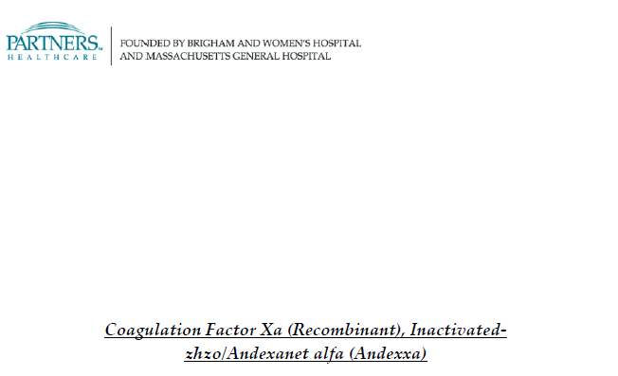
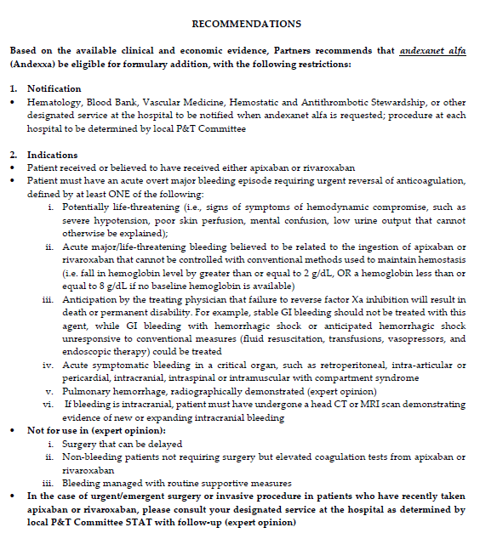
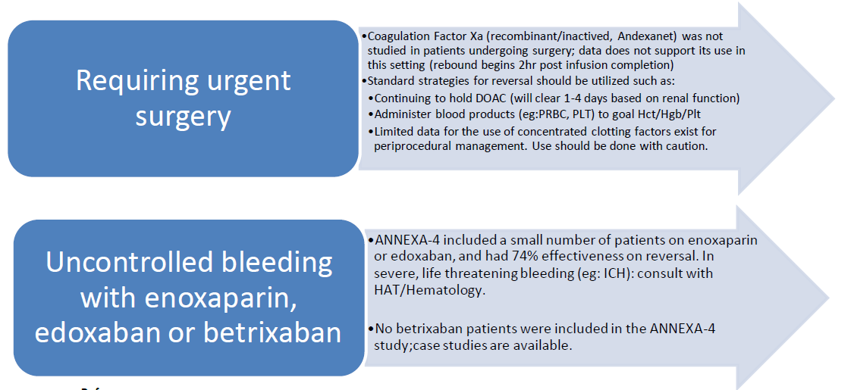
Health System Academic Review
System Recommendations
Local Guidelines
Bleeding:
With an anticoagulant (FXa) therapy,
In a critical space,
With hypotension,
And other measures have failed,
And the patient may die
Internal documents from Brigham and Women’s Hospital.

Slide 7
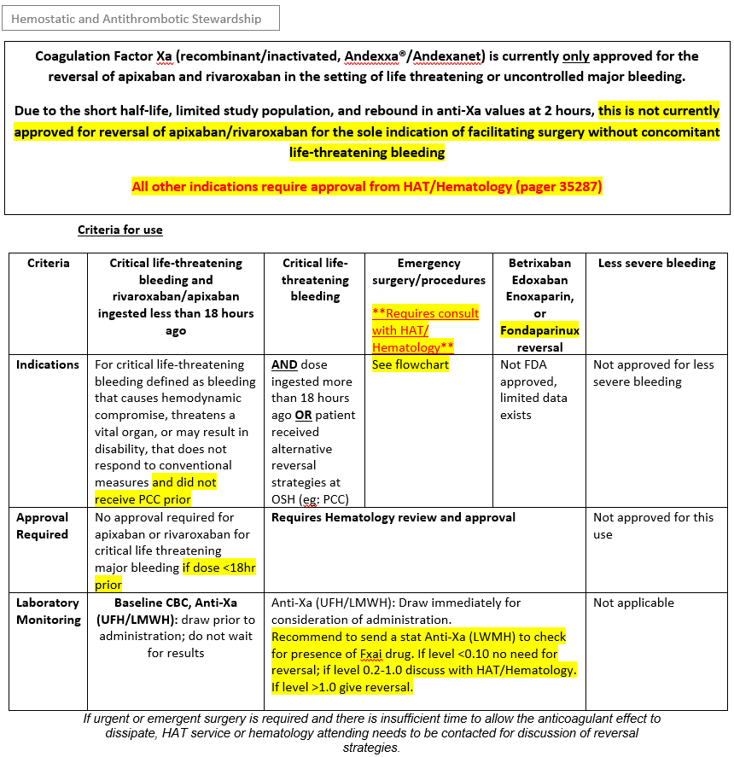
Andexanet Alfa Criteria for Use Document
FDA, Food and Drug Administration; HAT, Hematology and Transplant; LMWH, low molecular weight heparin; OSH, outside hospital; UFH, unfractionated heparin.

Slide 8
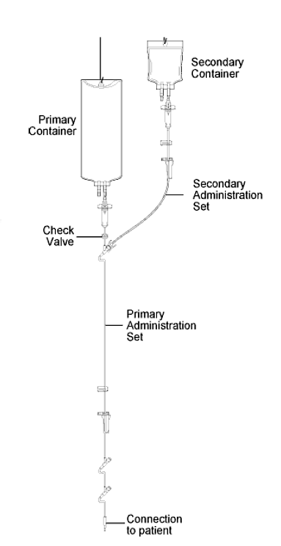
Coagulation Factor Xa (Recombinant) Inactivated-zhzo Drug Administration Guidelines
Administration Guidelines
Andexanet alfa should be run as a secondary infusion to ensure the entire dose is cleared from the tubing and administered to patient at the appropriate rate
For low dose administration, program pump as follows:
  Bolus dose (400mg over 15 minutes)
    Enter total VTBI of 58 mL
    This will increase the rate of infusion to administer the entire 400 mg dose/40 mL dose and the 18 mL primary tubing priming volume (total VTBI of 58 mL) in 15 minutes
  Maintenance dose (480mg over 2 hours)
    Enter total VTBI is 66 mL
    This will increase the rate of infusion to administer the entire 480 mg / 48 mL dose and the 18 mL primary tubing priming volume (total VTBI 66 mL) over 2 hours
  After the end of infusion, flush the line with 48 mL of NS
NS, normal saline; VTBI, volume to be infused.
IvyLeagueNurse. Accessed Mar 2023. www.ivyleaguenurse.com

Slide 9
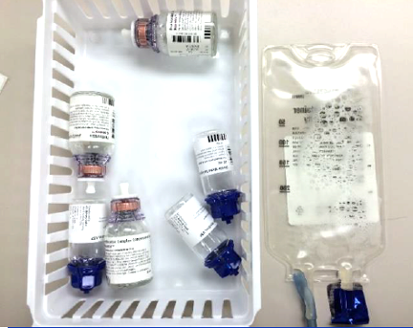
Getting the Medication to the Patient
Patient arrives
Situation assessed, medication history, last dose, labs
Utilize multidisciplinary
institution-developed guidelines
Decision to treat
Correct medication and dose ordered
Pharmacist reviews and processes the order
Pharmacist alerts technicians of the medication processed
to be started in production
Medication delivered immediately upon completion to patient for administration
Medication administered

Slide 10
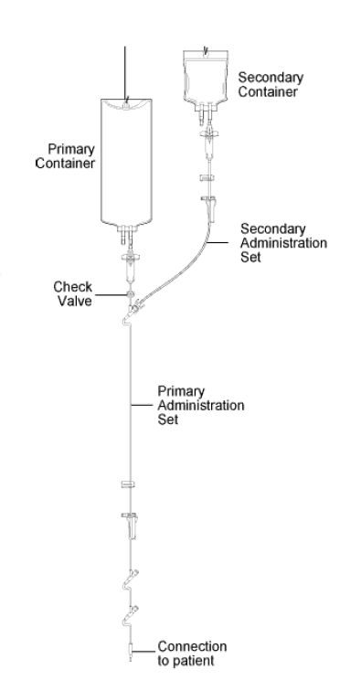
Primary Versus Secondary Lines
Primary Infusion
Secondary Infusion
Generally used for continuous IV Fluids or medication infusions at a set rate
Larger volume infusions
Length of tubing determines amount of drug sequestered
  At BWH ~ 18 mL of tubing
Generally used for intermittent medications with a discrete volume/dose
Administered via a secondary line connected to the primary tubing
If infused through the primary line only, then the line cannot be flushed and part of the dose stays in the tubing
Once secondary bag empty, automatically switches over to the primary bag and “flushes” the remaining drug from the tubing
BWH, Brigham and Women’s Hospital; IV, intravenous.
IvyLeagueNurse. Accessed Mar 2023. www.ivyleaguenurse.com.

Slide 11

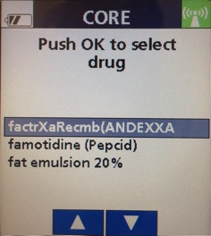


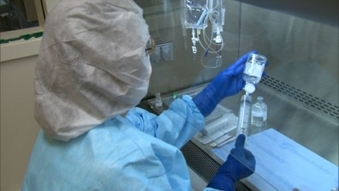
Time Frame for Establishing Hemostasis
Minutes | Hours | Days
Trauma, ICH patients on anticoagulation (AC) | Bleeding with Hemodynamic Changes | Bleeding
Hold anticoagulant & give a reversal agent Send laboratory analysis for baseline values and if necessary to modify therapy Initiate prior to lab being drawn or resulted | Hold anticoagulant & consider a reversal agent if expedited reversal is necessary Topical hemostatic agents may be used in select situations Supportive care: IV fluids, compression Send laboratory analysis for baseline values and if necessary to modify therapy, initiate prior to lab being drawn or resulted | Hold the anticoagulant Lab tests & reassess bleeding risks Supportive care
Time Verified to Delivery (Minutes)
30.9 Minutes
AC, anticoagulant; ICH, intracerebral hemorrhage.

Slide 12
Guidelines and Stewardship
Guidelines and stewardship programs should address the following:
Which patients should receive these reversal agents?
Which agents does your institution carry on formulary?
Do you limit to life-threatening bleeding? How do you define that?
  Should you treat the abnormal coagulation tests?
What about goals of care/expected outcomes?
What about urgent surgery? Elective surgery?
When should labs be drawn to assess effect?
When should anticoagulation be restarted?
Multi-disciplinary discussion in conjunction with goals of care

Slide 13
Andexanet Alfa Clinical Considerations
Outside hospital transfer s/p PCC treatment
  Hematoma expansion on CT
  Anti-Xa (LMWH/UFH) level remains elevated
Elevated standard coagulation tests versus chromogenic drug levels
  Anti-Xa (LMWH/UFH) versus drug concentration
  Not indicated unless evidence of bleeding/expansion
Doses of factor Xa inhibitor greater than 18 hours prior
Life threatening bleeding on direct or indirect factor Xa inhibitors other than apixaban or rivaroxaban (edoxaban, betrixaban, LMWH, fondaparinux)
CT, computed tomography; s/p, status post.

