Slide 1

What Novel Combination Strategies Are Being Studied for ADCs in Urothelial Cancer?
Petros Grivas, MD PhD
Professor, Dept. of Medicine, Division of Medical Oncology
Clinical Director, Genitourinary Cancers Program
University of Washington
Professor, Clinical Research Division
Fred Hutchinson Cancer Center
Seattle, WA
@PGrivasMDPhD

Slide 2
Disclaimer
The views and opinions expressed in this educational activity are those of the faculty and do not necessarily represent the views of TotalCME, Inc., the CME providers, or the companies providing educational grants. This presentation is not intended to define an exclusive course of patient management; the participant should use their clinical judgment, knowledge, experience, and diagnostic skills in applying or adopting for professional use any of the information provided herein. Any procedures, medications, or other courses of diagnosis or treatment discussed or suggested in this activity should not be used by clinicians without evaluation of their patient's conditions and possible contraindications or dangers in use, review of any applicable manufacturer’s product information, and comparison with recommendations of other authorities. Links to other sites may be provided as additional sources of information.

Slide 3
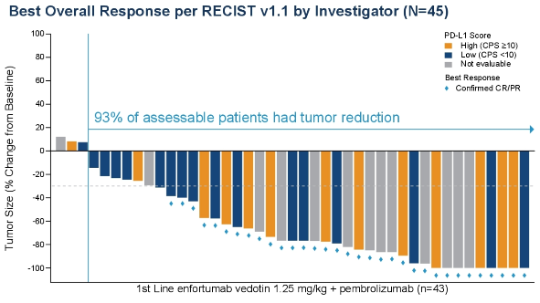
EV-103: Phase 1b/2 Trial of EV + Pembrolizumab
Cohort A
Patients with 1L cisplatin-ineligible
la/mUC (N=45)
Confirmed ORR 95% CI | 73% (33/45) (58.1, 85.4)
Complete response | 16% (7/45)
Partial response | 58% (26/45)
57% confirmed ORR in patients with liver metastases
Dose escalation
EV + pembro
(n=5)
Dose expansion cohort A
EV + pembro
(n=40)
Maximum Target Lesion Reduction from Baseline by PD-L1 Status
EV 1.25 mg/kg days 1 and 8
of a 3-week cycle
+
Pembrolizumab 200 mg on day 1
of a 3-week cycle
84% of patients had visceral disease, and 31% had liver metastasis
31% of patients had PD-L1 CPS ≥10

Slide 4
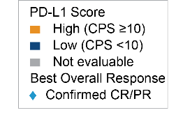
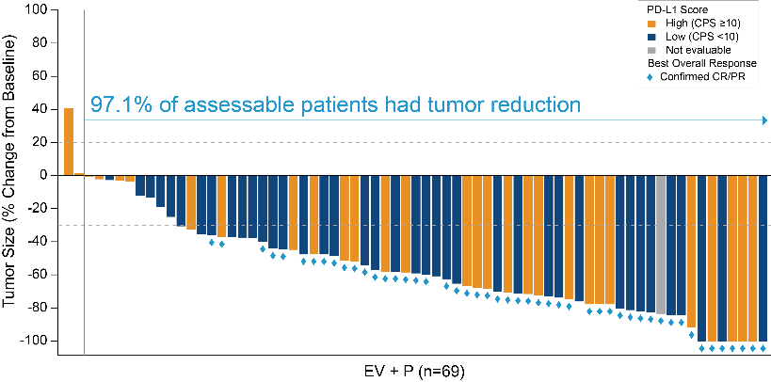


EV+P: Maximum Percent Reduction From Baseline of Target Lesion by BICR
Activity seen regardless of PD-L1 status
  27/44 (61.4%) cORR in CPS<10
                21/31 (67.7%) cORR in CPS≥10

Slide 5


EV-302: Randomized Phase 3 Trial of Enfortumab Vedotin + Pembrolizumab Versus Chemotherapy
Enfortumab vedotin
(Days 1 and 8)
+
Pembrolizumab
(Day 1)
Every 3-week cycle
Primary Objectives
PFS per RECIST by central review
OS
Secondary Objectives
PFS per RECIST by investigator
ORR
DOR
  DCR
  QOL
  Safety and tolerability
Key eligibility criteria:
Untreated locally advanced or metastatic urothelial cancer
Eligible for platinum-based chemotherapy and for pembrolizumab
1:1 randomization
Gemcitabine
(Days 1 and 8)
+
Cisplatin or Carboplatin
(Day 1)
Every 3-week cycle

Slide 6

TROPHY U-01: Sacituzumab Govitecan Multi-Cohort Trial in mUC
Cohort | Study population | Treatment
Cohort 1
(2L+)
After platinum-based chemo & anti-PD-1/L1 therapy
SG 10 mg/Kg IV on Days 1 and 8 of a 21-day cycle
Cohort 2
(2L)
Ineligible for platinum-based chemo; after anti-PD-1/L1 based therapy
SG 10 mg/Kg IV on Days 1 and 8 of a 21-day cycle
Cohort 3
(2L)
Progression after platinum-containing chemo in metastatic setting (CPI-naïve patients)
SG 10 mg/Kg IV on Days 1 and 8 of a 21-day cycle + Pembrolizumab 200 mg IV on Day 1 of a 21‑day cycle
Cohort 4
(1L)
Treatment naïve in metastatic/unresectable locally advanced setting
Cis + SG
(6 cycles)
SG+ Avelumab maintenance
Cohorts 5 & 6 Pending
Cohort 5
(1L)
Cis + SG + Avelumab (6 cycles)
SG+ Avelumab maintenance
Treatment naïve in metastatic/unresectable locally advanced setting
Key Inclusion Criteria:
ECOG PS 0-1
C1-C3: Creatinine clearance ≥30 mL/min; C4: Creatinine clearance ≥50 mL/min
Adequate organ function & stable brain metastases

Slide 7
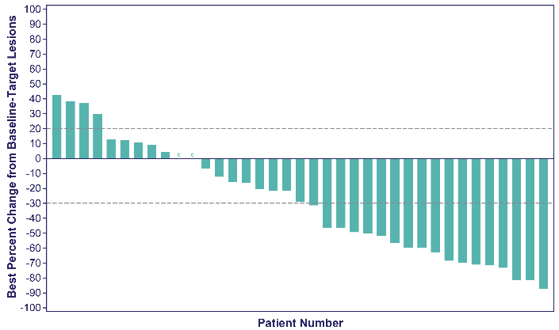
Overall Response and Best % Change From Baseline in Tumor Size
Median follow-up: 5.8 months (data cutoff date: 2021-09-24)
Median time to response: 2 months (1.3–2.8; n=14)
Median DOR not yet reached: N/A (2.80-N/A)
Median PFS (95% CI), 5.5 months (1.7–NR); median OS, not reached
 | Cohort 3ª (N=41)
Objective response rate (CR + PR), n (%) [95%CI] | 14 (34) [20.1-50.6]
Objective response rate (CR + PR), evaluable patients, n (%) | 14 (38)
Best overall response, n (%)
CR | 1 (2)
PR | 13 (32)
SD | 11 (27)
SD ≥ 6 months | 4 (10)
PD | 12 (29)
Not assessed | 4 (10)
Clinical Benefit Rate (CR + PR + SD), n (%) [95%CI] | 25 (61) [44.5-75.8]
63% of patients with tumor shrinkage^{a,b}

Slide 8
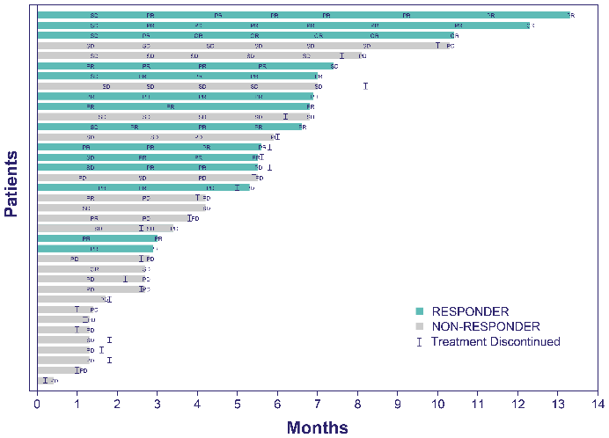
ORR by Subgroup and Individual Response Assessment
Subgroup | n/N | Objective response rate, % (95% CI)
Overall | 14/41 | 34.1 (20.08–50.59)
Age
<50 Years | 0/1 | N/A (N/A–N/A)
50 to 64 Years | 6/14 | 42.9 (17.66–71.14)
≥65 Years | 8/26 | 30.8 (14.33–51.79)
Race
White | 8/22 | 36.4 (17.20–59.34)
Other | 1/1 | 100.0 (2.50–100.00)
Not reported | 5/18 | 27.8 (9.69–53.48)
Ethnicity
Hispanic or Latino | 2/2 | 100.0 (15.81–100.00)
Not Hispanic or Latino | 8/22 | 36.4 (17.20–59.34)
Not reported | 4/16 | 25.0 (7.27–52.38)
Missing | 0/1 | N/A (N/A–N/A)
ECOG PS
0 | 7/16 | 43.8 (19.75–70.12)
1 | 7/25 | 28.0 (12.07–49.39)
Baseline visceral metastasis involvement
Yes | 10/28 | 35.7 (18.64–55.93)
No | 4/13 | 30.8 (9.09–61.43)
Baseline visceral metastasis, involvement of liver
Yes | 5/12 | 41.7 (15.17–72.33)
No | 9/29 | 31.0 (15.28–50.83)
Bellmunt risk factor groups
0 | 4/10 | 40.0 (12.16–73.76)
1 | 7/20 | 35.0 (15.39–59.22)
2 | 3/11 | 27.3 (6.02–60.97)
Patient Response Assessment from Start of Treatment to Progression^{a,b}

Slide 9
Most Common Treatment-Related Adverse Events for All Patients (SG + Pembro)
 | Cohort 3 (N=41)
TRAEs Occurring in >20% of Patients, n (%) | All Grades
Diarrhea | 29 (71)
Nausea | 22 (54)
Vomiting | 10 (24)
Neutropenia | 18 (44)
Anemia | 17 (41)
Leukopenia | 12 (29)
Fatigue | 12 (29)
Asthenia | 16 (39)
Alopecia | 14 (34)
Decreased appetite | 11 (27)
Pruritus | 9 (22)
Treatment-related Gr 3-4 AEs in 59% of patients
16 (39%) patients had SG dose reduction due to TRAE
No treatment-related death occurred
10 (25%) patients received steroids for iRAE
  Topical: 6 (15%) patients
  Oral: 4 (10%) patients
    diarrhea (2 patients)
    pruritus (1 patient)
    maculopapular rash (1 patient)
12 (29%) patients received G-CSF
Gr ≥3 febrile neutropenia, 4 (10%) without prior G-CSF

Slide 10
Conclusions
In this platinum-refractory population, SG + pembrolizumab showed encouraging antitumor efficacy: ORR 34% (38% in evaluable patients), meeting the primary objective; CBR 61%; median PFS 5.5 months
At 5.8 months of median follow-up, the median DOR and median OS were not reached
SG + pembrolizumab had a manageable safety profile with no new safety signal and no increase in systemic steroid-requiring iRAE rate
Data support further evaluation of SG + CPI in patients with mUC who progressed on/after platinum-based chemotherapy and earlier lines of therapy
Additional follow-up and biomarker evaluation are ongoing
Other TROPHY-U-01 cohorts are being assessed, including SG post-CPI in platinum-ineligible patients with mUC (Cohort 2), SG + cisplatin (Cohort 4)¹ and SG + cisplatin + avelumab (Cohort 5) in platinum-naïve patients with mUC (both followed by avelumab switch maintenance); TROPiCS-04 trial launched²

Slide 11
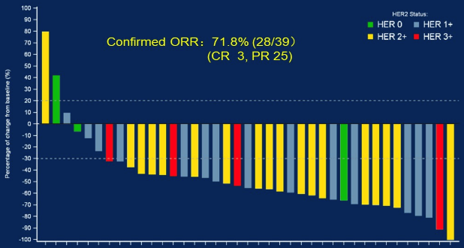
Disitamab Vedotin with Anti-PD-1 (Toripalimab) in mUC
Pts with locally advanced or metastatic UC
41 pts (25 treatment-naïve / 16 with 1+ line(s) of therapy)
  39 pts evaluable for response
Confirmed ORR: 72% (28/39)
  cORR in IHC 0 or 1+ pts: 9/17 (53%)
Median PFS: 9.2 months
Median OS: NR (86% 12-month OS)
Promising results with DV trials in China led to a breakthrough therapy designation by FDA
Phase II & III registrational trials (post-platinum monotherapy & combo with anti-PD-1) pending

Slide 12
Differences Among the ADC/IO Combinations
Regimen | Payload | N | Population | HER2 | ORR
Enfortumab vedotin + Pembrolizumab | MMAE (tubulin) | 43 | Cis-ineligible, tx naive | All | 73%
Disitimab vedotin + Toripalimab | MMAE (tubulin) | 39 | 60% tx naive | All | 72%
Trastuzumab deruxtecan + Nivolumab | Dxd (Topo I) | 26 | Progressed despite prior platinum | 2+ or 3+ | 36%
Sacitizumab govitecan + Pembrolizumab | SN38 (Topo I) | 41 | Progressed despite prior platinum | All | 34%

Slide 13
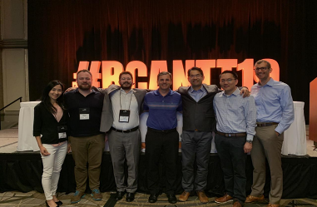
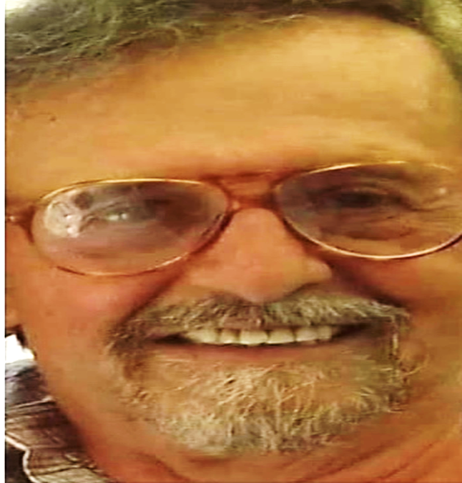
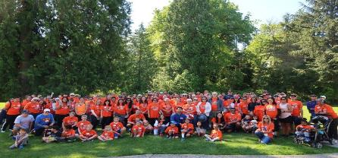
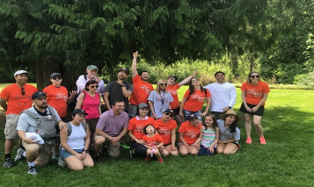

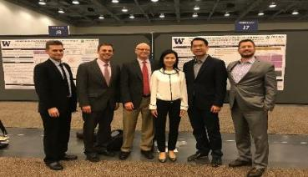
Thank You ☺
Patients & Families!
Collaborators, sponsors, institutions, foundations, colleagues, research, admin & clinical staff: TEAMS! @PGrivasMDPhD

