Slide 1

Will Anti-Drug Conjugates Advance Into Earlier Treatment Settings?
Petros Grivas, MD PhD
Professor, Dept. of Medicine, Division of Medical Oncology
Clinical Director, Genitourinary Cancers Program
University of Washington
Professor, Clinical Research Division
Fred Hutchinson Cancer Center
Seattle, WA
@PGrivasMDPhD

Slide 2
Disclaimer
The views and opinions expressed in this educational activity are those of the faculty and do not necessarily represent the views of TotalCME, Inc., the CME providers, or the companies providing educational grants. This presentation is not intended to define an exclusive course of patient management; the participant should use their clinical judgment, knowledge, experience, and diagnostic skills in applying or adopting for professional use any of the information provided herein. Any procedures, medications, or other courses of diagnosis or treatment discussed or suggested in this activity should not be used by clinicians without evaluation of their patient's conditions and possible contraindications or dangers in use, review of any applicable manufacturer’s product information, and comparison with recommendations of other authorities. Links to other sites may be provided as additional sources of information.

Slide 3
Treatment Landscape in Advanced Urothelial Carcinoma (present→2023)
Cisplatin-eligible
patients
Platinum-based Chemotherapy
4-6 cycles
Immune Checkpoint Inhibitor
If CR/PR/SD: Avelumab switch maintenance
If PD:
-Pembrolizumab
Enfortumab Vedotin
Unselected Population
Can be used as 2nd line in cisplatin-unfit pts
Sacituzumab Govitecan
Unselected Population
Cisplatin-ineligible but carboplatin-eligible patients
Cisplatin-ineligible patients with high PD-L1 expression
(atezolizumab)
Erdafitinib
Patients with FGFR2/3 mutation/fusion
post-platinum;
Can be used as 2nd line after platinum-based chemotherapy
?pembrolizumab + EV?
Platinum-ineligible
patients
(pembrolizumab or atezolizumab)
1st line therapy
2nd line therapy
3rd+ line therapy
Consideration of clinical trials across the spectrum of metastatic UC treatment

Slide 4
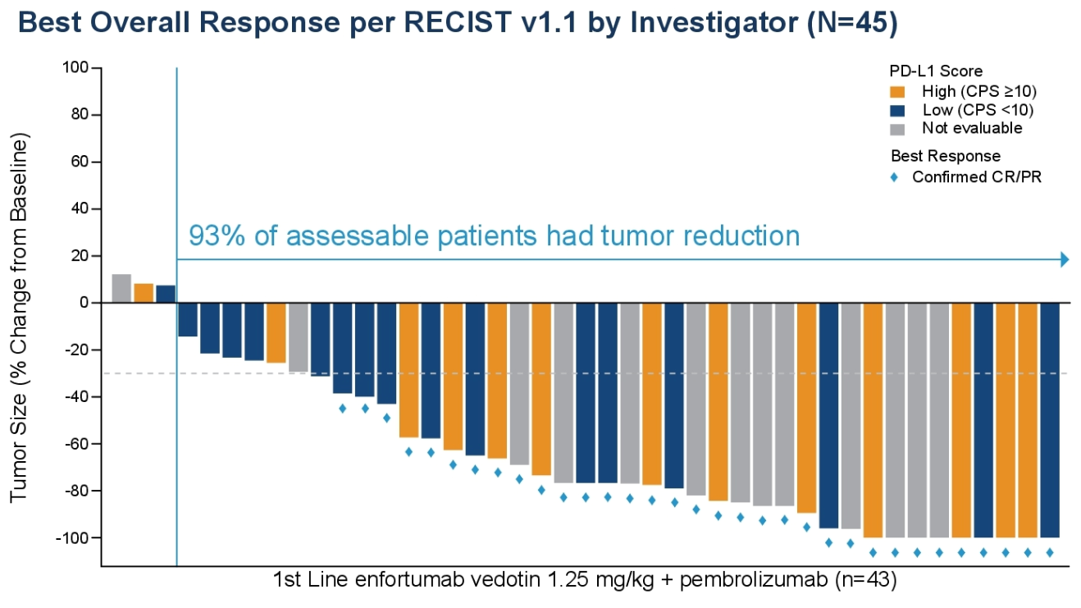
EV-103: Phase 1b/2 Trial of EV + Pembrolizumab
Cohort A
Patients with 1L cisplatin-ineligible
la/mUC (N=45)
Confirmed ORR 95% CI | 73% (33/45) (58.1, 85.4)
Complete response | 16% (7/45)
Partial response | 58% (26/45)
57% confirmed ORR in patients with liver metastases
Dose escalation
EV + pembro
(n=5)
Dose expansion cohort A
EV + pembro
(n=40)
Maximum Target Lesion Reduction from Baseline by PD-L1 Status
EV 1.25 mg/kg days 1 and 8
of a 3-week cycle
+
Pembrolizumab 200 mg on day 1
of a 3-week cycle
84% of patients had visceral disease, and 31% had liver metastasis
31% of patients had PD-L1 CPS ≥10

Slide 5
EV-103: Phase 1b/2 Trial of EV + Pembrolizumab
Cohort A
Patients with 1L cisplatin-ineligible
la/mUC (N=45)
Confirmed ORR 95% CI | 73% (33/45) (58.1, 85.4)
Complete response | 16% (7/45)
Partial response | 58% (26/45)
57% confirmed ORR in patients with liver metastases
Dose escalation
EV + pembro
(n=5)
Dose expansion cohort A
EV + pembro
(n=40)
Maximum Target Lesion Reduction from Baseline by PD-L1 Status
EV 1.25 mg/kg days 1 and 8
of a 3-week cycle
+
Pembrolizumab 200 mg on day 1
of a 3-week cycle
84% of patients had visceral disease, and 31% had liver metastasis
31% of patients had PD-L1 CPS ≥10

Slide 6
EV-103: Phase 1b/2 Trial of EV + Pembrolizumab
Cohort A
Patients with 1L cisplatin-ineligible
la/mUC (N=45)
Confirmed ORR 95% CI | 73% (33/45) (58.1, 85.4)
Complete response | 16% (7/45)
Partial response | 58% (26/45)
57% confirmed ORR in patients with liver metastases
Dose escalation
EV + pembro
(n=5)
Dose expansion cohort A
EV + pembro
(n=40)
Maximum Target Lesion Reduction from Baseline by PD-L1 Status
EV 1.25 mg/kg days 1 and 8
of a 3-week cycle
+
Pembrolizumab 200 mg on day 1
of a 3-week cycle
84% of patients had visceral disease, and 31% had liver metastasis
31% of patients had PD-L1 CPS ≥10

Slide 7
EV-103: Phase 1b/2 Trial of EV + Pembrolizumab
Cohort A
Patients with 1L cisplatin-ineligible
la/mUC (N=45)
Confirmed ORR 95% CI | 73% (33/45) (58.1, 85.4)
Complete response | 16% (7/45)
Partial response | 58% (26/45)
57% confirmed ORR in patients with liver metastases
Dose escalation
EV + pembro
(n=5)
Dose expansion cohort A
EV + pembro
(n=40)
Maximum Target Lesion Reduction from Baseline by PD-L1 Status
EV 1.25 mg/kg days 1 and 8
of a 3-week cycle
+
Pembrolizumab 200 mg on day 1
of a 3-week cycle
84% of patients had visceral disease, and 31% had liver metastasis
31% of patients had PD-L1 CPS ≥10

Slide 8
EV-103: Phase 1b/2 Trial of EV + Pembrolizumab
Cohort A
Patients with 1L cisplatin-ineligible
la/mUC (N=45)
Confirmed ORR 95% CI | 73% (33/45) (58.1, 85.4)
Complete response | 16% (7/45)
Partial response | 58% (26/45)
57% confirmed ORR in patients with liver metastases
Dose escalation
EV + pembro
(n=5)
Dose expansion cohort A
EV + pembro
(n=40)
Maximum Target Lesion Reduction from Baseline by PD-L1 Status
EV 1.25 mg/kg days 1 and 8
of a 3-week cycle
+
Pembrolizumab 200 mg on day 1
of a 3-week cycle
84% of patients had visceral disease, and 31% had liver metastasis
31% of patients had PD-L1 CPS ≥10

Slide 9
EV-103: Phase 1b/2 Trial of EV + Pembrolizumab
Cohort A
Patients with 1L cisplatin-ineligible
la/mUC (N=45)
Confirmed ORR 95% CI | 73% (33/45) (58.1, 85.4)
Complete response | 16% (7/45)
Partial response | 58% (26/45)
57% confirmed ORR in patients with liver metastases
Dose escalation
EV + pembro
(n=5)
Dose expansion cohort A
EV + pembro
(n=40)
Maximum Target Lesion Reduction from Baseline by PD-L1 Status
EV 1.25 mg/kg days 1 and 8
of a 3-week cycle
+
Pembrolizumab 200 mg on day 1
of a 3-week cycle
84% of patients had visceral disease, and 31% had liver metastasis
31% of patients had PD-L1 CPS ≥10

Slide 10
Key Demographic and Baseline Disease Characteristics
Cohort K
Representative of the 1L cisplatin-ineligible la/mUC population
 | EV+P (N=76) | EV Mono (N=73)
Male sex, n (%) | 54 (71.1) | 56 (76.7)
Age (yrs), median (range) | 71 (51, 91) | 74 (56, 89)
White race, n (%) | 61 (80.3) | 55 (75.3)
ECOG PS, n (%)
0 | 33 (43.4) | 28 (38.4)
1 | 33 (43.4) | 35 (47.9)
2 | 10 (13.2) | 10 (13.7)
Primary tumor location, n (%)
Lower tract | 46 (60.5) | 51 (69.9)
Upper tract | 30 (39.5) | 21 (28.8)
 | EV+P (N=76) | EV Mono (N=73)
Metastasis disease sites, n (%)
Bone | 19 (25.0) | 21 (28.8)
Liver | 13 (17.1) | 13 (17.8)
Lung | 37 (48.7) | 30 (41.1)
Metastasis category, n (%)
Lymph node only | 10 (13.2) | 12 (16.4)
Visceral disease | 64 (84.2) | 60 (82.2)
Not applicable¹ | 2 (2.6) | 1 (1.4)
PD-L1 status by combined positive score,² n (%)
CPS<10 | 44 (57.9) | 38 (52.1)
CPS≥10 | 31 (40.8) | 28 (38.4)
Not Evaluable | 1 (1.3) | 7 (9.6)

Slide 11
Key Demographic and Baseline Disease Characteristics
Cohort K
Representative of the 1L cisplatin-ineligible la/mUC population
 | EV+P (N=76) | EV Mono (N=73)
Male sex, n (%) | 54 (71.1) | 56 (76.7)
Age (yrs), median (range) | 71 (51, 91) | 74 (56, 89)
White race, n (%) | 61 (80.3) | 55 (75.3)
ECOG PS, n (%)
0 | 33 (43.4) | 28 (38.4)
1 | 33 (43.4) | 35 (47.9)
2 | 10 (13.2) | 10 (13.7)
Primary tumor location, n (%)
Lower tract | 46 (60.5) | 51 (69.9)
Upper tract | 30 (39.5) | 21 (28.8)
 | EV+P (N=76) | EV Mono (N=73)
Metastasis disease sites, n (%)
Bone | 19 (25.0) | 21 (28.8)
Liver | 13 (17.1) | 13 (17.8)
Lung | 37 (48.7) | 30 (41.1)
Metastasis category, n (%)
Lymph node only | 10 (13.2) | 12 (16.4)
Visceral disease | 64 (84.2) | 60 (82.2)
Not applicable¹ | 2 (2.6) | 1 (1.4)
PD-L1 status by combined positive score,² n (%)
CPS<10 | 44 (57.9) | 38 (52.1)
CPS≥10 | 31 (40.8) | 28 (38.4)
Not Evaluable | 1 (1.3) | 7 (9.6)

Slide 12
Key Demographic and Baseline Disease Characteristics
Cohort K
Representative of the 1L cisplatin-ineligible la/mUC population
 | EV+P (N=76) | EV Mono (N=73)
Male sex, n (%) | 54 (71.1) | 56 (76.7)
Age (yrs), median (range) | 71 (51, 91) | 74 (56, 89)
White race, n (%) | 61 (80.3) | 55 (75.3)
ECOG PS, n (%)
0 | 33 (43.4) | 28 (38.4)
1 | 33 (43.4) | 35 (47.9)
2 | 10 (13.2) | 10 (13.7)
Primary tumor location, n (%)
Lower tract | 46 (60.5) | 51 (69.9)
Upper tract | 30 (39.5) | 21 (28.8)
 | EV+P (N=76) | EV Mono (N=73)
Metastasis disease sites, n (%)
Bone | 19 (25.0) | 21 (28.8)
Liver | 13 (17.1) | 13 (17.8)
Lung | 37 (48.7) | 30 (41.1)
Metastasis category, n (%)
Lymph node only | 10 (13.2) | 12 (16.4)
Visceral disease | 64 (84.2) | 60 (82.2)
Not applicable¹ | 2 (2.6) | 1 (1.4)
PD-L1 status by combined positive score,² n (%)
CPS<10 | 44 (57.9) | 38 (52.1)
CPS≥10 | 31 (40.8) | 28 (38.4)
Not Evaluable | 1 (1.3) | 7 (9.6)

Slide 13
Key Demographic and Baseline Disease Characteristics
Cohort K
Representative of the 1L cisplatin-ineligible la/mUC population
 | EV+P (N=76) | EV Mono (N=73)
Male sex, n (%) | 54 (71.1) | 56 (76.7)
Age (yrs), median (range) | 71 (51, 91) | 74 (56, 89)
White race, n (%) | 61 (80.3) | 55 (75.3)
ECOG PS, n (%)
0 | 33 (43.4) | 28 (38.4)
1 | 33 (43.4) | 35 (47.9)
2 | 10 (13.2) | 10 (13.7)
Primary tumor location, n (%)
Lower tract | 46 (60.5) | 51 (69.9)
Upper tract | 30 (39.5) | 21 (28.8)
 | EV+P (N=76) | EV Mono (N=73)
Metastasis disease sites, n (%)
Bone | 19 (25.0) | 21 (28.8)
Liver | 13 (17.1) | 13 (17.8)
Lung | 37 (48.7) | 30 (41.1)
Metastasis category, n (%)
Lymph node only | 10 (13.2) | 12 (16.4)
Visceral disease | 64 (84.2) | 60 (82.2)
Not applicable¹ | 2 (2.6) | 1 (1.4)
PD-L1 status by combined positive score,² n (%)
CPS<10 | 44 (57.9) | 38 (52.1)
CPS≥10 | 31 (40.8) | 28 (38.4)
Not Evaluable | 1 (1.3) | 7 (9.6)

Slide 14
Key Demographic and Baseline Disease Characteristics
Cohort K
Representative of the 1L cisplatin-ineligible la/mUC population
 | EV+P (N=76) | EV Mono (N=73)
Male sex, n (%) | 54 (71.1) | 56 (76.7)
Age (yrs), median (range) | 71 (51, 91) | 74 (56, 89)
White race, n (%) | 61 (80.3) | 55 (75.3)
ECOG PS, n (%)
0 | 33 (43.4) | 28 (38.4)
1 | 33 (43.4) | 35 (47.9)
2 | 10 (13.2) | 10 (13.7)
Primary tumor location, n (%)
Lower tract | 46 (60.5) | 51 (69.9)
Upper tract | 30 (39.5) | 21 (28.8)
 | EV+P (N=76) | EV Mono (N=73)
Metastasis disease sites, n (%)
Bone | 19 (25.0) | 21 (28.8)
Liver | 13 (17.1) | 13 (17.8)
Lung | 37 (48.7) | 30 (41.1)
Metastasis category, n (%)
Lymph node only | 10 (13.2) | 12 (16.4)
Visceral disease | 64 (84.2) | 60 (82.2)
Not applicable¹ | 2 (2.6) | 1 (1.4)
PD-L1 status by combined positive score,² n (%)
CPS<10 | 44 (57.9) | 38 (52.1)
CPS≥10 | 31 (40.8) | 28 (38.4)
Not Evaluable | 1 (1.3) | 7 (9.6)

Slide 15
Key Demographic and Baseline Disease Characteristics
Cohort K
Representative of the 1L cisplatin-ineligible la/mUC population
 | EV+P (N=76) | EV Mono (N=73)
Male sex, n (%) | 54 (71.1) | 56 (76.7)
Age (yrs), median (range) | 71 (51, 91) | 74 (56, 89)
White race, n (%) | 61 (80.3) | 55 (75.3)
ECOG PS, n (%)
0 | 33 (43.4) | 28 (38.4)
1 | 33 (43.4) | 35 (47.9)
2 | 10 (13.2) | 10 (13.7)
Primary tumor location, n (%)
Lower tract | 46 (60.5) | 51 (69.9)
Upper tract | 30 (39.5) | 21 (28.8)
 | EV+P (N=76) | EV Mono (N=73)
Metastasis disease sites, n (%)
Bone | 19 (25.0) | 21 (28.8)
Liver | 13 (17.1) | 13 (17.8)
Lung | 37 (48.7) | 30 (41.1)
Metastasis category, n (%)
Lymph node only | 10 (13.2) | 12 (16.4)
Visceral disease | 64 (84.2) | 60 (82.2)
Not applicable¹ | 2 (2.6) | 1 (1.4)
PD-L1 status by combined positive score,² n (%)
CPS<10 | 44 (57.9) | 38 (52.1)
CPS≥10 | 31 (40.8) | 28 (38.4)
Not Evaluable | 1 (1.3) | 7 (9.6)

Slide 16
Key Demographic and Baseline Disease Characteristics
Cohort K
Representative of the 1L cisplatin-ineligible la/mUC population
 | EV+P (N=76) | EV Mono (N=73)
Male sex, n (%) | 54 (71.1) | 56 (76.7)
Age (yrs), median (range) | 71 (51, 91) | 74 (56, 89)
White race, n (%) | 61 (80.3) | 55 (75.3)
ECOG PS, n (%)
0 | 33 (43.4) | 28 (38.4)
1 | 33 (43.4) | 35 (47.9)
2 | 10 (13.2) | 10 (13.7)
Primary tumor location, n (%)
Lower tract | 46 (60.5) | 51 (69.9)
Upper tract | 30 (39.5) | 21 (28.8)
 | EV+P (N=76) | EV Mono (N=73)
Metastasis disease sites, n (%)
Bone | 19 (25.0) | 21 (28.8)
Liver | 13 (17.1) | 13 (17.8)
Lung | 37 (48.7) | 30 (41.1)
Metastasis category, n (%)
Lymph node only | 10 (13.2) | 12 (16.4)
Visceral disease | 64 (84.2) | 60 (82.2)
Not applicable¹ | 2 (2.6) | 1 (1.4)
PD-L1 status by combined positive score,² n (%)
CPS<10 | 44 (57.9) | 38 (52.1)
CPS≥10 | 31 (40.8) | 28 (38.4)
Not Evaluable | 1 (1.3) | 7 (9.6)

Slide 17
Key Demographic and Baseline Disease Characteristics
Cohort K
Representative of the 1L cisplatin-ineligible la/mUC population
 | EV+P (N=76) | EV Mono (N=73)
Male sex, n (%) | 54 (71.1) | 56 (76.7)
Age (yrs), median (range) | 71 (51, 91) | 74 (56, 89)
White race, n (%) | 61 (80.3) | 55 (75.3)
ECOG PS, n (%)
0 | 33 (43.4) | 28 (38.4)
1 | 33 (43.4) | 35 (47.9)
2 | 10 (13.2) | 10 (13.7)
Primary tumor location, n (%)
Lower tract | 46 (60.5) | 51 (69.9)
Upper tract | 30 (39.5) | 21 (28.8)
 | EV+P (N=76) | EV Mono (N=73)
Metastasis disease sites, n (%)
Bone | 19 (25.0) | 21 (28.8)
Liver | 13 (17.1) | 13 (17.8)
Lung | 37 (48.7) | 30 (41.1)
Metastasis category, n (%)
Lymph node only | 10 (13.2) | 12 (16.4)
Visceral disease | 64 (84.2) | 60 (82.2)
Not applicable¹ | 2 (2.6) | 1 (1.4)
PD-L1 status by combined positive score,² n (%)
CPS<10 | 44 (57.9) | 38 (52.1)
CPS≥10 | 31 (40.8) | 28 (38.4)
Not Evaluable | 1 (1.3) | 7 (9.6)

Slide 18
Overall Response Rate by BICR
EV+P: 64.5% confirmed ORR with rapid responses
 | EV+P (N=76) | EV Mono (N=73)
Confirmed ORR, n (% ) (95% CI) | 49 (64.5) (52.7, 75.1) | 33 (45.2) (33.5, 57.3)
Best overall response, n (%)
Complete Response | 8 (10.5) | 3 (4.1)
Partial Response | 41 (53.9) | 30 (41.1)
Stable Disease | 17 (22.4) | 25 (34.2)
Progressive Disease | 6 (7.9) | 7 (9.6)
Not Evaluable | 3 (3.9) | 5 (6.8)
No Assessment | 1 (1.3) | 3 (4.1)
Median time to objective response (range), mos | 2.07 (1.1, 6.6) | 2.07 (1.9, 15.4)
Median number of treatment cycles (range) | 11.0 (1, 29) | 8.0 (1, 33)
EV+P
41/49 (85.7%) of responses observed at first assessment
(week 9±1 wk)
cORRs were consistent across all pre-specified subgroups
7/13 (53.8%) cORR observed in patients with liver metastases
EV monotherapy
Activity is consistent with prior results in 2L+ la/mUC

Slide 19
Overall Response Rate by BICR
EV+P: 64.5% confirmed ORR with rapid responses
 | EV+P (N=76) | EV Mono (N=73)
Confirmed ORR, n (% ) (95% CI) | 49 (64.5) (52.7, 75.1) | 33 (45.2) (33.5, 57.3)
Best overall response, n (%)
Complete Response | 8 (10.5) | 3 (4.1)
Partial Response | 41 (53.9) | 30 (41.1)
Stable Disease | 17 (22.4) | 25 (34.2)
Progressive Disease | 6 (7.9) | 7 (9.6)
Not Evaluable | 3 (3.9) | 5 (6.8)
No Assessment | 1 (1.3) | 3 (4.1)
Median time to objective response (range), mos | 2.07 (1.1, 6.6) | 2.07 (1.9, 15.4)
Median number of treatment cycles (range) | 11.0 (1, 29) | 8.0 (1, 33)
EV+P
41/49 (85.7%) of responses observed at first assessment
(week 9±1 wk)
cORRs were consistent across all pre-specified subgroups
7/13 (53.8%) cORR observed in patients with liver metastases
EV monotherapy
Activity is consistent with prior results in 2L+ la/mUC

Slide 20
Overall Response Rate by BICR
EV+P: 64.5% confirmed ORR with rapid responses
 | EV+P (N=76) | EV Mono (N=73)
Confirmed ORR, n (% ) (95% CI) | 49 (64.5) (52.7, 75.1) | 33 (45.2) (33.5, 57.3)
Best overall response, n (%)
Complete Response | 8 (10.5) | 3 (4.1)
Partial Response | 41 (53.9) | 30 (41.1)
Stable Disease | 17 (22.4) | 25 (34.2)
Progressive Disease | 6 (7.9) | 7 (9.6)
Not Evaluable | 3 (3.9) | 5 (6.8)
No Assessment | 1 (1.3) | 3 (4.1)
Median time to objective response (range), mos | 2.07 (1.1, 6.6) | 2.07 (1.9, 15.4)
Median number of treatment cycles (range) | 11.0 (1, 29) | 8.0 (1, 33)
EV+P
41/49 (85.7%) of responses observed at first assessment
(week 9±1 wk)
cORRs were consistent across all pre-specified subgroups
7/13 (53.8%) cORR observed in patients with liver metastases
EV monotherapy
Activity is consistent with prior results in 2L+ la/mUC

Slide 21
Overall Response Rate by BICR
EV+P: 64.5% confirmed ORR with rapid responses
 | EV+P (N=76) | EV Mono (N=73)
Confirmed ORR, n (% ) (95% CI) | 49 (64.5) (52.7, 75.1) | 33 (45.2) (33.5, 57.3)
Best overall response, n (%)
Complete Response | 8 (10.5) | 3 (4.1)
Partial Response | 41 (53.9) | 30 (41.1)
Stable Disease | 17 (22.4) | 25 (34.2)
Progressive Disease | 6 (7.9) | 7 (9.6)
Not Evaluable | 3 (3.9) | 5 (6.8)
No Assessment | 1 (1.3) | 3 (4.1)
Median time to objective response (range), mos | 2.07 (1.1, 6.6) | 2.07 (1.9, 15.4)
Median number of treatment cycles (range) | 11.0 (1, 29) | 8.0 (1, 33)
EV+P
41/49 (85.7%) of responses observed at first assessment
(week 9±1 wk)
cORRs were consistent across all pre-specified subgroups
7/13 (53.8%) cORR observed in patients with liver metastases
EV monotherapy
Activity is consistent with prior results in 2L+ la/mUC

Slide 22
Overall Response Rate by BICR
EV+P: 64.5% confirmed ORR with rapid responses
 | EV+P (N=76) | EV Mono (N=73)
Confirmed ORR, n (% ) (95% CI) | 49 (64.5) (52.7, 75.1) | 33 (45.2) (33.5, 57.3)
Best overall response, n (%)
Complete Response | 8 (10.5) | 3 (4.1)
Partial Response | 41 (53.9) | 30 (41.1)
Stable Disease | 17 (22.4) | 25 (34.2)
Progressive Disease | 6 (7.9) | 7 (9.6)
Not Evaluable | 3 (3.9) | 5 (6.8)
No Assessment | 1 (1.3) | 3 (4.1)
Median time to objective response (range), mos | 2.07 (1.1, 6.6) | 2.07 (1.9, 15.4)
Median number of treatment cycles (range) | 11.0 (1, 29) | 8.0 (1, 33)
EV+P
41/49 (85.7%) of responses observed at first assessment
(week 9±1 wk)
cORRs were consistent across all pre-specified subgroups
7/13 (53.8%) cORR observed in patients with liver metastases
EV monotherapy
Activity is consistent with prior results in 2L+ la/mUC

Slide 23
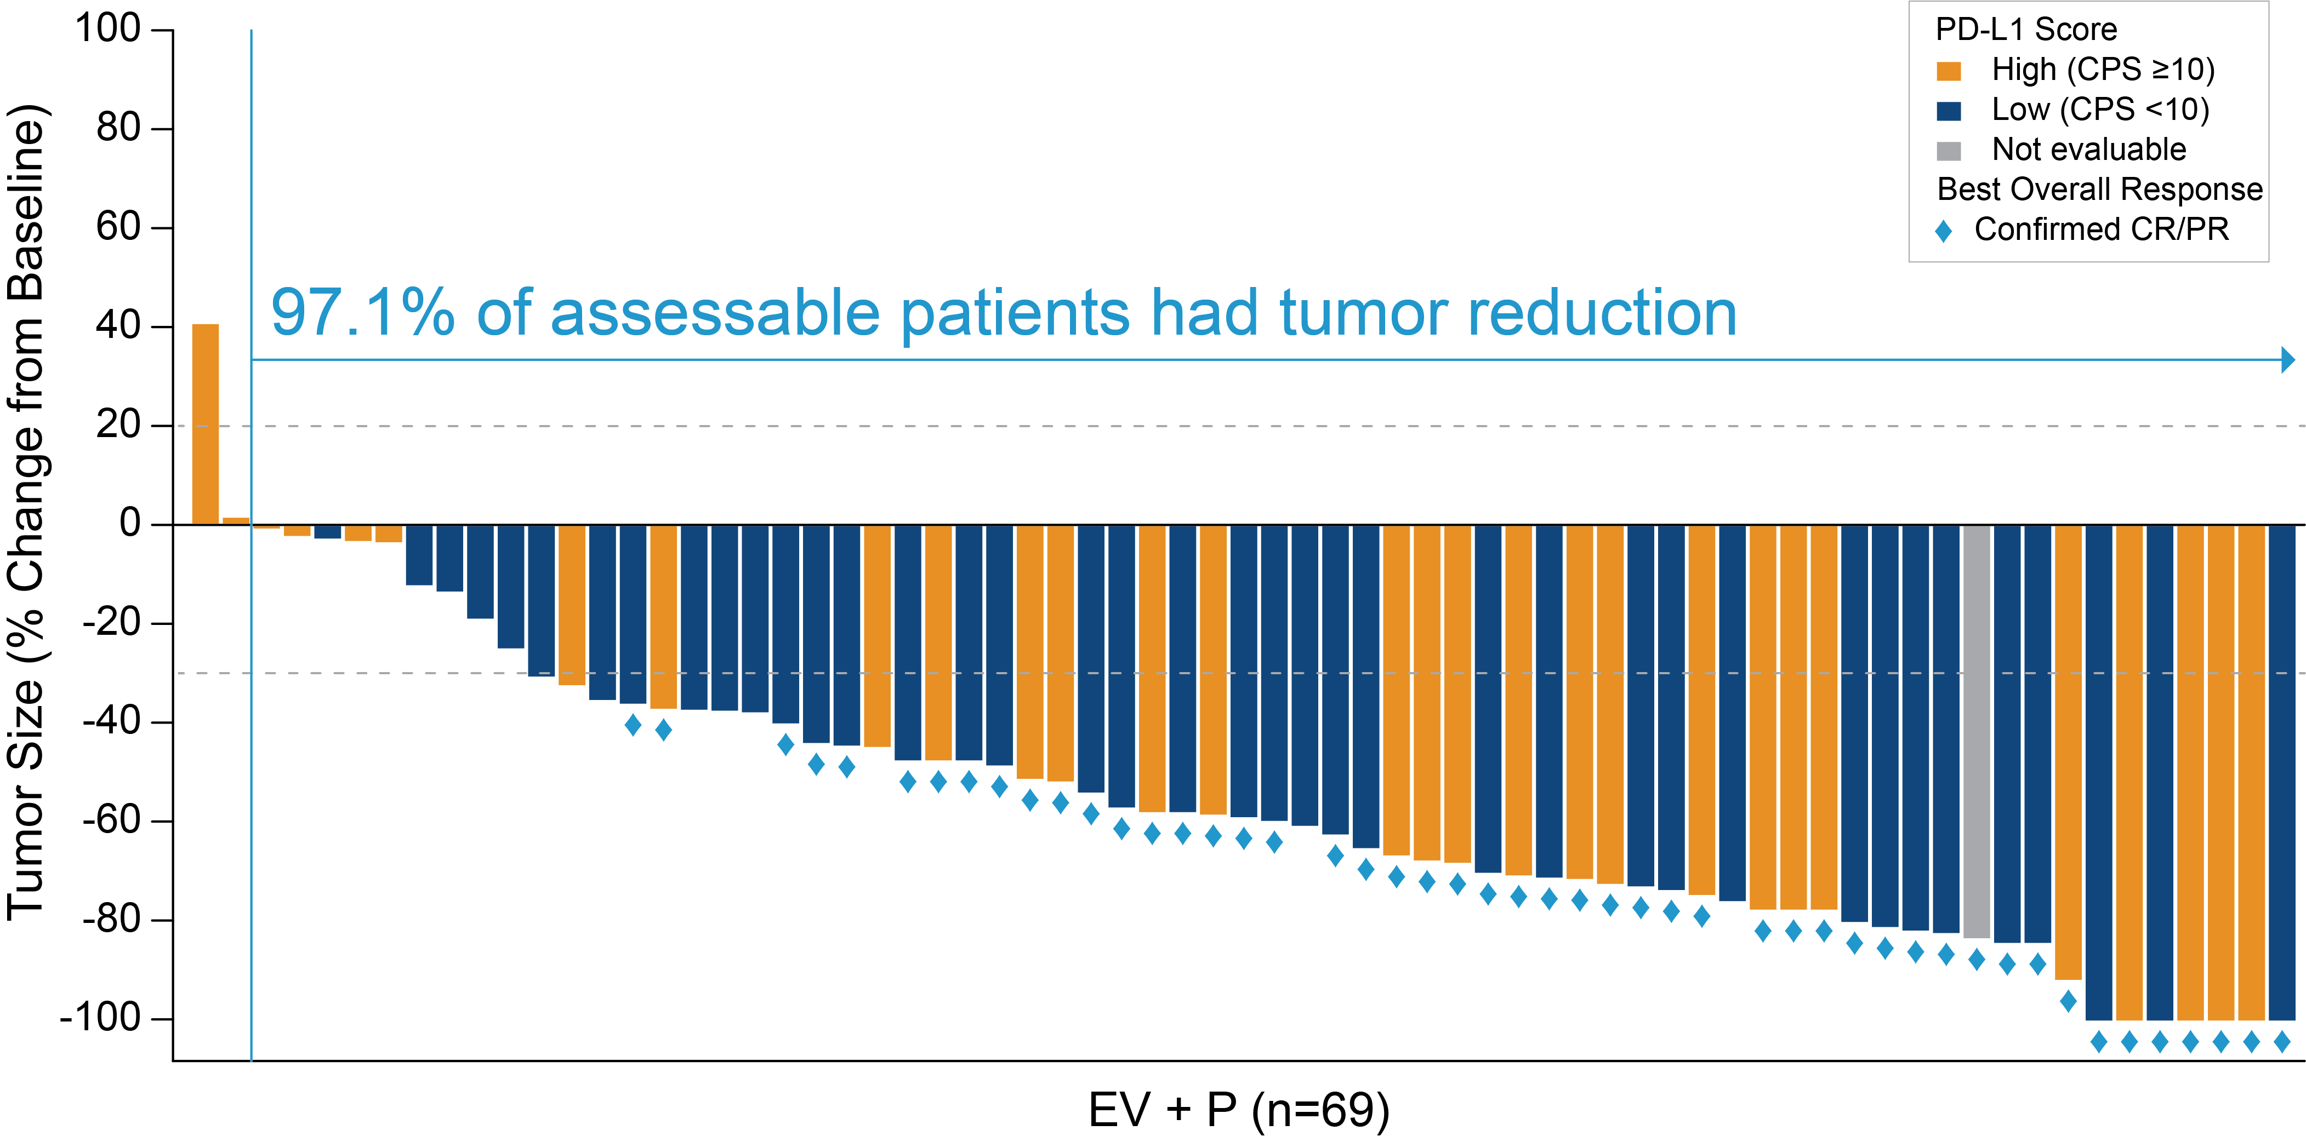
EV+P: Maximum Percent Reduction From Baseline of Target Lesion by BICR
Activity seen regardless of PD-L1 status
  27/44 (61.4%) cORR in CPS<10
                21/31 (67.7%) cORR in CPS≥10

Slide 24
Treatment-Related Adverse Events (TRAEs)
Most common AEs with EV+P were fatigue, peripheral sensory neuropathy, alopecia, and maculo-papular rash
TRAEs Any Grades by Preferred Term ≥20% of Patients | EV+P (N=76) n (%) |  | EV Mono (N=73) n (%)
TRAEs All Grades by Preferred Term ≥20% of Patients | Any Grade | Grade ≥3 | Any Grade | Grade ≥3
Overall | 76 (100.0) | 48 (63.2) | 68 (93.2) | 35 (47.9)
Fatigue | 43 (56.6) | 7 (9.2) | 29 (39.7) | 6 (8.2)
Peripheral sensory neuropathy | 39 (51.3) | 1 (1.3) | 32 (43.8) | 2 (2.7)
Alopecia | 35 (46.1) | 0 | 26 (35.6) | 0
Rash maculo-papular | 35 (46.1) | 13 (17.1) | 21 (28.8) | 1 (1.4)
Pruritus | 30 (39.5) | 3 (3.9) | 19 (26.0) | 1 (1.4)
Dysgeusia | 23 (30.3) | 0 | 25 (34.2) | 0
Weight decreased | 23 (30.3) | 3 (3.9) | 21 (28.8) | 1 (1.4)
Diarrhea | 22 (28.9) | 5 (6.6) | 20 (27.4) | 4 (5.5)
Decreased appetite | 20 (26.3) | 0 | 28 (38.4) | 0
Nausea | 19 (25.0) | 0 | 25 (34.2) | 1 (1.4)
Dry eye | 15 (19.7) | 0 | 8 (11.0) | 0
Serious TRAEs
18 (23.7%) EV+P
11 (15.1%) EV Mono
TRAEs leading to death
(per investigator)
3 (3.9%) EV+P (Pneumonitis, Respiratory failure, Sepsis)
2 (2.7%) EV Mono (Multiple organ dysfunction, Respiratory failure)

Slide 25
Treatment-Related Adverse Events (TRAEs)
Most common AEs with EV+P were fatigue, peripheral sensory neuropathy, alopecia, and maculo-papular rash
TRAEs Any Grades by Preferred Term ≥20% of Patients | EV+P (N=76) n (%) |  | EV Mono (N=73) n (%)
TRAEs All Grades by Preferred Term ≥20% of Patients | Any Grade | Grade ≥3 | Any Grade | Grade ≥3
Overall | 76 (100.0) | 48 (63.2) | 68 (93.2) | 35 (47.9)
Fatigue | 43 (56.6) | 7 (9.2) | 29 (39.7) | 6 (8.2)
Peripheral sensory neuropathy | 39 (51.3) | 1 (1.3) | 32 (43.8) | 2 (2.7)
Alopecia | 35 (46.1) | 0 | 26 (35.6) | 0
Rash maculo-papular | 35 (46.1) | 13 (17.1) | 21 (28.8) | 1 (1.4)
Pruritus | 30 (39.5) | 3 (3.9) | 19 (26.0) | 1 (1.4)
Dysgeusia | 23 (30.3) | 0 | 25 (34.2) | 0
Weight decreased | 23 (30.3) | 3 (3.9) | 21 (28.8) | 1 (1.4)
Diarrhea | 22 (28.9) | 5 (6.6) | 20 (27.4) | 4 (5.5)
Decreased appetite | 20 (26.3) | 0 | 28 (38.4) | 0
Nausea | 19 (25.0) | 0 | 25 (34.2) | 1 (1.4)
Dry eye | 15 (19.7) | 0 | 8 (11.0) | 0
Serious TRAEs
18 (23.7%) EV+P
11 (15.1%) EV Mono
TRAEs leading to death
(per investigator)
3 (3.9%) EV+P (Pneumonitis, Respiratory failure, Sepsis)
2 (2.7%) EV Mono (Multiple organ dysfunction, Respiratory failure)

Slide 26
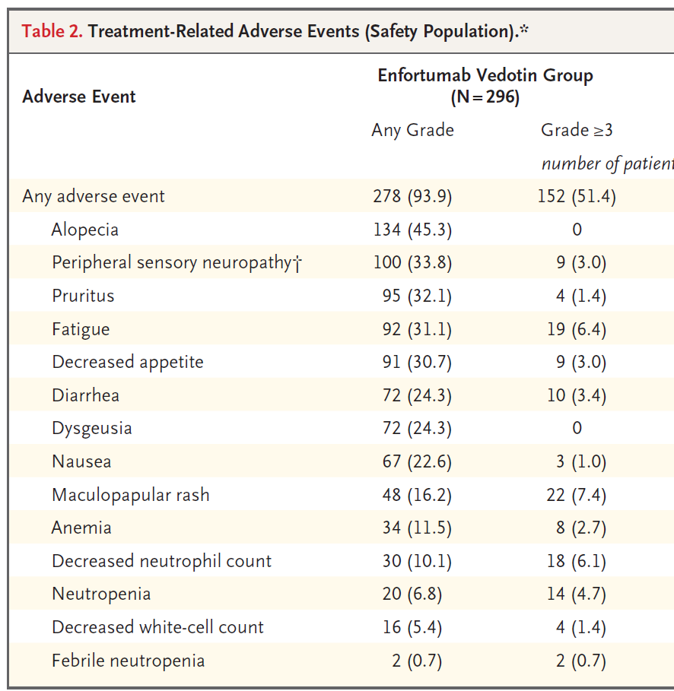
KEY FINDINGS (3)
Safety : Pembro may increase EV G≥3 TRAE ∆~15%
EV Mono (n= 301)
from EV 301 L3 trial
 | EV+P (N=76) n (%) |  | EV Mono (N=73) n (%)
TRAEs All Grades by Preferred Term ≥20% of Patients | Any Grade | Grade ≥3 | Any Grade | Grade ≥3
Overall | 76 (100.0) | 48 (63.2) | 68 (93.2) | 35 (47.9)
Fatigue | 43 (56.6) | 7 (9.2) | 29 (39.7) | 6 (8.2)
Peripheral sensory neuropathy | 39 (51.3) | 1 (1.3) | 32 (43.8) | 2 (2.7)
Alopecia | 35 (46.1) | 0 | 26 (35.6) | 0
Rash maculo-papular | 35 (46.1) | 13 (17.1) | 21 (28.8) | 1 (1.4)
Pruritus | 30 (39.5) | 3 (3.9) | 19 (26.0) | 1 (1.4)
Dysgeusia | 23 (30.3) | 0 | 25 (34.2) | 0
Weight decreased | 23 (30.3) | 3 (3.9) | 21 (28.8) | 1 (1.4)
Diarrhea | 22 (28.9) | 5 (6.6) | 20 (27.4) | 4 (5.5)
Decreased appetite | 20 (26.3) | 0 | 28 (38.4) | 0
Nausea | 19 (25.0) | 0 | 25 (34.2) | 1 (1.4)
Dry eye | 15 (19.7) | 0 | 8 (11.0) | 0
TRAEs Any Grade by Preferred
Term ≥20% of Patients

Slide 27
KEY FINDINGS (3)
Safety : Pembro may increase EV G≥3 TRAE ∆~15%
EV Mono (n= 301)
from EV 301 L3 trial
 | EV+P (N=76) n (%) |  | EV Mono (N=73) n (%)
TRAEs All Grades by Preferred Term ≥20% of Patients | Any Grade | Grade ≥3 | Any Grade | Grade ≥3
Overall | 76 (100.0) | 48 (63.2) | 68 (93.2) | 35 (47.9)
Fatigue | 43 (56.6) | 7 (9.2) | 29 (39.7) | 6 (8.2)
Peripheral sensory neuropathy | 39 (51.3) | 1 (1.3) | 32 (43.8) | 2 (2.7)
Alopecia | 35 (46.1) | 0 | 26 (35.6) | 0
Rash maculo-papular | 35 (46.1) | 13 (17.1) | 21 (28.8) | 1 (1.4)
Pruritus | 30 (39.5) | 3 (3.9) | 19 (26.0) | 1 (1.4)
Dysgeusia | 23 (30.3) | 0 | 25 (34.2) | 0
Weight decreased | 23 (30.3) | 3 (3.9) | 21 (28.8) | 1 (1.4)
Diarrhea | 22 (28.9) | 5 (6.6) | 20 (27.4) | 4 (5.5)
Decreased appetite | 20 (26.3) | 0 | 28 (38.4) | 0
Nausea | 19 (25.0) | 0 | 25 (34.2) | 1 (1.4)
Dry eye | 15 (19.7) | 0 | 8 (11.0) | 0
TRAEs Any Grade by Preferred
Term ≥20% of Patients

Slide 28
KEY FINDINGS (3)
Safety : Pembro may increase EV G≥3 TRAE ∆~15%
EV Mono (n= 301)
from EV 301 L3 trial
 | EV+P (N=76) n (%) |  | EV Mono (N=73) n (%)
TRAEs All Grades by Preferred Term ≥20% of Patients | Any Grade | Grade ≥3 | Any Grade | Grade ≥3
Overall | 76 (100.0) | 48 (63.2) | 68 (93.2) | 35 (47.9)
Fatigue | 43 (56.6) | 7 (9.2) | 29 (39.7) | 6 (8.2)
Peripheral sensory neuropathy | 39 (51.3) | 1 (1.3) | 32 (43.8) | 2 (2.7)
Alopecia | 35 (46.1) | 0 | 26 (35.6) | 0
Rash maculo-papular | 35 (46.1) | 13 (17.1) | 21 (28.8) | 1 (1.4)
Pruritus | 30 (39.5) | 3 (3.9) | 19 (26.0) | 1 (1.4)
Dysgeusia | 23 (30.3) | 0 | 25 (34.2) | 0
Weight decreased | 23 (30.3) | 3 (3.9) | 21 (28.8) | 1 (1.4)
Diarrhea | 22 (28.9) | 5 (6.6) | 20 (27.4) | 4 (5.5)
Decreased appetite | 20 (26.3) | 0 | 28 (38.4) | 0
Nausea | 19 (25.0) | 0 | 25 (34.2) | 1 (1.4)
Dry eye | 15 (19.7) | 0 | 8 (11.0) | 0
TRAEs Any Grade by Preferred
Term ≥20% of Patients

Slide 29


EV-302: Randomized Phase 3 Trial of Enfortumab Vedotin + Pembrolizumab Versus Chemotherapy
Enfortumab vedotin
(Days 1 and 8)
+
Pembrolizumab
(Day 1)
Every 3-week cycle
Primary Objectives
PFS per RECIST by central review
OS
Secondary Objectives
PFS per RECIST by investigator
ORR
DOR
  DCR
  QOL
  Safety and tolerability
Key eligibility criteria:
Untreated locally advanced or metastatic urothelial cancer
Eligible for platinum-based chemotherapy and for pembrolizumab
1:1 randomization
Gemcitabine
(Days 1 and 8)
+
Cisplatin or Carboplatin
(Day 1)
Every 3-week cycle

Slide 30

TROPHY U-01: Sacituzumab Govitecan Multi-Cohort Trial in mUC
Cohort | Study population | Treatment
Cohort 1
(2L+)
After platinum-based chemo & anti-PD-1/L1 therapy
SG 10 mg/Kg IV on Days 1 and 8 of a 21-day cycle
Cohort 2
(2L)
Ineligible for platinum-based chemo; after anti-PD-1/L1 based therapy
SG 10 mg/Kg IV on Days 1 and 8 of a 21-day cycle
Cohort 3
(2L)
Progression after platinum-containing chemo in metastatic setting (CPI-naïve patients)
SG 10 mg/Kg IV on Days 1 and 8 of a 21-day cycle + Pembrolizumab 200 mg IV on Day 1 of a 21‑day cycle
Cohort 4
(1L)
Treatment naïve in metastatic/unresectable locally advanced setting
Cis + SG
(6 cycles)
SG+ Avelumab maintenance
Cohorts 5 & 6 Pending
Cohort 5
(1L)
Cis + SG + Avelumab (6 cycles)
SG+ Avelumab maintenance
Treatment naïve in metastatic/unresectable locally advanced setting
Key Inclusion Criteria:
ECOG PS 0-1
C1-C3: Creatinine clearance ≥30 mL/min; C4: Creatinine clearance ≥50 mL/min
Adequate organ function & stable brain metastases

Slide 31
EV-103 Cohort H (Neoadjuvant Setting)
Eligibility
Cisplatin-ineligible
Clinical stage
T2-T4aN0M0
No upper tract or
urethral tumors
allowed
>50% Urothelial
carcinoma histology
ECOG 0-3
Medically fit for
RC+PLND
TURBT
≤90 days from C1D1
Neoadjuvant EV
Monotherapy
X 3 cycles
1.25 mg/kg of EV on
D1 and D8
of 21-day cycle
Radical
cystectomy
and pelvic
lymph node
dissection
Follow-Up Imaging
Q12W for the first
2 years, then Q24W
Imaging
≤4 weeks
Pre-RC Imaging
≤4 weeks
4 to 12 weeks after
last dose of
neoadjuvant EV
Primary endpoint: pCR rate by central pathology review
Secondary endpoints: pDS rate (central review), EFS, DFS, OS, safety, PROs, biomarkers

Slide 32
EV-103 Cohort H: Rates of pCR and Pathologic Downstaging by Central Pathology Review
EV-103 Cohort H Conclusions
Neoadjuvant enfortumab vedotin showed promising antitumor activity in patients with MIBC ineligible for cisplatin as shown by pCR of 36% and pDS of 50%
All patients were able to undergo surgery and there was no delay in surgery due to neoadjuvant enfortumab vedotin
The observed safety profile of neoadjuvant enfortumab vedotin monotherapy in patients with cisplatin-ineligible MIBC is consistent with the known AE profile of enfortumab vedotin in other settings
  Overall incidence of Grade 3 or higher treatment-related Aes was low
  No new safety signals were identified
This first disclosure of data supports the ongoing phase 2 and 3 programs evaluating enfortumab vedotin alone or in combination with pembrolizumab in MIBC
(EV-103 Cohort L, KN-905, KN-B15)
Pathologic Response, n (%) (95% CI) | Cohort H (N = 22)
Primary endpoint: pCR* | 8 (36.4) (17.2-59.3)
Pathologic downstaging rate† | 11 (50.0) (28.2-71.8)
Defined as: *Absence of any viable tumor tissue (ypT0 and N0).
†Presence of ypT0, ypTis, ypTa, ypT1, and N0.
Antitumor activity observed with neoadjuvant enfortumab vedotin

Slide 33
Enfortumab Vedotin for Perioperative Treatment:
KEYNOTE-B15 / EV-304 Study
Neoadjuvant Therapy
Adjuvant Therapy
R
C
+
P
L
N
D
Enfortumab vedotin
(Days 1 and 8)
Q 21 Days for 5 Cycles + Pembrolizumab
(Day 1)
Q 21 Days for 13 Cycles
Enfortumab vedotin
(Days 1 and 8) + Pembrolizumab
(Day 1)
Q 21 Days for 4 Cycles
Key eligibility criteria:
Cisplatin-eligible MIBC
Stage cT2 -T4aN0M0 or cT1-T4aN1M0
No distant metastases
ECOG PS 0 or 1
Dual Primary Endpoints:
pCR, EFS
Key Secondary Endpoint:
OS
1:1 randomization
Gemcitabine 1000 mg/m²
(Days 1 and 8) + Cisplatin 70 mg/m²
(Day 1)
Q 21 Days for 4 Cycles
Observation
RC = Radical Cystectomy; PLND = Pelvic lymph node dissection

Slide 34
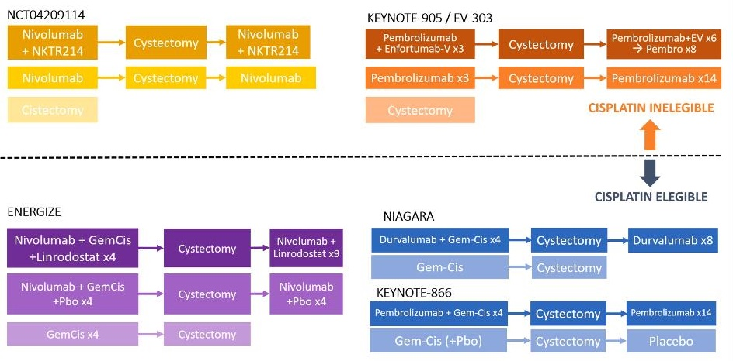
Phase III Neoadjuvant IO Trials
VOLGA trial: durva/treme/EV as peri-operative therapy

Slide 35

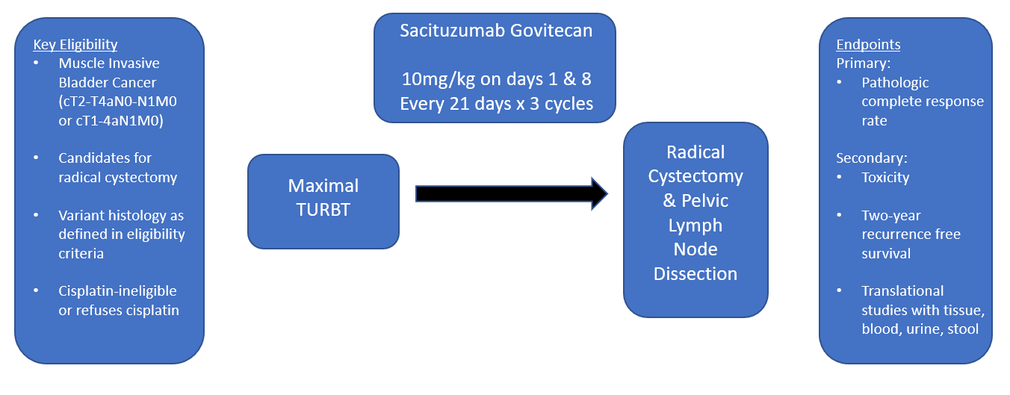
Neoadjuvant Trial for Cisplatin-Unfit Patients
With Variant Histology MIBC
Accrual target: 18 pts
Rafee Talukder

Slide 36
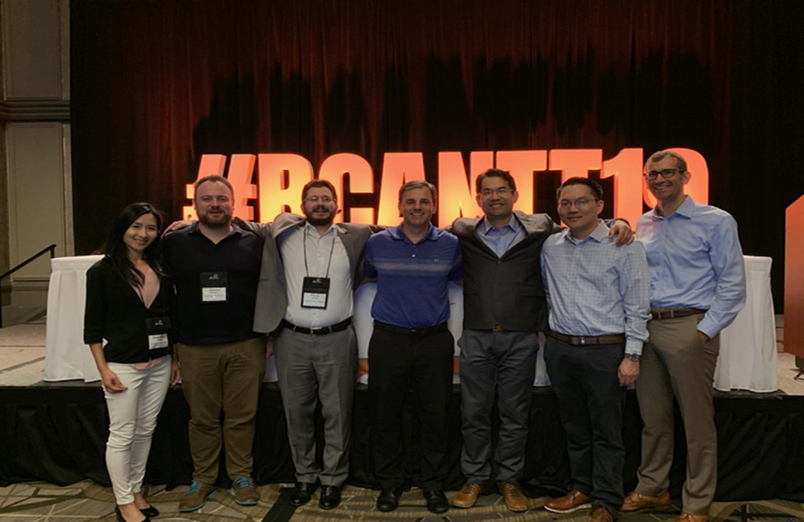

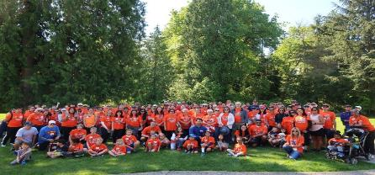


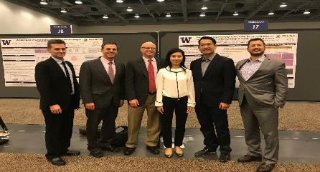
Thank You ☺
Patients & Families!
Collaborators, sponsors, institutions, foundations, colleagues, research, admin & clinical staff: TEAMS! @PGrivasMDPhD

