Slide 1

How Do Antibody-Drug Conjugates Improve Patient Outcomes in Patients With Urothelial Cancer?
Vadim S Koshkin, MD
Assistant Professor
Helen Diller Family Comprehensive Cancer Center
University of California, San Francisco
San Francisco, CA
@koshkin85

Slide 2
Disclaimer
The views and opinions expressed in this educational activity are those of the faculty and do not necessarily represent the views of TotalCME, Inc., the CME providers, or the companies providing educational grants. This presentation is not intended to define an exclusive course of patient management; the participant should use their clinical judgment, knowledge, experience, and diagnostic skills in applying or adopting for professional use any of the information provided herein. Any procedures, medications, or other courses of diagnosis or treatment discussed or suggested in this activity should not be used by clinicians without evaluation of their patient's conditions and possible contraindications or dangers in use, review of any applicable manufacturer’s product information, and comparison with recommendations of other authorities. Links to other sites may be provided as additional sources of information.

Slide 3
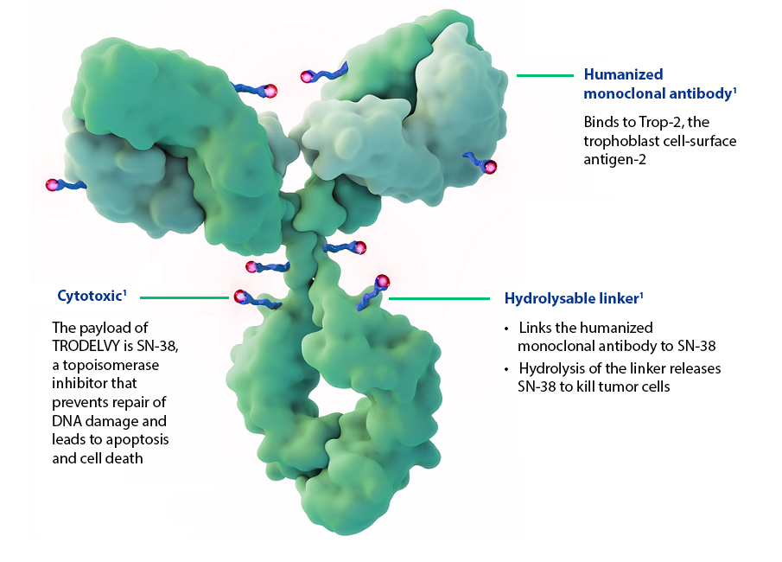
Relevant Components of an Antibody-Drug Conjugate
Antibody
Antibody/target interaction
Linker
Payload (cytotoxic drug)
Targets cancer cells
Cytotoxic drug
Destroys cancer cells
Linker
Joins antibody and drug

Slide 4
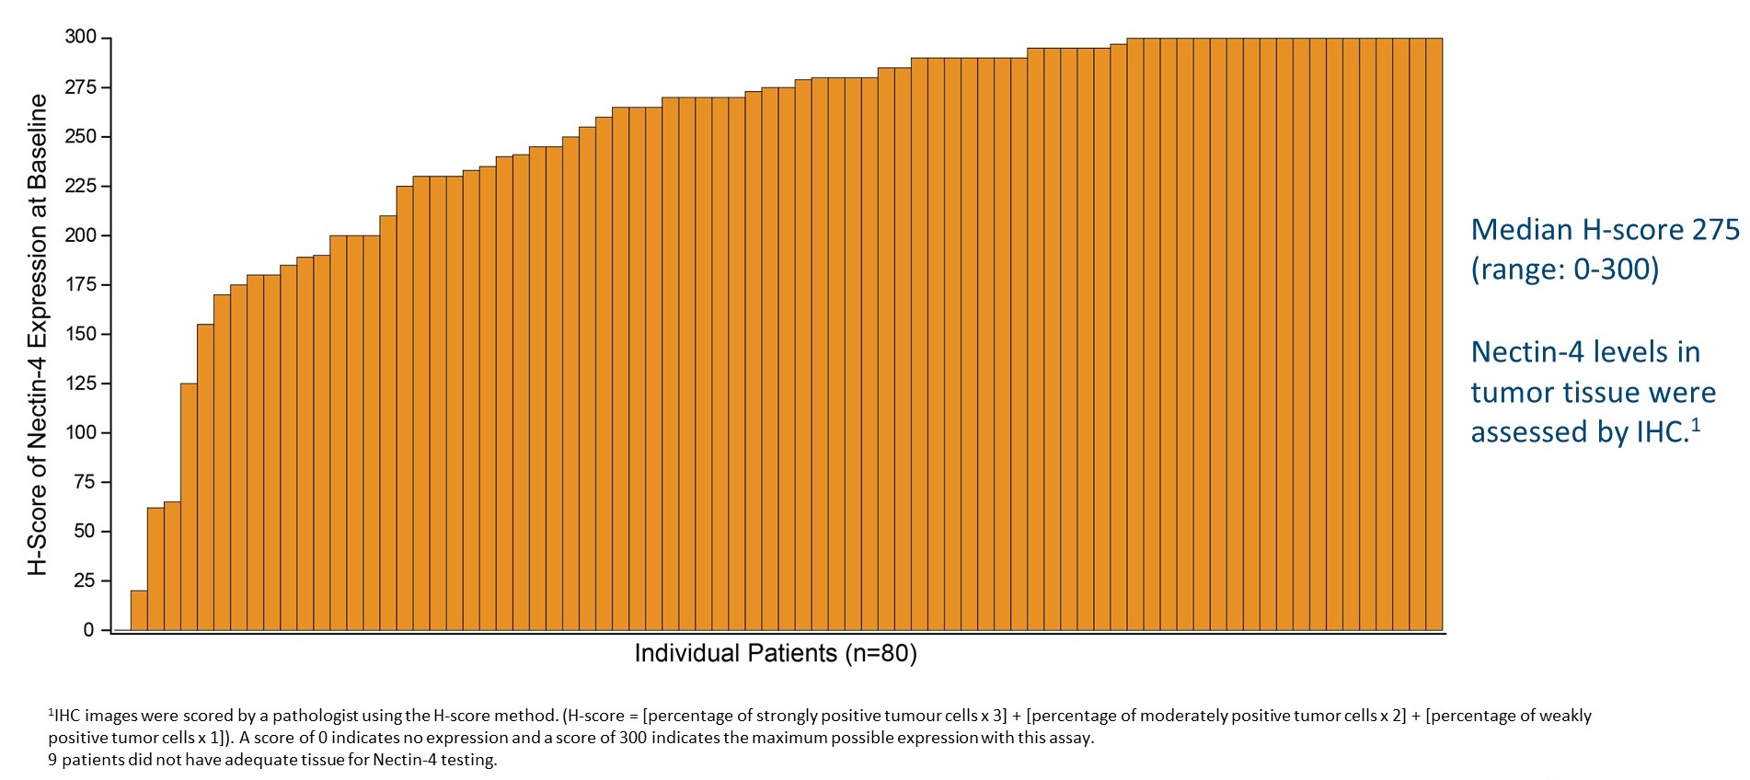
Nectin-4 is Highly Expressed in aUC → Good ADC Target

Slide 5
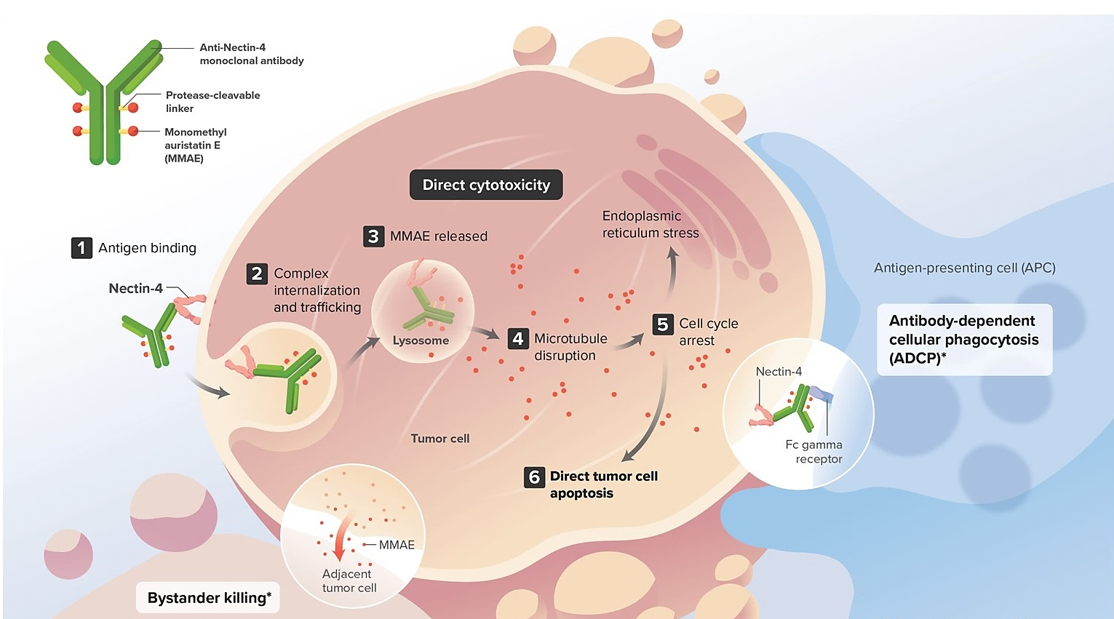
Linker → Release of ADC Payload Leads to Cancer Cell Destruction and Can Also Lead to Bystander Effect
Bystander effect: Payload (chemotherapy) molecule released from ADC through cleavage of the linker can diffuse across cell membranes to cause apoptosis in adjacent cells independent of their expression of the ADC target

Slide 6
Payload
Chemotherapy drug portion of the AD
Responsible for killing cancer cells after targeted delivery
Mechanisms of action can vary
Microtubule disrupting agents, topoisomerase inhibitors, etc.
Payloads are not created equal
Different mechanisms of resistance
Different toxicities
Are some more immunogenic?

Slide 7
Differences Among the ADC/IO Combinations
Regimen | Payload | N | Population | HER2 | ORR
Enfortumab vedotin + Pembrolizumab | MMAE (tubulin) | 43 | Cis-ineligible, tx naive | All | 73%
Disitimab vedotin + Toripalimab | MMAE (tubulin) | 39 | 60% tx naive | All | 72%
Trastuzumab deruxtecan + Nivolumab | Dxd (Topo I) | 26 | Progressed despite prior platinum | 2+ or 3+ | 36+
Sacitizumab govitecan + Pembrolizumab | SN38 (Topo I) | 41 | Progressed despite prior platinum | All | 34%

Slide 8
Summary
ADCs allow for targeted delivery of cytotoxic drugs to cancer cells
Mediate direct cancer cell killing
Potentially mitigate treatment-related toxicities by limiting off-target effects
Potentially better tolerated while being an effective cytotoxic option
Targets and payloads vary significantly among different ADCs
Different efficacy and toxicity profiles
Bystander and other off-target effects
Lead to differential toxicities
Can affect combination strategies with other drugs like IO agents

Slide 9

Thank you!
vadim.koshkin@ucsf.edu
@koshkin85

