Slide 1

Why Are Nectin-4 and Trop-2
Important Targets in Urothelial Cancer?
Vadim S Koshkin, MD
Assistant Professor
Helen Diller Family Comprehensive Cancer Center
University of California, San Francisco
San Francisco, CA
@koshkin85

Slide 2
Disclaimer
The views and opinions expressed in this educational activity are those of the faculty and do not necessarily represent the views of TotalCME, Inc., the CME providers, or the companies providing educational grants. This presentation is not intended to define an exclusive course of patient management; the participant should use their clinical judgment, knowledge, experience, and diagnostic skills in applying or adopting for professional use any of the information provided herein. Any procedures, medications, or other courses of diagnosis or treatment discussed or suggested in this activity should not be used by clinicians without evaluation of their patient's conditions and possible contraindications or dangers in use, review of any applicable manufacturer’s product information, and comparison with recommendations of other authorities. Links to other sites may be provided as additional sources of information.

Slide 3
Disclosures
Research Support (Institutions): Taiho, Clovis, Nektar, Endocyte/Novartis, Merck
Research Funding: Prostate Cancer Foundation Young Investigator Award
Consulting or Advisory Role: AstraZeneca, Astellas, Seattle Genetics, Pfizer, Clovis, EMD Serono, Dendreon, Gerson Lehrman Group, Guidepoint

Slide 4
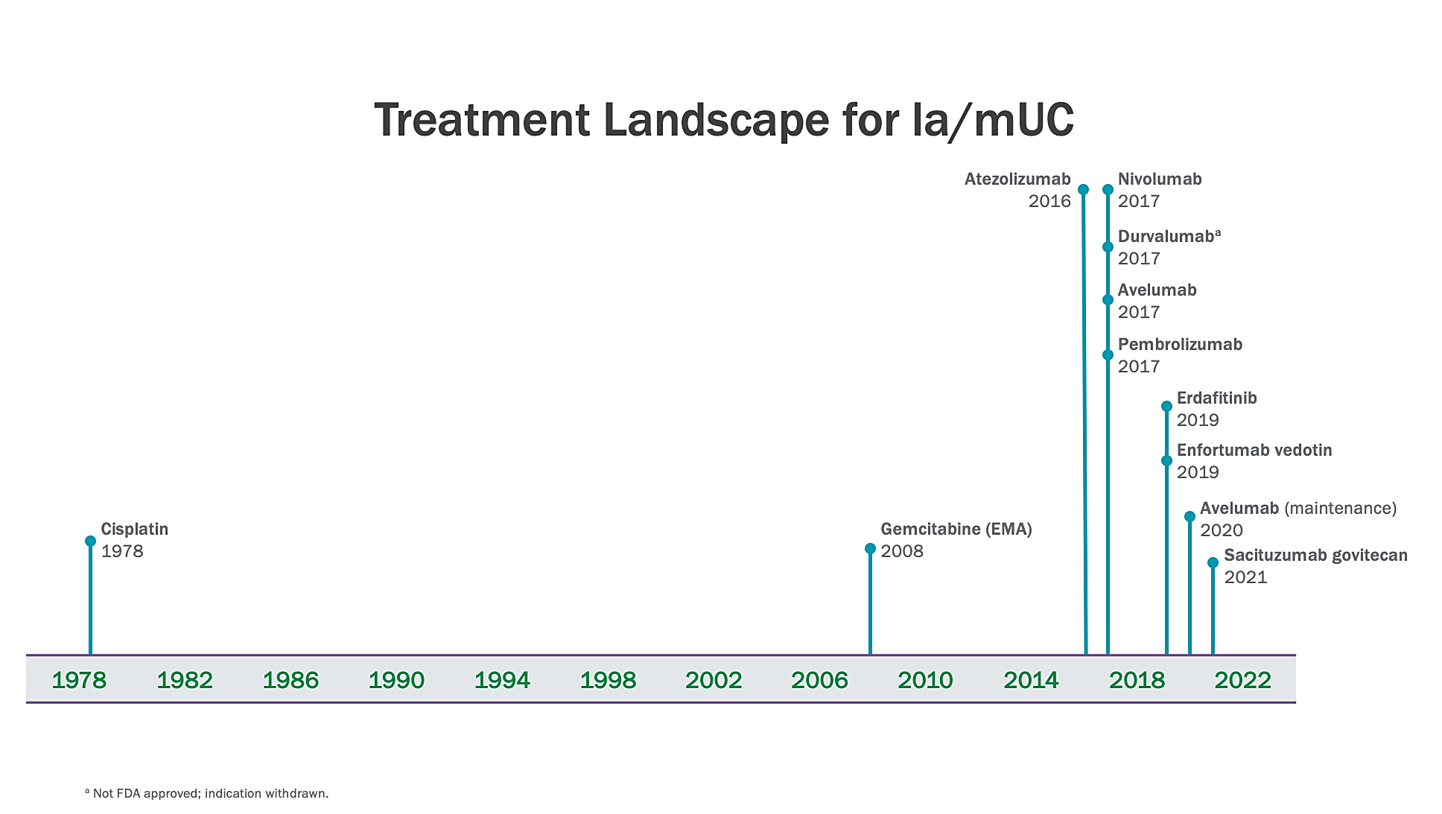

Drugs Approved for Metastatic UC

Slide 5
Current Treatment Landscape in Metastatic Urothelial Carcinoma
Cisplatin-eligible
patients
Platinum-based Chemotherapy
for
4-6 cycles
Immune Checkpoint Inhibitors
If CR/PR/SD: Avelumab switch maintenance
If PD: Multiple ICIs approved for platinum-refractory disease: Pembrolizumab (level I evidence), Nivolumab, Avelumab
Enfortumab Vedotin
Unselected Population
Can be used as 2nd line
Sacituzumab Govitecan
Unselected Population
Carboplatin-eligible
patients
Cisplatin-ineligible patients with high PD-L1 expression
(Atezolizumab only)
Erdafitinib
Patients with FGFR2/3 alterations who are
post-platinum;
Can be used as 2nd line after platinum-based chemotherapy
Platinum-ineligible
patients
(Pembrolizumab/Atezolizumab only)
1st line therapy
2nd line therapy
3rd line therapy
Consideration of clinical trials across the spectrum of metastatic UC treatment

Slide 6
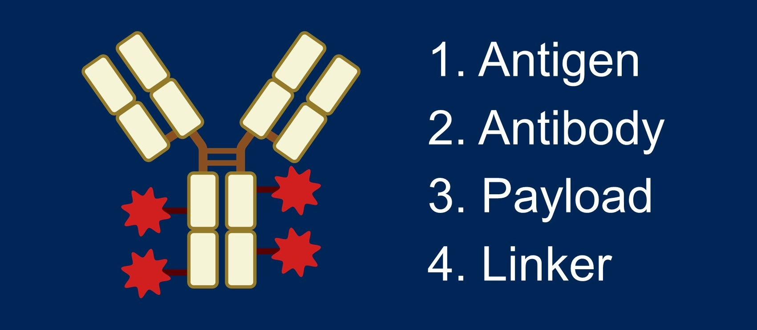
The Anatomy of an Antibody-Drug Conjugate

Slide 7
Enfortumab Vedotin
Antibody-drug conjugate targeting Nectin-4, an overexpressed protein on urothelial cancer cells
Combines anti-Nectin-4 antibody with MMAE (a microtubule-disrupting agent) via a protease-cleavable linker
Approved for treatment of refractory urothelial cancer in late 2019

Slide 8
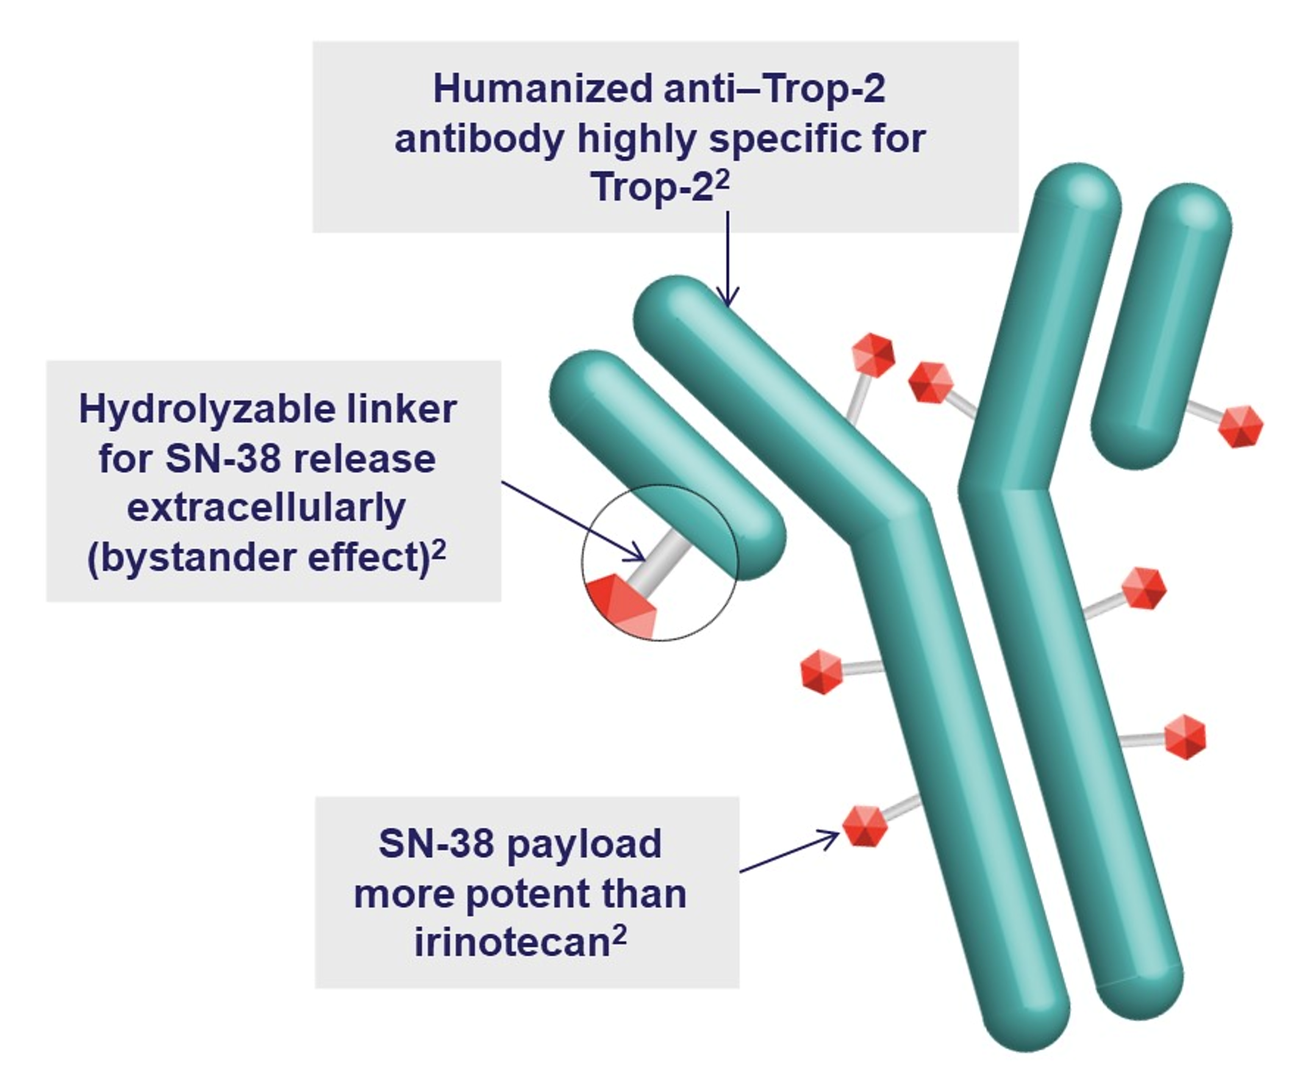
Sacituzumab Govitecan
Received accelerated approval from the FDA for the treatment of platinum and IO-refractory metastatic urothelial cancer in April 2021
Payload is SN-38, a topoisomerase inhibitor with a different side effect profile than that of enfortumab vedotin

Slide 9
Enfortumab Vedotin and Sacituzumab Govitecan
 | Enfortumab Vedotin | Sacituzumab Govitecan
Target | Nectin-4 | Trop-2
Linker | Protease-cleavable | Hydrolysable
Payload | MMAE (taxane) | SN-38 (topoisomerase inhibitor)
Treatment Population | Post 1st line of therapy | Post-platinum and IO
Response Rate (post-platinum and IO) | 41%¹ | 27%²

Slide 10
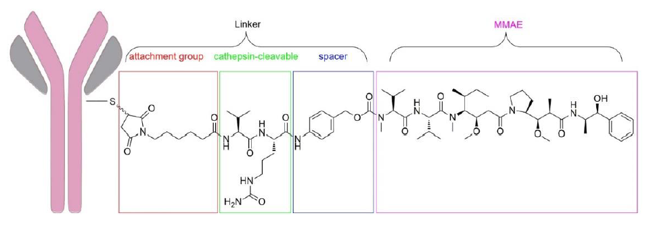
Future Antibody-Drug Conjugates in mUC
ADCs targeting HER2
  Disitamab vedotin (RC48): anti-HER2 antibody with MMAE payload (similar to enfortumab)
  Trastuzumab deruxtecan (T-DXd): anti-HER2 antibody with topoisomerase I payload
  HER2 expression in mUC: ~35-40% overall including 15% high expressors (3+ or 2+/FISH+)
    Ongoing studies to define true prevalence
Linker
MMAE
attachment group
cathepsin-cleavable
spacer

Slide 11
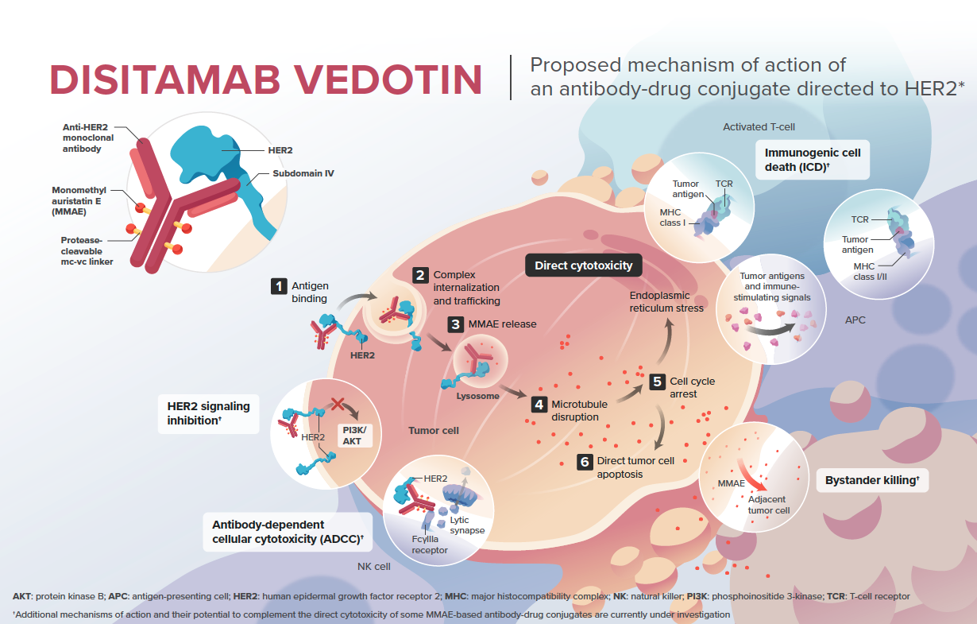
Disitamab Vedotin
Promising data from clinical trials in China as monotherapy and in combination with immune checkpoint inhibitors¹
Global phase II and phase III studies are accruing data (both monotherapy and combo)²

Slide 12

Thank you!
vadim.koshkin@ucsf.edu
@koshkin85

