Slide 1
Self-Administered Etripamil for Termination of Spontaneous Paroxysmal Supraventricular Tachycardia: Primary Analysis from the RAPID Study
Manesh R. Patel, MD Richard S. Stack Distinguished Professor Chief, Division of Cardiology Co-Director, Duke Heart Center Duke University School of Medicine Durham, NC
Bruce S Stambler¹, A John Camm², Marco Alings³, Paul Dorian⁴, Hein Heidbuchel⁵, Jaco Houtgraaf ⁶, Jose L. Merino⁷, Blandine Mondésert⁸, Philip Sager⁹, Atul Verma¹⁰, J Marcus Wharton¹¹, David B. Bharucha¹², Francis Plat¹², Silvia Shardonofsky¹², Michael Chen¹³, James E Ip¹⁴ on behalf of the RAPID investigators
¹Piedmont Heart Inst, Atlanta, GA; ²St. George's Univ of London, London, United Kingdom; ³Amphia Ziekenhuis, Breda, Netherlands; ⁴Univ of Toronto, Toronto, ON, Canada; ⁵Univ of Antwerp, Edegem, Belgium; ⁶Diakonessenhuis - Locatie Utrecht, Breda, Netherlands; ⁷La Paz Univ Hosp, Madrid, Spain; ⁸Montreal Heart Inst, Univ de Montréal, Montréal, QC, Canada; ⁹Stanford Univ, Palo Alto, CA; ¹⁰Southlake Regional Health Ctr, Univ of Toronto, Newmarket, ON, Canada; ¹¹Medical Univ of South Carolina, Charleston, SC; ¹²Milestone Pharmaceuticals, Charlotte, NC and Montreal, QC, Canada; ¹³TCM Groups, Berkeley Heights, NJ; ¹⁴Cornell Med, New York, NY

Slide 2
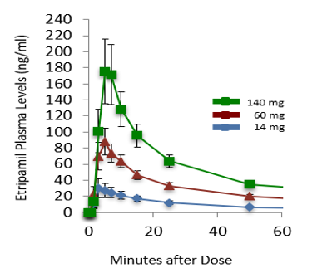
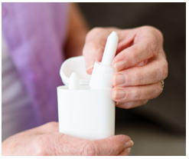
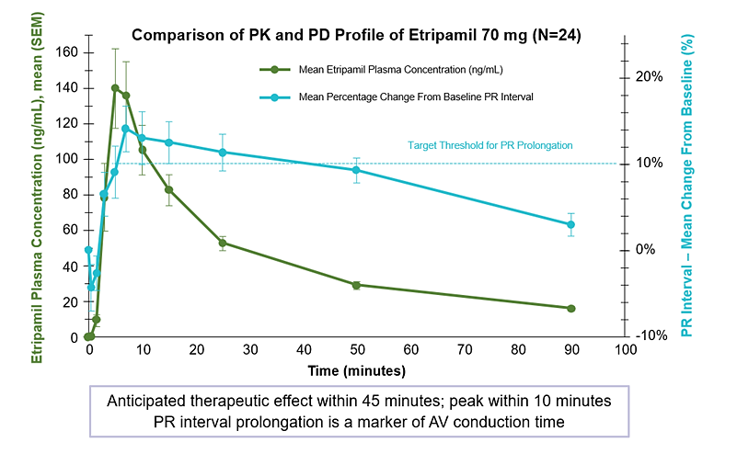
Etripamil: A New Treatment for PSVT
Novel, investigational, L-type channel calcium channel blocker
Formulated for intranasal spray with:
Rapid onset of action (T_{max} ≤ 7 min)
Short-lasting: inactivated by blood esterases
Developed to satisfy unmet need for self-administered therapy that is convenient & safe outside healthcare settings
Effective at rapidly terminating AV nodal-dependent PSVT

Slide 3
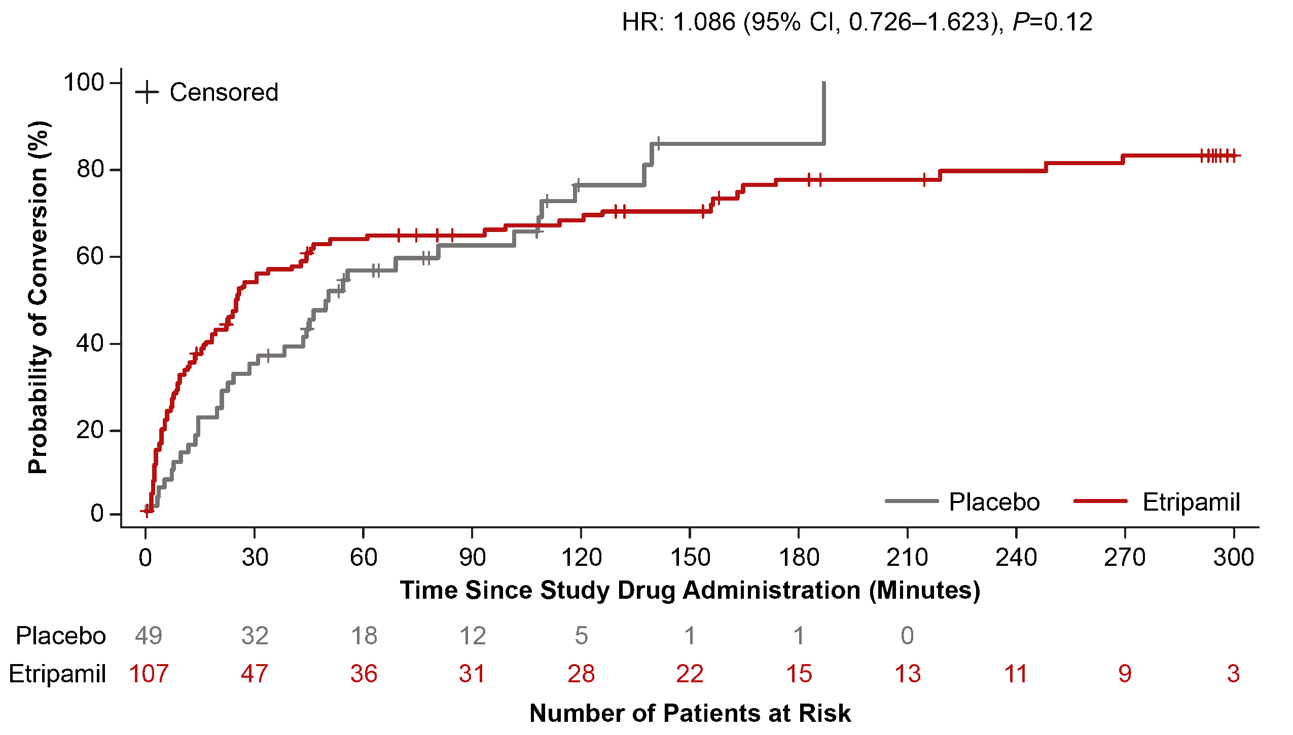
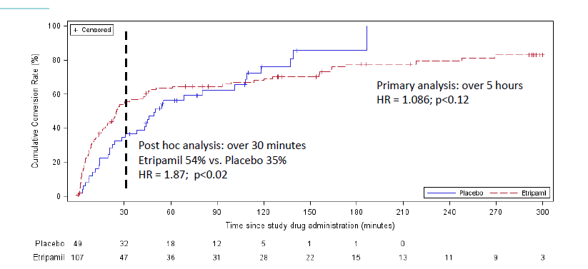
Phase 3, NODE-301 (Part 1) Study Results
Randomized, double-blind, placebo-controlled, phase 3 study
Primary endpoint: Time for PSVT conversion to sinus rhythm
​
Did not meet primary endpoint of conversion of PSVT over 5 hours
Post-hoc efficacy analysis demonstrated a clinically meaningful treatment effect, consistent with the drug’s pharmacology
Etripamil was safe and well-tolerated when self-administered in a medically unsupervised setting

Slide 4
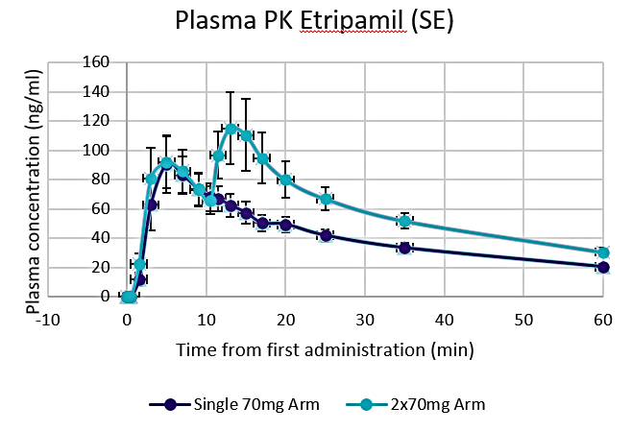
NODE-301 Efficacy – Time to Conversion Over 45 Minutes
Repeat Dose Option for RAPID
Primary Endpoint for RAPID
54%
Etripamil 70mg
32%
35%
14%
Placebo
HR 1.87, p=0.02 (post-hoc)

Slide 5
RAPID Phase III Clinical Study Design
Objective: Evaluate the efficacy and safety of etripamil nasal spray in patients experiencing a PSVT episode in an at-home setting
Screening visit
Outcome measures
Key inclusion criteria
Patients ≥18 years
ECG-documented diagnosis of PSVT
Hx of PSVT lasting ≥20 min
Test dose visit
At-Home Treated PSVT Event
Independent Adjudication, Primary Efficacy Analysis
Test dose given
70 mg etripamil repeat dose regimen
Administer in office while in sinus rhythm for safety evaluation
RANDOMIZATION (1:1)
PLACEBO NS¹
Patient recognizes symptoms
Applies cardiac monitor (ECG)
Attempts VM
Administers double-blind study drug
If symptoms persist for 10 minutes, dose study drug again
ECG of event is adjudicated for PSVT; only PSVT events count toward primary efficacy
Primary Endpoint = PSVT conversion to SR Kaplan Meier analysis over 30 min
Power: 90%, alpha < 0.05; delta = 19% in conversion rates between arms
Study concluded after 180 confirmed PSVT events²
Key exclusion criteria
Evidence of ventricular pre-excitation
2nd or 3rd degree AV block
History of severe symptoms of hypotension or syncope during PSVT
ETRIPAMIL NS
70 mg / 70 mg¹

Slide 6
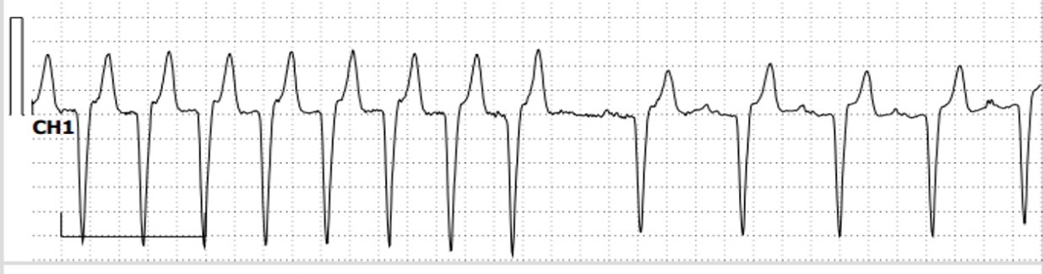
RAPID Study Patient Populations
Overall safety population¹
N = 706
Blinded Adjudication of Safety Population
Test dose¹
N = 706
14 not randomized, (9 test dose failures, 5 Other)
No
ECG
(9%)
Randomized²
N = 692
102: discontinued by time of RAPID data cut.³
335: no PSVT episode at time of RAPID data cut;³ patients continuing in RAPID Extension study, blind maintained.
Non-PSVT (19%)
Verified PSVT (72%)
Safety population⁴
N = 255
Placebo
n = 120
Etripamil
n = 135
Efficacy population⁵
N = 184
PSVT treated with placebo
n = 85
PSVT treated with etripamil
n = 99

Slide 7
Demographics and Baseline Characteristics
 | Placebo (N=120) | Etripamil (N=135) | Overall (N=255)
Age, years
Mean (SD) | 56.2 (12.0) | 52.4 (14.0) | 54.2 (13.2)
Median (range) | 58.0 (21, 78) | 52.0 (19, 82) | 55.0 (19, 82)
Sex, female, n (%) | 88 (73.3) | 93 (68.9) | 181 (71.0)
Race, n (%)
American Indian or Alaska native | 0 | 1 (0.7) | 1 (0.4)
Asian | 4 (3.3) | 2 (1.5) | 6 (2.4)
Black or African American | 3 (2.5) | 4 (3.0) | 7 (2.7)
White | 110 (91.7) | 126 (93.3) | 236 (92.5)
Other | 3 (2.5) | 2 (1.5) | (2.0)
PSVT confirmation duration, years
Mean (SD) | 1.9 (4.2) | 2.8 (6.1) | 2.4 (5.3)
Median (range) | 0.4 (0.0, 32.2) | 0.4 (0.0, 30.7) | 0.4 (0.0, 32.2)
PSVT episodes in past year
Mean (SD) | 10.8 (22.9) | 6.3 (13.9) | 8.4 (18.8)
Median (range) | 5.0 (0.0, 200.0) | 3.0 (0.0, 150.0) | 4.0 (0.0, 150.0)
Lifetime emergency department visits for PSVT
Mean (SD) | 3.9 (11.2) | 4.6 (15.5) | 4.3 (13.6)
Median (range) | 2.0 (0.0, 120.0) | 2.0 (0.0, 160.0) | 2.0 (0.0, 160.0)
Concomitant medications, n (%)
Beta blocker or calcium channel blocker | 80 (66.7) | 86 (63.7) | 166 (65.1)
Beta blocker only | 40 (33.3) | 45 (33.3) | 85 (33.3)
Calcium channel blocker only | 29 (24.2) | 30 (22.2) | 59 (23.1)
Beta blocker and calcium channel blocker | 11 (9.2) | 11 (8.1) | 22 (8.6)

Slide 8
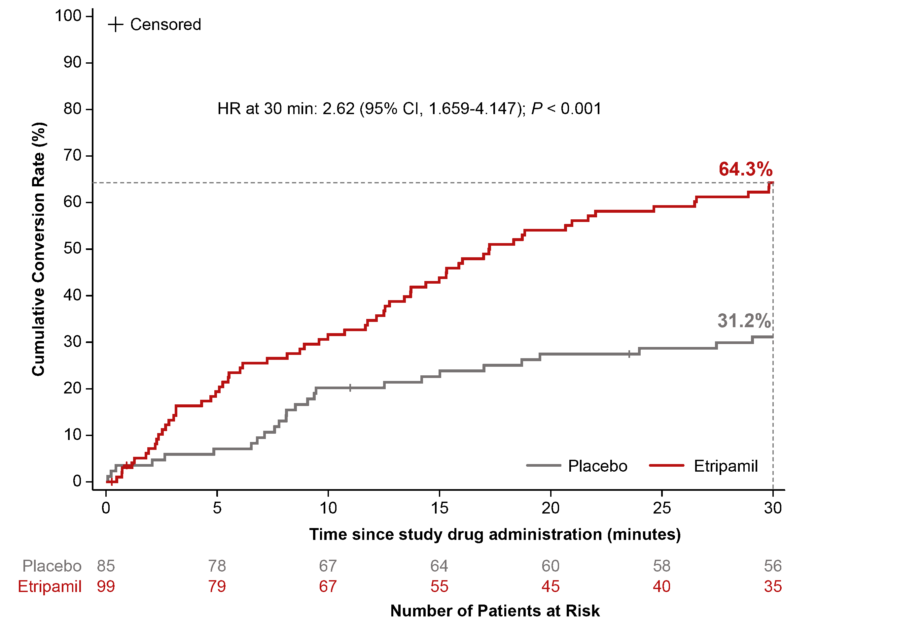
Primary Endpoint: Conversion of Adjudicated PSVT to Sinus Rhythm
Primary: 30-Minute Endpoint
300-Minute Endpoint
30 min.: HR = 2.62 (95% CI, 1.659-4.147); p<0.001
HR at 300 min: 1.70 (95% CI, 1.213-2.383); p<.001
81.8%
73.5%
69.4%
64.3%
54.5%
31.2%
"+" symbol on graph indicates censoring for signal loss (n=4 over 30 minutes)
"+" symbol on graph indicates censoring for signal loss (n=8 over 300 minutes)

Slide 9
Median Time to Conversion
Etripamil
17.2 min
Placebo
53.5 min
Number of Patients at Risk

Slide 10
Secondary Endpoints: Rescue Medical Interventions, Emergency Department Utilization
Patients Seeking Medical Intervention
Patients Seeking Emergency Department
P=0.1193
P=0.103
P=0.009
P=0.076
P=0.209
P=0.035
n=13
n=16
n=21
n=15
n=34
n=30
n=12
n=14
n=18
n=14
n=30
n=28
n=49
n=107
n=85
n=99
n=134
n=206
n=49
n=107
n=85
n=99
n=134
n=206

Slide 11
RAPID Safety – Direct ECG Reading¹
 | Placebo Randomized Dose² N=120 | Etripamil Randomized Dose² N=135
Non-sustained ventricular tachycardia | 19 (16.4) | 18 (14.1)
Sustained ventricular tachycardia (≥ 30 seconds) | 1 (0.9)³ | 0
PSVT Recurrence | 5 (4.3) | 4 (3.1)
Atrial Fibrillation ≥ 30 seconds | 4 (3.5) | 1 (0.8)
Atrial Tachycardia ≥ 30 seconds | 1 (0.9) | 2 (1.6)
Prolonged PR, for duration of ≥ 30 seconds | 1 (0.9) | 2 (1.6)
Pause ≥ 3 seconds | 1 (0.9)⁴ | 1 (0.8)⁴
Atrial Flutter ≥ 30 seconds | 1 (0.9) | 0
Sinus Bradycardia ≤ 40 bpm | 1 (0.9) | 0
PVC greater than 6 PVCs within 45 seconds | 0 | 0
2nd Degree AV Block - Mobitz I AV Block | 0 | 0
2nd Degree AV Block - Mobitz II AV Block | 0 | 0
3rd Degree AV Block | 0 | 0

Slide 12
RAPID Safety – Adverse Events
Subjects with Randomized-Period TEAE, Incidence >5%, n (%) | Placebo Randomized Dose² (n=120) | Etripamil Randomized Dose² (n=135)
Nasal discomfort | 6 (5.0) | 31 (23.0)
Nasal congestion | 1 (0.8) | 17 (12.6)
Rhinorrhea | 3 (2.5) | 12 (8.9)
Epistaxis | 2 (1.7) | 8 (5.9)³
Subjects with Randomized-Period TEAE,¹ n (%) | Placebo Randomized Dose² (n=120) | Etripamil Randomized Dose² (n=135)
Syncope | 0.0 | 0.0
Loss of Consciousness | 0.0 | 0.0
Pre-Syncope | 0.0 | 0.0
Dizziness | 0.0 | 1 (0.7)⁴

Slide 13
RAPID Study: Summary and Conclusions
RAPID study achieved primary efficacy endpoint of terminating PSVT with self-administered etripamil, using symptom-based optional repeat dosing (HR 2.62, p < 0.001)
Conversion of PSVT to sinus rhythm: 64.3% at 30 minutes, 73.5% at 60 minutes
Favorable safety and tolerability data were consistent with those observed in prior etripamil trials
No new safety signals or AEs with a 2nd dose of etripamil
Majority of AEs are mild, local, and transient
Pooled analysis with NODE-301 showed a significant reduction in ED utilization and rescue / medical intervention
Results demonstrated a potential management strategy for patients to self-treat episodes with etripamil in a medically unsupervised setting
Ongoing analysis of RAPID open-label period and NODE-303 trial will provide more insights into the safety and efficacy of etripamil for recurrent episodes of PSVT

