Slide 1

Rivaroxaban to Reduce the Risk of Major Venous and Arterial Thrombotic Events, Hospitalization and Death in Medically Ill Outpatients with COVID-19: Primary Results of the PREVENT-HD Randomized Clinical Trial
Gregory Piazza, MD, MS
Director, Vascular Medicine Section, Division of Cardiovascular Medicine
Associate Professor of Medicine, Harvard Medical School
Brigham and Women's Faulkner Hospital, Cardiology Clinic
Boston, MA

Slide 2
Disclaimer
The views and opinions expressed in this educational activity are those of the faculty and do not necessarily represent the views of TotalCME, Inc., the CME providers, or the companies providing educational grants. This presentation is not intended to define an exclusive course of patient management; the participant should use their clinical judgment, knowledge, experience, and diagnostic skills in applying or adopting for professional use any of the information provided herein. Any procedures, medications, or other courses of diagnosis or treatment discussed or suggested in this activity should not be used by clinicians without evaluation of their patient's conditions and possible contraindications or dangers in use, review of any applicable manufacturer’s product information, and comparison with recommendations of other authorities. Links to other sites may be provided as additional sources of information.

Slide 3
Background: Spring 2020
Hospitalized COVID-19 patients were recommended to receive thromboprophylaxis as “acute, medically ill” patients per ACC, ACCP, WHO, and ISTH guidelines
Rivaroxaban was approved in the US for thromboprophylaxis in hospitalized acute, medically ill patients who were at risk for VTE but low risk for bleeding
D-dimer in COVID-19 was identified as a marker of a procoagulant state and a risk factor for VTE, clinical deterioration, and death
Despite focus on hospitalized patients, the majority of patients with COVID-19 were treated as outpatients
Outpatients with COVID-19 were suspected to be at risk for venous and arterial thrombotic events, especially in setting of risk factors
Histopathological evidence suggested that at least part of the deterioration in lung function leading to hospitalization may have been due to in situ pulmonary artery thrombosis

Slide 4
Background: Spring 2020
Hospitalized COVID-19 patients were recommended to receive thromboprophylaxis as “acute, medically ill” patients per ACC, ACCP, WHO, and ISTH guidelines
Rivaroxaban was approved in the US for thromboprophylaxis in hospitalized acute, medically ill patients who were at risk for VTE but low risk for bleeding
D-dimer in COVID-19 was identified as a marker of a procoagulant state and a risk factor for VTE, clinical deterioration, and death
Despite focus on hospitalized patients, the majority of patients with COVID-19 were treated as outpatients
Outpatients with COVID-19 were suspected to be at risk for venous and arterial thrombotic events, especially in setting of risk factors
Histopathological evidence suggested that at least part of the deterioration in lung function leading to hospitalization may have been due to in situ pulmonary artery thrombosis

Slide 5
Background: Spring 2020
Hospitalized COVID-19 patients were recommended to receive thromboprophylaxis as “acute, medically ill” patients per ACC, ACCP, WHO, and ISTH guidelines
Rivaroxaban was approved in the US for thromboprophylaxis in hospitalized acute, medically ill patients who were at risk for VTE but low risk for bleeding
D-dimer in COVID-19 was identified as a marker of a procoagulant state and a risk factor for VTE, clinical deterioration, and death
Despite focus on hospitalized patients, the majority of patients with COVID-19 were treated as outpatients
Outpatients with COVID-19 were suspected to be at risk for venous and arterial thrombotic events, especially in setting of risk factors
Histopathological evidence suggested that at least part of the deterioration in lung function leading to hospitalization may have been due to in situ pulmonary artery thrombosis

Slide 6
Background: Spring 2020
Hospitalized COVID-19 patients were recommended to receive thromboprophylaxis as “acute, medically ill” patients per ACC, ACCP, WHO, and ISTH guidelines
Rivaroxaban was approved in the US for thromboprophylaxis in hospitalized acute, medically ill patients who were at risk for VTE but low risk for bleeding
D-dimer in COVID-19 was identified as a marker of a procoagulant state and a risk factor for VTE, clinical deterioration, and death
Despite focus on hospitalized patients, the majority of patients with COVID-19 were treated as outpatients
Outpatients with COVID-19 were suspected to be at risk for venous and arterial thrombotic events, especially in setting of risk factors
Histopathological evidence suggested that at least part of the deterioration in lung function leading to hospitalization may have been due to in situ pulmonary artery thrombosis

Slide 7
Background: Spring 2020
Hospitalized COVID-19 patients were recommended to receive thromboprophylaxis as “acute, medically ill” patients per ACC, ACCP, WHO, and ISTH guidelines
Rivaroxaban was approved in the US for thromboprophylaxis in hospitalized acute, medically ill patients who were at risk for VTE but low risk for bleeding
D-dimer in COVID-19 was identified as a marker of a procoagulant state and a risk factor for VTE, clinical deterioration, and death
Despite focus on hospitalized patients, the majority of patients with COVID-19 were treated as outpatients
Outpatients with COVID-19 were suspected to be at risk for venous and arterial thrombotic events, especially in setting of risk factors
Histopathological evidence suggested that at least part of the deterioration in lung function leading to hospitalization may have been due to in situ pulmonary artery thrombosis

Slide 8
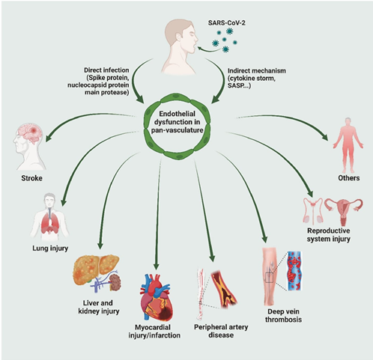
Background: Spring 2020
Hospitalized COVID-19 patients were recommended to receive thromboprophylaxis as “acute, medically ill” patients per ACC, ACCP, WHO, and ISTH guidelines
Rivaroxaban was approved in the US for thromboprophylaxis in hospitalized acute, medically ill patients who were at risk for VTE but low risk for bleeding
D-dimer in COVID-19 was identified as a marker of a procoagulant state and a risk factor for VTE, clinical deterioration, and death
Despite focus on hospitalized patients, the majority of patients with COVID-19 were treated as outpatients
Outpatients with COVID-19 were suspected to be at risk for venous and arterial thrombotic events, especially in setting of risk factors
Histopathological evidence suggested that at least part of the deterioration in lung function leading to hospitalization may have been due to in situ pulmonary artery thrombosis

Slide 9
Study Design
Randomized, double-blind, placebo-controlled, event-driven study**
Screening Period Up to 14 days
Double-Blind
Treatment Period
Post Treatment Period
Symptomatic patients with positive COVID-19 test for infection
(eg, PCR, antigen)
Rivaroxaban 10 mg OD
(+ standard of care)
Screening Visit
Day -14 to Day -1#
R
Stratification by the time from COVID-19 positive test to randomization (1 to 5 days inclusive, 6 to 14 days inclusive)
Placebo OD
(+ standard of care)
Randomization Visit (Baseline)
Day 1
Study intervention sent to participant after randomization
Visit:
Screen
(TC or IWI)
Day 1
(TC or IWI)
Day 3 (±1)
(TC or IWI)
Day 14 (±7)
(TC or IWI)
Day 35 (±6)
(Last Dose, EOT)
(TC or IWI)
Day 49 (±7)
(Follow-up, EOT)
(TC or IWI)
**Stopped early due to a lower-than-expected event rate
EOT, end of treatment; IWI, interactive web Interface; OD, once daily; PCR, polymerase chain reaction; TC, telephone contact

Slide 10
Primary Efficacy Outcome
ITT vs mITT Analysys Sets

Slide 11
Primary Efficacy Outcome
ITT vs mITT Analysys Sets
ITT (n=1284)
22
19
3
2
21
17
2
2
12
16
2
2
11
15
1
1

Slide 12
Primary Efficacy Outcome
ITT vs mITT Analysys Sets
ITT (n=1284)
mITT (n=1197)
22
19
3
2
21
17
2
2
12
16
2
2
11
15
1
1
Note: mITT=randomized participants who took at least one dose of study intervention

Slide 13
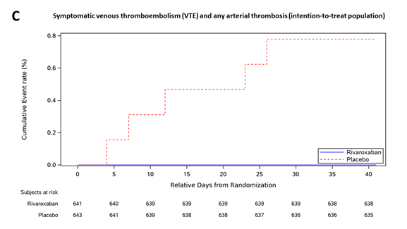
Additional Analyses
ITT Analysis Set
Post Hoc Exploratory Outcome:
Symptomatic VTE and Arterial Thrombotic Events
First Major Secondary Outcome
Log-rank P=0.025
2
7

Slide 14
Safety Outcomes: Bleedinmg Safety Analysis Set
p=0.01
p=0.01
1
9
1
17
5

Slide 15
Conclusions
Rivaroxaban, prescribed for 35 days in nonhospitalized patients with symptomatic COVID-19 at risk for thrombosis, was not found to reduce a composite endpoint of venous and arterial thrombotic events, hospitalization, and death
There was a significant reduction in venous and arterial thrombotic events
Bleeding overall was low and generally consistent with the known safety profile of rivaroxaban
With the caveat that the trial was underpowered to provide a definitive conclusion, these data do not support routine antithrombotic prophylaxis in nonhospitalized patients with symptomatic COVID-19

