Slide 1
New Agents in Hypertension:
The BrigHTN Trial
Sreekanth Vemulapalli, MD
Assistant Professor of Medicine
Division of Cardiology
Duke University School of Medicine
Durham, NC

Slide 2
Disclaimer
The views and opinions expressed in this educational activity are those of the faculty and do not necessarily represent the views of TotalCME, Inc., the CME providers, or the companies providing educational grants. This presentation is not intended to define an exclusive course of patient management; the participant should use their clinical judgment, knowledge, experience, and diagnostic skills in applying or adopting for professional use any of the information provided herein. Any procedures, medications, or other courses of diagnosis or treatment discussed or suggested in this activity should not be used by clinicians without evaluation of their patient's conditions and possible contraindications or dangers in use, review of any applicable manufacturer’s product information, and comparison with recommendations of other authorities. Links to other sites may be provided as additional sources of information.

Slide 3
Background
Of patients with hypertension in the United States, 10% have resistant hypertension
Treatment-resistant hypertension: Uncontrolled blood pressure on at least 3 drugs of different classes at maximally tolerated doses, including a diuretic
Increased risk of cardiovascular and renal events
Currently suggested fourth-line agent: Spironolactone
Off-target effects can limit dosing
Baxdrostat is an oral aldosterone synthase inhibitor

Slide 4
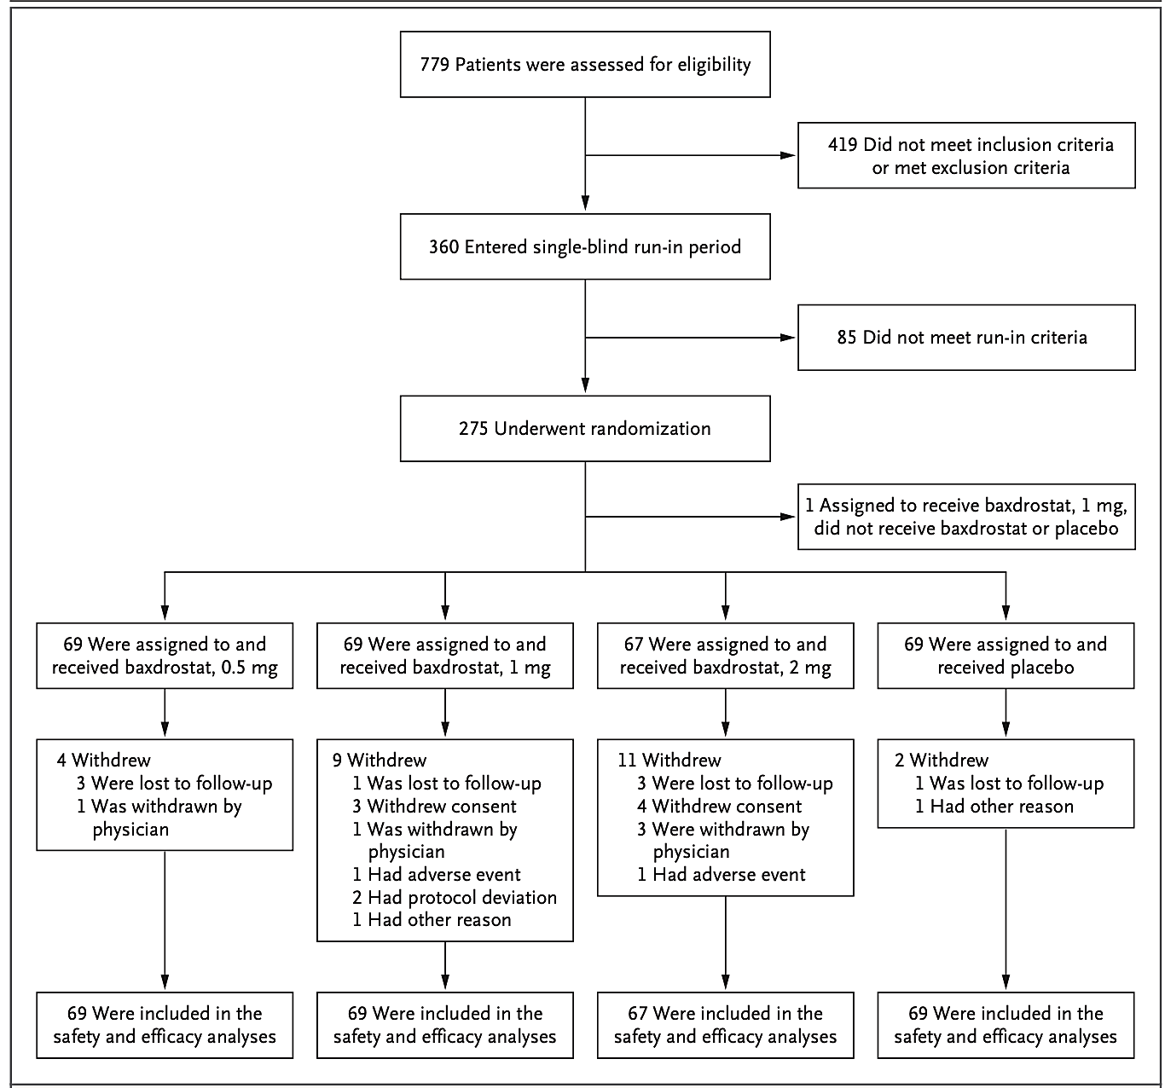
BrigHTN: Phase 2 Study
Inclusion/Exclusion
Inclusion:
18 years of age or older
Stable doses of at least 3 antihypertensives
Including a diuretic
Mean office blood pressure of >130/80 mm Hg
Exclusion:
Mean office SBP of at least 180 mm Hg
Mean office DBP of at least 110 mm Hg
Uncontrolled diabetes
eGFR <45 ml/1.73 m2
Screening, Randomization and Follow-up

Slide 5
Endpoints
Primary endpoint: Change in mean seated blood pressure from baseline to 12 weeks vs placebo
Prespecified safety events:
  Hyperkalemia
  Hyponatremia
  HTN requiring intervention

Slide 6
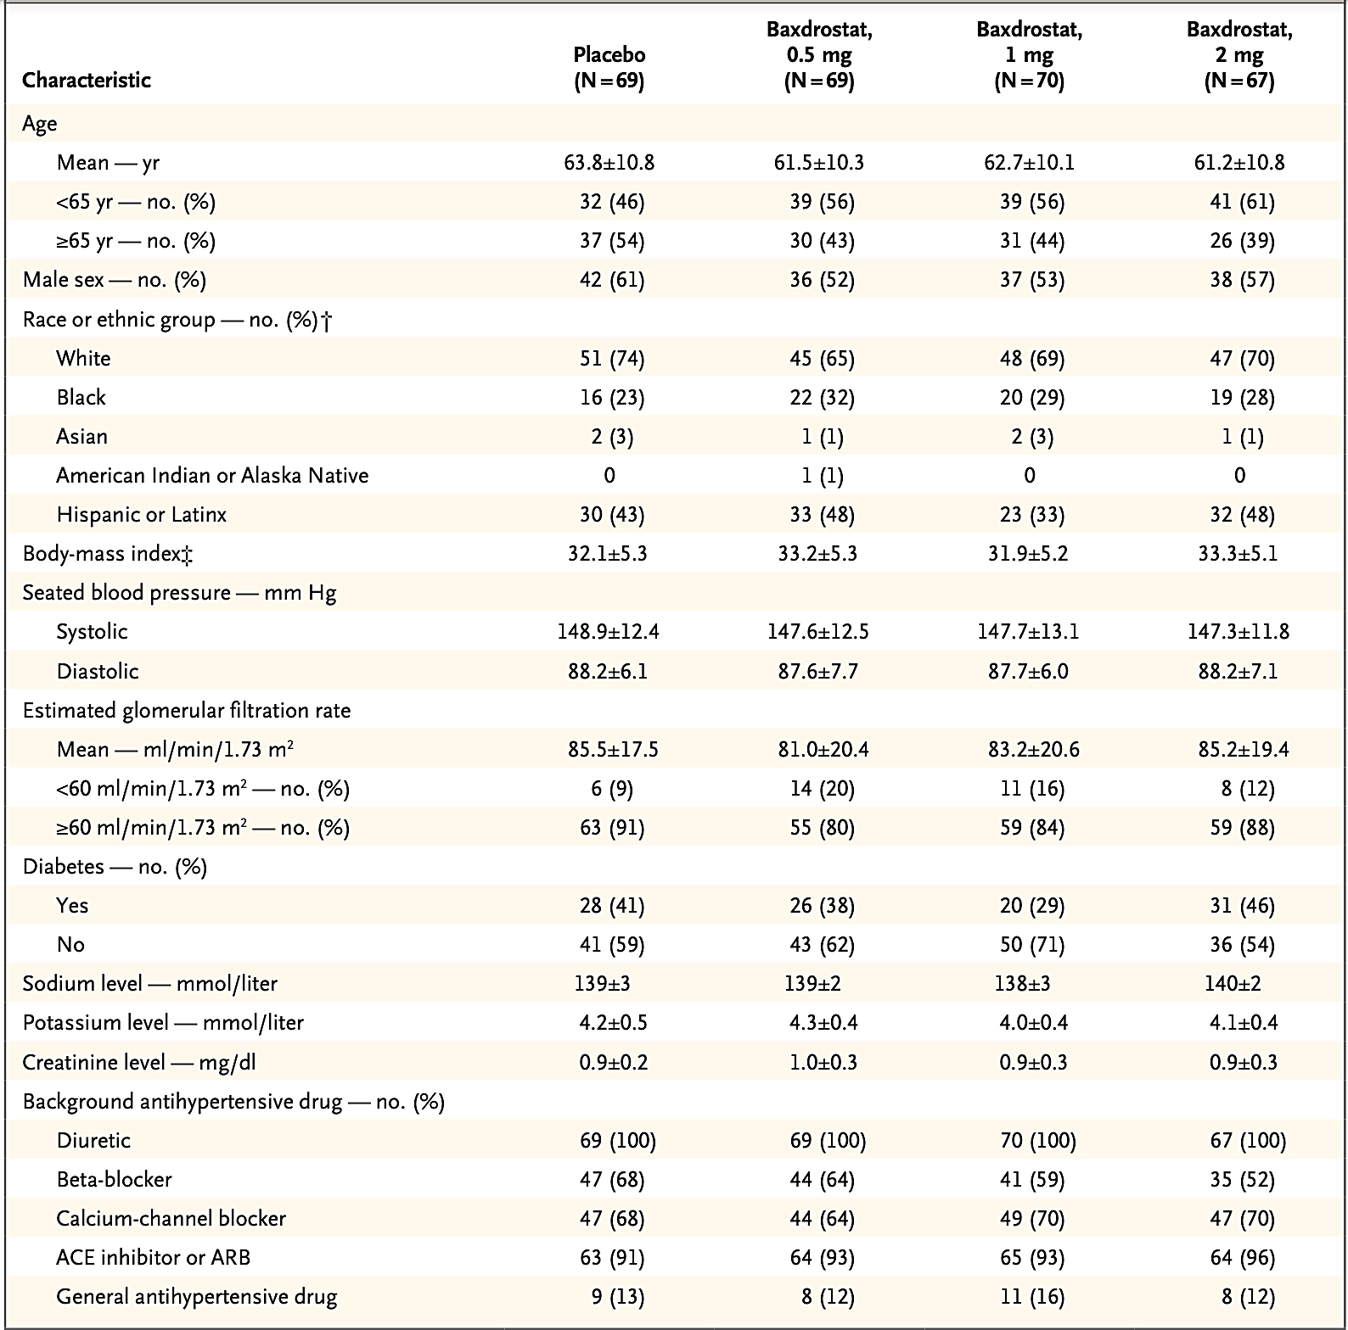
Baseline Characteristics

Slide 7
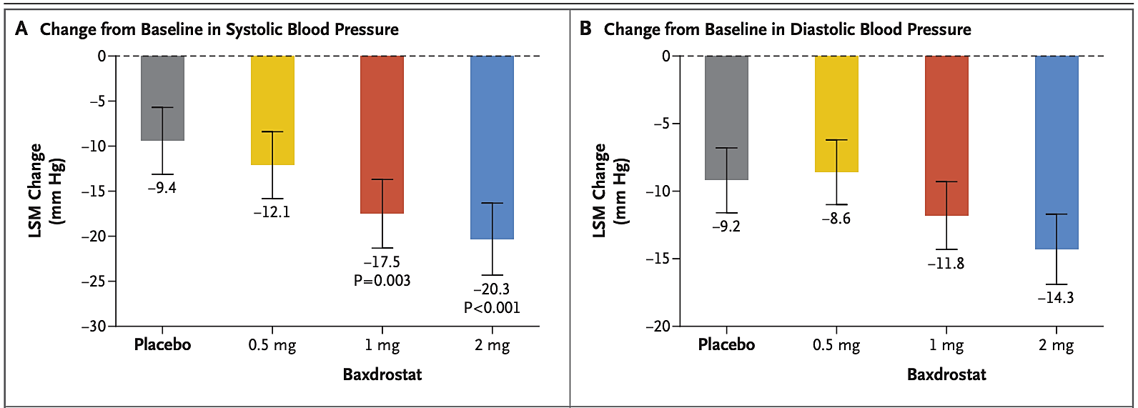
Primary Endpoint

Slide 8
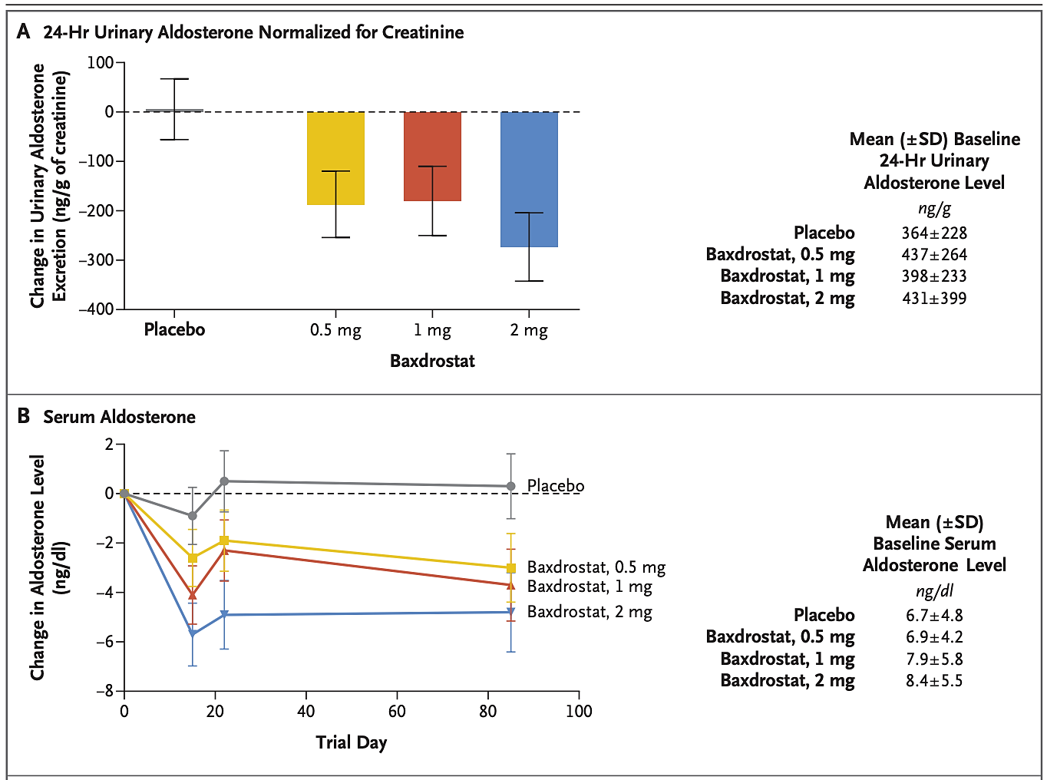
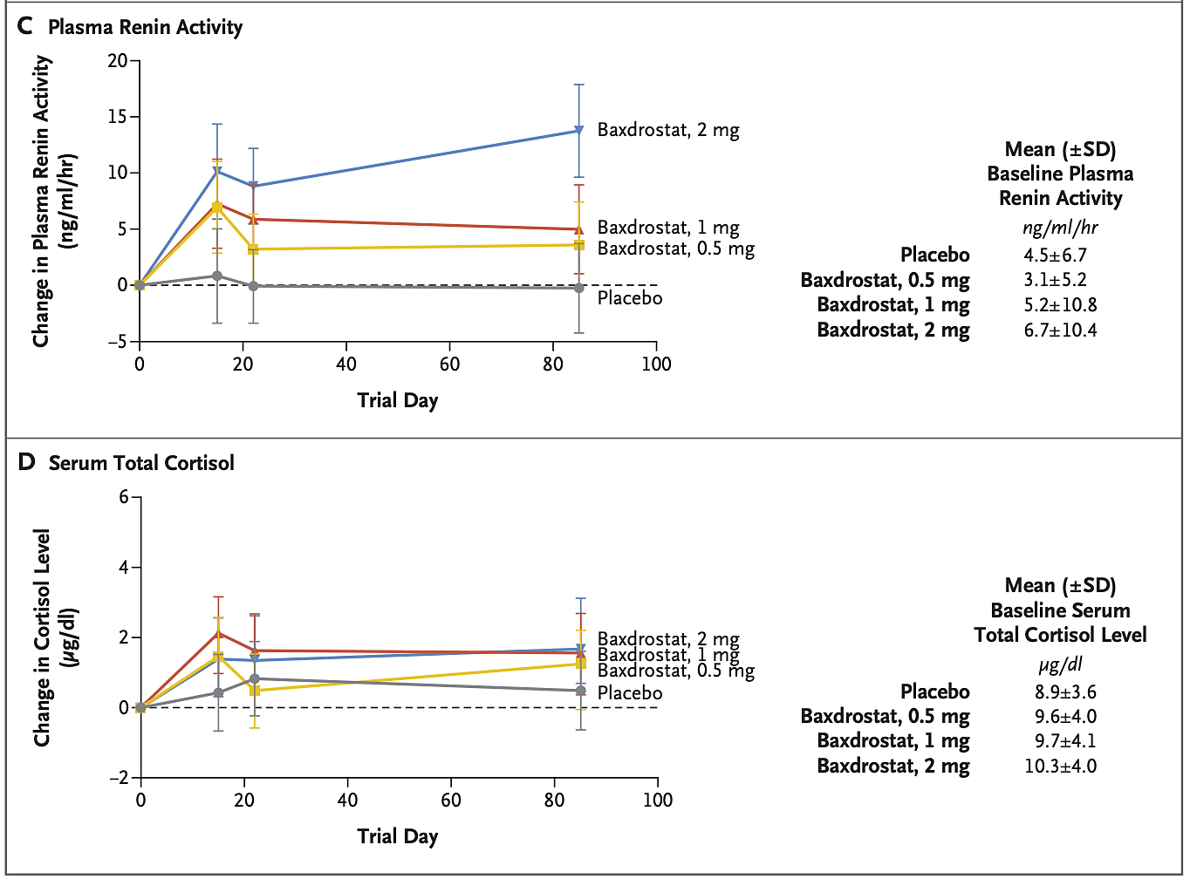
Pharmacodynamic Measures

Slide 9
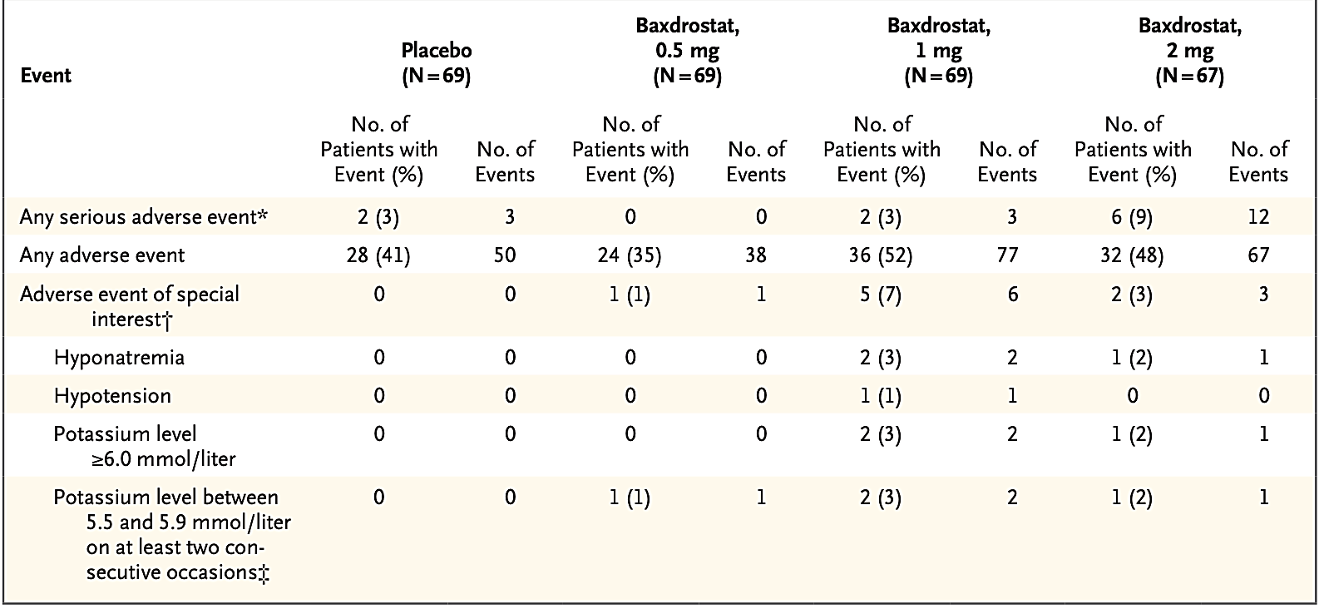
Adverse Events
UTI
Headache
Hyperkalemia
Fatigue
89% not related

Slide 10
Conclusions
Treatment-resistant hypertension is common and associated with adverse cardiovascular and renal events
Spironolactone is suggested as fourth-line therapy
Baxdrostat lowered mean office blood pressure as compared to placebo in patients with resistant hypertension
  No substantial impact on cortisol levels
Phase 3 trial with longer follow-up needed
Direct comparison to spironolactone as fourth-line agent needed

