Slide 1
Sustained Blood Pressure Lowering Effect With the Dual Endothelin Receptor Antagonist Aprocitentan in Resistant Hypertension: Results From a Randomized, Controlled Study Including a Withdrawal Phase
Markus Schlaich, MD; Marc Bellet, MD; Michael Weber, MD; Parisa Danaietash, PhD; George Bakris, MD; John Flack, MD, MPH; Roland Dreier, PhD; Mouna Sassi-Sayadi, MS; Lloyd Haskell, MD; Krzysztof Narkiewicz, MD, PhD; Ji-Guang Wang, MD, PhD; Schlaich MP, et al. Lancet. Nov. 7, 2022. doi:10.1016/S0140-6736(22)02034-7 Schlaich MP, et al. Lancet. Nov. 7, 2022. doi:10.1016/S0140-6736(22)02034-7
On behalf of the PRECISION investigators.
George L. Bakris, MD Professor of Medicine Director, American Heart Association Comprehensive Hypertension Center University of Chicago Medicine Chicago, IL

Slide 2
Disclaimer
The views and opinions expressed in this educational activity are those of the faculty and do not necessarily represent the views of TotalCME, Inc., the CME providers, or the companies providing educational grants. This presentation is not intended to define an exclusive course of patient management; the participant should use their clinical judgment, knowledge, experience, and diagnostic skills in applying or adopting for professional use any of the information provided herein. Any procedures, medications, or other courses of diagnosis or treatment discussed or suggested in this activity should not be used by clinicians without evaluation of their patient's conditions and possible contraindications or dangers in use, review of any applicable manufacturer’s product information, and comparison with recommendations of other authorities. Links to other sites may be provided as additional sources of information.

Slide 3
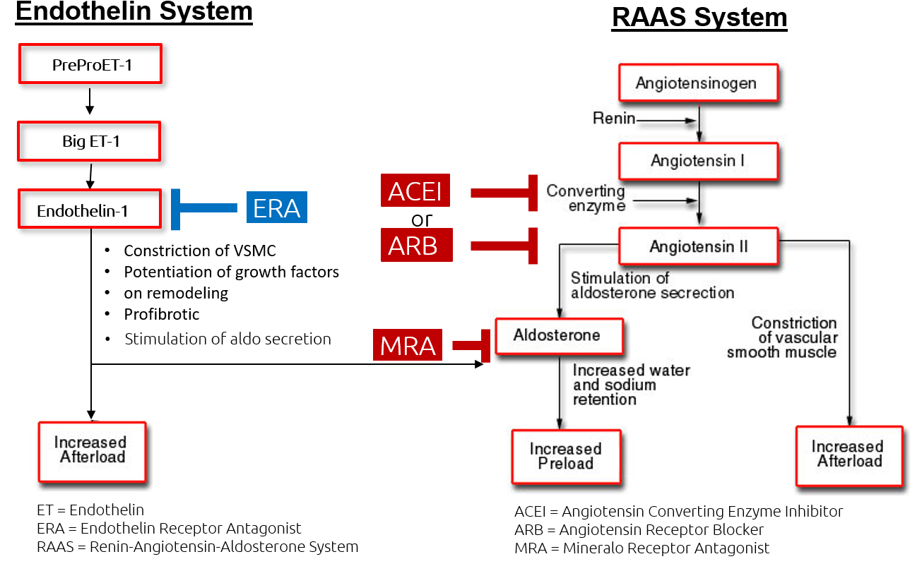

Background
Stimulation of
Aldosterone secretion

Slide 4
Background
Failure to control blood pressure (BP) with currently available drugs suggests that relevant pathophysiologic pathways remain unopposed
Endothelin (ET) has been implicated in the pathogenesis of hypertension^{1,2}
Aprocitentan is a dual ET_{A}/ET_{B} receptor antagonist (ERA) investigated in the phase 3 PRECISION study
Stimulation of
Aldosterone secretion

Slide 5
Background
Failure to control blood pressure (BP) with currently available drugs suggests that relevant pathophysiologic pathways remain unopposed
Endothelin (ET) has been implicated in the pathogenesis of hypertension^{1,2}
Aprocitentan is a dual ET_{A}/ET_{B} receptor antagonist (ERA) investigated in the phase 3 PRECISION study
Stimulation of
Aldosterone secretion

Slide 6
Background
Failure to control blood pressure (BP) with currently available drugs suggests that relevant pathophysiologic pathways remain unopposed
Endothelin (ET) has been implicated in the pathogenesis of hypertension^{1,2}
Aprocitentan is a dual ET_{A}/ET_{B} receptor antagonist (ERA) investigated in the phase 3 PRECISION study
Stimulation of
Aldosterone secretion

Slide 7
Background
Failure to control blood pressure (BP) with currently available drugs suggests that relevant pathophysiologic pathways remain unopposed
Endothelin (ET) has been implicated in the pathogenesis of hypertension^{1,2}
Aprocitentan is a dual ET_{A}/ET_{B} receptor antagonist (ERA) investigated in the phase 3 PRECISION study
Stimulation of
Aldosterone secretion

Slide 8
Study Design and Methods
Primary endpoint:
Change from baseline to week 4 (PART 1) in mean trough sitting office systolic blood pressure (SBP)
Key secondary endpoint:
Change from withdrawal baseline (week 36) to week 40 (PART 3) in mean trough sitting office SBP
Other secondary endpoint:
Changes in 24-hour ambulatory BP at week 4 and week 40
Randomization
Rerandomization
Week:
0
4
36
40
48

Slide 9
Study Population
Key inclusion criteria:¹
History of uncontrolled office BP despite ≥3 antihypertensive medications
Unattended sitting office SBP ≥140 mmHg
Key exclusion criteria:¹
Confirmed severe hypertension (grade 3)
Major cardiovascular, renal, cerebrovascular medical complications in the past 6 months or New York Heart Association stage III-IV heart failure
N-terminal pro-BNP levels ≥500 pg/ml
Estimated glomerular filtration rate (eGFR) <15 ml/min/1.73 m²

Slide 10
Study Population
Characteristic | Aprocitentan 12.5 mg (n=243) | Aprocitentan 25 mg (n=243) | Placebo (n=244)
Age (years) at screening | 61.2 | 61.7 | 62.2
Men | 59% | 60% | 59%
Race
White | 84% | 82% | 83%
Black/African American | 12% | 12% | 11%
Asian | 5% | 6% | 5%
BMI (kg/m²) at screening | 33.6 | 34.3 | 33.3
eGFR at baseline between 15 and <60 mL/min/1.73 m² | 23% | 25% | 19%
UACR (mg/g) at baseline | (n=241) | (n=238) | (n=238)
<30 | 60% | 65% | 65%
30-300 | 26% | 23% | 24%
>300 | 14% | 12% | 12%
≥4 BP drugs at screening | 62% | 65% | 62%
uAOBP at baseline (mmHg) | 153/88 | 153/88 | 153/87
ABPM at baseline (mmHg) | 138/84 | 138/83 | 137/83
History of heart failure | 20% | 21% | 18%
History of diabetes mellitus | 54% | 56% | 52%
Key inclusion criteria:¹
History of uncontrolled office BP despite ≥3 antihypertensive medications
Unattended sitting office SBP ≥140 mmHg
Key exclusion criteria:¹
Confirmed severe hypertension (grade 3)
Major cardiovascular, renal, cerebrovascular medical complications in the past 6 months or New York Heart Association stage III-IV heart failure
N-terminal pro-BNP levels ≥500 pg/ml
Estimated glomerular filtration rate (eGFR) <15 ml/min/1.73 m²

Slide 11
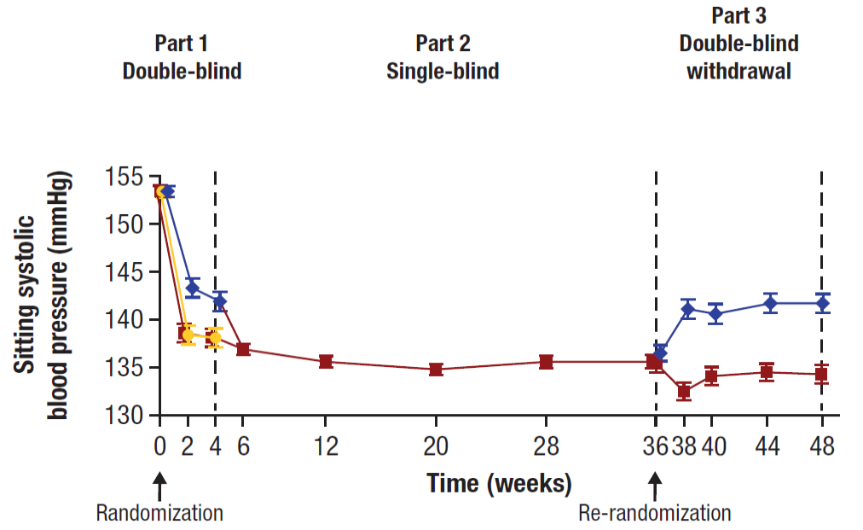



Unattended Office SBP
*
†
*Primary endpoint.
p=0.0042 for aprocitentan 12.5 mg vs placebo
p=0.0046 for aprocitentan 25 mg vs placebo
†Key secondary endpoint
p<0.0001 for aprocitentan 25 mg vs placebo
Bars are standard error of the mean. Values are offset from each other for readability.

Slide 12
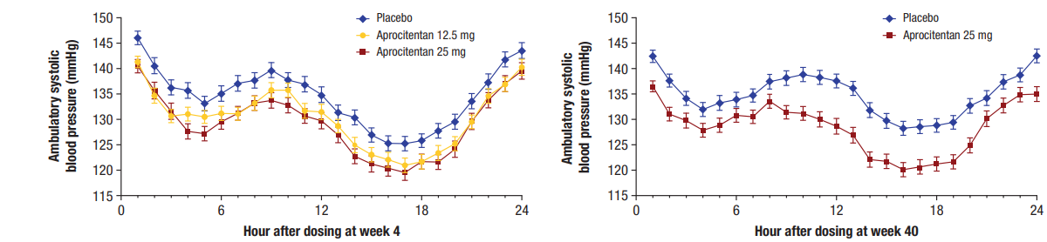
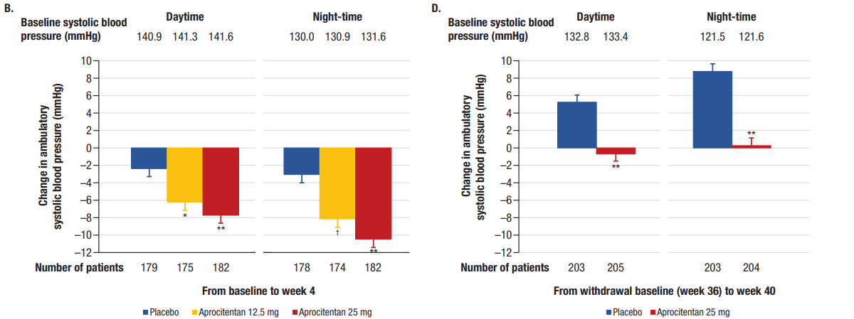
24-Hour Ambulatory SBP
Part 1: Double-blind
Part 3: Double-blind withdrawal
Bars are standard error of the mean
*p=0.003, †p=0.0002, **p<0.0001 (for comparison with placebo). No correction for multiplicity was applied.

Slide 13
24-Hour Ambulatory SBP
Part 1: Double-blind
Part 3: Double-blind withdrawal
Bars are standard error of the mean
*p=0.003, †p=0.0002, **p<0.0001 (for comparison with placebo). No correction for multiplicity was applied.

Slide 14
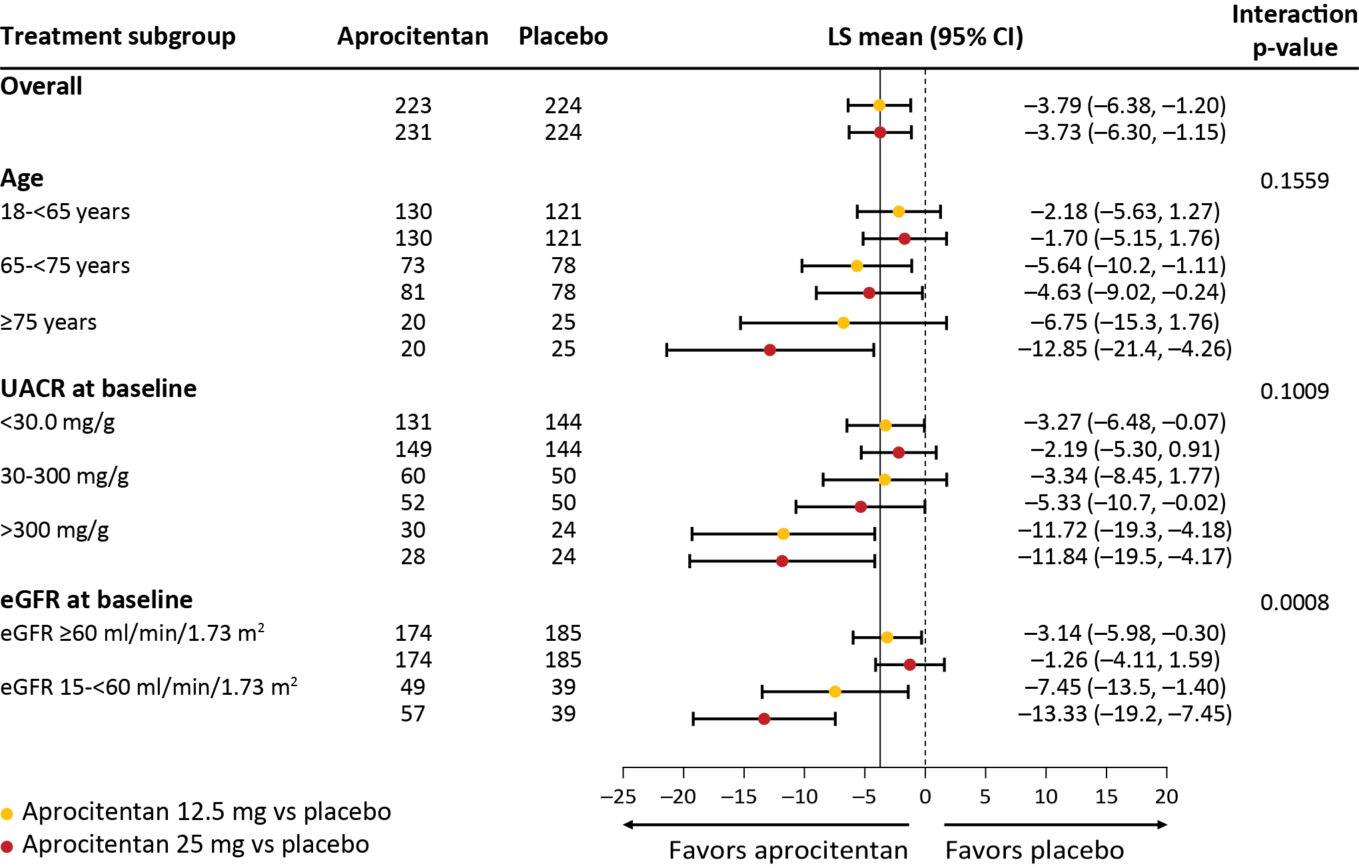
Subgroup Analysis/Change in UACR
Selected subgroup analyses

Slide 15
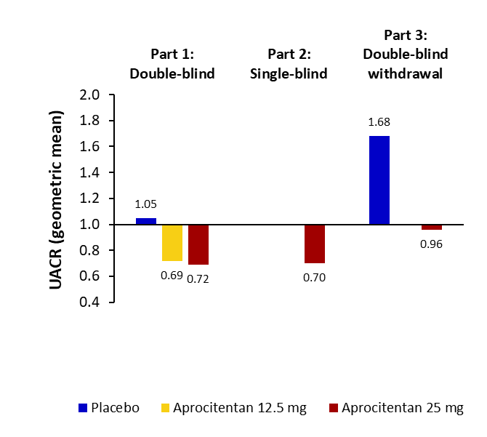
Subgroup Analysis/Change in UACR
Change in UACR over time: Overall population
Selected subgroup analyses
Ratio of week 4 to baseline (week 0)
Ratio of week 36 to baseline (week 0)
Ratio of week 40 to week 36
Rerandomization

Slide 16
Subgroup Analysis/Change in UACR
Change in UACR over time: Overall population
Selected subgroup analyses
Ratio of week 4 to baseline (week 0)
Ratio of week 36 to baseline (week 0)
Ratio of week 40 to week 36
Rerandomization

Slide 17
Selected Treatment-Emergent Adverse Events of Special Interest
Study part | Aprocitentan 12.5 mg | Aprocitentan 25 mg | Placebo
Part 1 Double-blind (4 weeks) | (n=243) | (n=245) | (n=242)
Edema/fluid retention | 22 (9.1) | 45 (18.4) | 5 (2.1)
Severe AE* | 0 | 3 | 0
Additional diuretic used | 10 | 21 | 3
Discontinued study treatment | 0 | 1 | 0
Hospitalization for heart failure | 0 | 2 (0.8) | 0
Part 2 Single-blind (32 weeks) |  | (n=704)
Edema/fluid retention |  | 128 (18.2)
Severe AE* |  | 3
Additional diuretic used |  | 63
Discontinued study treatment |  | 5
Hospitalization for heart failure |  | 6 (0.9)
Part 3 Double-blind withdrawal (12 weeks) |  | (n=310) | (n=303)
Edema/fluid retention |  | 8 (2.6) | 4 (1.3)
Severe AE* |  | 1 | 0
Additional diuretic used |  | 3 | 3
Discontinued study treatment |  | 1 | 0
Hospitalization for heart failure |  | 2 (0.6) | 1 (0.3)
*Adverse event that may cause noticeable discomfort and usually interferes with daily activities. The patient may not be able to continue in the study, and treatment or intervention is usually needed.

Slide 18
Selected Treatment-Emergent Adverse Events of Special Interest
Study part | Aprocitentan 12.5 mg | Aprocitentan 25 mg | Placebo
Part 1 Double-blind (4 weeks) | (n=243) | (n=245) | (n=242)
Edema/fluid retention | 22 (9.1) | 45 (18.4) | 5 (2.1)
Severe AE* | 0 | 3 | 0
Additional diuretic used | 10 | 21 | 3
Discontinued study treatment | 0 | 1 | 0
Hospitalization for heart failure | 0 | 2 (0.8) | 0
Part 2 Single-blind (32 weeks) |  | (n=704)
Edema/fluid retention |  | 128 (18.2)
Severe AE* |  | 3
Additional diuretic used |  | 63
Discontinued study treatment |  | 5
Hospitalization for heart failure |  | 6 (0.9)
Part 3 Double-blind withdrawal (12 weeks) |  | (n=310) | (n=303)
Edema/fluid retention |  | 8 (2.6) | 4 (1.3)
Severe AE* |  | 1 | 0
Additional diuretic used |  | 3 | 3
Discontinued study treatment |  | 1 | 0
Hospitalization for heart failure |  | 2 (0.6) | 1 (0.3)
*Adverse event that may cause noticeable discomfort and usually interferes with daily activities. The patient may not be able to continue in the study, and treatment or intervention is usually needed.

Slide 19
Conclusions
Aprocitentan lowered both standardized automated office and 24-hour ambulatory BP compared to placebo after 4 weeks
The BP lowering effect was maintained over 48 weeks
Edema/fluid retention was the most common AE reported with aprocitentan within the first 4 weeks of treatment
Events were clinically manageable with the addition/up-titration of diuretic therapy
Dual ET antagonism with aprocitentan may represent a new alternative pharmacological approach to treat resistant hypertension

Slide 20
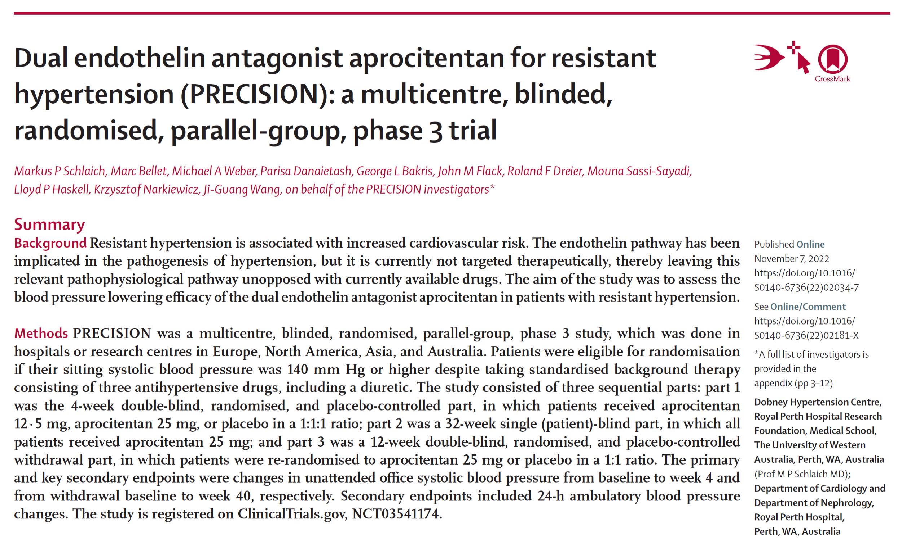
Simultaneous Publication

