Slide 1
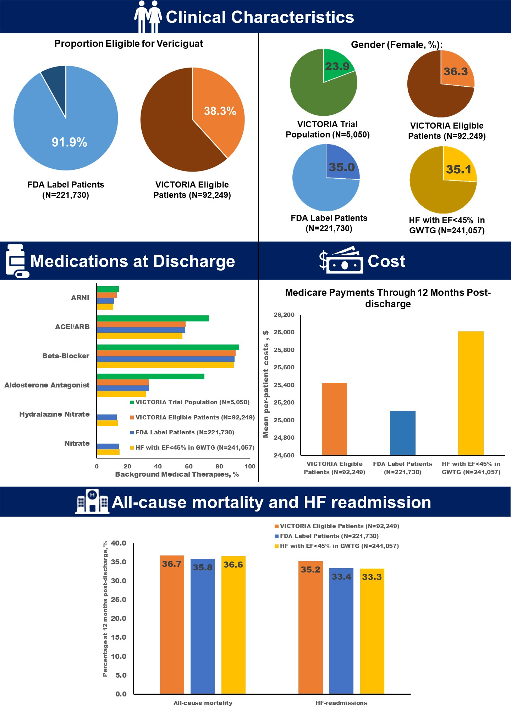



Generalizability of the VICTORIA Trial and the US FDA Label for Vericiguat to Patients Hospitalized for Heart Failure in the United States
RESULTS
More than 9 of 10 US patients hospitalized for HF with EF<45% may be candidates for vericiguat based on the FDA label.
Medicare beneficiaries hospitalized for HF and EF<45% and potentially eligible for vericiguat face high rates of post-discharge mortality and readmission, and accrue substantial healthcare costs.
Starting Population: 241,057 patients hospitalized for HF with EF<45% in the GWTG-HF registry
Muhammad Shahzeb Khan MD MSc¹; Haolin Xu MS²; Gregg C. Fonarow MD³; Dominik Lautsch PhD⁴; Robert Hilkert MD⁴; Larry A. Allen MD MHS⁵; Adam D. DeVore MD MHS^{1,2}; Brooke Alhanti PhD²; Clyde W. Yancy, MD MSc⁶, Nancy M. Albert PhD⁷; Javed Butler MD MPH MBA^{8,9}; Stephen J. Greene, MD^{1,2}
¹ Division of Cardiology, Duke University School of Medicine, Durham, North Carolina, USA
² Duke Clinical Research Institute, Durham, North Carolina
³ Division of Cardiology, Ahmanson-UCLA Cardiomyopathy Center, University of California Los Angeles Medical Center, Los Angeles, California
⁴ Merck & Co., Inc., Rahway, New Jersey, USA
⁵ Division of Cardiology & Colorado Cardiovascular Outcomes Research Consortium, University of Colorado School of Medicine, Aurora, Colorado
⁶ Division of Cardiology, Northwestern University Feinberg School of Medicine, Chicago, Illinois
⁷Nursing Institute and Kaufman Center for Heart Failure, Cleveland Clinic, Cleveland, Ohio,
⁸ Baylor Scott and White Research Institute, Dallas, Texas
⁹ Department of Medicine, University of Mississippi, Jackson, Mississippi
BACKGROUND
In January 2021, vericiguat, a soluble guanylate cyclase (sGC) stimulator, was approved by the US FDA to reduce the risk of cardiovascular death and heart-failure (HF) hospitalization following hospitalization for HF or need for outpatient IV diuretics in adults with symptomatic chronic HFrEF based on the pivotal VICTORIA trial.
Limited data are available characterizing its generalizability to US clinical practice.
METHODS
We studied patients with HF and EF (≤45%) at 406 sites in the Get With The Guidelines (GWTG)-HF registry admitted between January 2014 – September 2020.
We excluded patients who left against medical advice, transferred to an acute care facility or to hospice care, or had missing critical data elements.
We applied the FDA label (excluding eGFR<15 mL/min/1.73 m², dialysis, or patients with durable mechanical device support) and eligibility criteria of VICTORIA trial to the GWTG-HF registry sample.
Post-discharge outcomes and healthcare expenditure was assessed among Medicare cohort only
DISCLOSURES
Funding: This study was supported by Merck Sharp & Dohme LLC, a subsidiary of Merck & Co., Inc., Rahway, NJ, USA. The Get With The Guidelines–Heart Failure (GWTG-HF) program is provided by the American Heart Association and sponsored, in part, by Novartis, Boehringer Ingelheim and Eli Lilly Diabetes Alliance, Novo Nordisk, Sanofi, AstraZeneca, and Bayer.
Drs. Lautsch and Hilkert, are employees of Merck Sharp & Dohme LLC, a subsidiary of Merck & Co., Inc., Rahway, NJ, USA. Dr. Allen reports grant support from NIH and PCORI, and consulting fees from ACI Clinical, American Heart Association, Boston Scientific, Cytokinetics, Novartis, and UpToDate. Dr. Fonarow reports consulting for Abbott, Amgen, AstraZeneca, Bayer, Cytokinetics, Janssen, Medtronic, Merck Sharp & Dohme LLC (a subsidiary of Merck & Co., Inc., Rahway, NJ, USA), and Novartis. Dr. Albert reports grant support from Novartis and AstraZeneca and consulting fees from Boston Scientific, Boehringer Ingelheim/Lilly, Cytokinetics, and Merck Sharp & Dohme LLC (a subsidiary of Merck & Co., Inc., Rahway, NJ, USA). Dr. Butler has served as a consultant to Abbott, Adrenomed, Arena Pharma, Array, Amgen, Applied Therapeutics, Astra Zeneca, Bayer, Boehringer Ingelheim, Cardior, CVRx, Eli Lilly, G3 Pharma, Imbria, Impulse Dynamics, Innolife, Janssen, LivaNova, Luitpold, Medtronic, Merck, Novartis, Novo Nordisk, Sequana Medical, V-Wave Limited, and Vifor. Dr. Greene has received research support from the Duke University Department of Medicine Chair’s Research Award, American Heart Association (#929502), National Heart Lung and Blood Institute, Amgen, AstraZeneca, Bristol Myers Squibb, Cytokinetics, Merck & Co., Inc., Novartis, Pfizer, and Sanofi; has served on advisory boards for Amgen, AstraZeneca, Boehringer Ingelheim/ Lilly, Bristol Myers Squibb, Cytokinetics, Roche Diagnostics, and Sanofi; serves as a consultant for Amgen, Bayer, Boehringer Ingelheim/ Lilly, Bristol Myers Squibb, Corteria Therapeutics, Merck Sharp & Dohme LLC (a subsidiary of Merck & Co., Inc., Rahway, NJ, USA), PharmaIN, Roche Diagnostics, Sanofi, Tricog Health, Urovant Pharmaceuticals, and Vifor; and has received speaker fees from Boehringer Ingelheim and Cytokinetics. All other authors report no disclosures.
The most frequent reasons for ineligibility for the FDA label were eGFR<15 mL/min/1.73 m² (5.7%) and dialysis (1.6%).
LIMITATIONS
In determining eligibility, a requirement that patients were already receiving each foundational component of GDMT was not applied.
The extent to which clinical outcomes and healthcare expenditure findings generalize to younger patients is unclear.
For more information, please contact:
Dr. Shahzeb Khan, shahzeb.khan@duke.edu, @ShahzebKhanMD
Dr. Stephen Greene, stephen.greene@duke.edu, @SJGreene_md

Slide 2
Disclaimer
The views and opinions expressed in this educational activity are those of the faculty and do not necessarily represent the views of TotalCME, Inc., the CME providers, or the companies providing educational grants. This presentation is not intended to define an exclusive course of patient management; the participant should use their clinical judgment, knowledge, experience, and diagnostic skills in applying or adopting for professional use any of the information provided herein. Any procedures, medications, or other courses of diagnosis or treatment discussed or suggested in this activity should not be used by clinicians without evaluation of their patient's conditions and possible contraindications or dangers in use, review of any applicable manufacturer’s product information, and comparison with recommendations of other authorities. Links to other sites may be provided as additional sources of information.

Slide 3
Generalizability of the VICTORIA Trial
and the US FDA Label for Vericiguat to
Patients Hospitalized for Heart Failure
in the United States
Muhammad Shahzeb Khan MD MSc¹; Haolin Xu MS²; Gregg C. Fonarow MD³; Dominik Lautsch PhD⁴; Robert Hilkert MD⁴; Larry A. Allen MD MHS⁵; Adam D. DeVore MD MHS^{1,2}; Brooke Alhanti PhD²;
Clyde W. Yancy, MD MSc⁶, Nancy M. Albert PhD⁷; Javed Butler MD MPH MBA^{8,9}; Stephen J. Greene, MD^{1,2}
¹ Division of Cardiology, Duke University School of Medicine, Durham, North Carolina, USA
² Duke Clinical Research Institute, Durham, North Carolina
³ Division of Cardiology, Ahmanson-UCLA Cardiomyopathy Center, University of California Los Angeles Medical Center, Los Angeles, California
⁴ Merck & Co., Inc., Rahway, New Jersey, USA
⁵ Division of Cardiology & Colorado Cardiovascular Outcomes Research Consortium, University of Colorado School of Medicine, Aurora, Colorado
⁶ Division of Cardiology, Northwestern University Feinberg School of Medicine, Chicago, Illinois
⁷Nursing Institute and Kaufman Center for Heart Failure, Cleveland Clinic, Cleveland, Ohio,
⁸ Baylor Scott and White Research Institute, Dallas, Texas
⁹ Department of Medicine, University of Mississippi, Jackson, Mississippi

Slide 4
BACKGROUND
In January 2021, vericiguat, a soluble guanylate cyclase (sGC) stimulator, was approved by the US FDA to reduce the risk of cardiovascular death and heart-failure (HF) hospitalization following hospitalization for HF or need for outpatient IV diuretics in adults with symptomatic chronic HFrEF based on the pivotal VICTORIA trial.
Limited data are available characterizing its generalizability to US clinical practice.

Slide 5
METHODS
We studied patients with HF and EF (≤45%) at 406 sites in the Get With The Guidelines (GWTG)-HF registry admitted between January 2014 – September 2020.
We excluded patients who left against medical advice, transferred to an acute care facility or to hospice care, or had missing critical data elements.
We applied the FDA label (excluding eGFR<15 mL/min/1.73 m², dialysis, or patients with durable mechanical device support) and eligibility criteria of VICTORIA trial to the GWTG-HF registry sample.
Post-discharge outcomes and healthcare expenditure was assessed among Medicare cohort only.

Slide 9
More than 9 of 10 US patients hospitalized for
HF with EF<45% may be candidates for
vericiguat based on the FDA label.
Medicare beneficiaries hospitalized for HF and EF<45% and potentially eligible for vericiguat face high rates of post-discharge mortality and readmission, and accrue substantial healthcare costs.

