Slide 1
Pemafibrate to Reduce Cardiovascular Outcomes by Reducing Triglycerides in Patients With Diabetes - PROMINENT
Karol E. Watson, MD, PhD, FNLA, FACC, FAHA
Co-Director, UCLA Program in Preventive Cardiology
David Geffen School of Medicine at UCLA
Los Angeles, CA

Slide 2
Disclaimer
The views and opinions expressed in this educational activity are those of the faculty and do not necessarily represent the views of TotalCME, Inc., the CME providers, or the companies providing educational grants. This presentation is not intended to define an exclusive course of patient management; the participant should use their clinical judgment, knowledge, experience, and diagnostic skills in applying or adopting for professional use any of the information provided herein. Any procedures, medications, or other courses of diagnosis or treatment discussed or suggested in this activity should not be used by clinicians without evaluation of their patient's conditions and possible contraindications or dangers in use, review of any applicable manufacturer’s product information, and comparison with recommendations of other authorities. Links to other sites may be provided as additional sources of information.

Slide 3
Background
Evidence suggests that hypertriglyceridemia is an independent risk factor for cardiovascular disease (CVD)
However, the 3 predominate pharmacotherapies for triglyceride (TG) lowering (niacin, fibrates, EPA-only omega-3 fatty acids) show differing effects on cardiovascular risk reduction
Post hoc analyses have suggested that patients with diabetes mellitus (DM), high TG/low HDL-C or high CVD risk may have the most benefit from TG lowering
In order to evaluate potential risk reduction with the fibrate pemafibrate, the PROMINENT study was performed in the above population

Slide 4
Background (cont.)
PROMINENT enrolled individuals with
  Type 2 diabetes mellitus
  Moderate hypertriglyceridemia (TG 200-499 mg/dL)
  Low HDL-C (≤40 mg/dL)
  High cardiovascular risk (established ASCVD, age ≥50 for men or ≥55 for women)
All participants were on background LDL lowering therapy, then were randomized to pemafibrate or placebo
The primary efficacy outcome was a composite of myocardial infarction (MI), ischemic stroke, coronary revascularization, or CV death

Slide 5
Results
Pemafibrate reduced triglycerides ~20%
Despite this, pemafibrate did not reduce cardiovascular events
There were also worrisome adverse events with pemafibrate, such as an increase in venous thromboembolism and renal events
The investigators noted possible beneficial reduction in nonalcoholic fatty liver disease

Slide 6
What Do These Results Mean For…
The strategy (triglyceride lowering)
The drug (pemafibrate)
The drug class (fibrates)

Slide 7
What Do These Results Mean For…
The strategy (triglyceride lowering)
The drug (pemafibrate)
The drug class (fibrates)
No effect

Slide 8
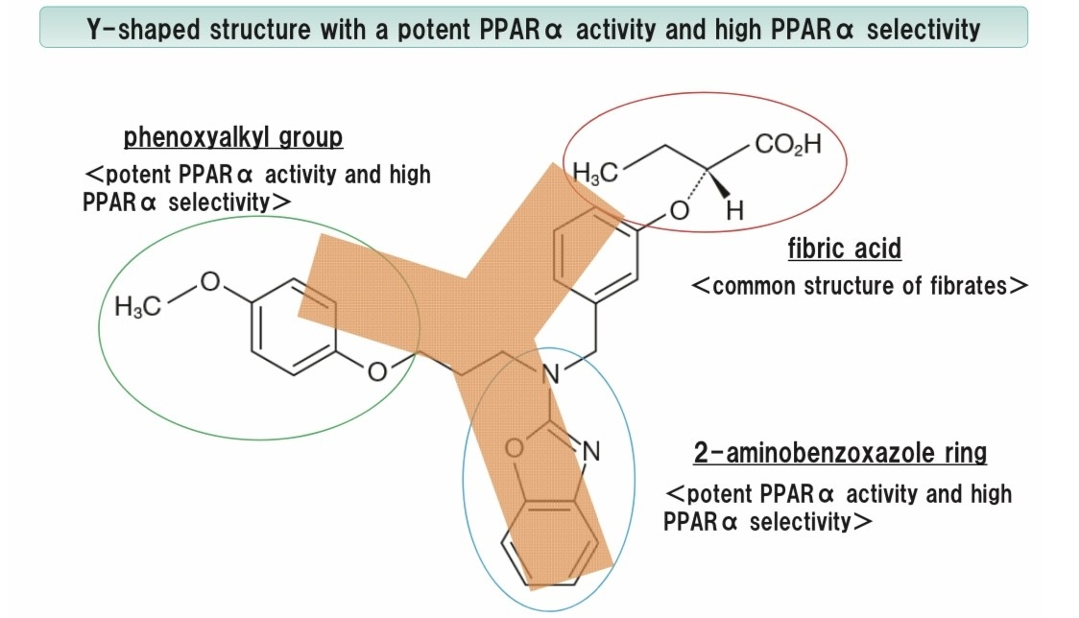
Structural Conformation of Pemafibrate Favoring Better Selectivity for PPARα

Slide 9
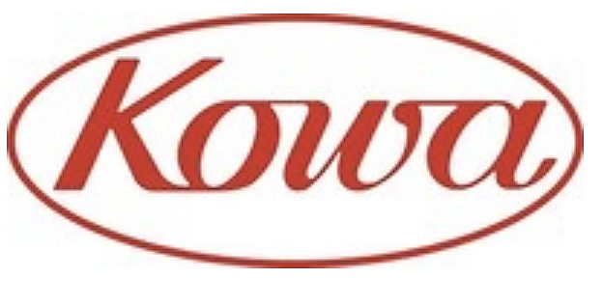
Kowa to Discontinue K-877 (Pemafibrate) “PROMINENT” Cardiovascular Outcomes Study
www.prnewswire.com/news-releases/kowa-to-discontinue-k-877-pemafibrate-prominent-cardiovascular-outcomes-study-301520956.html Apr 8, 2022,

Slide 10
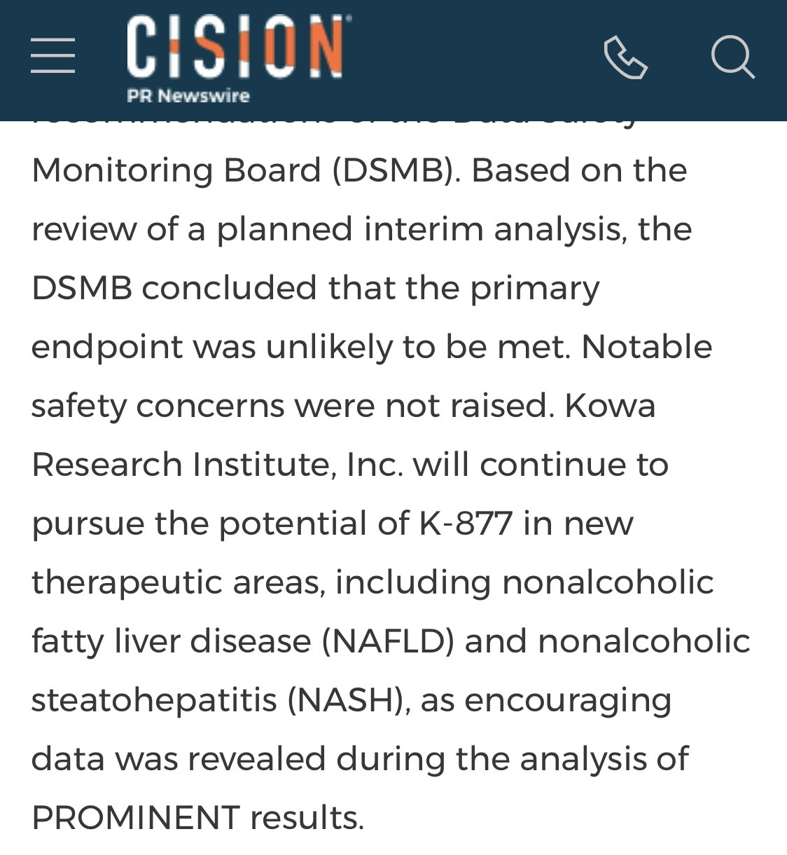
Kowa to Discontinue K-877 (Pemafibrate) “PROMINENT” Cardiovascular Outcomes Study
www.prnewswire.com/news-releases/kowa-to-discontinue-k-877-pemafibrate-prominent-cardiovascular-outcomes-study-301520956.html Apr 8, 2022,

Slide 11
Kowa to Discontinue K-877 (Pemafibrate) “PROMINENT” Cardiovascular Outcomes Study
www.prnewswire.com/news-releases/kowa-to-discontinue-k-877-pemafibrate-prominent-cardiovascular-outcomes-study-301520956.html Apr 8, 2022,

Slide 12
What Do These Results Mean For…
The strategy (triglyceride lowering)
The drug (pemafibrate)
The drug class (fibrates)
No effect

Slide 13
What Do These Results Mean For…
The strategy (triglyceride lowering)
The drug (pemafibrate)
The drug class (fibrates)
No effect
Effective for TG lowering

Slide 14
What Do These Results Mean For…
The strategy (triglyceride lowering)
The drug (pemafibrate)
The drug class (fibrates)
No effect
Effective for TG lowering
No CV risk reduction in PROMINENT; worrisome AEs

Slide 15
What Do These Results Mean For…
The strategy (triglyceride lowering)
The drug (pemafibrate)
The drug class (fibrates)
No effect
Effective for TG lowering
No CV risk reduction in PROMINENT; worrisome AEs
The developers may pursue other beneficial effects

Slide 16
Randomized Controlled Trials of Fibrates
Trial | Year | Pop. | No. | Study drug | vs | Primary outcome | Result
HHS | 1987 | Dyslip | 4,081 | gemfibrozil | PBO | Nonfatal MI or CHD death | 34%
VA-HIT | 1999 | CHD | 2,531 | gemfibrozil | PBO | Nonfatal MI or CHD death | 22%
BIP | 2000 | CHD | 3,090 | bezafibrate | PBO | Nonfatal MI or sudden cardiac death | NS
LEADER | 2002 | PAD | 1,568 | bezafibrate | PBO | CHD or stroke | NS
FIELD | 2005 | T2DM | 9,795 | fenofibrate | PBO | Nonfatal MI or CHD death | NS
ACCORD | 2010 | T2DM | 5,518 | fenofibrate + simvastatin | simva | Nonfatal MI, nonfatal stroke, CVD death | NS
PROMINENT | 2022 | T2DM | 10,497 | pemafibrate | PBO | Nonfatal MI, ischemic stroke, revasc, CVD death | NS

Slide 17
What Do These Results Mean For…
The strategy (triglyceride lowering)
The drug (pemafibrate)
The drug class (fibrates)
No effect
Effective for TG lowering
No CV risk reduction in PROMINENT; worrisome AEs
The developers may pursue other beneficial effects

Slide 18
What Do These Results Mean For…
The strategy (triglyceride lowering)
The drug (pemafibrate)
The drug class (fibrates)
No effect
Effective for TG lowering
No CV risk reduction in PROMINENT; worrisome AEs
The developers may pursue other beneficial effects
No CV risk reduction in multiple fibrate trials during statin era

Slide 19
Take-Home Points
Fibrates are one of the most widely prescribed medications for TG lowering
Recent fibrate trials, however, do not show cardiovascular risk reduction
In the statin era, currently tested fibrates do not appear to lower risk
In the PROMINENT trial, despite enrolling a population with high TG, low HDL-C and high CV risk, pemafibrate did not lower events and had worrisome adverse effects
We’ve asked similar questions of fibrates in the past and we’ve gotten similar answers

