Slide 1
Torsemide Comparison With Furosemide For Management of Heart Failure
TORSEMIDE COMPARED WITH FUROSEMIDE FOR MANAGEMENT OF HEART FAILURE
Speaker:
Robert J. Mentz, MD
Chief, Heart Failure Section, Duke University Medical Center
Associate Program Director, Duke Cardiovascular Disease Fellowship
Editor-in-Chief, Journal of Cardiac Failure, Official Journal of the HFSA
Durham, NC
On Behalf of the TRANSFORM-HF Investigators and Participants
Supported through cooperative agreements from the NHLBI (U01-HL125478 and U01-HL125511)
Robert J. Mentz, MD Chief, Heart Failure Section, Duke University Medical Center Associate Program Director, Duke Cardiovascular Disease Fellowship Editor-in-Chief, Journal of Cardiac Failure, Official Journal of the HFSA Durham, NC
On Behalf of the TRANSFORM-HF Investigators and Participants

Slide 2
Disclaimer
The views and opinions expressed in this educational activity are those of the faculty and do not necessarily represent the views of TotalCME, Inc., the CME providers, or the companies providing educational grants. This presentation is not intended to define an exclusive course of patient management; the participant should use their clinical judgment, knowledge, experience, and diagnostic skills in applying or adopting for professional use any of the information provided herein. Any procedures, medications, or other courses of diagnosis or treatment discussed or suggested in this activity should not be used by clinicians without evaluation of their patient's conditions and possible contraindications or dangers in use, review of any applicable manufacturer’s product information, and comparison with recommendations of other authorities. Links to other sites may be provided as additional sources of information.

Slide 3
Background
LOOP DIURETICS are routinely used to manage congestion in patients with heart failure
FUROSEMIDE is the most commonly used loop diuretic
TORSEMIDE may offer advantages over furosemide
More consistent oral bioavailability and longer duration of action
Anti-aldosterone effects and anti-fibrotic myocardial effects
Prior observational studies have suggested potential outcome benefits

Slide 4
Background
LOOP DIURETICS are routinely used to manage congestion in patients with heart failure
FUROSEMIDE is the most commonly used loop diuretic
TORSEMIDE may offer advantages over furosemide
More consistent oral bioavailability and longer duration of action
Anti-aldosterone effects and anti-fibrotic myocardial effects
Prior observational studies have suggested potential outcome benefits
Whether torsemide improves clinical outcomes compared with furosemide in patients with HF is unknown.

Slide 5
Design
Primary Objective: Compare the treatment strategy of torsemide vs. furosemide on long-term clinical outcomes among patients hospitalized with HF through a pragmatic trial

Slide 6
Design
Primary Objective: Compare the treatment strategy of torsemide vs. furosemide on long-term clinical outcomes among patients hospitalized with HF through a pragmatic trial
Hospitalized Patients with HF
Regardless of EF
Long-term plan for loop diuretic
(60 US Sites)

Slide 7
Design
Primary Objective: Compare the treatment strategy of torsemide vs. furosemide on long-term clinical outcomes among patients hospitalized with HF through a pragmatic trial
Hospitalized Patients with HF
Regardless of EF
Long-term plan for loop diuretic
(60 US Sites)
1:1 Randomization
Torsemide
Furosemide
Open-Label
Dosing per Clinician

Slide 8
Design
Primary Objective: Compare the treatment strategy of torsemide vs. furosemide on long-term clinical outcomes among patients hospitalized with HF through a pragmatic trial
Hospitalized Patients with HF
Regardless of EF
Long-term plan for loop diuretic
(60 US Sites)
1:1 Randomization
Torsemide
Furosemide
Open-Label
Dosing per Clinician
Routine Clinical Follow-up
DCRI Call Center (30 d, 6 m, 12 m)
No in-person study visits
National Death Index
Primary Endpoint:
All-Cause Mortality

Slide 9
Design
Primary Objective: Compare the treatment strategy of torsemide vs. furosemide on long-term clinical outcomes among patients hospitalized with HF through a pragmatic trial
Hospitalized Patients with HF
Regardless of EF
Long-term plan for loop diuretic
(60 US Sites)
1:1 Randomization
Torsemide
Furosemide
Open-Label
Dosing per Clinician
Routine Clinical Follow-up
DCRI Call Center (30 d, 6 m, 12 m)
No in-person study visits
National Death Index
Primary Endpoint:
Primary Hypothesis: Torsemide reduces mortality by 20% vs. furosemide
All-Cause Mortality
Event-Driven
721 Death Events
(85% power)

Slide 10
Design
Primary Objective: Compare the treatment strategy of torsemide vs. furosemide on long-term clinical outcomes among patients hospitalized with HF through a pragmatic trial
Hospitalized Patients with HF
Regardless of EF
Long-term plan for loop diuretic
(60 US Sites)
1:1 Randomization
Torsemide
Furosemide
Open-Label
Dosing per Clinician
Routine Clinical Follow-up
DCRI Call Center (30 d, 6 m, 12 m)
No in-person study visits
National Death Index
Primary Endpoint:
Primary Hypothesis: Torsemide reduces mortality by 20% vs. furosemide
All-Cause Mortality
Event-Driven
721 Death Events
(85% power)
Secondary Endpoints:
All-cause Mortality + All-cause Hospitalization
Total Hospitalizations
Health-related Quality of Life (KCCQ)
Symptoms of Depression (PHQ-2)

Slide 11
Baseline Characteristics (N=2859)
Characteristics | Torsemide (N=1431) | Furosemide (N=1428)
Age (yr) | 64.0±14.0 | 65.0±14.0
Female | 34.8% | 39.0%
White race | 58.2% | 58.7%
Black race | 33.2% | 34.7%
Presented as %, Mean ± SD or median (IQR)

Slide 12
Baseline Characteristics (N=2859)
Characteristics | Torsemide (N=1431) | Furosemide (N=1428)
Age (yr) | 64.0±14.0 | 65.0±14.0
Female | 34.8% | 39.0%
White race | 58.2% | 58.7%
Black race | 33.2% | 34.7%
Newly diagnosed HF | 29.9% | 28.7%
EF ≥50% | 22.2% | 23.1%
41-49% | 5.7% | 4.9%
≤40% | 65.3% | 63.1%
NT-proBNP (pg/mL) | 3994 (1938, 8850) | 3833 (1936, 7807)
Ischemic etiology | 29.8% | 26.7%
Presented as %, Mean ± SD or median (IQR)

Slide 13
Baseline Characteristics (N=2859)
Characteristics | Torsemide (N=1431) | Furosemide (N=1428)
Age (yr) | 64.0±14.0 | 65.0±14.0
Female | 34.8% | 39.0%
White race | 58.2% | 58.7%
Black race | 33.2% | 34.7%
Newly diagnosed HF | 29.9% | 28.7%
EF ≥50% | 22.2% | 23.1%
41-49% | 5.7% | 4.9%
≤40% | 65.3% | 63.1%
NT-proBNP (pg/mL) | 3994 (1938, 8850) | 3833 (1936, 7807)
Ischemic etiology | 29.8% | 26.7%
Systolic blood pressure (mmHg) | 118±19 | 119±21
Body mass index (kg/m²) | 32.3±9.7 | 32.0±9.3
eGFR (ml/min/1.73 m²) | 59±25 | 60±26
Presented as %, Mean ± SD or median (IQR)

Slide 14
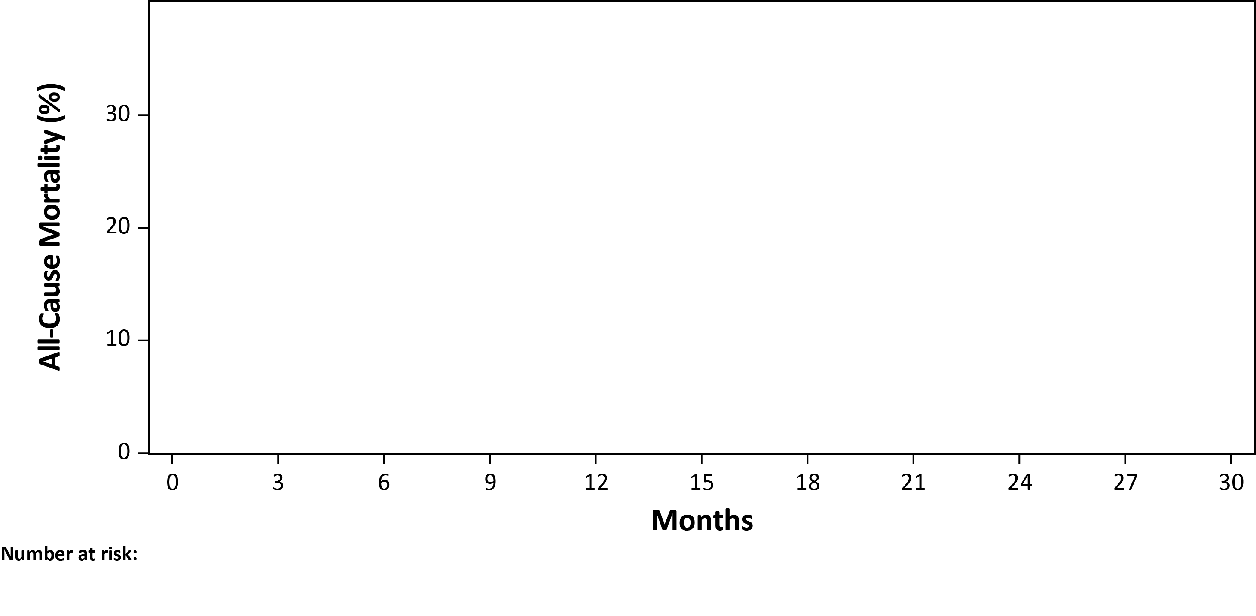
Primary Endpoint: All-Cause Mortality
Median follow-up: 17.4 months (IQR: 8.0 to 29.0)

Slide 15
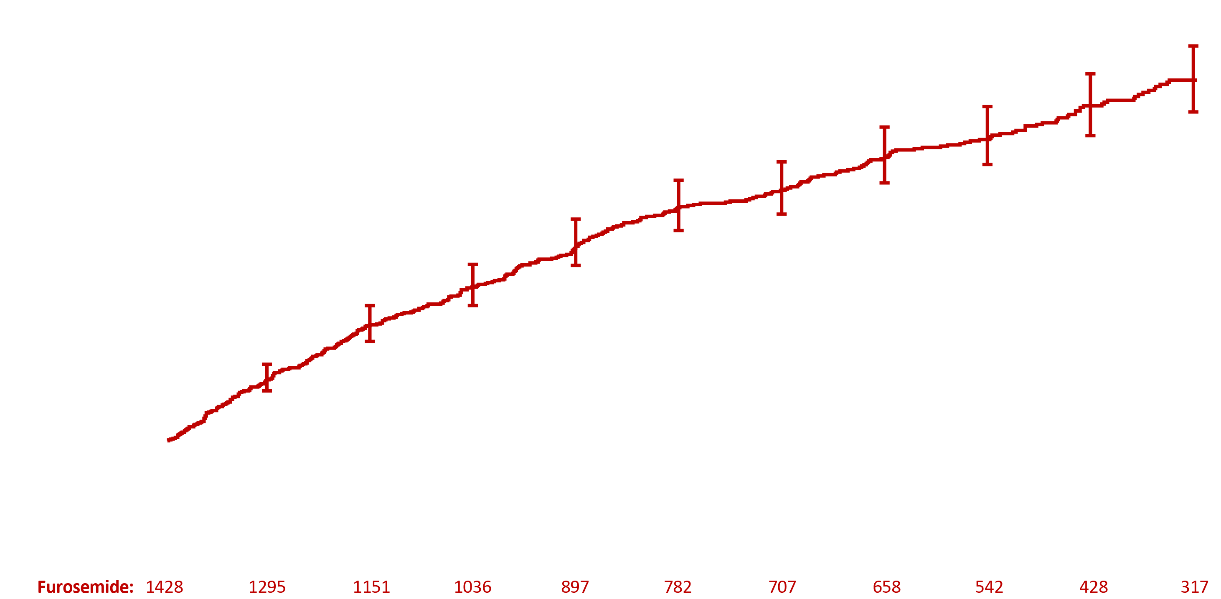
Primary Endpoint: All-Cause Mortality
Furosemide: 374 events (26.2%); 17.0 per 100 pt-yr
Median follow-up: 17.4 months (IQR: 8.0 to 29.0)

Slide 16
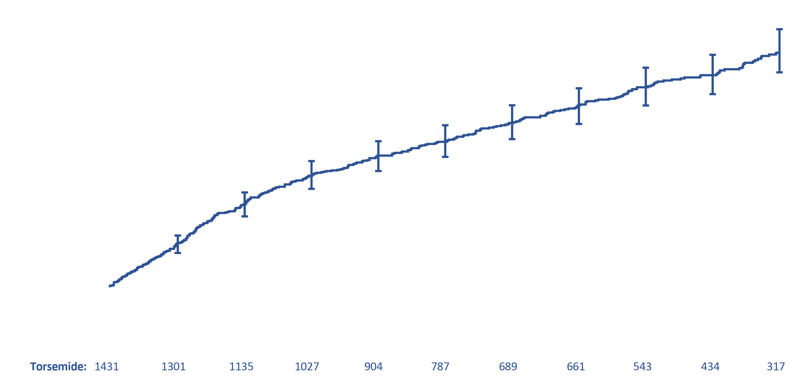
Primary Endpoint: All-Cause Mortality
HR 1.02 (95% CI, 0.89 to 1.18); P-value 0.77
Furosemide: 374 events (26.2%); 17.0 per 100 pt-yr
Torsemide: 373 events (26.1%); 17.0 per 100 pt-yr
Median follow-up: 17.4 months (IQR: 8.0 to 29.0)

Slide 17
Primary Endpoint: All-Cause Mortality
HR 1.02 (95% CI, 0.89 to 1.18); P-value 0.77
Furosemide: 374 events (26.2%); 17.0 per 100 pt-yr
Torsemide: 373 events (26.1%); 17.0 per 100 pt-yr
Consistent across all pre-specified subgroups including age, sex, race, EF, HF chronicity, GFR
Median follow-up: 17.4 months (IQR: 8.0 to 29.0)

Slide 18
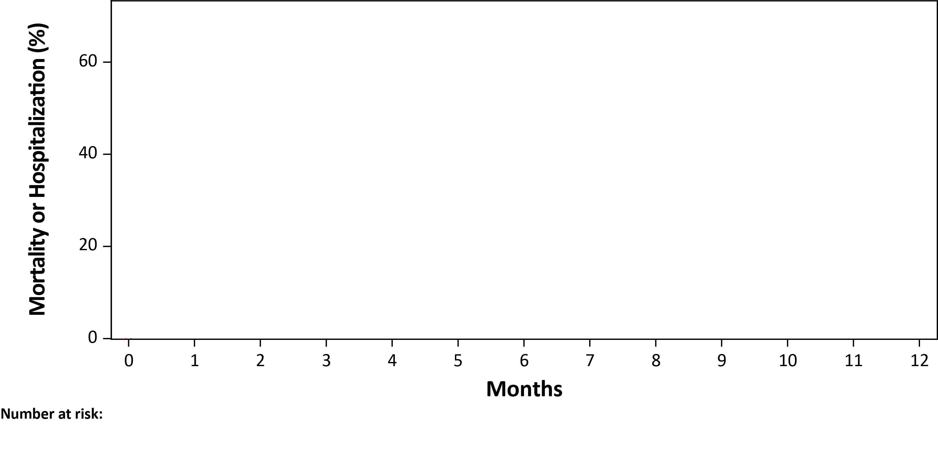
All-Cause Mortality or Hospitalization (12 mos)

Slide 19
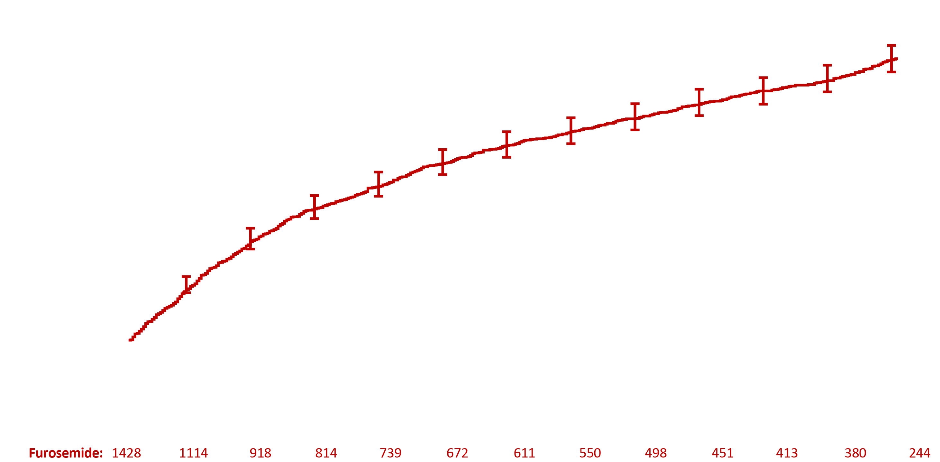
All-Cause Mortality or Hospitalization (12 mos)
Furosemide: 704 events (49.3%); 107.6 per 100 pt-yr

Slide 20
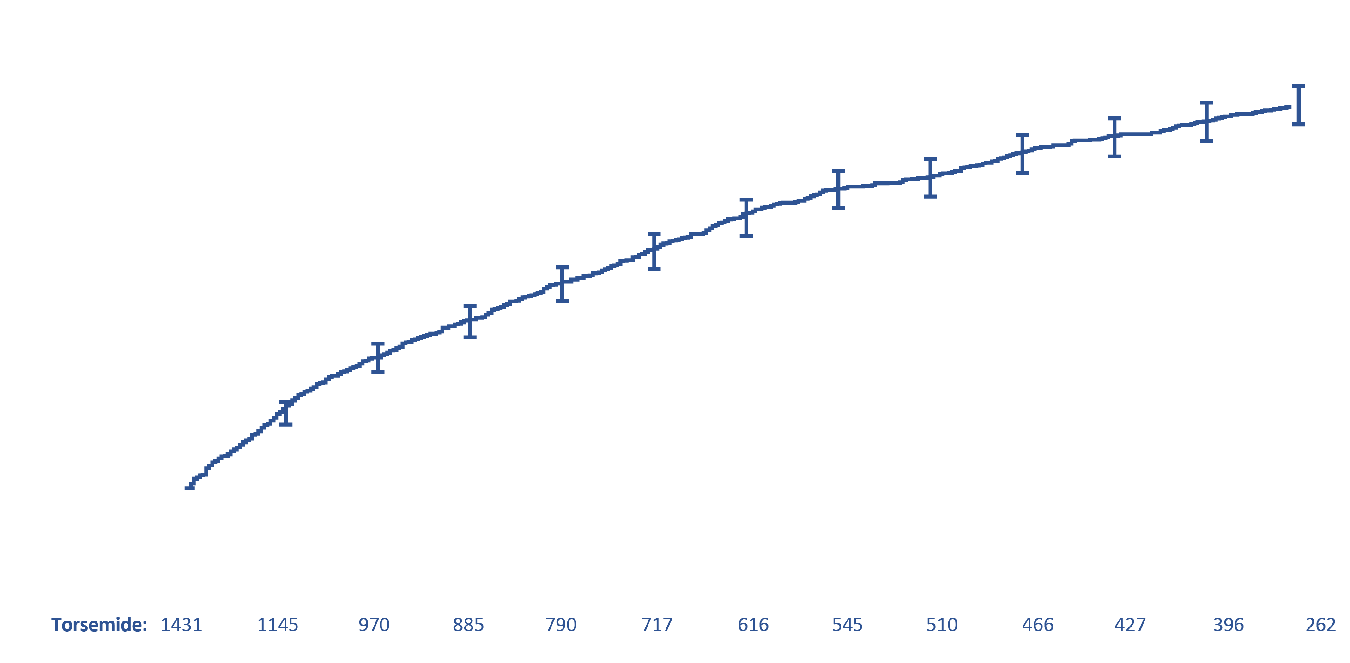
All-Cause Mortality or Hospitalization (12 mos)
HR 0.92 (95% CI, 0.83 to 1.02); P-value 0.11
Furosemide: 704 events (49.3%); 107.6 per 100 pt-yr
Torsemide: 677 events (47.3%); 99.2 per 100 pt-yr

Slide 21
Total Hospitalizations (12 mos)
Among
577 (40.4%)
Participants
Among
536 (37.5%)
Participants

Slide 22
Total Hospitalizations (12 mos)
Furosemide
Among
577 (40.4%)
Participants
Among
536 (37.5%)
Participants

Slide 23
Total Hospitalizations (12 mos)
RR 0.94 (95% CI, 0.84 to 1.07)
Furosemide
Torsemide
Among
577 (40.4%)
Participants
Among
536 (37.5%)
Participants

Slide 24
Pragmatic Trial Insights
Broad eligibility criteria and streamlined study protocol embedded within routine care supported the inclusion of diverse participants
Pragmatic elements lowered traditional barriers for patient and site participation to support robust enrollment rates (even during the COVID-19 pandemic)
Opportunities to enhance patient adherence and engagement at follow-up
In this context, this real-world comparative-effectiveness study provides results that are generalizable to routine clinical practice

Slide 25
Conclusions and Implications
Torsemide and furosemide have similar efficacy based on clinical outcomes of mortality and hospitalization in patients hospitalized with heart failure
Clinical attention should be directed towards determining appropriate diuretic dosing and prioritizing guideline-directed medical therapy (GDMT) initiation/titration
Insights from the pragmatic trial design and execution may inform future studies aiming to assess real-world comparative effectiveness

