Slide 1
Real-World Eligibility for Vericiguat According to Trial, Guideline, and Labeling Eligibility Criteria: Data from the Swedish Heart Failure Registry
Marat Fudim, MD, MHS
Assistant Professor
Duke University
Durham, NC, USA

Slide 2
Disclaimer
The views and opinions expressed in this educational activity are those of the faculty and do not necessarily represent the views of TotalCME, Inc., the CME providers, or the companies providing educational grants. This presentation is not intended to define an exclusive course of patient management; the participant should use their clinical judgment, knowledge, experience, and diagnostic skills in applying or adopting for professional use any of the information provided herein. Any procedures, medications, or other courses of diagnosis or treatment discussed or suggested in this activity should not be used by clinicians without evaluation of their patient's conditions and possible contraindications or dangers in use, review of any applicable manufacturer’s product information, and comparison with recommendations of other authorities. Links to other sites may be provided as additional sources of information.

Slide 3
The New Gold Standard
Relative Risk
2 Year Mortality
--
35%
The Pillars of Medical Therapy in HFrEF
None
ARNI
BB
MRA
SGLT2
28%
25.2%
ARNI
35%
16.4%
BB
30%
11.5%
MRA
17%
9.5%
SGLT2

Slide 4
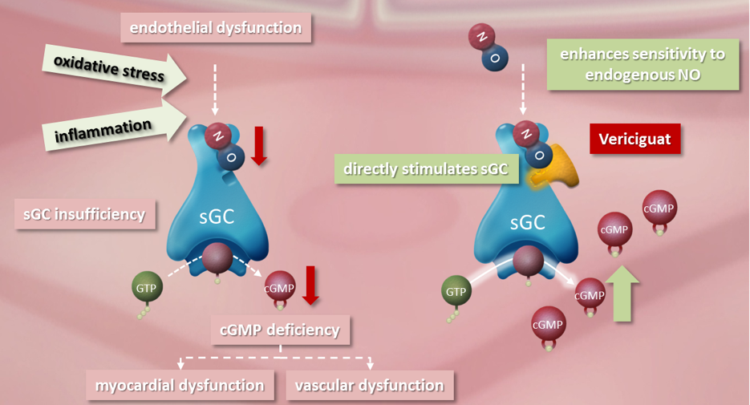
Vericiguat: A Soluble Guanylate Cyclase (sGC) Stimulator

Slide 5
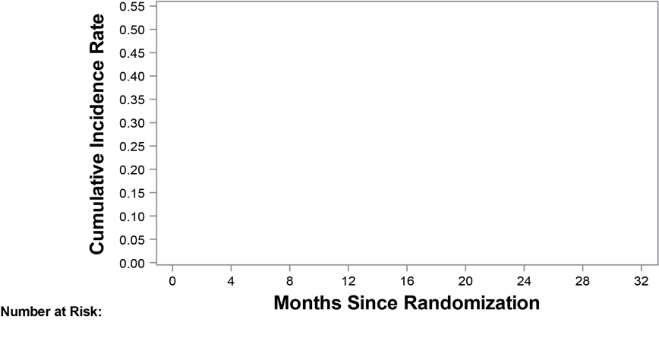
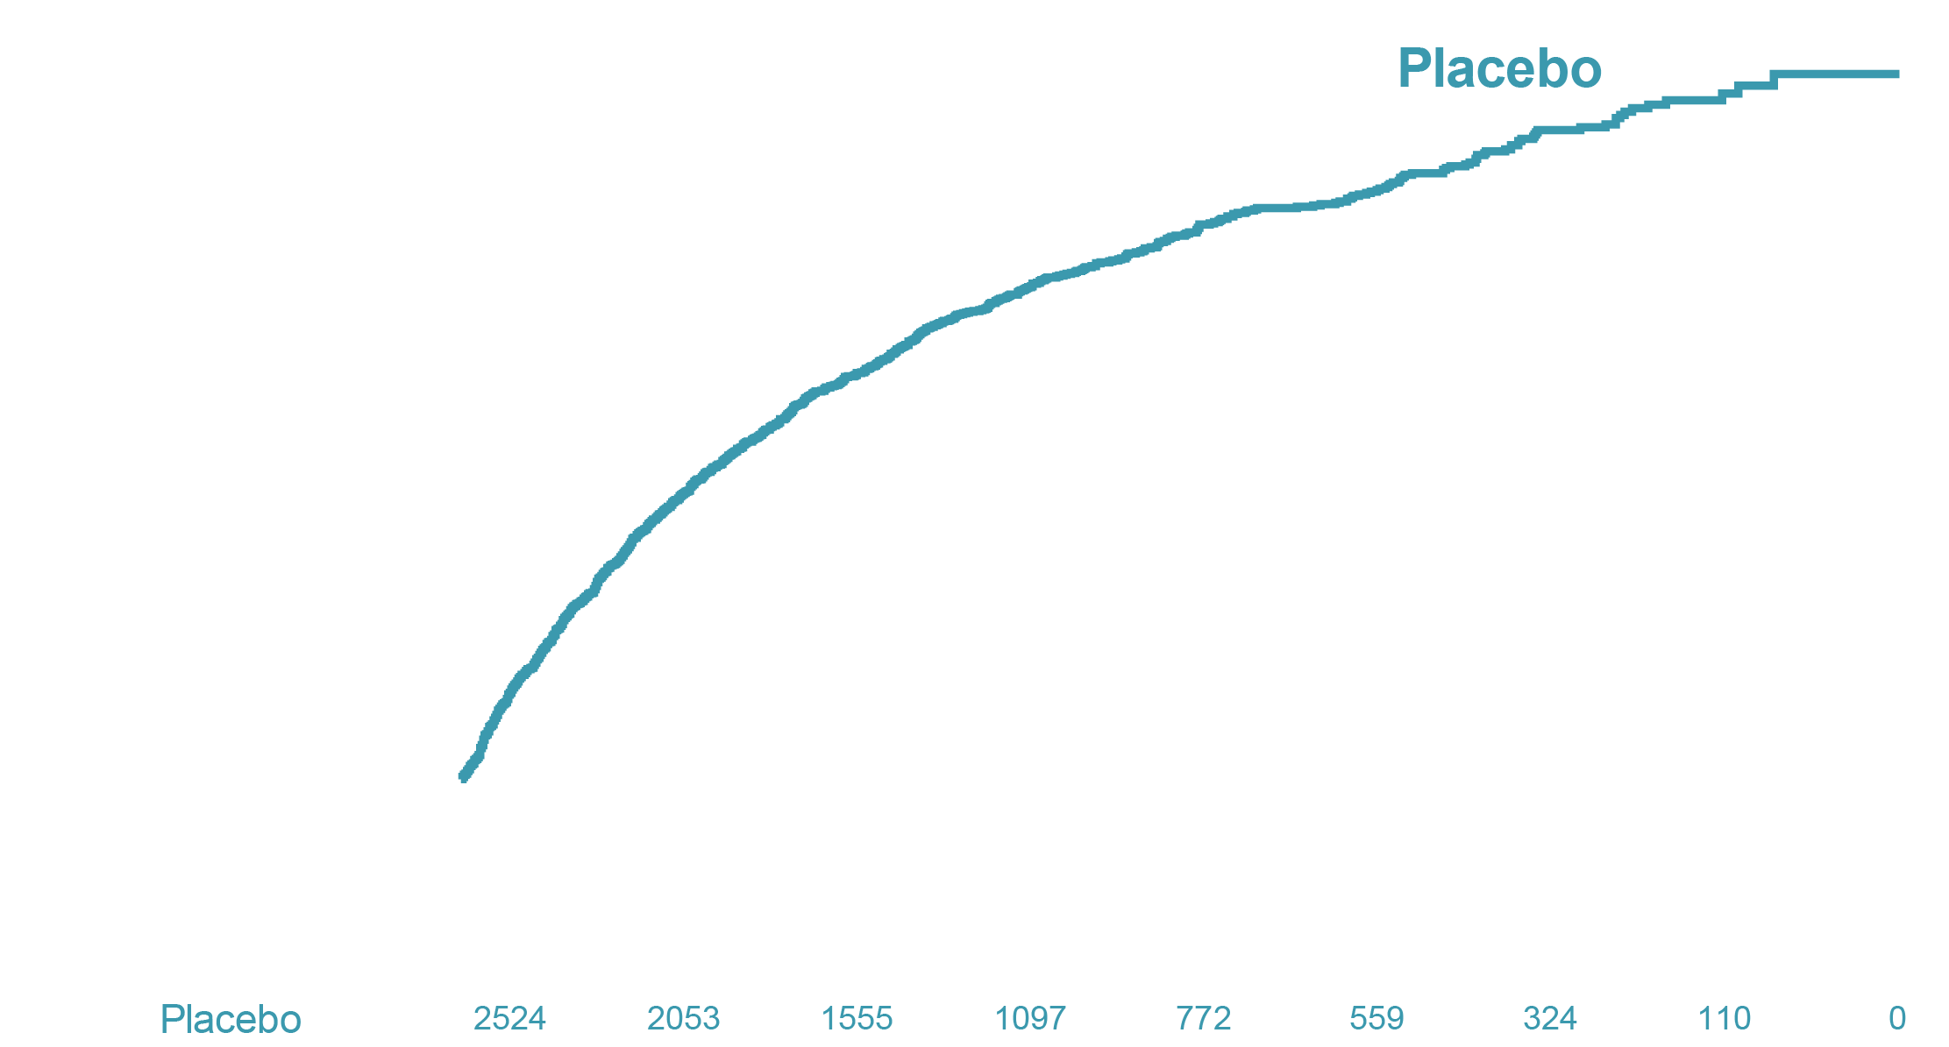
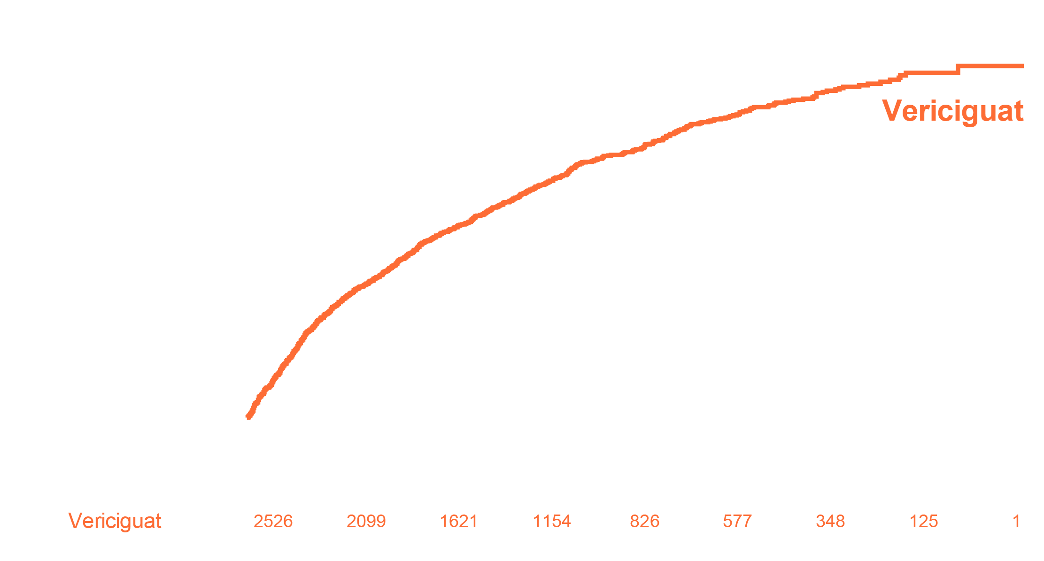
VICTORIA Primary Outcome: CV Death or First HF Hospitalization
HR 0.90 (95% CI 0.82–0.98)
P-value 0.019

Slide 6
Real-World Eligibility for Vericiguat According to Trial, Guideline, and Label Criteria Data from the Swedish Heart Failure Registry
41,635 HFrEF patients in Swedish HF registry (2000-2018) were considered
Key criteria in all scenarios: HF duration >6 months (a surrogate for chronic HFrEF & optimal medical therapy), NYHA II-IV, and HF hospitalization within 6 months. The trial scenario also considered elevated NT-proBNP and many exclusion criteria
Rates of CV death, non-CV death, and HF hospitalization were compared among eligible and ineligible patients using exact Poisson test

Slide 7
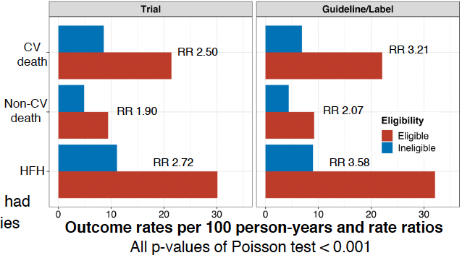
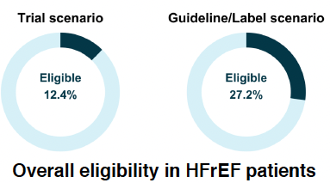
Results
All P-values of Poisson test < 0.001

Slide 8
Results
Main causes of ineligibility
(%patients meeting
individual criteria)
76.1%
60
57.6%
50.2%
40
Eligibility proportion (%)
20
0
Recent HF hospitilization
HF duration >6 months
Elevated NT-proBNP
Trial scenario: exclusion criteria nitrate use
And low SBP also impacted eligibility

Slide 9
Conclusions
Overall, eligibility for vericiguat among HFrEF patients was limited. Eligibility according to guideline/label scenarios was less restrictive than that of the trial scenario
In all scenarios, eligibility criteria selected a population at high risk of both CV and non-CV events; this was consistent with increased HF severity and a greater prevalence of comorbidities in eligible patients
Recent HF hospitalization and chronic HF/optimal medical therapy were major criteria linked with ineligibility

