Slide 1
Geographic Variation in Heart Failure with Reduced Ejection Fraction: Insights from the VICTORIA Trial
Justin A. Ezekowitz, MBBCh, MSc Professor of Medicine Division of Cardiology, University of Alberta Cardiologist, Mazankowski Alberta Heart Institute Co-Director, Canadian VIGOUR Centre Edmonton, Canada

Slide 2
Disclaimer
The views and opinions expressed in this educational activity are those of the faculty and do not necessarily represent the views of TotalCME, Inc., the CME providers, or the companies providing educational grants. This presentation is not intended to define an exclusive course of patient management; the participant should use their clinical judgment, knowledge, experience, and diagnostic skills in applying or adopting for professional use any of the information provided herein. Any procedures, medications, or other courses of diagnosis or treatment discussed or suggested in this activity should not be used by clinicians without evaluation of their patient's conditions and possible contraindications or dangers in use, review of any applicable manufacturer’s product information, and comparison with recommendations of other authorities. Links to other sites may be provided as additional sources of information.

Slide 3
Authors of the Abstract / Affiliations
Affiliations: (1) Kyushu University Graduate School of Medical Sciences, Fukuoka, Japan (2) National Heart Centre Singapore, Duke-NUS, Singapore, Singapore (3) Fuwai Hospital Chinese Academy of Medical Sciences, Beijing, China (4) Instituto Nacional Cardiovascular INCOR, Lima, Peru (5) Democritus University of Thrace, Alexandroupolis, Greece (6) Hospital Lariboisiere, Paris, France (7) Bayer AG, Wuppertal, Germany (8) Merck & Co., Inc., Kenilworth, United States of America (9) University of Alberta, Canadian VIGOUR Centre, Edmonton, Canada (10) Duke Clinical Research Institute, Duke University School of Medicine, Durham, United States of America (11) Charité - University Medicine Berlin, Berlin, Germany (12) Inova Heart and Vascular Institute, Falls Church, United States of America

Slide 4
Background / Objectives
Background
Globalization of clinical trials has highlighted geographic variations in patient characteristics, background therapies, and clinical outcomes
May affect benefits afforded by novel therapies and global generalizability of results
The VICTORIA trial enrolled 5050 high-risk patients with recent worsening HF and HFrEF from around the world, but the impact of regional differences has not been explored
Objectives
Evaluate geographical differences in patient characteristics (age, sex, comorbidity, and background therapies) on event rates and the relation to the treatment effect of vericiguat in VICTORIA

Slide 5
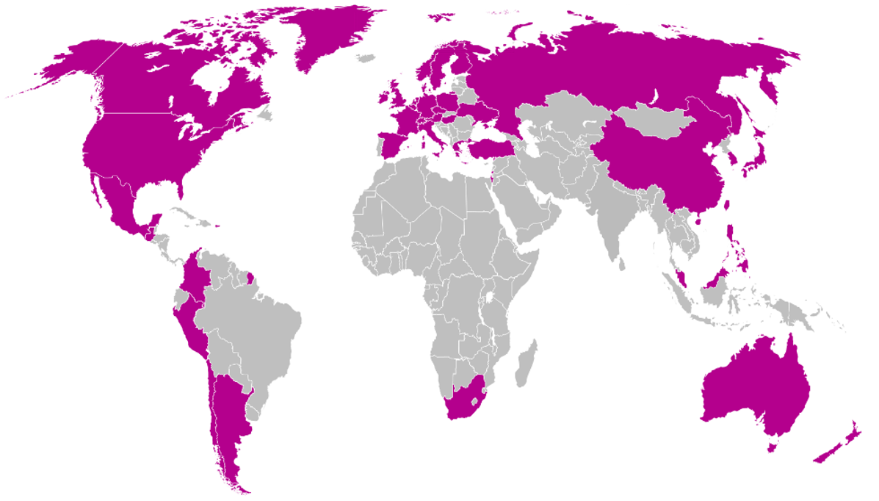
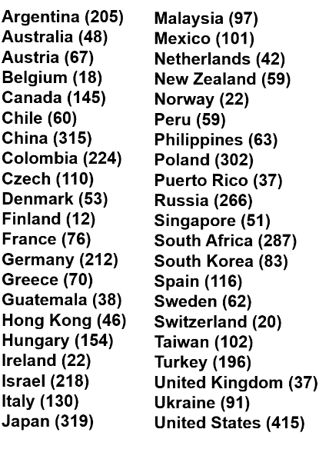
VICTORIA: 42 Countries Across 5 Regions
W. Europe
(n=889)
E. Europe
(n=1694)
N.
America
(n=560)
Asia Pacific
(n=1183)
Latin
And S. America
(n=724)
Overall
(n=5050)

Slide 6
Patient Demographics
Characteristic | E. Europe (n=1694) | W. Europe (n=889) | Asia Pacific (n=1183) | Latin and S. America (n=724) | N. America (n=560) | P-value
Age, years* | 67 (59-74) | 74 (67-80) | 67 (57-76) | 69 (61-77) | 68 (58-75) | <.001
Female, % | 23.4 | 21.3 | 21.1 | 30.8 | 26.8 | <.001
BMI (kg/m²)* | 28 (25-32) | 27 (24-31) | 24 (22-27) | 27 (24-31) | 30 (25-35) | <.001
Ejection Fraction, %* | 30 (23-35) | 30 (25-35) | 30 (24-36) | 28 (21-35) | 26 (20-35) | <.001
Medical History
Diabetes, % | 47.6 | 45.3 | 46.9 | 39.8 | 56.7 | <.001
Atrial fibrillation,% | 44.2 | 59.6 | 41.2 | 32.6 | 47.9 | <.001
SBP (mmHg)* | 122 (112-133) | 117 (109-130) | 115 (107-128) | 119 (110-133) | 117 (107-127) | <.001
eGFR (mL/min/1.73 m²)* | 60.4 (43.1-78.8) | 48.6 (34.7-65.0) | 59.5 (42.7-80.5) | 64.6 (46.4-84.2) | 55.3 (40.3-74.8) | <.001
MAGGIC Risk Score* | 23 (18-28) | 26 (22-31) | 24 (19-28) | 23 (19-27) | 24 (20-29) | <.001
* - median (25th, 75th percentiles) reported for continuous variables; all other values reported were %

Slide 7
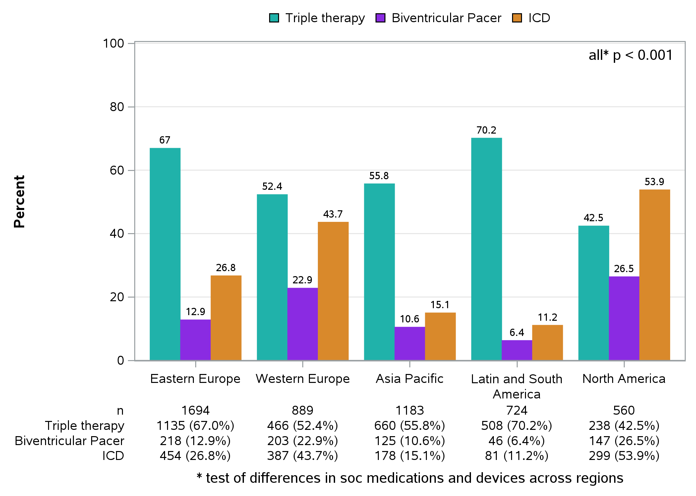
Medication and Device Use by Region
*test of differences in SOC medications and devices across regions

Slide 8
Placebo Event Rates and MAGGIC Risk Scores
Composite Endpoint: CV death or HFH | E. Europe (n=1694) | W. Europe (n=889) | Asia Pacific (n=1183) | Latin and S. America (n=724) | N. America (n=560) | P-value
events/100 person-yrs | 38.8 | 32.0 | 36.1 | 35.4 | 40.1 | 0.26
Adjusted for MAGGIC risk score
Placebo event rates nominally differed by region but were not statistically different after adjusting for the MAGGIC risk score.

Slide 9
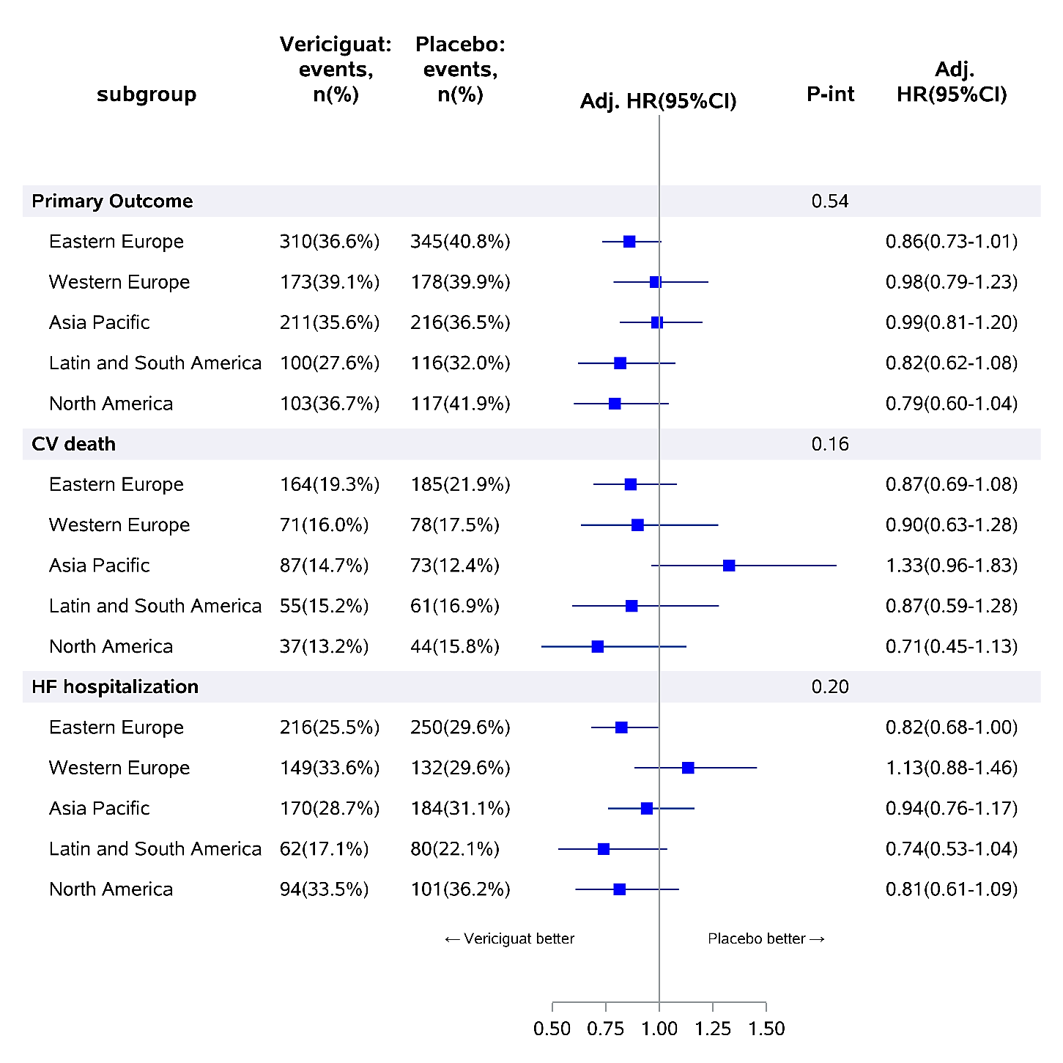
Whereas the benefit of vericiguat varied somewhat across regions, there were no significant impacts on its efficacy as measured by composite outcomes and individual components in pre-specified geographical regions

Slide 10
Summary of Key Findings
Regional variations in patient risk profiles revealed that, relative to patients in other regions, patients in Western Europe had the greatest elevations in NT-proBNP levels and the highest MAGGIC risk scores
Substantial regional differences existed in the use of triple therapy and cardiac devices
Whereas the benefit of vericiguat varied somewhat across regions, there were no significant impacts on its efficacy as measured by composite outcomes and individual components in pre-specified geographical regions

Slide 11
Conclusions
In this post hoc evaluation of geographic differences in a large randomized trial of vericiguat used to treat HFrEF patients with recent worsening event, we found substantial regional differences in patient characteristics and background medical and device HF therapies
Despite these differences, the overall treatment efficacy effect of vericiguat did not differ significantly across regions

