Slide 1
A Look at HER2-Targeted TKIs: How Does Target Specificity Impact Outcomes?
Andrea Cercek, MD
Section Head, Colorectal Cancer
Co-Director, Center for Young Onset Colorectal and Gastrointestinal Cancers
Memorial Sloan Kettering Cancer Center
New York, NY

Slide 2
Disclaimer
The views and opinions expressed in this educational activity are those of the faculty and do not necessarily represent the views of TotalCME, Inc., the CME providers, or the companies providing educational grants. This presentation is not intended to define an exclusive course of patient management; the participant should use their clinical judgment, knowledge, experience, and diagnostic skills in applying or adopting for professional use any of the information provided herein. Any procedures, medications, or other courses of diagnosis or treatment discussed or suggested in this activity should not be used by clinicians without evaluation of their patient's conditions and possible contraindications or dangers in use, review of any applicable manufacturer’s product information, and comparison with recommendations of other authorities. Links to other sites may be provided as additional sources of information.

Slide 3
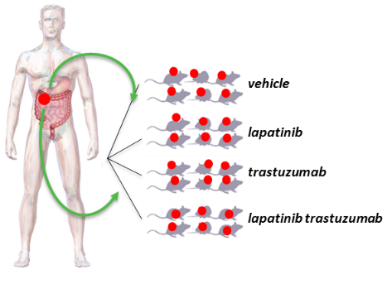
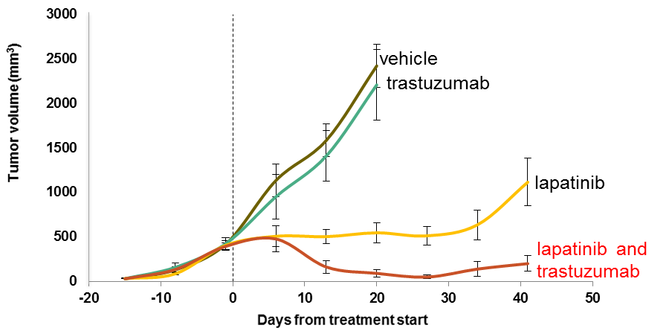
Anti-HER2 Preclinical Trials in HER2+ mCRC PDXs
HER2+ mCRC-PDXs are sensitive to dual HER2-blockade
with lapatinib + trastuzumab but not with either drug alone
mCRC PDX
CRC080
Image courtesy of S. Siena

Slide 4
Tucatinib and Trastuzumab for HER2+ mCRC
HER2+ mCRC PDXs are sensitive to dual (vertical) HER2 blockade with a TKI + trastuzumab, but not with either drug alone
 | HER2 IC₅₀* (nmol/L) | EGFR IC₅₀* (nmol/L)
Tucatinib | 6.9 | 449
Lapatinib | 109 | 48
Neratinib | 5.6 | 1.8
CTG-0383
CTG-0121
CTG-0784
1500
2000
1500
1500
1000
1000
Colorectal models
tumor volume (mm³)
tumor volume (mm³)
tumor volume (mm³)
1000
500
500
500
0
Days
0
Days
0
Days
0
7
14
21
28
35
42
49
56
0
7
14
21
28
35
42
49
56
0
7
14
21
28
35
42
vehicle control
trastuzumab
tucatinib
tucatinib + trastuzumab

Slide 5
MOUNTAINEER: Tucatinib Monotherapy ORR by 12 Weeks of Treatment
Responses | Tucatinib monotherapy
 | Cohort C (n=30)
Best overall response per BICRª, n (%)
CR | 0
PR | 1 (3.3)
SD | 23 (76.7)
PD | 4 (13.3)
Not available^{b} | 2 (6.7)
ORR per BICR, % (95% CI) | 3.3 (0.1, 17.2)
ORR per investigator, % (95% CI) | 3.3 (0.1, 17.2)
DCR per BICR | 24 (80.0)

Slide 6
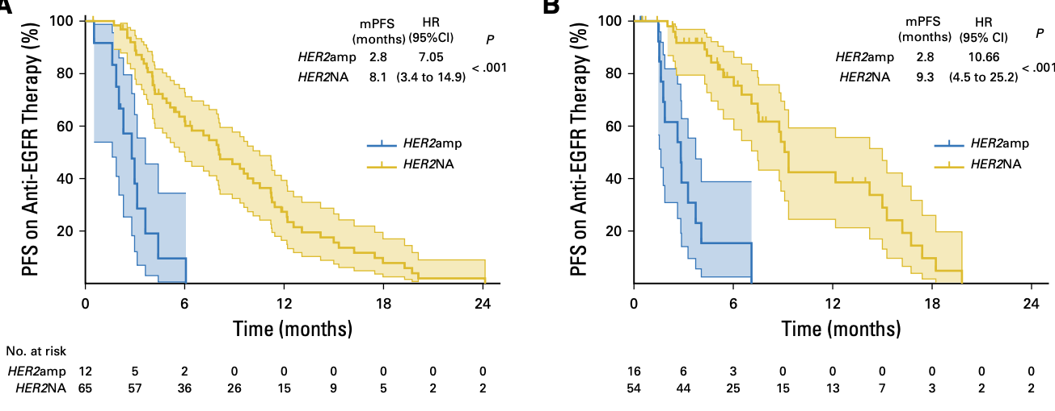
HER2 Amplification Is Associated with Resistance to Anti-EGFR Therapy
HER2+ associated with significantly shorter progression-free survival (PFS)

Slide 7
MyPathway: Biomarkers of Sensitivity/Resistance
 | ORR n (%, 95% CI) | Median PFS Months (95% CI) | Median OS Months (95% CI)
All patients (n=57) | 18 (32%, 20-45) | 2.9 (1.4-5.3) | 11.5 (7.7-NE)
KRAS status Wild-type (n=43) Mutated (n=13) | 17 (40%, 25-56) 1 (8%, 0.2-36) | 5.3 (2.7-6.1) 1.4 (1.2-2.8) | 14.0 (8.0-NE) 8.5 (3.9-NE)
PIK3CA status Wild-type (n=40) Mutated (n=8) | 17 (43%, 27-59) 1 (13%, 0.3-53) | 5.3 (2.8-6.1) 1.4 (1.1-5.7) | 14.0 (8.5-NE) 7.3 (1.2-12.6)
Previous anti-EGFR* Any (n=31) None (n=12) | 11 (36%, 19-55) 6 (50%, 21-79) | 4.1 (1.6-8.2) 5.6 (1.3-14.7) | 11.5 (7.2-22.1) NE (3.2-NE)

Slide 8
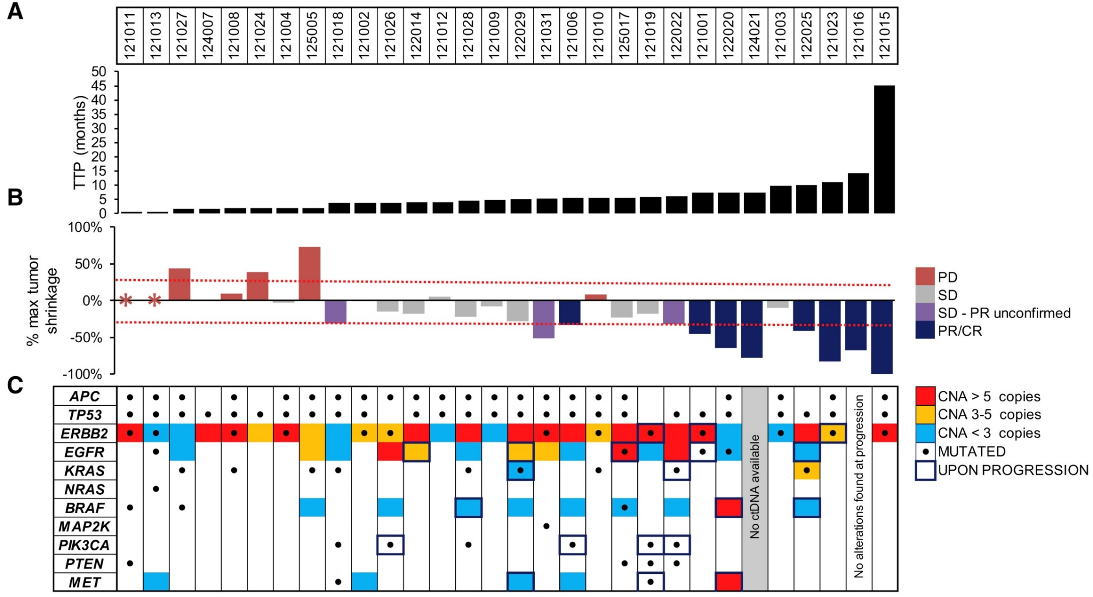
HERACLES: Absence of RAS/ BRAF/ PIK3CA Mutations in ctDNA Associated with Longer TTP

Slide 9
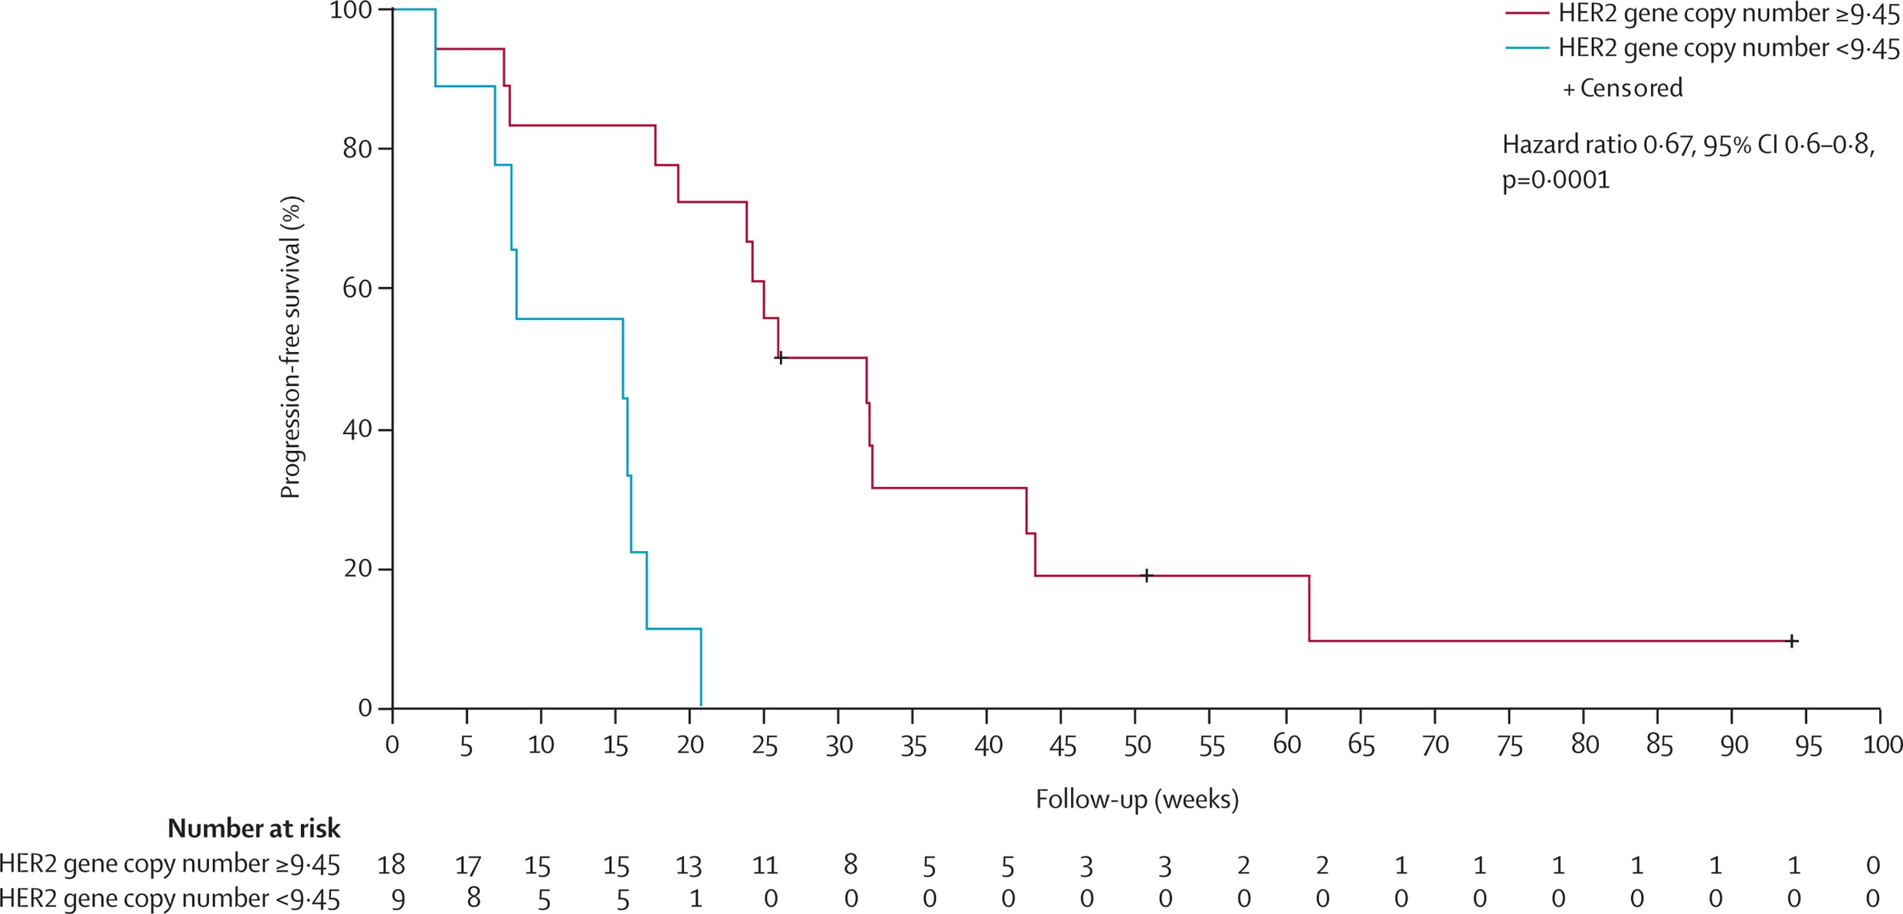
HERACLES: Treatment Benefit Favors Higher Gene Copy Number (FISH)

Slide 10
Tucatinib: Highly Selective HER2 Tyrosine Kinase Inhibitor
Oral, small molecule TKI that targets HER2 (Seattle Genetics, Inc.)
Highly selective for the HER2 receptor
Selectivity may improve tolerability (skin rash, diarrhea, etc.) compared to nonselective TKIs
Potential for enhanced target inhibition, patient compliance, and opportunity for combinations with other drugs
 | HER2 IC₅₀* (nmol/L) | EGFR IC₅₀* (nmol/L)
Tucatinib | 6.9 | 449
Lapatinib | 109 | 48
Neratinib | 5.6 | 1.8

Slide 11
Results of Dual Anti-HER2 Clinical Trials in Patients with Treatment Refractory HER2+ Metastatic CRC
Clinical Trial | Therapies | Patients (N) | Response Rate | PFS (median)
HERACLES¹ | Lapatinib + trastuzumab | 32 | 28% | 4.7 months
MyPathway^{2,3} | Pertuzumab + trastuzumab | 68 (RAS WT) | 31% | 5.3 months*
MOUNTAINEER⁴ | Tucatinib + trastuzumab | 84 | 38% | 8.2 months

