Slide 1
Genetic Testing in PAH: Cascade Genetic Testing Approach
Sudarshan Rajagopal, MD, PhD
Associate Professor of Medicine
Co-Director, Pulmonary Vascular Disease Center
Duke University School of Medicine
Durham, NC

Slide 2
Disclaimer
The views and opinions expressed in this educational activity are those of the faculty and do not necessarily represent the views of Total CME, LLC, the CME providers, or the companies providing educational grants. This presentation is not intended to define an exclusive course of patient management; the participant should use their clinical judgment, knowledge, experience, and diagnostic skills in applying or adopting for professional use any of the information provided herein. Any procedures, medications, or other courses of diagnosis or treatment discussed or suggested in this activity should not be used by clinicians without evaluation of their patient's conditions and possible contraindications or dangers in use, review of any applicable manufacturer’s product information, and comparison with recommendations of other authorities. Links to other sites may be provided as additional sources of information.

Slide 3



Resource Information
About This Resource
These slides are one component of a continuing education program available online at MedEd On The Go titled Advancing Diagnosis and Risk Assessment in PH
Program Learning Objectives:
Gain and understanding of the new guidelines and algorithms developed to detect PH early in the community
Identify appropriate circumstances to implement 3 or 4 strata risk assessments.
Enable early recognition of sub-populations of patients who are at high risk and identify appropriate screening candidates
MedEd On The Go®
www.mededonthego.com
This content or portions thereof may not be published, posted online or used in presentations without permission.
This content can be saved for personal use (non-commercial use only) with credit given to the resource authors.
To contact us regarding inaccuracies, omissions or permissions please email us at support@MedEdOTG.com

Slide 4
Genetic Testing in PAH
BC is a 56-year-old female, recently diagnosed with presumed idiopathic PAH
Her parents have passed away, but she has two siblings and two children of her own, as well as grandchildren
She is concerned about the risk of PAH in her family members
Should we offer her genetic testing?

Slide 5
Heritable PAH - Prevalence
Distribution of Group 1 PAH By Cause
2%
Only ~2% of cases of PAH are defined as heritable PAH
However, 25-30% of patients with idiopathic PAH are found to have an underlying genetic cause when tested
Complicated because of incomplete penetrance (For BMPR2, ~14% in male carriers and 42% in females)
7%
8%
1%
37%
34%
11%

Slide 6
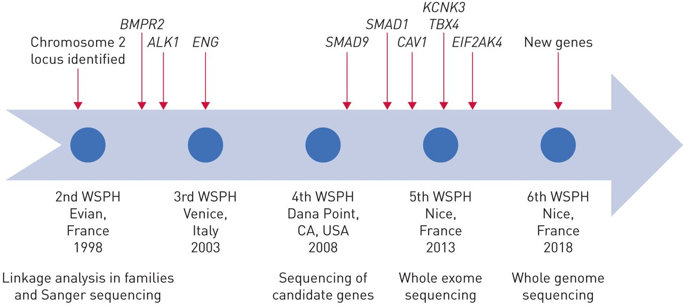
Identification of Genes Associated with PAH

Slide 7
Cascade Genetic Testing: What is It?
GRANDPA
GRANDMA
AUNT SARA
DAD
MOM
CASCADE GENETIC TESTING:
the process of testing through a family in a specific order to identify all of the relatives who did, or did not, inherit a genetic mutation that is causing the condition of concern in the family
ME
TAYLOR

Slide 8
Summary
While most registries report that only 2% of PAH is heritable (HPAH), studies have shown than 25-30% of idiopathic PAH patients have an underlying genetic cause
If a patient is found to have a genetic cause for PAH, genetic testing can be offered to family members through cascade testing
For unaffected family members who are negative for a mutation, the risk of PAH is the same as for the general population
Those with a mutation are at risk for developing PAH. They should be monitored annually

Slide 9



Looking for more resources on this topic?
CME/CE in minutes
Congress highlights
Late-breaking data
Quizzes
Webinars
In-person events
Slides & resources
www.MedEdOTG.com

