Slide 1
How Do We Screen For PAH in the Systemic Sclerosis Patient?
Dinesh Khanna, MD, MS
Director, University of Michigan Scleroderma Program
Medical Director, Michigan Medical Clinical Research Unit
Ann Arbor, MI

Slide 2
Disclaimer
The views and opinions expressed in this educational activity are those of the faculty and do not necessarily represent the views of Total CME, LLC, the CME providers, or the companies providing educational grants. This presentation is not intended to define an exclusive course of patient management; the participant should use their clinical judgment, knowledge, experience, and diagnostic skills in applying or adopting for professional use any of the information provided herein. Any procedures, medications, or other courses of diagnosis or treatment discussed or suggested in this activity should not be used by clinicians without evaluation of their patient's conditions and possible contraindications or dangers in use, review of any applicable manufacturer’s product information, and comparison with recommendations of other authorities. Links to other sites may be provided as additional sources of information.

Slide 3



Resource Information
About This Resource
These slides are one component of a continuing education program available online at MedEd On The Go titled Advancing Diagnosis and Risk Assessment in PH
Program Learning Objectives:
Gain and understanding of the new guidelines and algorithms developed to detect PH early in the community
Identify appropriate circumstances to implement 3 or 4 strata risk assessments.
Enable early recognition of sub-populations of patients who are at high risk and identify appropriate screening candidates
MedEd On The Go®
www.mededonthego.com
This content or portions thereof may not be published, posted online or used in presentations without permission.
This content can be saved for personal use (non-commercial use only) with credit given to the resource authors.
To contact us regarding inaccuracies, omissions or permissions please email us at support@MedEdOTG.com

Slide 4
Importance of Early Detection of PAH in SSc
PAH is a common and serious complication of SSc which justifies systematic screening¹
The WHO defines screening as the “the presumptive identification of unrecognized disease in an apparently healthy, asymptomatic population...”²
Due to the high level of missed diagnoses using echo alone, the 2022 ESC/ERS guidelines now recommend the use of DETECT as an option to screen for PAH-SSc⁵
DETECT is a multidimensional tool recommended by the 6th WSPH and the 2022 ESC/ERS guidelines as a screening option to identify patients with SSc at increased risk for PAH³⁻⁵
Regardless of the method of screening, both the WSPH and ESC/ERS recommend annual screening for PAH in patients with SSc^{4,5}
Notes:
Weatherald Eur Respir Rev 2019 RF-98546
P1/Abstract/para1/ln1-2; p3/para2/ln1-2
P1/Abstract/para1/ln2-3
P1/Abstract/para1/ln4-6
Frost Eur Respir J 2019_RF-92738
p1/Author line/ln5; p4/para4, para5/ln8-15
Coghlan-Ann Rheum Dis 2014 RF-116676 p1346/Fig 2
Weatherald Eur Respir Rev 2019 RF-98546
P1/Abstract/para1/ln1-2; p3/para2/ln1-2
P1/Abstract/para1/ln2-3
P1/Abstract/para1/ln4-6
Frost Eur Respir J 2019_RF-92738
p1/Author line/ln5; p4/para4, para5/ln8-15
Coghlan-Ann Rheum Dis 2014 RF-116676 p1346/Fig 2
Humbert Eur Heart J 2022 - ESC-ERS PH Guidelines RF-230262 p37/col2/Recommendation Table 3 continued/top row
p37/col1/Recommendation Table 3 continued/top row
Humbert Eur Heart J 2022 - ESC-ERS PH Guidelines RF-230262 p37/col2/Recommendation Table 3 continued/top row
Sagan WHO Screening 2020 RF-XXXXXX p6/col1/para1/ln1-5
Sagan WHO Screening 2020 RF-XXXXXX p6/col1/para1/ln1-5
Frost Eur Respir J 2019_RF-92738
p4/para5/bullet1
Humbert Eur Heart J 2022 - ESC-ERS PH Guidelines RF-230262
p37/col1/Recommendation Table 3 continued/top row
Frost Eur Respir J 2019_RF-92738
p4/para5/bullet1

Slide 5
CAVEAT: False Negativity Is Associated with Echocardiography - DETECT Study (N=303)
eRVSP = 4 (TR velocity)² + RAP (assumed 5 mm Hg)
The use of TR velocity thresholds alone for detecting PAH is associated with a high rate of missed PAH diagnoses
PAH Suspicion Threshold (TR Velocity/eRVSP) | Percentage of PAH Patients
<2.5 m/s; 30 mm Hg | 20%
≤2.8 m/s; 36 mm Hg | 36%
≤3.4 m/s; 50 mm Hg | 63%
SSc
DLCO <60%
Disease duration >3 years

Slide 6
A Multimodal Approach for PAH-SSc Screening Is Warranted¹
ESC/ERS Guidelines^{1,2}
ASIG^{1,3}
SSc and Asymptomatic for PAH
DLCO_{corr} <70.3% + FVC/DLco <1.82 AND NT-proBNP ≤209.8 pg/mL
DLCO_{corr} <70.3% + FVC/DLCO ≥1.82 AND/OR NT-proBNP >209.8 pg/mL
SSc >3 years + FVC ≥40% + DLCO <60%
NO
YES
Annual screening using practical approach to assess risk of PAH*
DETECT
Low likelihood of PAH
Echo ± HRCT, 6MWT (optional)
Suspected PAH
No need for echo and/or RHC
Echo and/or RHC
Repeat screen in 6-12 months
RHC
2022 ESC/ERS guidelines recommend a multimodal approach to screen (eg, DETECT and ASIG) for PAH-SSc as the diagnostic accuracy of echo/or other tests alone is suboptimal¹
Notes:
Humbert Eur Heart J 2022 - ESC-ERS PH Guidelines RF-230262 p37/col2/Recommendation Table 3 continued/top row
Humbert Eur Heart J 2022 - ESC-ERS PH Guidelines RF-230262 p36/col1/para4/ln1-5
Humbert Eur Heart J 2022 - ESC-ERS PH Guidelines Suppl Data RF-XXXXXX p83/para2/ln2-6
Galie Eur Heart J 2016 RF-131327
P76/col2/Table 8A, Table 8B; p77/col2/para2/ln2-11
Humbert Eur Heart J 2022 - ESC-ERS PH Guidelines RF-230262
p36/col1/para4/ln1-10
Humbert Eur Heart J 2022 - ESC-ERS PH Guidelines Suppl Data RF-XXXXXX p80/Table/Section: Certainty of the evidence of test accuracy/para1/ln4-6
Thakker Arthritis Res Ther. 2012 RF-97454 p6/col2/para1/ln15-18, para2/ln1-12; p8/col1/Fig 3
Humbert Eur Heart J 2022 - ESC-ERS PH Guidelines RF-230262
p37/col2/Recommendation Table 3 continued/top row
p36/col1/para4/ln1-10
p36/col1/para4/ln2-5,9-10, para5/ln1-2
p37/col1/Recommendation Table 3/top row; col2/Recommendation table 3 continued/row6
Humbert Eur Heart J 2022 - ESC-ERS PH Guidelines RF-230262 p36/col1/para4/ln1-10
Thakker Arthritis Res Ther. 2012 RF-97454 p6/col2/para1/ln15-18, para2/ln1-12; p8/col1/Fig 3

Slide 7

Focus on DETECT: 2-Step, 8-Variable Algorithm Supports PAH-SSc Screening/Early Detection
STEP 1
STEP 2
Non-echocardiographic variables
TOTAL RISK
POINTS >300
Echocardiogram
TOTAL RISK
POINTS >35
Total risk points ≤300
No referral to echocardiogram
Total risk points ≤35
No referral to RHC
RA area
TRV
Referral for RHC
FVC % predicted/DLCO % predicted
Current/past telangiectasias
Serum anticentromere antibodies
Serum NT-proBNP
Serum urate
Right-axis deviation on electrocardiogram
Notes:
Coghlan-Ann Rheum Dis 2014 RF-116676 p1340/col1/para3/ln1-2; p1342/col1/para3/ln1-2; p1345/Fig2, Fig 2 caption/ln1
Coghlan-Ann Rheum Dis 2014 RF-116676 p1345/Fig2
Coghlan-Ann Rheum Dis 2014 RF-116676 p1340/col2/para3/ln1-2; p1342/col1/para3/ln1-2; p1345/Fig2, Fig 2 caption/ln1
Coghlan-Ann Rheum Dis 2014 RF-116676 p1345/Fig2
Coghlan-Ann Rheum Dis 2014 RF-116676 p1342/col2/para2/ln6-7; p1344/col1/para1/ln1—4, Table 2
P1344/col1/para1/ln5-11; p1345/Fig 2; p1346/Fig 3
P1341/col1/col2/para5/15-19
p1345/Fig 2; p1346/Fig 3
P1341/ln15-22

Slide 8
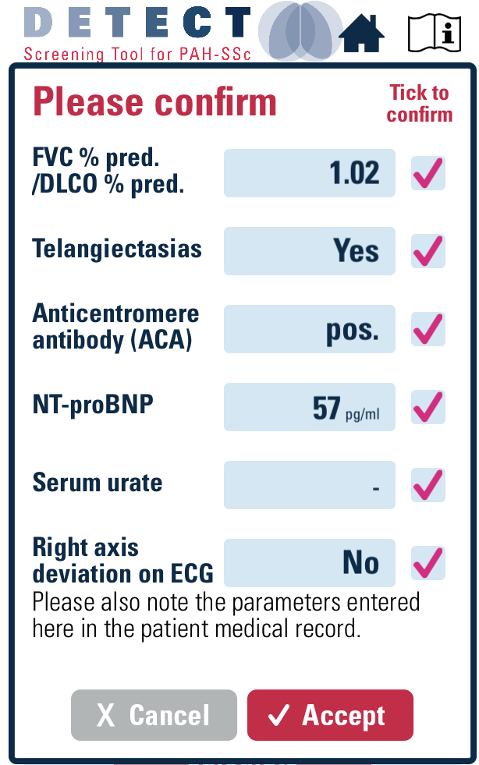
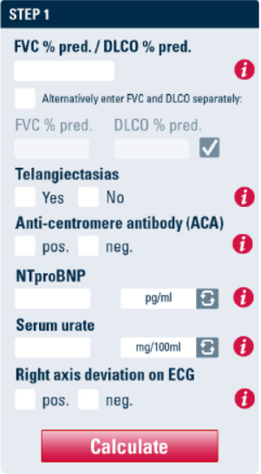
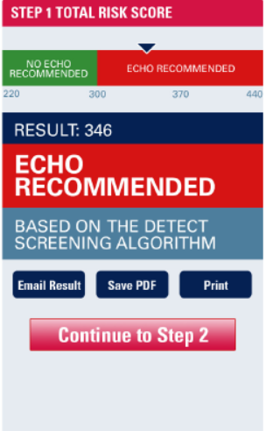
DETECT Smart Phone App: A Two-Step Decision Tree for Screening SSc-PAH
STEP 1
STEP 1 CALCULATE
1.02
✓
84
82
✓
✓
57
✓
DETECT v2.0 smart phone application was released in January 2019

Slide 9
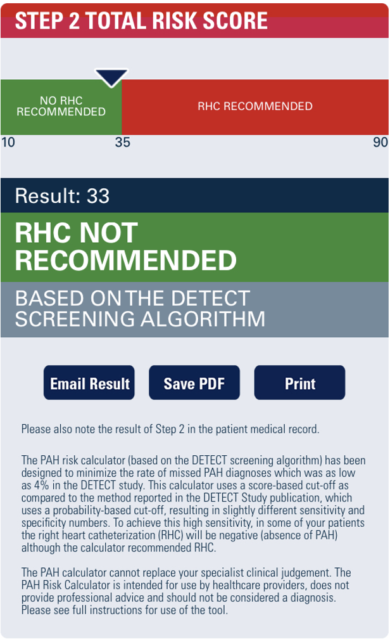
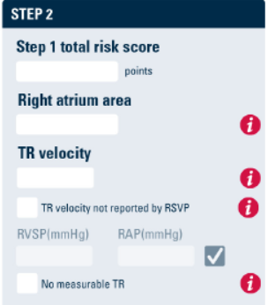

DETECT Two-Step Decision Tree to Screen for SSc-PAH
STEP 2 CALCULATE
STEP 2 – Echo Results
314
13
2.06
✓
22
5
DETECT v2.0 smart phone application was released in January 2019

Slide 10
The Value of DETECT: Highly Sensitive, Reduces Chance of a Missed PAH Diagnosis (Compared with 2009 ESC/ERS Guidelines)
Comparisons of DETECT and 2009 ESC/ERS Screening Algorithms
PAH-SSc prevalence in DETECT: 19%
Missed diagnosis rate
DETECT: 4%
2009 ESC/ERS guidelines: 29%
PPV
DETECT: 35%
2009 ESC/ERS guidelines: 40%
DETECT’s missed diagnosis rate and PPV were better than those of the guidelines even when DETECT’s specificity at step 2 was increased from 35% to 65% and RHC referral rate was lowered
Notes:
Coghlan-Ann Rheum Dis 2014 RF-116676 p1348/col1/para3/ln5-6
Coghlan-Ann Rheum Dis 2014 RF-116676 p1347/Table 3
Coghlan-Ann Rheum Dis 2014 RF-116676 p1348/col1/para3/ln5-6
p1342/col1/para1/ln2-5
Coghlan-Ann Rheum Dis 2014 RF-116676 p1347/Table 3/footer/ln1-5
Coghlan-Ann Rheum Dis 2014 RF-116676 p1347/Table 3
Coghlan-Ann Rheum Dis 2014 RF-116676 p1344/col2/para2/ln8-9
Coghlan-Ann Rheum Dis 2014 RF-116676 p1344/col1/para2/ln1, col2/para2/ln14-19; p1347/Table 3
Coghlan-Ann Rheum Dis 2014 RF-116676 p1342/col1/para1/ln2-5
p1344/col1/para2/ln1; p1347/Table 3
p1344/col1/para2/ln1; p1347/Table 3

Slide 11
DETECT Is Highly Sensitive* and Reduces Missed PAH Diagnosis in Patients with Any DLCO† Compared with 2015 ESC/ERS Guidelines
UNIVERSITY OF MICHIGAN STUDY
DETECT vs 2015 ESC/ERS Guidelines in Patients With Any DLCO† and DLCO ≥60% Using 6th WSPH Definition of PAH‡
Any DLCO† (n=68)
DLCO ≥60% (n=27)
Result Summary
 | Missed Diagnosis |  | PPV
 | DETECT | 2015 ESC/ERS | DETECT | 2015 ESC/ERS
Any DLCO† | 0% | 20% | 20% | 24%
DLCO ≥60% | 0% | 33% | 15% | 20%
Missed diagnosis
PPV
Results support 6th WSPH’s recommendation to use DETECT for patients with DLCO <80% and suggest that DETECT is a better PAH-SSc screening tool than echo alone
Notes:
Young and Khanna Manuscript DOF 2021 RF-155937 p3/Abstract/para4; p10/para2/ln5-9; p21/Table 2
Young and Khanna Manuscript DOF 2021 RF-155937 p5/para3/ln1-2; p21/Table 2/right side
All values multiplied by 100 to yield percentages
Calculation for Missed diagnosis which is inversely related to sensitivity so higher sensitivity means fewer missed diagnosis:
-------FOR DLco≥60%------
DETECT: sensitivity of 1*100=100% means 0% missed diagnosis
2015 ESC/ERS:
sensitivity of 0.67*100=67% so 100%-67%=33% missed diagnosis
------FOR ANY DLco--------
DETECT: sensitivity of 1*100=100% means 0% missed diagnosis
2015 ESC/ERS:
sensitivity of 0.8*100=80% so 100%-80%=20% missed diagnosis
Young and Khanna Manuscript DOF 2021 RF-155937
P13/para1/ln1-5; p14/para3/ln4-5
Young and Khanna Manuscript DOF 2021 RF-155937 p9/para1/ln1,3; p19/Table 1/column titles; P20/Table 1 (continued)/Row: DLco
p5/para2, para3/ln1; p6/para2/ln4-6; P7/para2/ln1-4; p14/para2/ln3-4,8-9
p19/Table 1/column titles; P20/Table 1 (continued)/Row: DLco
P13/para1/ln1-5; p14/para3/ln4-5
Young and Khanna Manuscript DOF 2021 RF-155937 P7/para2/ln1-4
Young and Khanna Manuscript DOF 2021 RF-155937 p3/Abstract/para4; p10/para2/ln5-9; p21/Table 2
Young and Khanna Manuscript DOF 2021 RF-155937
p21/Table 2
All values multiplied by 100 to yield percentages
Calculation for Missed diagnosis which is inversely related to sensitivity so higher sensitivity means fewer missed diagnosis:
-------FOR DLco≥60%------
DETECT: sensitivity of 1*100=100% means 0% missed diagnosis
2015 ESC/ERS:
sensitivity of 0.67*100=67% so 100%-67%=33% missed diagnosis
------FOR ANY DLco--------
DETECT: sensitivity of 1*100=100% means 0% missed diagnosis
2015 ESC/ERS:
sensitivity of 0.8*100=80% so 100%-80%=20% missed diagnosis
NOTE TO CAC: This slide animates. Please see subsequent pages for animation and corresponding slide notes

Slide 12
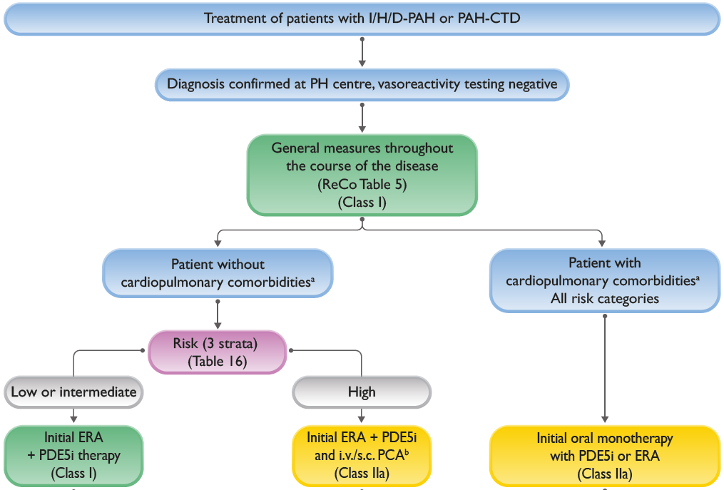
A Final Thought: Risk Stratification Guides Medical Therapy

Slide 13



Looking for more resources on this topic?
CME/CE in minutes
Congress highlights
Late-breaking data
Quizzes
Webinars
In-person events
Slides & resources
www.MedEdOTG.com

