Slide 1
Why Should We Screen for PAH in Systemic Sclerosis?
Dinesh Khanna, MD, MS
Director, University of Michigan Scleroderma Program
Medical Director, Michigan Medical Clinical Research Unit
Ann Arbor, MI

Slide 2
Disclaimer
The views and opinions expressed in this educational activity are those of the faculty and do not necessarily represent the views of Total CME, LLC, the CME providers, or the companies providing educational grants. This presentation is not intended to define an exclusive course of patient management; the participant should use their clinical judgment, knowledge, experience, and diagnostic skills in applying or adopting for professional use any of the information provided herein. Any procedures, medications, or other courses of diagnosis or treatment discussed or suggested in this activity should not be used by clinicians without evaluation of their patient's conditions and possible contraindications or dangers in use, review of any applicable manufacturer’s product information, and comparison with recommendations of other authorities. Links to other sites may be provided as additional sources of information.

Slide 3



Resource Information
About This Resource
These slides are one component of a continuing education program available online at MedEd On The Go titled Advancing Diagnosis and Risk Assessment in PH
Program Learning Objectives:
Gain and understanding of the new guidelines and algorithms developed to detect PH early in the community
Identify appropriate circumstances to implement 3 or 4 strata risk assessments.
Enable early recognition of sub-populations of patients who are at high risk and identify appropriate screening candidates
MedEd On The Go®
www.mededonthego.com
This content or portions thereof may not be published, posted online or used in presentations without permission.
This content can be saved for personal use (non-commercial use only) with credit given to the resource authors.
To contact us regarding inaccuracies, omissions or permissions please email us at support@MedEdOTG.com

Slide 4
Importance of Early Detection of PAH in SSc
PAH is a common and serious complication of SSc which justifies systematic screening¹
Many patients present with advanced symptoms, significant functional impairment, and severe hemodynamics at diagnosis¹
The WHO defines screening as the “the presumptive identification of unrecognized disease in an apparently healthy, asymptomatic population...”²
Timely diagnosis via systematic screening of asymptomatic patients may help support early intervention efforts to improve outcomes in PAH-SSc¹
DETECT is a multidimensional tool recommended by the 6th WSPH and the 2022 ESC/ERS guidelines as a screening option to identify patients with SSc at increased risk for PAH³⁻⁵
Regardless of the method of screening, both the WSPH and ESC/ERS recommend annual screening for PAH in patients with SSc^{4,5}
Notes:
Weatherald Eur Respir Rev 2019 RF-98546
P1/Abstract/para1/ln1-2; p3/para2/ln1-2
P1/Abstract/para1/ln2-3
P1/Abstract/para1/ln4-6
Frost Eur Respir J 2019_RF-92738
p1/Author line/ln5; p4/para4, para5/ln8-15
Coghlan-Ann Rheum Dis 2014 RF-116676 p1346/Fig 2
Weatherald Eur Respir Rev 2019 RF-98546
P1/Abstract/para1/ln1-2; p3/para2/ln1-2
P1/Abstract/para1/ln2-3
P1/Abstract/para1/ln4-6
Frost Eur Respir J 2019_RF-92738
p1/Author line/ln5; p4/para4, para5/ln8-15
Coghlan-Ann Rheum Dis 2014 RF-116676 p1346/Fig 2
Humbert Eur Heart J 2022 - ESC-ERS PH Guidelines RF-230262 p37/col2/Recommendation Table 3 continued/top row
p37/col1/Recommendation Table 3 continued/top row
Humbert Eur Heart J 2022 - ESC-ERS PH Guidelines RF-230262 p37/col2/Recommendation Table 3 continued/top row
Sagan WHO Screening 2020 RF-XXXXXX p6/col1/para1/ln1-5
Sagan WHO Screening 2020 RF-XXXXXX p6/col1/para1/ln1-5
Frost Eur Respir J 2019_RF-92738
p4/para5/bullet1
Humbert Eur Heart J 2022 - ESC-ERS PH Guidelines RF-230262
p37/col1/Recommendation Table 3 continued/top row
Frost Eur Respir J 2019_RF-92738
p4/para5/bullet1

Slide 5


Screening Is Recommended for Asymptomatic Patients
Screening
Symptomatic
WHO
Diagnosis
Screening is not the same as early diagnosis
People who do not have symptoms are invited to undergo screening tests
Early diagnosis is intended to detect conditions as early as possible among people with symptoms

Slide 6
Screening Is Recommended for Asymptomatic Patients
Screening
Symptomatic
WHO
Diagnosis
The purpose of screening is to identify people who are at higher risk of a health problem or a condition, so that an early treatment or intervention can be offered and thereby reduce the incidence and/or mortality of the health problem or condition within the population.

Slide 7
Screening Allows Earlier Detection of PAH in SSc Patients
Routine practice
(n = 16)
Screened*
(n = 16)
8-year survival from diagnosis of SSc-PAH
100%
81%
73%
64%
100
12.5% in FC I/II
50% in FC I/II
80
75%
60
Screened
Survival rate (%)
40
31%
Routine practice
25%
20
17%
0
1
3
5
8
Years of follow-up
p = 0.036; routine versus screened patients

Slide 8
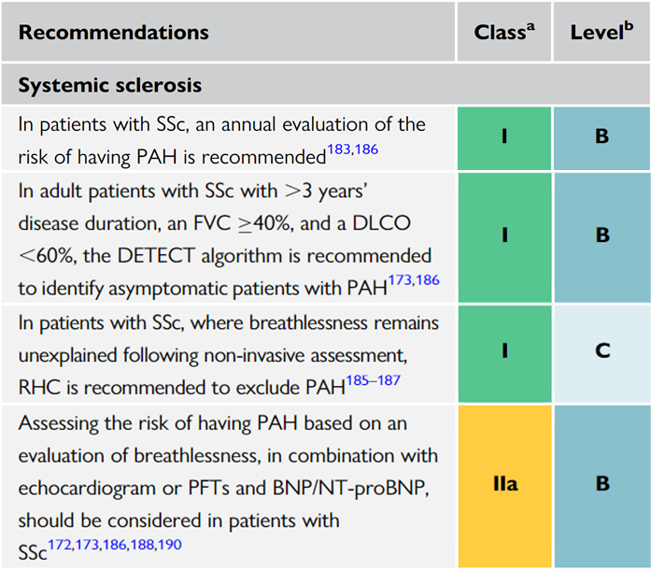
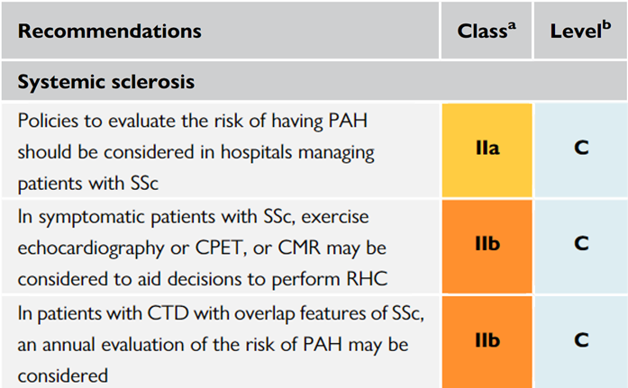
Screening for PAH in SSc Patients Is Recommended
Recommendations from the 2022 ESC/ERS Guidelines on PAH

Slide 9
Summary
PAH is a known complication in 5%-12% of SSc cases and has been reported to be the primary cause of death in the PAH-CTD¹⁻³
Many patients with SSc experience long delays in diagnosis of PAH and worsening prognosis⁴⁻⁶
Certain demographic and clinical features are associated with an increased risk of PAH in SSc⁷
Proactive screening can help detect PAH at earlier disease stages and improve patient outcomes⁸
The DETECT algorithm has been reported to have greater sensitivity and reduce missed diagnoses of PAH in SSc when compared with the 2009 and 2015 ESC/ERS guidelines^{9,10}
Due to the high level of missed diagnoses using echo alone, the 2022 ESC/ERS guidelines now recommend the use of DETECT as an option to screen for PAH-SSc^{11,12}
Notes:
Weatherald Eur Respir Rev 2019 RF-98546
P1/Abstract/para1/ln1-2
Galie Eur Heart J 2016 RF-131327
P100/col2/para1/ln8-10
Kolstad Ann Rheum Dis. 2018 RF-87325 p864/col1/para2/ln1-2; p866/col2/Table 2
Denominator: 44+12=56
PAH: ((27+2)/56)*100=51.7~52%
Cancer: ((4+2)/56)*100=10.71~11%
Infection: ((4+1)/56)*100=8.93~9%
Others: (1+1+1+4+2+1+1+1+3+1)/56*100=28.57~28%
Hachulla Chest 2009 RF-102181 p1211/Abstract/para3/ln1-2
Vachiery Eur Respir Rev 2009 RF-110434 p163/col2/para3/ln8-11
Condliffe Am J Respir Crit Care Med 2009_RF-92779 p152/col2/para3/ln3-5
Yaqub Curr Rheumatol Rep 2013 RF-97296 p4/col1/Table 2
Humbert-Arthritis Rheum 2011 RF-124352 p3523/col2/para3/ln1-7, para4/ln1-6, para5; p3524/col1/para1/ln1-4; p3526/Fig 2
Coghlan-Ann Rheum Dis 2014 RF-116676 p1348/col1/para3/ln5-6
Young and Khanna Manuscript DOF 2021 RF-155937 p3/Abstract/para4; p10/para2/ln5-9; p21/Table 2
Weatherald Eur Respir Rev 2019 RF-98546
P1/Abstract/para1/ln1-2
Galie Eur Heart J 2016 RF-131327
P100/col2/para1/ln8-10
Kolstad Ann Rheum Dis. 2018 RF-87325 p864/col1/para2/ln1-2; p866/col2/Table 2
Denominator: 44+12=56
PAH: ((27+2)/56)*100=51.7~52%
Cancer: ((4+2)/56)*100=10.71~11%
Infection: ((4+1)/56)*100=8.93~9%
Others: (1+1+1+4+2+1+1+1+3+1)/56*100=28.57~28%
Hachulla Chest 2009 RF-102181 p1211/Abstract/para3/ln1-2
Vachiery Eur Respir Rev 2009 RF-110434 p163/col2/para3/ln8-11
Condliffe Am J Respir Crit Care Med 2009_RF-92779 p152/col2/para3/ln3-5
Yaqub Curr Rheumatol Rep 2013 RF-97296 p4/col1/Table 2
Humbert-Arthritis Rheum 2011 RF-124352 p3523/col2/para3/ln1-7, para4/ln1-6, para5; p3524/col1/para1/ln1-4; p3526/Fig 2
Young and Khanna Manuscript DOF 2021 RF-155937 p3/Abstract/para4; p10/para2/ln5-9; p21/Table 2
Coghlan-Ann Rheum Dis 2014 RF-116676 p1348/col1/para3/ln5-6
Humbert Eur Heart J 2022 - ESC-ERS PH Guidelines Suppl Data RF-XXXXXX p80/Table/Section: Certainty of the evidence of test accuracy/para1/ln4-6
Humbert Eur Heart J 2022 - ESC-ERS PH Guidelines RF-230262
p37/col2/Recommendation Table 3 continued/top row
Humbert Eur Heart J 2022 - ESC-ERS PH Guidelines Suppl Data RF-XXXXXX p80/Table/Section: Certainty of the evidence of test accuracy/para1/ln4-6
Humbert Eur Heart J 2022 - ESC-ERS PH Guidelines RF-230262
p37/col2/Recommendation Table 3 continued/top row

Slide 10



Looking for more resources on this topic?
CME/CE in minutes
Congress highlights
Late-breaking data
Quizzes
Webinars
In-person events
Slides & resources
www.MedEdOTG.com

