Slide 1
Understanding the 4-Strata Approach to Risk Assessment (RA) for Patient Monitoring and Management
Vallerie V. McLaughlin, MD
Associate Chief Clinical Officer, Cardiovascular Services
Director, Pulmonary Hypertension Program
University of Michigan
Ann Arbor, MI

Slide 2
Disclaimer
The views and opinions expressed in this educational activity are those of the faculty and do not necessarily represent the views of Total CME, LLC, the CME providers, or the companies providing educational grants. This presentation is not intended to define an exclusive course of patient management; the participant should use their clinical judgment, knowledge, experience, and diagnostic skills in applying or adopting for professional use any of the information provided herein. Any procedures, medications, or other courses of diagnosis or treatment discussed or suggested in this activity should not be used by clinicians without evaluation of their patient's conditions and possible contraindications or dangers in use, review of any applicable manufacturer’s product information, and comparison with recommendations of other authorities. Links to other sites may be provided as additional sources of information.

Slide 3



Resource Information
About This Resource
These slides are one component of a continuing education program available online at MedEd On The Go titled Advancing Diagnosis and Risk Assessment in PH
Program Learning Objectives:
Gain and understanding of the new guidelines and algorithms developed to detect PH early in the community
Identify appropriate circumstances to implement 3 or 4 strata risk assessments.
Enable early recognition of sub-populations of patients who are at high risk and identify appropriate screening candidates
MedEd On The Go®
www.mededonthego.com
This content or portions thereof may not be published, posted online or used in presentations without permission.
This content can be saved for personal use (non-commercial use only) with credit given to the resource authors.
To contact us regarding inaccuracies, omissions or permissions please email us at support@MedEdOTG.com

Slide 4
Variables Used to Calculate Simplified Four-Strata Risk Assessment Tool
Determinants of Prognosis | Low Risk | Intermediate-Low Risk | Intermediate-High Risk | High Risk
Points Assigned | 1 | 2 | 3 | 4
WHO-FC | I or II | --- | III | IV
6MWD, m | > 440 | 320 - 440 | 165 - 319 | < 165
BNP or NT-proBNP, ng/L | < 50 < 300 | 50 – 199 300 - 649 | 200 – 800 650 - 1100 | > 800 > 1100

Slide 5
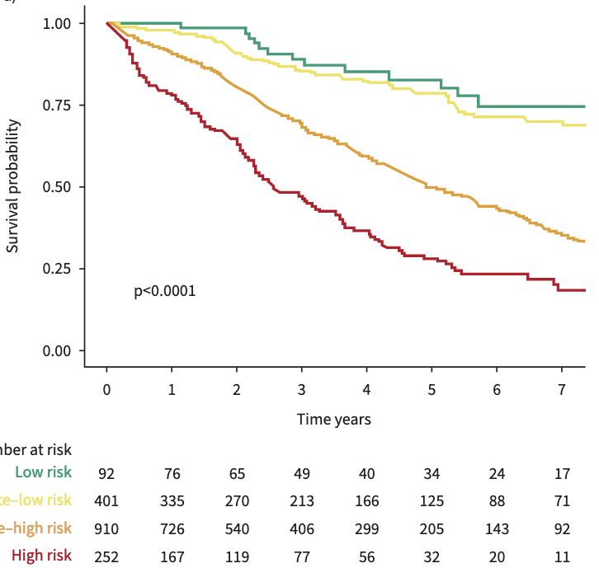
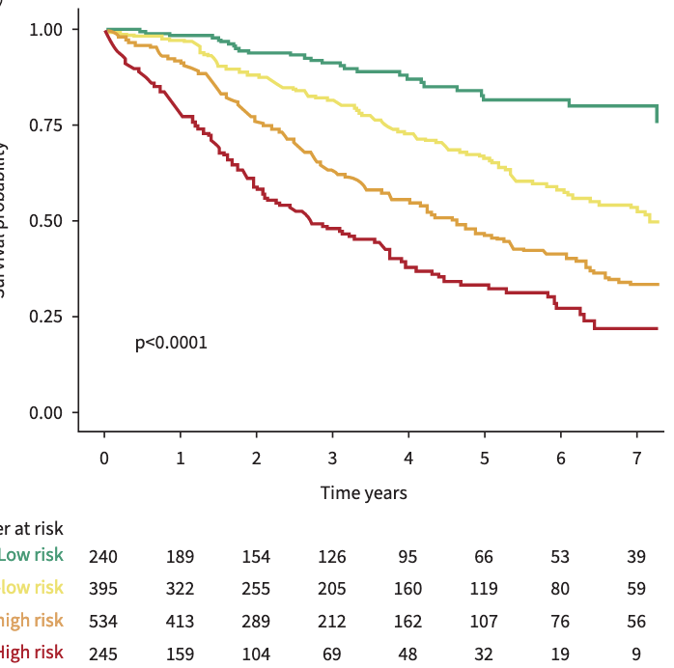
COMPERA 2.0: Refined 4-Stratum Risk Assessment Model
Low
Intermed- Low
Intermed- High
Survival Probability
High
Low
I-L I-H
High
Low
I-L I-H
High
Intermediate-low / intermediate-high 4-stratum model is more sensitive to prognostically relevant changes in risk than the original 3-stratum model with only one intermediate category.

Slide 6
French Validation: Risk Assessment at Baseline and First Reassessment
Survival According to a 3-strata Model
Using the 3-strata SPAHR/COMPERA risk assessment method, most patients (67%) were classified as intermediate risk at baseline, with 16% classified as low-risk and 16% classified as high-risk.
Using the 4-strata approach, 12% were low-risk, 40% were intermediate-low risk, 33% were intermediate-high risk, and 15% were high-risk.
There were significant differences in survival across risk groups using the 3-strata approach and the 4-strata approach.
3-Strata After diagnosis
3-Strata First Reassessment
C. 4-Strata, After Diagnosis
D. 4-Strata, First Reassessment
Survival According to a 4-strata Model

Slide 7
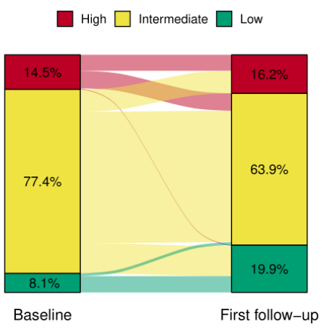
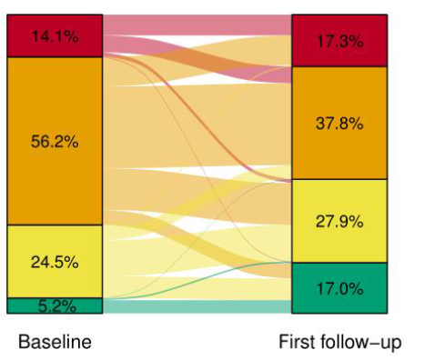
Sensitivity to Change in Status (French Pulmonary Hypertension Registry)
Changes in Risk Status From Baseline and First Follow-Up
Original 3-Strata Approach
New 4-Strata Approach
Intermediate Risk at Baseline
High Risk at First Follow-Up (n=134)
Low Risk at First Follow-Up (n=179)
0
1
2
3
Hazard Ratio and 95% Confidence Interval
High Risk at Baseline
Intermediate Risk at First Follow-Up (n=104)
0
1
2
3
Hazard Ratio and 95% Confidence Interval

Slide 8
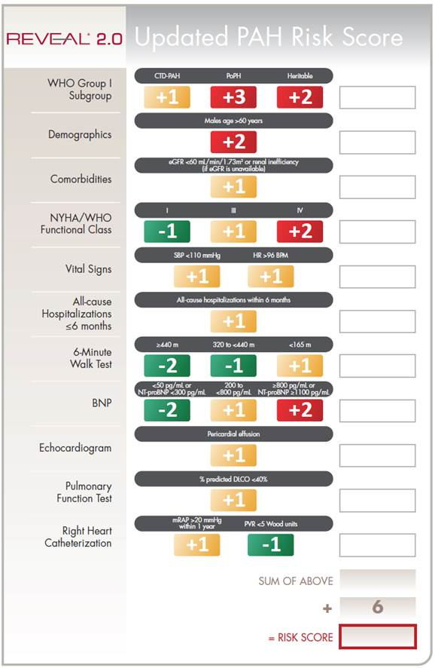
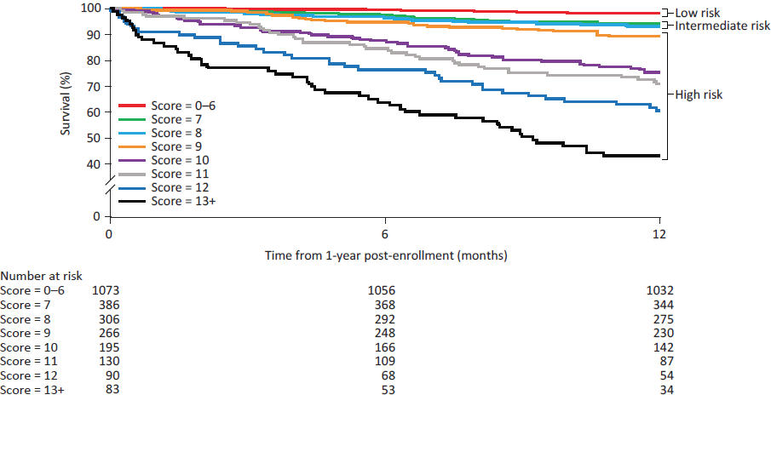
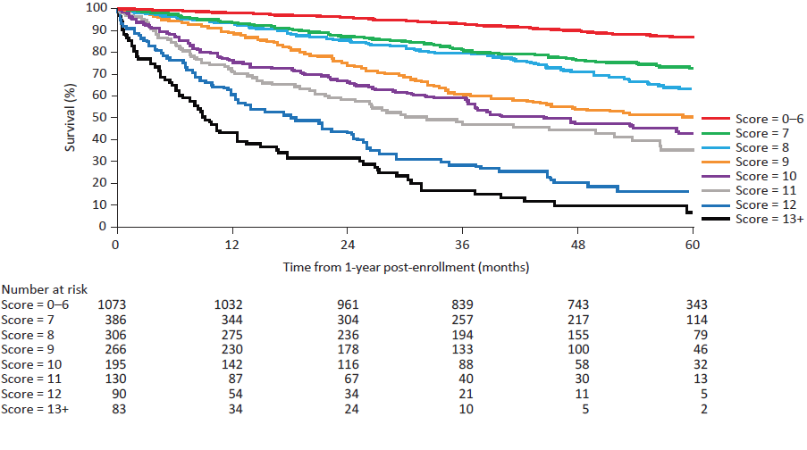
PAH REVEAL Risk Score Calculator 2.0

Slide 9
REVEAL 2.0 and Lite 2 Risk Score Parameters and Scoring
Parameter | REVEAL 2.0 (13 variables) |  |  |  |  |  | REVEAL Lite 2 (6 variables)
Cause | CTD-PAH: +1 pt | PoPH: +3 pt |  |  | Heritable: +2 pt |  | -
Demographics | Men > 60 y: +2 pt |  |  |  |  |  | -
Renal Insufficiency | eGFR < 60 mL/min/1.73m² or defined by clinical judgement if eGFR not available: +1 |  |  |  |  |  | ✓
NYHA or WHO FC | FC I: −1 pt | FC III: +1 pt |  |  | FC IV: +2 pt |  | ✓
All-Cause Hospitalization | Within previous 6 mo: +1 |  |  |  |  |  | -
Vital Signs | SBP < 110 mmHg: +1 pt |  |  | HR > 96 bpm: +1 pt |  |  | ✓✓
6MWD | ≥ 440 m: −2 pt | 320 to <440 m: −1 pt | 320 to < 440 m: −1 pt |  | <165 m: +1 pt | < 165 m: +1 pt | ✓
BNP (or NT-proBNP) | < 50 pg/mL (< 300 pg/mL): −2 pt | 200 to <800 pg/mL: +1 | 200 to < 800 pg/mL: +1 pt |  | ≥800 pg/mL (≥1100 pg/mL): +2 | ≥ 800 pg/mL (≥ 1100 pg/mL): +2 pt | ✓
Echocardiogram | Pericardial effusion: +1 pt |  |  |  |  |  | -
PFT | % predicted DLCO <40%: +1 pt |  |  |  |  |  | -
RHC Within 1 y | mRAP ≥ 20 mmHg: +1 pt |  |  | PVR < 5 Wood units: −1 |  |  | -
Total Score | Sum of above +6 pt |  |  |  |  |  | ✓
CTD-PAH, connective tissue disease associated pulmonary arterial hypertension; DLco, diffusion capacity forcarabon monoxide; eGFR, estimated glomerular filtration rate; FC, functional class; HR, heart rate; mRAP, mean right atrial pressure; NHYA, New York Heart Association; PFT, pulmonary function test; PoPH, portopulmonary hypertension;PVR, pulmonary vascular resistance; RHC, right heart catheterization; SBP, systolic blood pressure; WHO, World Health Organization

Slide 10



Looking for more resources on this topic?
CME/CE in minutes
Congress highlights
Late-breaking data
Quizzes
Webinars
In-person events
Slides & resources
www.MedEdOTG.com

