Slide 1
Understanding the Proposed 3-Strata Approach for Initial Risk Assessment (RA) at Diagnosis
Vallerie V. McLaughlin, MD
Associate Chief Clinical Officer, Cardiovascular Services
Director, Pulmonary Hypertension Program
University of Michigan
Ann Arbor, MI

Slide 2
Disclaimer
The views and opinions expressed in this educational activity are those of the faculty and do not necessarily represent the views of Total CME, LLC, the CME providers, or the companies providing educational grants. This presentation is not intended to define an exclusive course of patient management; the participant should use their clinical judgment, knowledge, experience, and diagnostic skills in applying or adopting for professional use any of the information provided herein. Any procedures, medications, or other courses of diagnosis or treatment discussed or suggested in this activity should not be used by clinicians without evaluation of their patient's conditions and possible contraindications or dangers in use, review of any applicable manufacturer’s product information, and comparison with recommendations of other authorities. Links to other sites may be provided as additional sources of information.

Slide 3



Resource Information
About This Resource
These slides are one component of a continuing education program available online at MedEd On The Go titled Advancing Diagnosis and Risk Assessment in PH
Program Learning Objectives:
Gain and understanding of the new guidelines and algorithms developed to detect PH early in the community
Identify appropriate circumstances to implement 3 or 4 strata risk assessments.
Enable early recognition of sub-populations of patients who are at high risk and identify appropriate screening candidates
MedEd On The Go®
www.mededonthego.com
This content or portions thereof may not be published, posted online or used in presentations without permission.
This content can be saved for personal use (non-commercial use only) with credit given to the resource authors.
To contact us regarding inaccuracies, omissions or permissions please email us at support@MedEdOTG.com

Slide 4
A Multi-parameter Risk Assessment Is Needed
Risk assessment
Biochemical markers
Hemodynamic evaluations
NT-proBNP
Clinical assessment
Echocardiographic evaluations
CI
RAP
FC
Syncope
Mixed venous
saturation
RA area
Progression of symptoms
Signs of right heart failure
Pericardial effusion
Exercise tests
CPET
6MWD

Slide 5
ESC/ERS: Risk Assessment Parameters
Prognostic Determinants (est. 1-yr mortality) | Low risk (<5%) | Intermediate risk (5-20%) | High risk (>20%)
Signs of right HF | Absent | Absent | Present
Progression of symptoms and clinical manifestations | No | Slow | Rapid
Syncope | No | Occasional | Repeated
WHO FC | I, II | III | IV
6MWD | >440 m | 165-440 m | <165 m
CPET Peak VO₂ (% predicted) VE/VCO₂ slope | >15 mL/min/kg (>65%) <36 | 11-15 mL/min/kg (35-65%) 36-44 | <11 mL/min/kg (<35%) >44
BNP NT-proBNP | <50 ng/L <300 ng/L | 50-800 ng/L 300-1100 ng/L | >800 ng/L >1100 ng/L

Slide 6
ESC/ERS: Risk Assessment Parameters (cont’d)
Prognostic Determinants (est. 1-yr mortality) | Low risk (<5%) | Intermediate risk (5-20%) | High risk (>20%)
Echocardiography RA area TAPSE/sPAP Pericardial effusion | <18 cm² >0.32 mm/mmHg No | 18-26 cm² 0.19-0.32 mm/mmHg Minimal | >26 cm² <0.19 mm/mmHg Moderate or large
cMRI RVEF SVI RVESVI | >54% >40 mL/m² <42 mL/m² | 37-54% 26-40 mL/m² 42-54 mL/m² | <37% <26 mL/m² >54 mL/m²
Hemodynamics RAP CI SVI SvO₂ | <8 mmHg, ≥2.5 L/min/m² >38mL/m² >65% | 8-14 mmHg, 2.0-2.4 L/min/m² 31-38 mL/m² 60-65% | >14 mmHg <2.0 L/min/m² <31 mL/m² <60%

Slide 7
Importance of Risk Assessment at Baseline
Swedish PAH Registry
COMPERA
100
99%
95%
100
83%
85%
80
80
67%
60
74%
52%
60
Survival (%)
51%
Survival (%)
40
40
35%
20
Low risk
Intermediate risk
High risk
20
Low risk
Intermediate risk
High risk
Log rank, p<0.001
0
0
0
1
2
3
4
5
0
1
2
3
4
5
Years
Time since PAH diagnosis (years)
No. at risk:
Years after enroll-ment | Survival (%) |  |  | Cases left (n)
 | Low risk | Inter-mediate risk | High risk | Low risk | Inter-mediate risk | High risk
0 | 100 | 100 | 100 | 196 | 1116 | 276
1 | 97.2 | 90.1 | 78.8 | 156 | 764 | 170
2 | 91.5 | 80.3 | 66.0 | 111 | 540 | 117
3 | 84.2 | 68.1 | 53.2 | 75 | 376 | 77
4 | 80.2 | 60.1 | 44.7 | 47 | 252 | 47
5 | 75.9 | 51.9 | 32.4 | 31 | 149 | 24
120
355
55
100
246
35
86
176
22
73
124
13
58
80
5
42
51
4
Galiè N et al. Eur Respir J. 2015;46:903-75.

Slide 8
Risk Stratification and Initial Treatment Approaches to PAH
Monotherapy
Combination Oral Therapy
Combination Therapy Including Parenteral Therapy
No. of Patients
Low risk
Intermediate risk
High risk

Slide 9
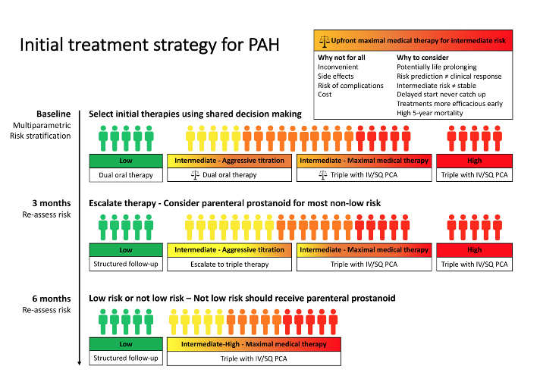
Initial Treatment Strategy for PAH

Slide 10



Looking for more resources on this topic?
CME/CE in minutes
Congress highlights
Late-breaking data
Quizzes
Webinars
In-person events
Slides & resources
www.MedEdOTG.com

