Slide 1
What Echo Aspects are Essential to PH Diagnosis?
Richard Krasuski, MD
Professor of Medicine and Pediatrics
Director, Adult Congenital Heart Disease Center
Director, Hemodynamic Research
Director, Interventional CTEPH Program
Duke University Medical Center
Durham, NC

Slide 2
Disclaimer
The views and opinions expressed in this educational activity are those of the faculty and do not necessarily represent the views of Total CME, LLC, the CME providers, or the companies providing educational grants. This presentation is not intended to define an exclusive course of patient management; the participant should use their clinical judgment, knowledge, experience, and diagnostic skills in applying or adopting for professional use any of the information provided herein. Any procedures, medications, or other courses of diagnosis or treatment discussed or suggested in this activity should not be used by clinicians without evaluation of their patient's conditions and possible contraindications or dangers in use, review of any applicable manufacturer’s product information, and comparison with recommendations of other authorities. Links to other sites may be provided as additional sources of information.

Slide 3



Resource Information
About This Resource
These slides are one component of a continuing education program available online at MedEd On The Go titled Advancing Diagnosis and Risk Assessment in PH
Program Learning Objectives:
Gain and understanding of the new guidelines and algorithms developed to detect PH early in the community
Identify appropriate circumstances to implement 3 or 4 strata risk assessments.
Enable early recognition of sub-populations of patients who are at high risk and identify appropriate screening candidates
MedEd On The Go®
www.mededonthego.com
This content or portions thereof may not be published, posted online or used in presentations without permission.
This content can be saved for personal use (non-commercial use only) with credit given to the resource authors.
To contact us regarding inaccuracies, omissions or permissions please email us at support@MedEdOTG.com

Slide 4
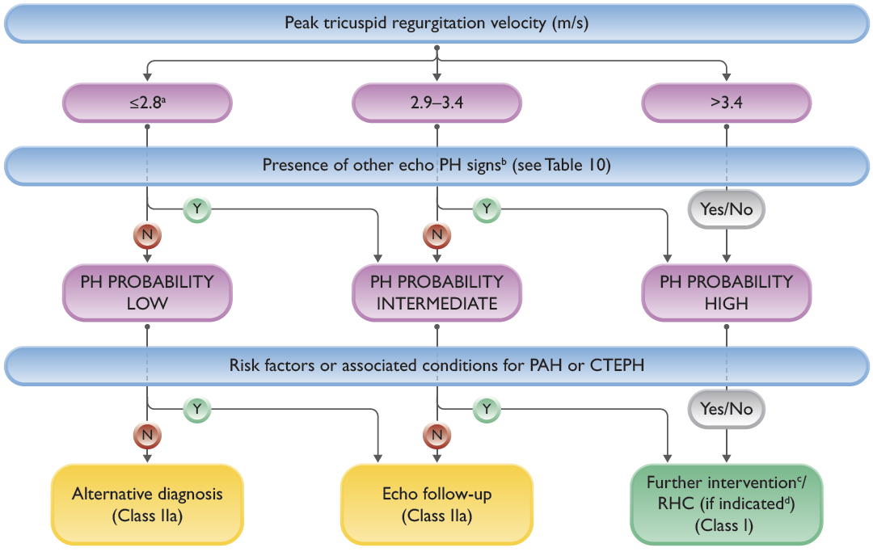
Echocardiographic Probability of Pulmonary Hypertension and Recommendations for Further Assessment
Or unmeasurable. The TRV threshold of 2.8 m/s was not changed according to the updated hemodynamic definition of PH
Signs from at least two categories in Table 10 (A/B/C) must be present to alter the level of echocardiographic probability of PH

Slide 5
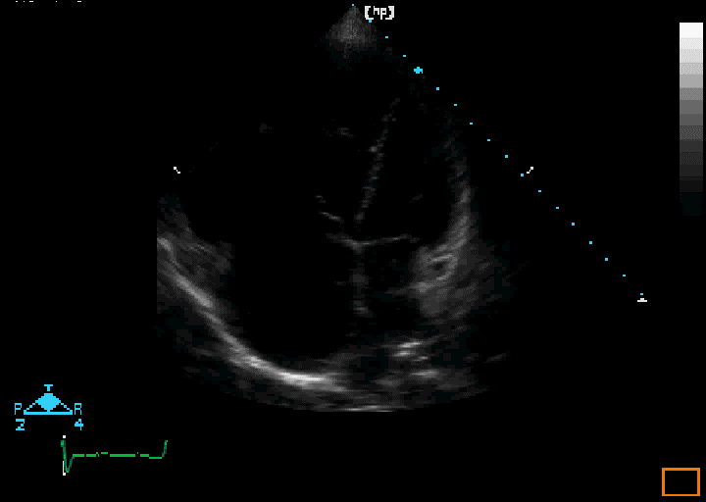
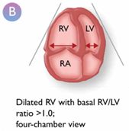
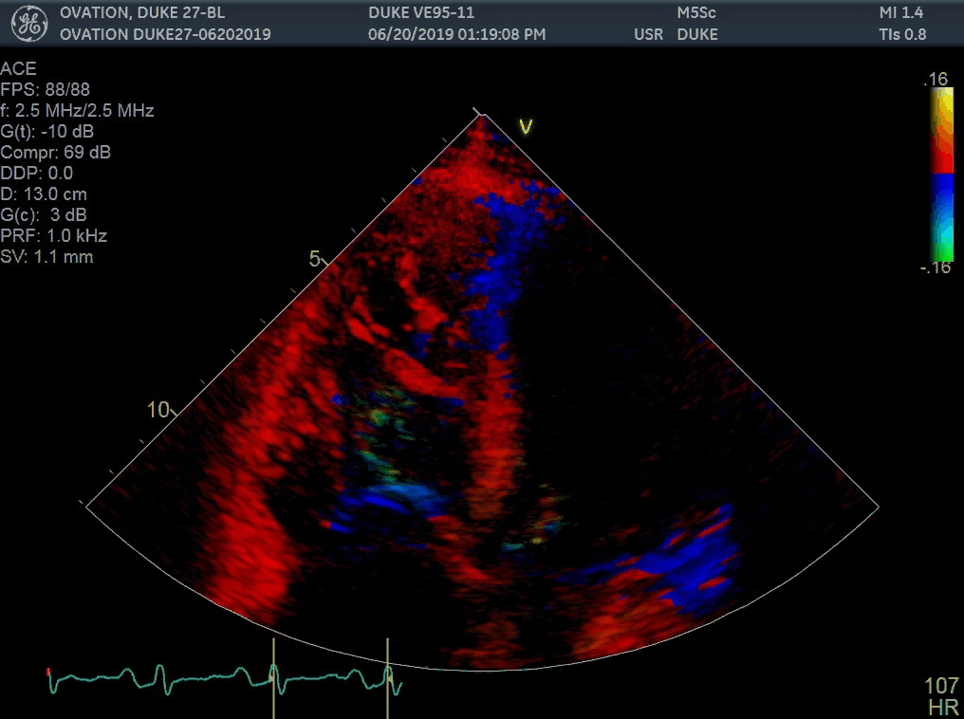
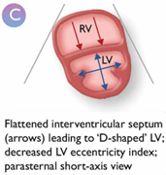
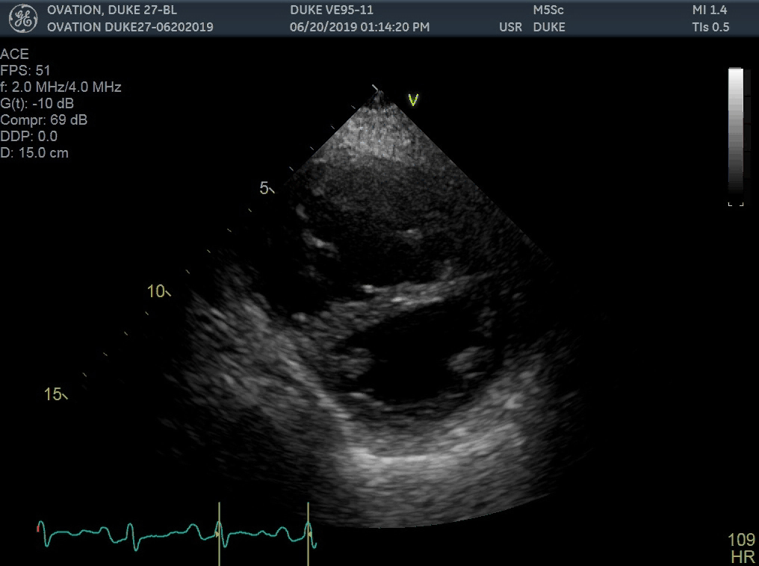
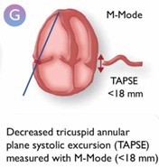
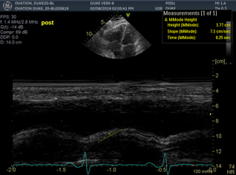
Signs that Suggest Pulmonary Hypertension on Echo
The Ventricles
RV/LV basal diameter/area ratio >1.0
Flattening of the interventricular septum (LVEI > 1.1 in systole and/or diastole
Tapse/sPAP ratio < 0.55 mm/mmHg
Dilated RV with basal RV/LV ratio > 1.0;
4-Chamber View
Flattened interventricular septum (arrows) leading to “D”-shaped LV; decreased LV eccentricity index; parasternal short axis view
Decreased tricuspid annular plane excursion (TAPSE) measured in M-mode (< 18 mm)

Slide 6
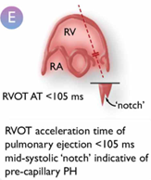
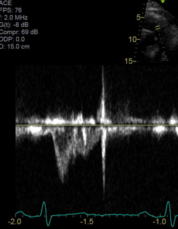
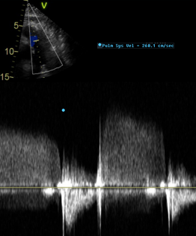
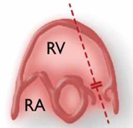
Signs that Suggest Pulmonary Hypertension on Echo
Pulmonary Artery
RVOT AT < 105 ms and/or mid-systolic notching
Early diastolic pulmonary regurgitation velocity > 2.2 m/sec
PA diameter > AR diameter PA diameter > 25 mm
RVOT AT < 105 ms
RVOT acceleration time of pulmonary ejection < 105 ms
Mid-systolic “notch” indicative of pre-capillary PH
AO
PA

Slide 7
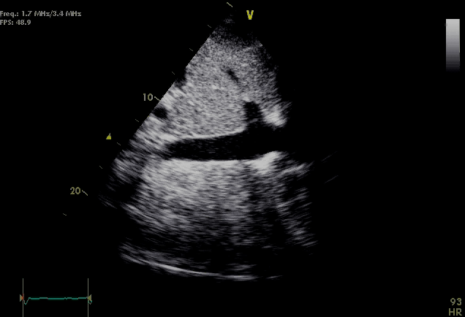
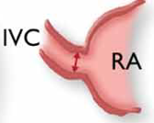
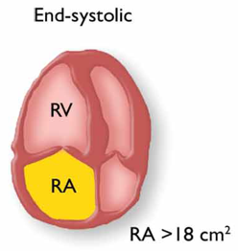
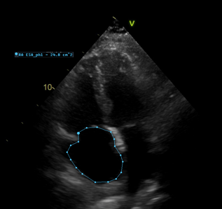
Signs that Suggest Pulmonary Hypertension on Echo
Estimated RAP
Inferior Vena Cava and RA
IVC diameter > 21 mm with decreased inspiratory collapse (< 50% with a sniff or < 20% with quiet inspiration)
RA area (end-systole) > 18 cm²
IVC | Collapse | eRAP
< 2.1 cm | > 50% | 3 (0-5)
> 2.1 cm | > 50% | 8 (5-10)
> 2.1 cm | < 50% | 15 (10-20)
Enlarged right atrial area
(>18 cm²);
4-chamber view

Slide 8
Echocardiographic Probability of Pulmonary Hypertension and Recommendations for Further Assessment
Further testing may be necessary (e.g. imaging, CPET)
RHC should be performed if useful information/a therapeutic consequence is anticipated (e.g. suspected PAH or CTEPH), and may not be indicated in patients without risk factors or associated conditions for PAH or CTEPH (e.g. when mild PH and predominant LHD or lung disease are present).

Slide 9



Looking for more resources
on this topic?
CME/CE in minutes
Congress highlights
Late-breaking data
Quizzes
Webinars
In-person events
Slides & resources
www.MedEdOTG.com

