Slide 1
Case: 66-Year-Old Patient Who Quit Smoking 20+ Years Ago With a History of Diabetes
Diagnosed at stage III unresectable NSCLC and underwent concurrent chemotherapy and radiation therapy for 6 weeks with carboplatin and paclitaxel
After about 2 1/2 months of consolidation therapy with durvalumab, the patient presented to the urgent care with worsening shortness of breath and was otherwise asymptomatic

Slide 2
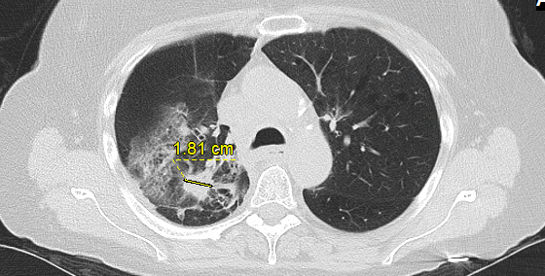
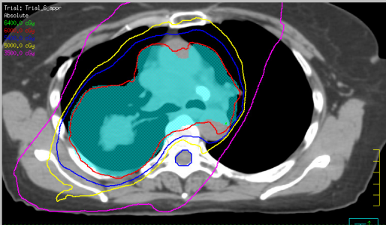
Case (cont’d)
The interval between the radiation therapy and the durvalumab was approximately 18 days
ECOG PS = 1
Representative CT slice (left) with approximately the same slice from the treatment plan (right)

Slide 3
Determining if Pneumonitis Is Related to Radiation vs Immunotherapy
Does the inflammation on CT overlap with the radiation field?
Is the area of change significantly overlapping with the field of radiation?
Is it more diffuse?
Is it possible that the pneumonitis is related to radiation?
What was the timing of development in relation to radiation vs immunotherapy?

Slide 4
It's really important to determine that underlying etiology [of the pneumonitis] to assess is this something that a patient would need to stop the immunotherapy permanently, or can it be rechallenged?
Joshua E. Reuss, MD

Slide 5
Engaging the radiation oncologists early and frequently through these processes is imperative

Slide 6
Pneumonitis Due to Immunotherapy vs Radiation Therapy
Bilateral patchy infiltrates that are more diffuse with no clear demarcation is more indicative of immunotherapy-related pneumonitis
Occurs most commonly within the first few months of starting immunotherapy
Initiate steroids early based on CT findings, even if the patient is asymptomatic

