Slide 1
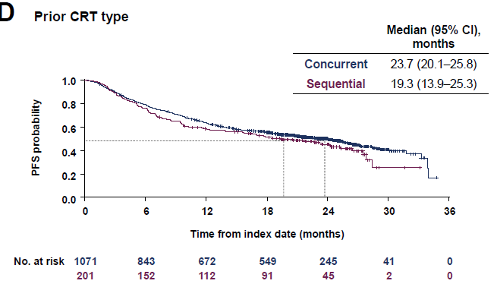
PACIFIC-R: sCRT Subset
14.3% of patients received sCRT; 18% of patients had PD-L1 status <1%

Slide 2
PACIFIC-6
Consolidated durvalumab after sCRT and RT in 2 cohorts:
ECOG PS 0-1
ECOG PS 0-2
mPFS for all patients: 13.1 mo
mOS for all patients: 39 mo
Garassino MC, et al. J Thorac Oncol. 2022;17(12):1415-1427.

Slide 3
Chemotherapy-Sparing Approaches
DUART (phase 2): Durvalumab after RT¹
2 cohorts: standard RT (Cohort A), palliative RT (Cohort B)
mPFS for all cohorts: 8 months; mOS for all cohorts: 15.8 mo
SPIRAL-RT (phase 2): Durvalumab after RT monotherapy²
Japanese trial; mPFS: 8.9 mo, mOS: 20.8
S1933 (NCT04310020)³
Hypofractionated radiation followed by atezolizumab consolidation

