Slide 1
Evaluation and Staging Workup
For patients with suspected stage III NSCLC,
evaluation to exclude metastatic disease
should include:
  History and physical exam
  CT scan of chest and upper abdomen with contrast,
  unless contraindicated
  FDG PET/CT and MRI scan and brain imaging
  Mediastinal lymph node status, confirmed by pathologic assessment either by endoscopic staging or surgical confirmation
  Discussions with multidisciplinary team about treatment plan
  prior to initiation

Slide 2
Pathologic Staging
If there is no concern for metastatic disease, consult with interventional pathologist to perform both a diagnostic and staging bronchoscopy
  Obtain tissue from the concerning lung lesion
  Effectively stages the mediastinum

Slide 3
Determining Resectability
In certain clinical scenarios (eg, N2 lymph node involvement or multistation N2) multidisciplinary discussions are crucial to determine resectability
There are currently no data to support the use of perioperative systemic therapy approaches to convert a patient from unresectable to resectable
Resectability should be determined up front

Slide 4
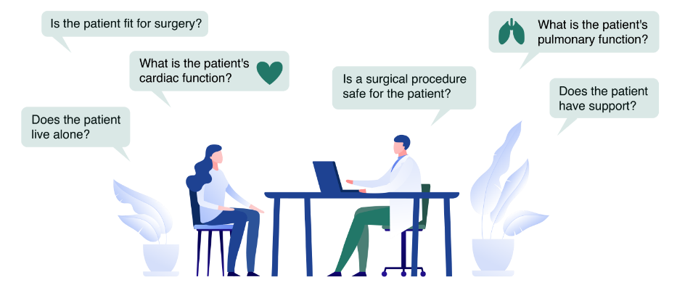
Other Considerations When Determining Resectability

