Slide 1
Case Studies in Trauma Patients on DOACs
Babak Sarani, MD, FACS, FCCM
Professor of Surgery and Emergency Medicine
George Washington University
Washington, DC

Slide 2
Disclaimer
The views and opinions expressed in this educational activity are those of the faculty and do not necessarily represent the views of TotalCME, Inc., the CME providers, or the companies providing educational grants. This presentation is not intended to define an exclusive course of patient management; the participant should use their clinical judgment, knowledge, experience, and diagnostic skills in applying or adopting for professional use any of the information provided herein. Any procedures, medications, or other courses of diagnosis or treatment discussed or suggested in this activity should not be used by clinicians without evaluation of their patient's conditions and possible contraindications or dangers in use, review of any applicable manufacturer’s product information, and comparison with recommendations of other authorities. Links to other sites may be provided as additional sources of information.

Slide 3
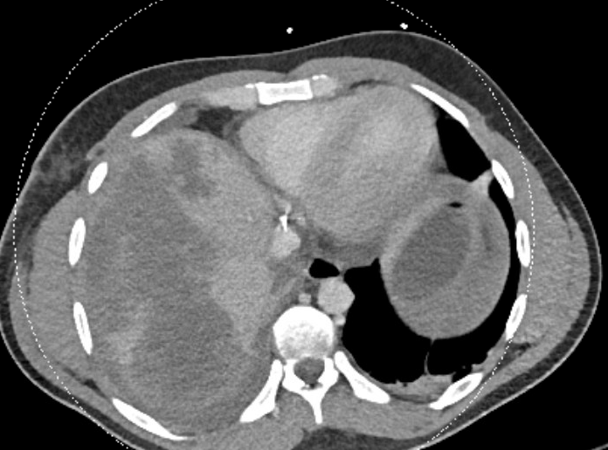
25-Year-Old Rifle Wound to the Right Chest/Liver

Slide 4
Initial Course
RSI, MTP, PCC, TXA
Right chest tube = 1800cc immediately
OR for right thoracotomy: minor lung injury, large diaphragm injury
Ex lap = packed liver
IR = embolized branches of right hepatic artery

Slide 5
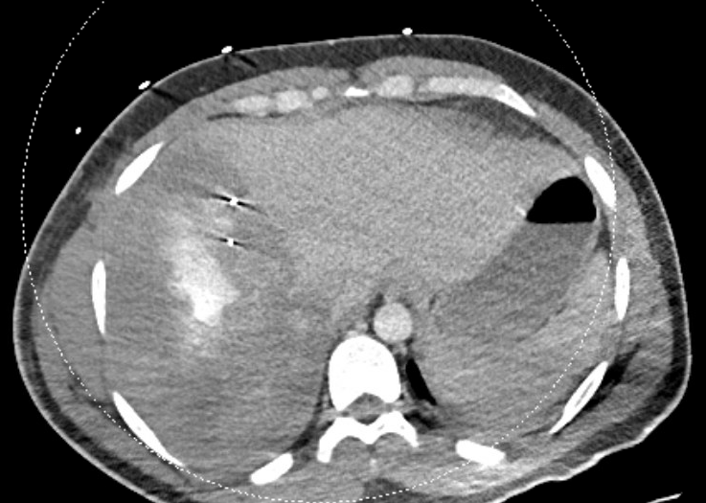
Post-Op Day 11
Dialysis dependent AKI
Short of breath. CTA = PE
Started on Apixaban
48 hours later, hemorrhagic shock (post-op day 13)
Repeat hepatic arteriogram negative

Slide 6
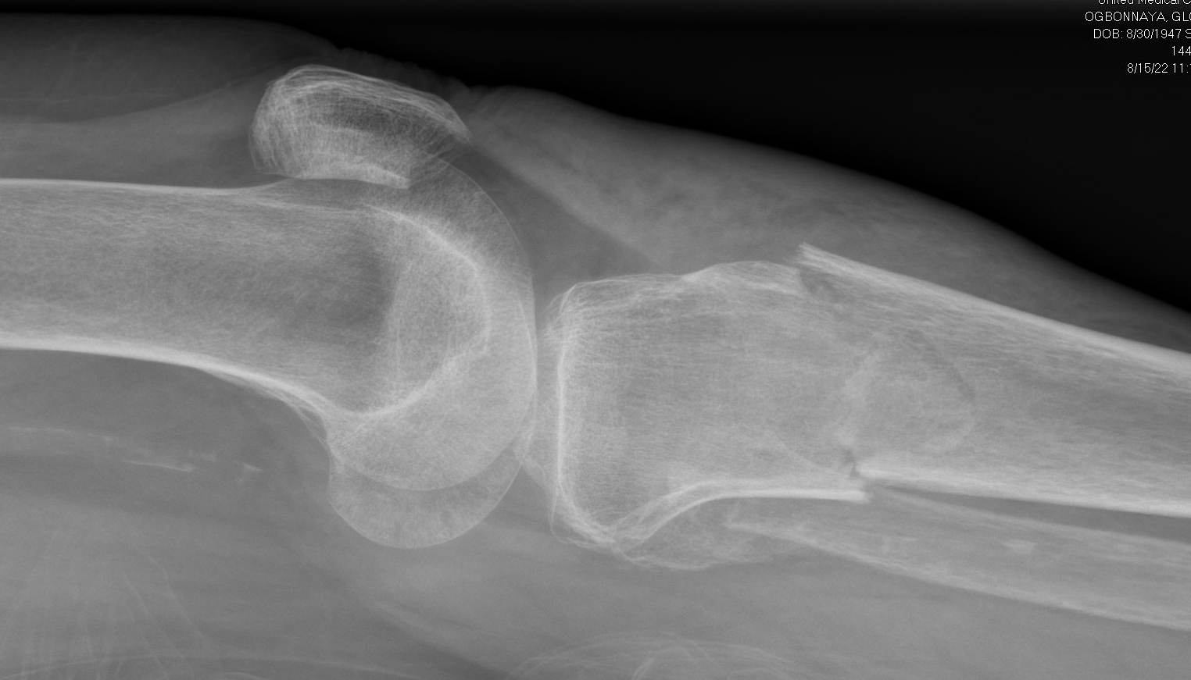
Trauma #2
74 yo female fall from standing. Presents to OSH with RLE pain
PMH: A-fib on Apixaban, HTN, PVD, CHF, CAD s/p stents years ago, IDDM

Slide 7
Trauma #2
At OSH, initially had DP/PT but within 3 hours, loses DP and leg is “more swollen”
Rapidly transferred to trauma center
Awake, c/o leg pain, palpable PT but not palpable DP
Contralateral leg has PT and DP
Sensation is intact
ABI 0.6
CTA shows PVD only

Slide 8
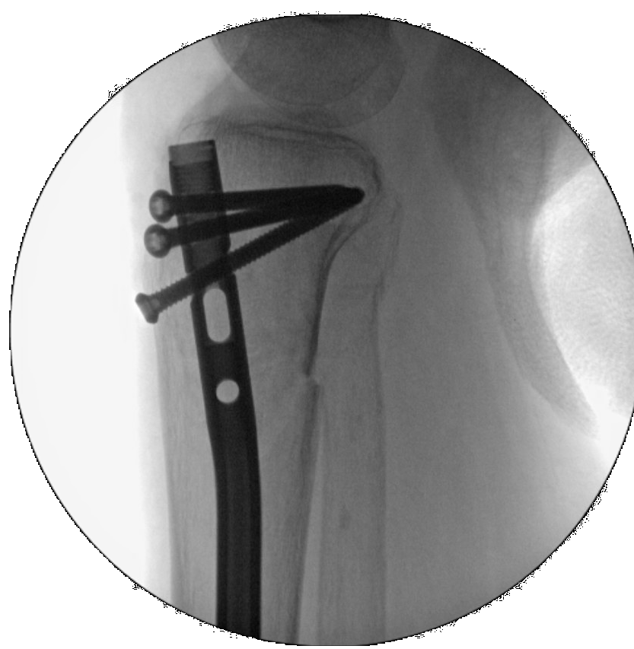

Slide 9
