Slide 1
Life-Threatening Traumatic Bleeds and Anticoagulation – Reversal Approaches in the Emergency Department
Babak Sarani, MD, FACS, FCCM
Professor of Surgery and Emergency Medicine
George Washington University
Washington, DC

Slide 2
Disclaimer
The views and opinions expressed in this educational activity are those of the faculty and do not necessarily represent the views of TotalCME, Inc., the CME providers, or the companies providing educational grants. This presentation is not intended to define an exclusive course of patient management; the participant should use their clinical judgment, knowledge, experience, and diagnostic skills in applying or adopting for professional use any of the information provided herein. Any procedures, medications, or other courses of diagnosis or treatment discussed or suggested in this activity should not be used by clinicians without evaluation of their patient's conditions and possible contraindications or dangers in use, review of any applicable manufacturer’s product information, and comparison with recommendations of other authorities. Links to other sites may be provided as additional sources of information.

Slide 3
Disclosures
None

Slide 4
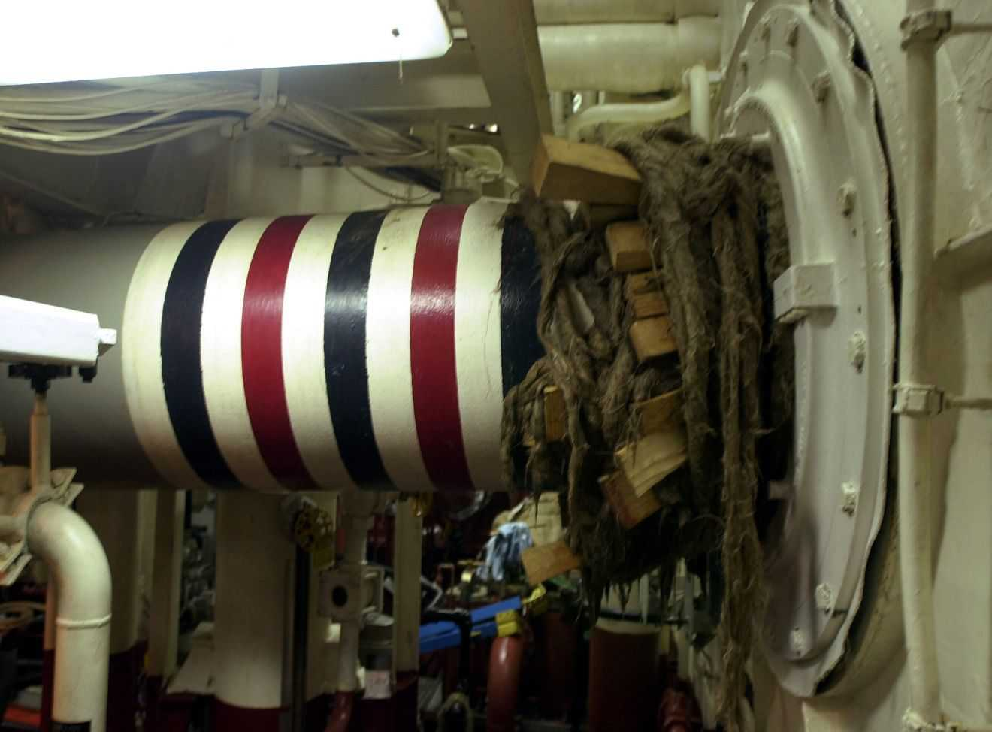
Emergency Surgery and Damage Control
Hemorrhage control
Contamination control
Assumes non-pharmacologic mediated coagulopathy (trauma) or intact coagulation system

Slide 5
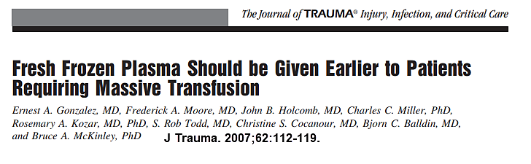
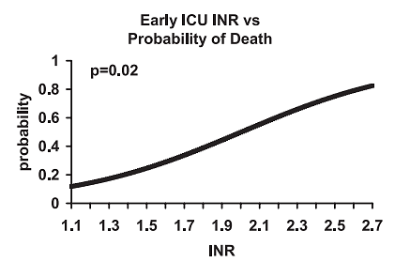

Slide 6
Damage Control Resuscitation
FFP : RBC N=246 | Overall Mortality | Hemorrhagic Death
Low (1:8) | 65% | 93%
Medium (1:2.5) | 34% | 78%
High (1:1.4) | 19% | 37%

Slide 7
What if the Patient Is on a DOAC?
Factors to consider:
Last dose
Renal function
Severity and location of bleed
Surgical Options
Availability of specific reversal agent vs. off-label use of PCC

Slide 8
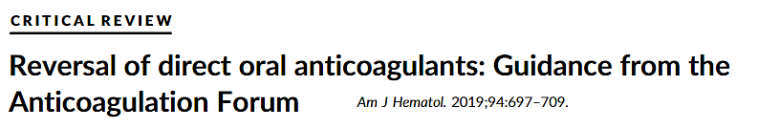
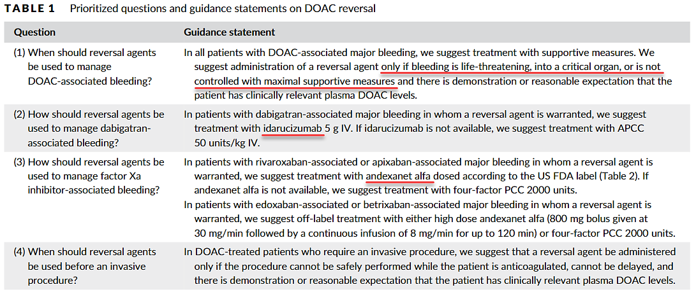

Slide 9
PCC vs Andexanet Alfa*
Cost vs. FDA approved agent
Multicenter 2-year retrospective study
Inclusion: Adult pts, trauma, DOAC within 12 hours of injury, actively bleeding or TBI
*Not yet published

Slide 10
PCC vs Andexanet Alfa*
273 patients (77 PCC and 186 Andexanet Alfa)
Outcome:
No difference in PRBC transfusion needs
No difference in mortality
No difference in change in head CT Marshall Score
*Not yet published

Slide 11
Questions that Remain
Can I use PCC in lieu of Andexanet Alfa?
Is there drug rebound after Andexanet Alfa infusion has stopped?
Can I “wait and see what happens” and then give AA/PCC if the bleed worsens?
Is the VTED risk higher with PCC than with AA?

