Slide 1
Case: 60 yo Male on Factor Xa Inhibitor with Bright Red Vomiting
Brooks D. Cash, MD, FACP, AGAF, FACG, FASGE
Dan and Lillie Sterling Professor of Medicine
Chief, Gastroenterology, Hepatology, and Nutrition
University of Texas Health Science Center at Houston
Houston, TX

Slide 2
Disclaimer
The views and opinions expressed in this educational activity are those of the faculty and do not necessarily represent the views of TotalCME, Inc., the CME providers, or the companies providing educational grants. This presentation is not intended to define an exclusive course of patient management; the participant should use their clinical judgment, knowledge, experience, and diagnostic skills in applying or adopting for professional use any of the information provided herein. Any procedures, medications, or other courses of diagnosis or treatment discussed or suggested in this activity should not be used by clinicians without evaluation of their patient's conditions and possible contraindications or dangers in use, review of any applicable manufacturer’s product information, and comparison with recommendations of other authorities. Links to other sites may be provided as additional sources of information.

Slide 3
Starting With a Case…
Mr. B, a 60-year-old man is brought to the ED by his wife after syncope at home
HPI: Reports black tarry stools for the last 5 hours and upper abdominal pain for the last 3 days
History: recurrent venous thromboembolism (2 pulmonary emboli; last was 2 years ago), hypertension
Medications: rivaroxaban 20 mg q.d.; bisoprolol 5 mg q.d.; valsartan 80 mg q.d.; atorvastatin 20 mg q.d.
Blood pressure 94/60 mmHg, HR 110 /min
Hgb 7.4 g/dL (baseline 2 months ago 13.2 g/dL); BUN 45 mg/dL; INR 1.3

Slide 4
Mr. B Likely has a GI Bleed
Glasgow-Blatchford Score = 16
High risk of mortality
Qualifies as a life-threatening bleed
Last dose of rivaroxaban was at 0600 (6 hours prior)
Admit to ICU
2 large bore IVs
2 u PRBCs + crystalloid infusion BP 110/84 mmHg, P 90/min
PPI bolus 80 mg and qtt 8 mg/hr
Has witnessed hematemesis
Reglan 10 mg

Slide 5
Critical Decisions
To reverse or not reverse
Other resuscitation (plasma, red cells, platelets), pressors
Stability for and timing of endoscopic evaluation (diagnostic & therapeutic)
Diagnostic (CT) angiography, therapeutic angiography - Endovascular interventions
Surgery

Slide 6
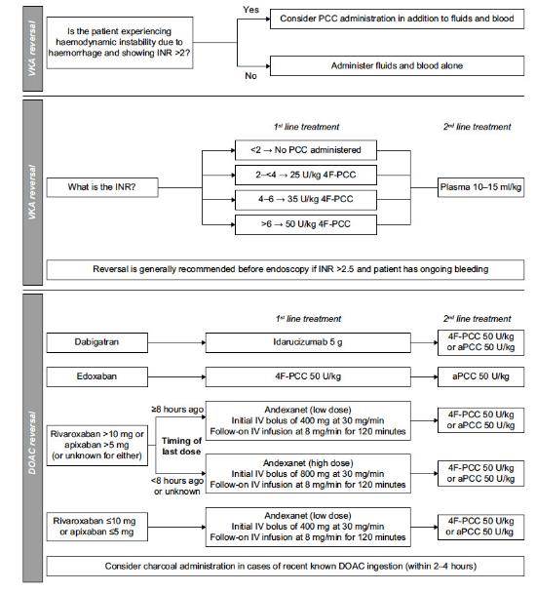
Approach to Anticoagulant Reversal for GI Bleeding
4 Key Questions:
Is the GIB life-threatening? - Use a validated score
Warfarin users: What is the INR?
DOAC users: Which one and when/what was the last dose, renal function?
Indication for anticoagulation
How risky is stopping (or reversing)? When to resume after bleed?

Slide 7
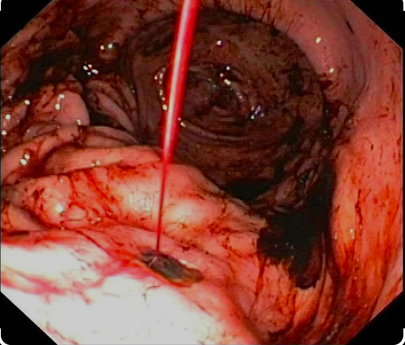
Decide to Reverse DOAC Anticoagulation and Perform Urgent (within 6 hrs) Upper Endoscopy
Andexanet 800 mg bolus then 8 mg/min x 120 minutes
Another 1 u PRBC; more crystalloid
Endoscopy: Forest 1A PUD
Endoscopic hemostasis achieved with 15 cc 1:10,000 epinephrine injected around and in ulcer + 3 hemostatic clips

Slide 8
Endoscopic Stigmata & Rebleed Risk
Stigmata | Forrest class | Prevalence (%) | Rebleeding w/o endotherapy (%) | Surgery (%) | Mortality (%)
Active bleeding | IA IB | 12 (spurting and oozing) | 55 (17-100%) | 35 | 11
Nonbleeding visible vessel | IIA | 8 | 43 | 34 | 11
Adherent clot | IIB | 8 | 22 | 10 | 7
Pigmented spot | IIC | 16 | 10 | 6 | 3
Clean base | III | 55 | 5 | 0.5 | 2

Slide 9
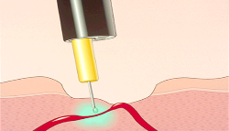
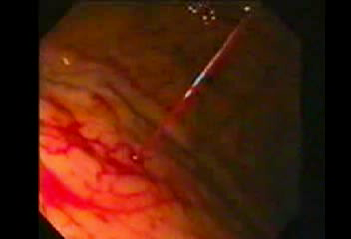
Injection
Multiple agents available for injection
Main action: tamponade
Secondary effects (i.e., vasoconstriction, vaso-occlusion, sclerosis) based on type of injectate
Epinephrine 1:10,000 is most commonly used and can be further diluted if needed
Four-quadrant injection around vessel
Monotherapy not sufficient; augment with clamping or thermal therapy

Slide 10
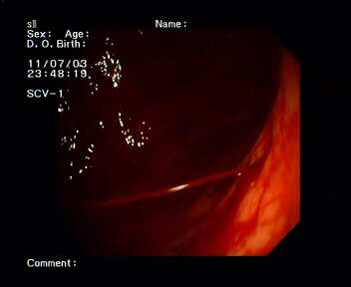
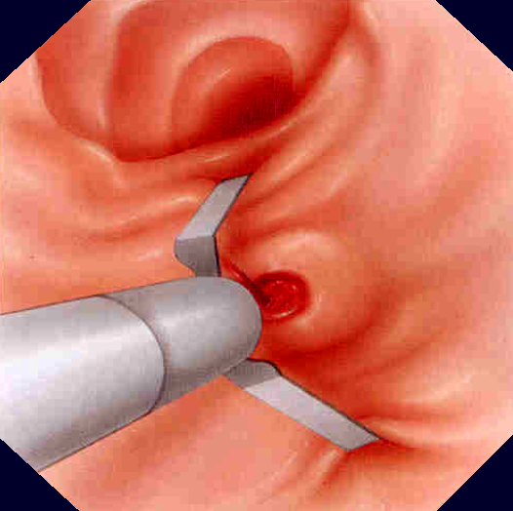
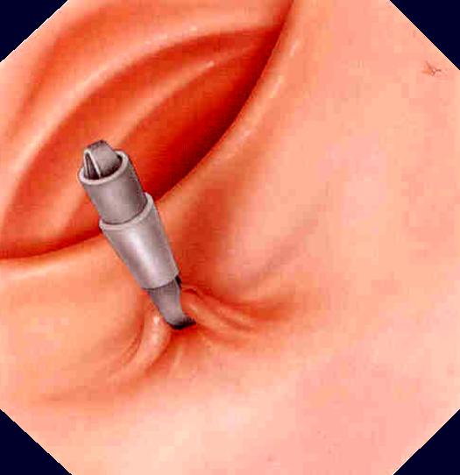
Hemoclips

Slide 11
Case Conclusion
Mr. B does well post-endoscopy
Remains in hospital x 72 hours; melena clears; VSS
IV PPI qtt; diet advanced at 24 hours to clear liquids, then regular
Discharged on BID PPI x 2 weeks, then q.d. for life
Found to be H pylori + on gastric biopsies
Successfully eradicated with quadruple therapy x 14 days
Managed with traditional anticoagulants for 1 week then restated on DOAC with close monitoring

