Slide 1
Intracranial Hemorrhages and Anticoagulation – Reversal Approaches in the Emergency Department
Natalie Kreitzer, MD, MS
Associate Professor, Emergency Medicine and Neurocritical Care
University of Cincinnati College of Medicine
Cincinnati, Ohio

Slide 2
Disclaimer
The views and opinions expressed in this educational activity are those of the faculty and do not necessarily represent the views of TotalCME, Inc., the CME providers, or the companies providing educational grants. This presentation is not intended to define an exclusive course of patient management; the participant should use their clinical judgment, knowledge, experience, and diagnostic skills in applying or adopting for professional use any of the information provided herein. Any procedures, medications, or other courses of diagnosis or treatment discussed or suggested in this activity should not be used by clinicians without evaluation of their patient's conditions and possible contraindications or dangers in use, review of any applicable manufacturer’s product information, and comparison with recommendations of other authorities. Links to other sites may be provided as additional sources of information.

Slide 3
Objectives
To recognize the indications for urgent anticoagulation reversal in the setting of acute intracranial hemorrhages
To describe the literature describing VKA and DOAC reversal in the setting of acute intracranial hemorrhages

Slide 4
Overview
Intracranial hemorrhages are neurological emergencies
Nearly all cases require immediate reversal
Unlike other major bleeds, cessation is hard to measure
Typically, volume resuscitation is not required

Slide 5
Anticoagulation
Any patient with an intracranial bleed
Anticoagulant medication
What is dose? When was last dose?
Laboratory tests
CBC with platelet count, INR, PTT
Consider viscoelastic or platelet function assays

Slide 6
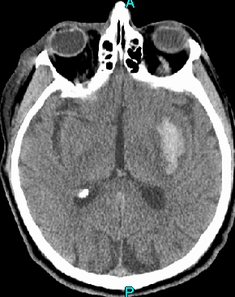
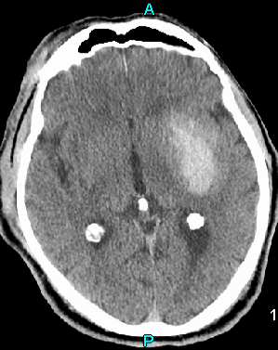
Hemorrhage Expansion

Slide 7
Indications for Reversal
Almost all patients with acute intracranial hemorrhage
Pitfalls:
Ultra-early prognostication
Waiting for a decline in exam to reverse
Not reversing “small” hemorrhages
Considerations:
Time since last dose of DOAC or INR
Age and comorbidities
Location and size of hemorrhage
Institutional guidelines

Slide 8
Vitamin K Antagonists Reversal (Warfarin)
AHA Guidelines:
…INR elevations due to VKA should have their VKA withheld, receive therapy to replace vitamin K–dependent factors and correct the INR, and receive intravenous vitamin K (Class I; Level of Evidence C)
PCCs may have fewer complications and correct the INR more rapidly than FFP; therefore, they may be considered over FFP (Class IIb; Level of Evidence B)

Slide 9
Factor IIa Inhibitor Reversal (Dabigatran)
RE-VERSE AD cohort:
98 (32%) of patients presented with intracranial hemorrhage
No serial neuroimaging
Mortality rate was 16.4% among intracranial hemorrhages

Slide 10
Factor Xa Inhibitor Reversal (Apixaban, Rivaroxaban)
Prior to Andexanet Alfa, in vitro testing demonstrated that PCCs may be used for reversal
ANNEXA-4 cohort: 227 subjects (64%) had an intracranial hemorrhage
Average presenting GCS 14, with 80% (95% CI, 74 to 86) excellent or good efficacy of reversal in ICH

Slide 11
Future Directions
Direct comparisons of PCCs and Andexanet Alfa
“Real life” and registry use of agent specific antidotes
New assays to detect presence and levels of DOACs

