Slide 1
What Do the Mechanistic Differences Between IMiD and CELMoD® -Based Therapies Mean for Clinical Practice?
Sagar Lonial, MD
Chair and Professor
Department of Hematology and Medical Oncology
Chief Medical Officer, Winship Cancer Institute
Emory University School of Medicine
Atlanta, GA

Slide 2
Disclaimer
The views and opinions expressed in this educational activity are those of the faculty and do not necessarily represent the views of TotalCME, Inc., the CME providers, or the companies providing educational grants. This presentation is not intended to define an exclusive course of patient management; the participant should use their clinical judgment, knowledge, experience, and diagnostic skills in applying or adopting for professional use any of the information provided herein. Any procedures, medications, or other courses of diagnosis or treatment discussed or suggested in this activity should not be used by clinicians without evaluation of their patient's conditions and possible contraindications or dangers in use, review of any applicable manufacturer’s product information, and comparison with recommendations of other authorities. Links to other sites may be provided as additional sources of information.

Slide 3
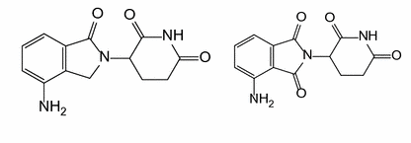
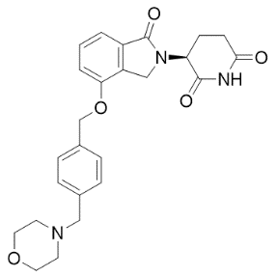
Novel Cereblon E3 Ligase Modulators (CELMoD® Agents) in Development
LEN and POM
(a subgroup of CELMoD® agents)
helped to transform therapy and drive
survival in MM¹⁻³
Rational selection of molecules based on
deep scientific understanding of CRBN and MM biology: iberdomide (IBER; CC-220) and
mezigdomide (CC-92480)⁴⁻⁶
2019 and 2020: First clinical data for IBER and CC-92480 in MM
LEN
POM
IBER
CC-92480

Slide 4
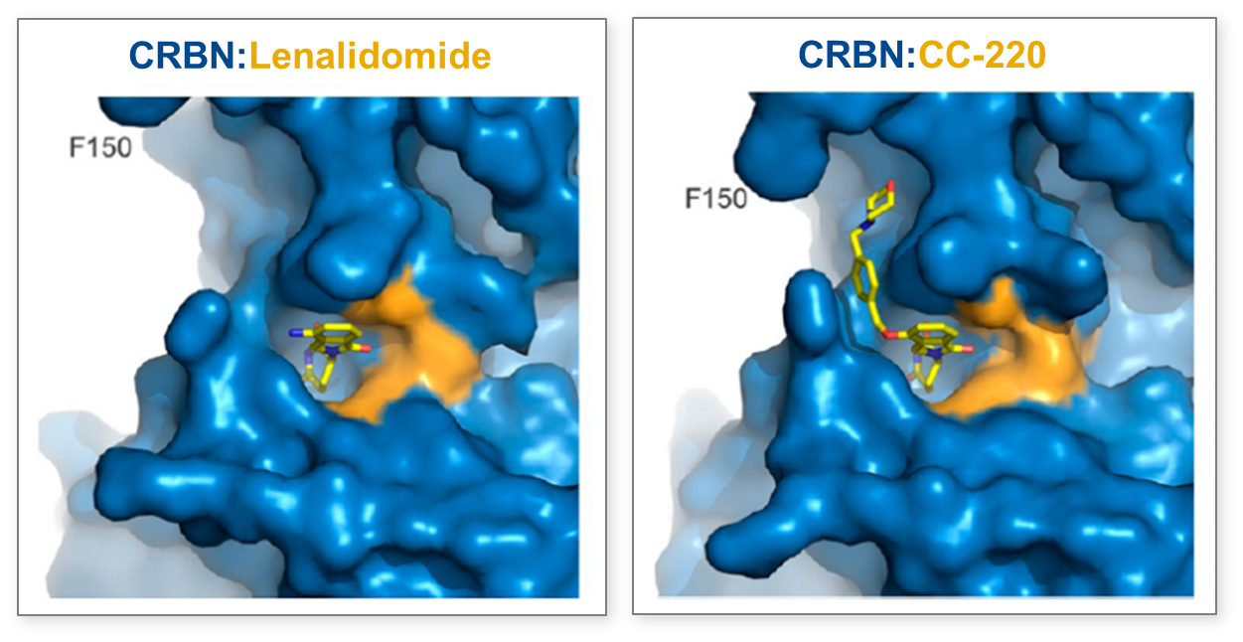
Novel CELMoD® Agent: Iberdomide
(preclinical data)
Binding-surface interactions with CRBN
IBER has enhanced affinity for binding to CRBN
Rapid protein degradation
Increased depth of protein degradation
At lower concentrations than needed with LEN or POM
→ Increased efficacy in preclinical studies
CRBN: LEN
CRBN: IBER
In preclinical models,
IBER is a novel CELMoD® agent that:
Co-opts CRBN to enable enhanced degradation of target proteins; 20 times higher affinity than LEN or POM
Is 20-fold more efficient than LEN or POM in degrading substrates
EC₅₀, nM | Ikaros | Aiolos
LEN | 67 | 87
POM | 24 | 22
IBER | 1 | 0.5

Slide 5
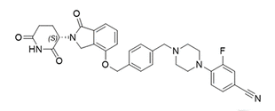
Mezigdomide (CC-92480) Is a Novel CELMoD® Agent^{1,2}
Efficient substrate degradation leading to apoptosis and potent anti-proliferative activity in LEN and POM resistance³
Aiolos degradation efficiency¹
Apoptosis induction kinetics
Anti-proliferative activity in LEN/POM resistance
100
7.5
LEN-resistant cells (H929-1051)
LEN
POM
CC-92480
10,000
80
0.01 µM CC-92480
0.1 µM POM
1,000
60
LEN
5.0
Control (%)
POM
100
Caspase-3 induction
40
10
Ymin = 35
Proliferation IC₅₀ (nM)
2.5
20
Ymin = 18
1
No CRBNª
CC-92480
0.1
Parental cell line^{b}
Ymin = 5
0
0
Resistant cell line^{c}
1 × 10⁻⁶
0.001
1
0
50
100
150
0.01
Compound concentration (μM)
Time (hours)
CC-92480, a potent CELMoD® agent¹
LEN¹
POM¹

Slide 6
Iberdomide Showed Significant T cell Activation and NK Cell Proliferation and Activation
(translational data)
CD8⁺ T cell
NK cell
Increased expression of activation markers and decreased expression of markers associated with exhaustion/senescence
Overall increase of both CD56hi and CD16⁺ NK cells, with increased expression of activation/proliferation markers
Up at C2D15
Down at C2D15
  TIGIT
  KLRG1
  CD57
  Exhausted
  cells
Up at C2D15
Down at C2D15
  HLA-DR
  Ki-67
  GZMB
  CD56hi
  CD16⁺
  Ki-67
  GZMB
  TIGIT
  KLRG1

Slide 7
Differences Between Classes (IMiDs vs CELMoD®)
Binding affinity is different
Impact on downstream targets are different
Pharmacokinetics may be different aiding in extramedullary disease
Impact on immune cells are much more potent with CELMoD®

